Slide 1



How to Use The
G/I Bill Comparison Tool
“Nothing is more expensive than a missed opportunity.”
- H. Jackson Brown, Jr.

Slide 2





Forever G/I Bill
Benefits:
Up to $25,162/year for tuition
Up to $3,081/month for room/board
Up to $1,000/year for books
Benefits DO NOT EXPIRE with non-use.
https://www.va.gov/education/gi-bill-comparison-tool/
Requirements:
36 Months Active Duty Service = 100%
30 Months Active Duty Service = 90%
24 Months Active Duty Service = 80%
18 Months Active Duty Service = 70%
6-18 Months Active Duty Service = 60%
90 Days Active Duty Service = 50%
All Branches
Active Duty

Slide 3
Forever G/I Bill
Yellow Ribbon Schools Provide up to 100% TUITION COVERAGE
  MIT (MASSACHUSETTS)
  HARVARD (MASSACHUSETTS)
  YALE (CONNECTICUT)
  DARTMOUTH (NEW HAMPSHIRE)
  COLUMBIA (NEW YORK)
  CORNELL (NEW YORK)
  BROWN (RHODE ISLAND
  PRINCETON (NEW JERSEY)
The Education Grant will apply to:
Colleges/Universities
Trade Schools
Technical/Vocational Schools
How many of your students have 100% of their expenses covered to these Universities?
University of Michigan
Wayne State University
Michigan State University
Grand Valley State University
All Branches
Active Duty

Slide 4
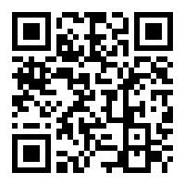
Forever G/I Bill
STEP 1: Visit the Website
https://www.va.gov/education/gi-bill-comparison-tool/

Slide 5
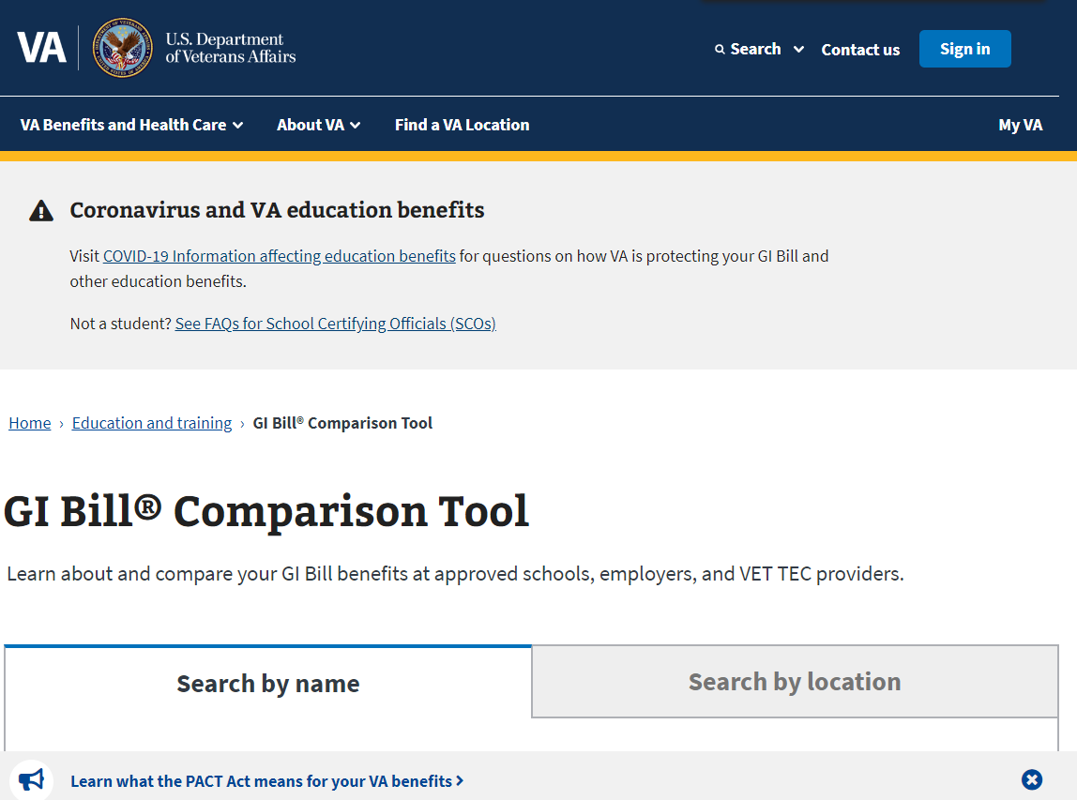
Forever G/I Bill
STEP 2: Scroll Down to the Comparison Tool
Scroll Down!
“Sign In” is not required

Slide 6
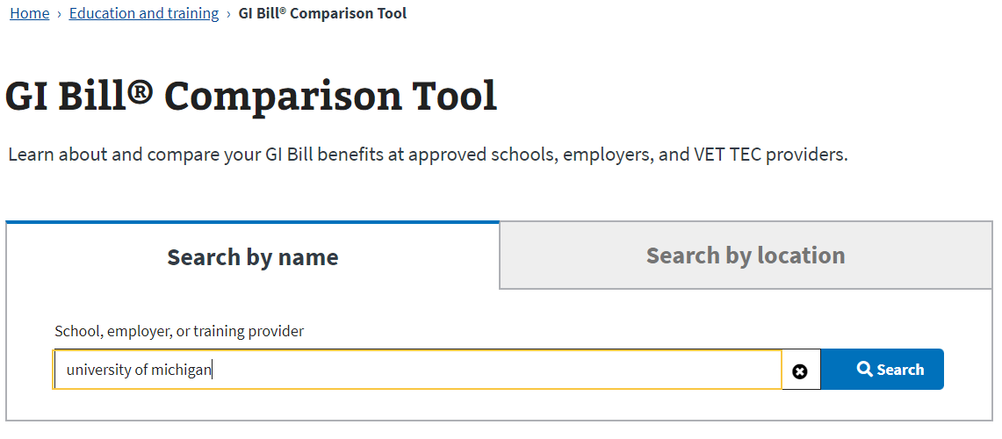
Forever G/I Bill
STEP 3: Input Your Student’s School of Choice

Slide 7
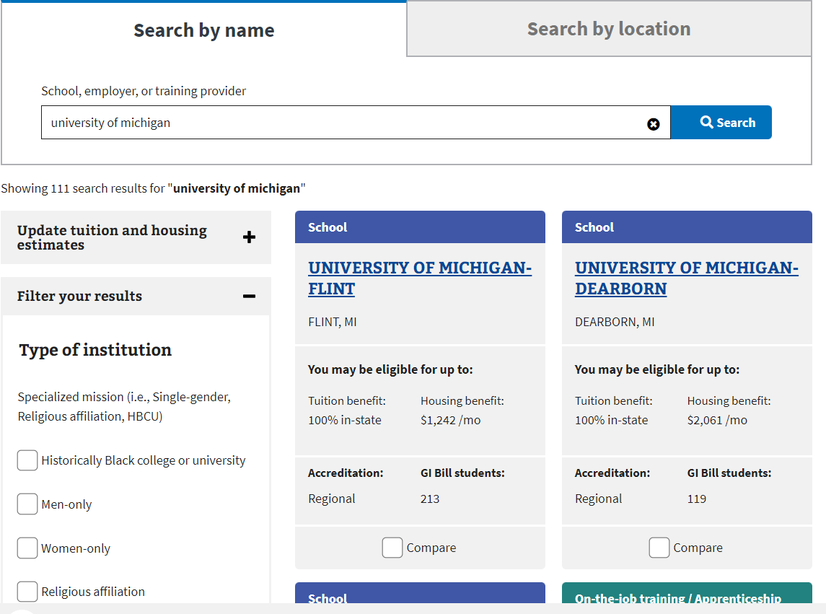
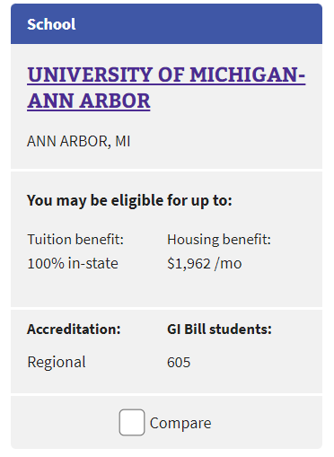
Forever G/I Bill
STEP 4: Select the “Blue Field” to see Detailed Benefits
Click Here!

Slide 8
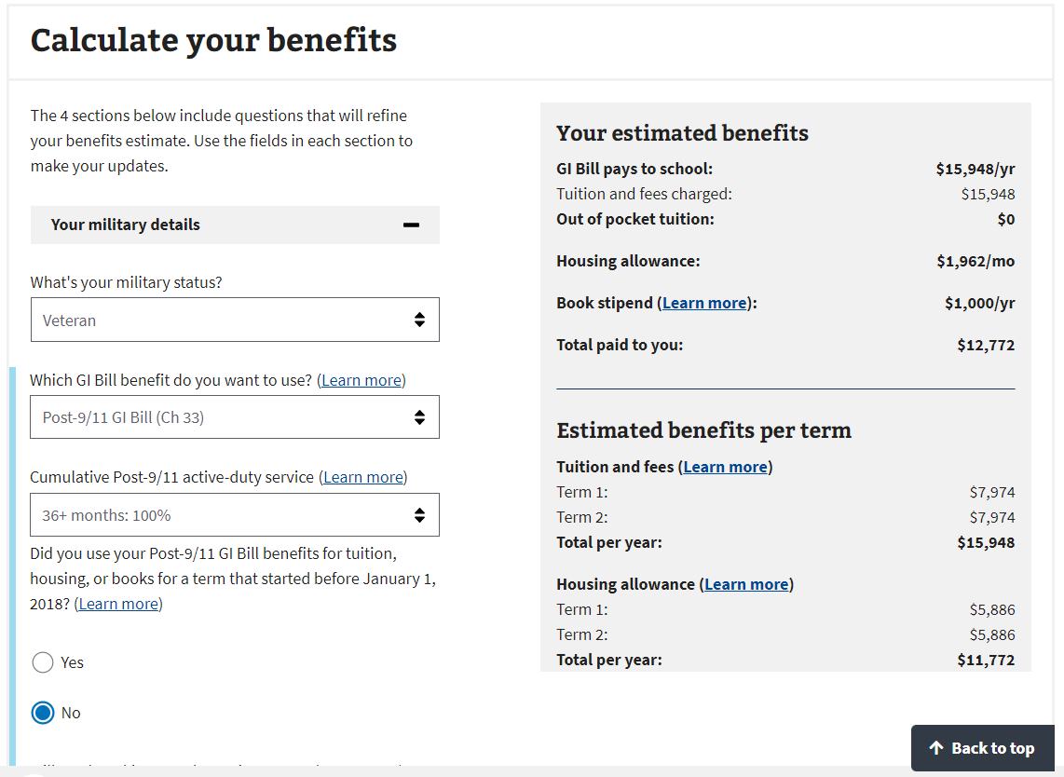
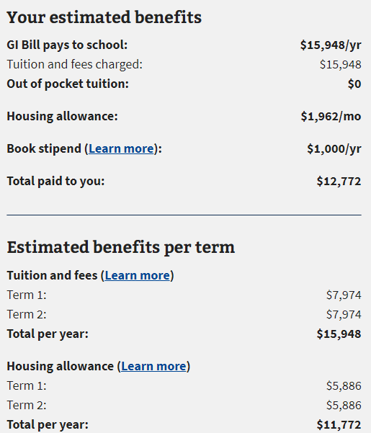
Forever G/I Bill
STEP 5: Scroll Down - See How Much of the School is Covered
Tuition: $0
This Fund is Paid to the Student’s Bank Account
Overall Expenditures at UofM (Ann Arbor): Net Gain $51,088

Slide 9
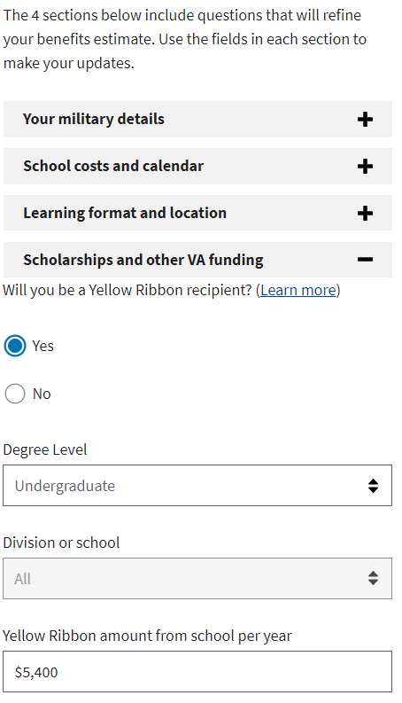
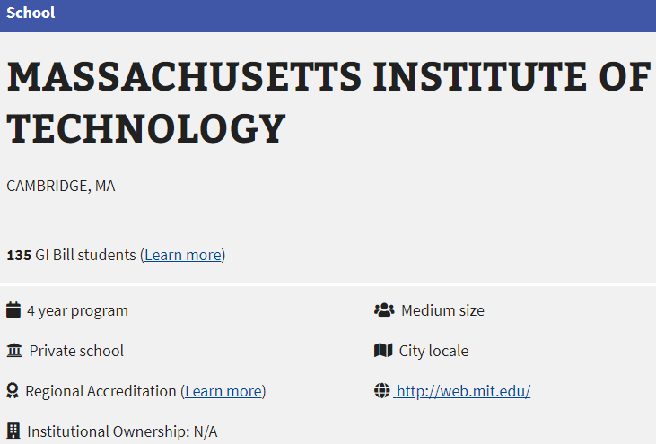
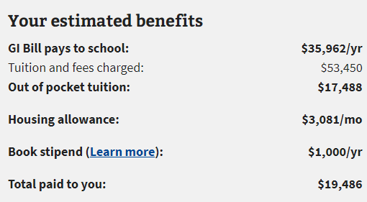
Forever G/I Bill
STEP 6: For More Expensive Schools, Enable “Yellow Ribbon”
Click Here!
Click Here!
Without the US Navy:
$213,800 Total Tuition Cost
(Not Including Room and Board)
With the US Navy:
$69,952 Total Tuition Cost
(Including Room and Board)

Slide 10
What do High School Students Want after Graduation?
Enrollment
~60% of students intend on enrolling in college after graduation
Approximately 2 out of 5 dropout (Mainly due to Financial Instability)
~15% of students elect to perform a trade skill after graduation
Scholarships and Grants
0.1% of students are awarded a full-ride scholarship
1.5% of students are awarded a full-tuition scholarship
The average cost of an in-state 4-year university is $80,000-$100,000
The average amount of aid-per-student is $10,000/year
Employment
23% of students enter the work force directly after graduation.
The US Median Salary for individuals age 20-24 earn $16,000-$30,000/year
https://educationdata.org/scholarship-statistics
https://research.com/research/scholarship-statistics

Slide 11
USMAP – Trade Skill Programs
70+ Trade Skill Certification Jobs (US Navy)
https://usmap.osd.mil/
Unlike Most Apprenticeship Programs:
-Full-Time Benefits on Day One
-All Equipment/Materials Paid For
-College is Always an Option
Requirements:
-Active Duty Enlisted
-12 Months Remaining on Contract
-Work in your Trade Full Time
-Report Hours Worked in Trade
(Monthly)
-One Trade/Occupation at a Time
All Branches
Active Duty

Slide 12
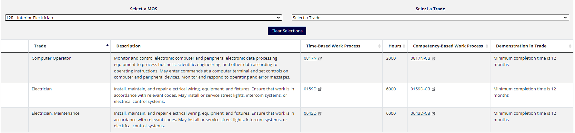
USMAP – Trade Skill Programs
US Army – MOS: 12R – Interior Electrician – 3 Certifications Available
All Branches
Active Duty

Slide 13
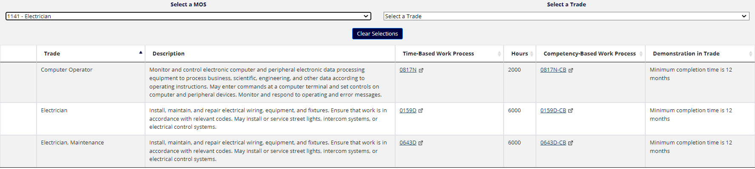
USMAP – Trade Skill Programs
US Marine Corps – MOS: 1141 – Electrician – 3 Certifications Available
All Branches
Active Duty

Slide 14
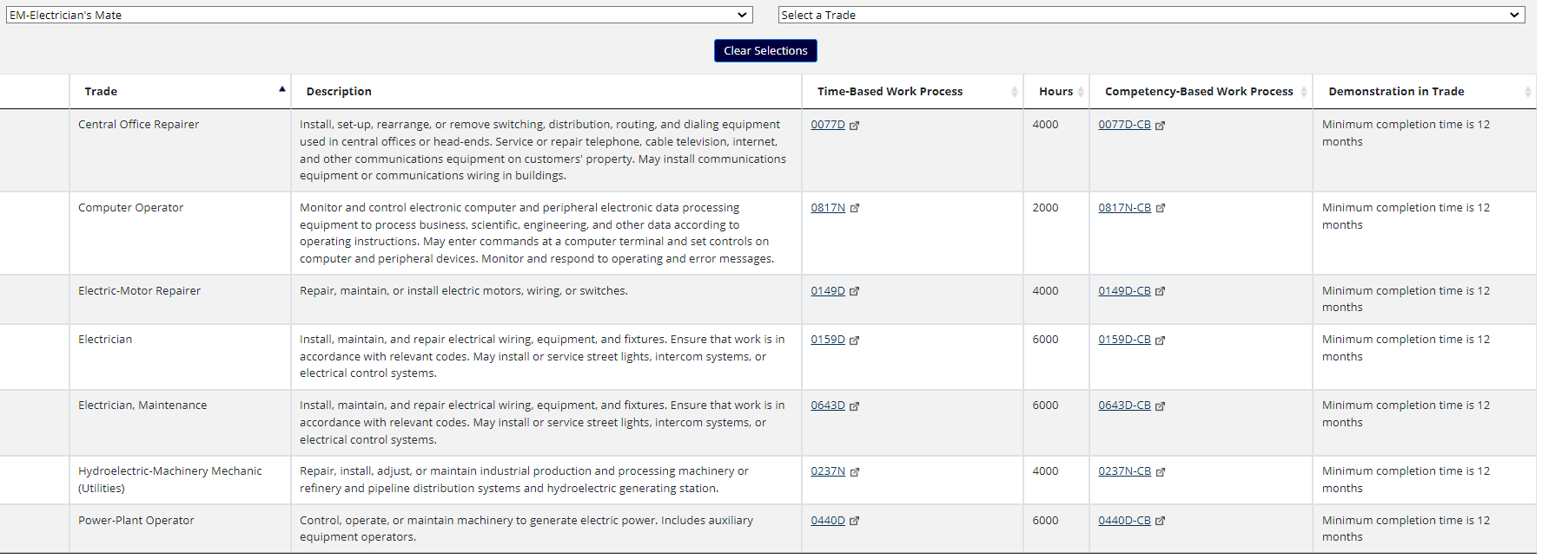
USMAP – Trade Skill Programs
US Navy – Rating: Electrician’s Mate – 7 Certifications Available
US Navy Specific
Active/Reserve Duty

Slide 15
Other Ways to Earn College Credits
College Level Examination Program (CLEP)
A series of 33 standardized subject exams that can be taken for recommended college credit introductory-level classes taken in the first two years of college. Recognized at over 2,900 participating colleges and universities. All first attempts on exams are funded by the US Military
https://www.navycollege.navy.mil/sailors/resources.htm
Joint Service Transcript (JST)
Earn college credit recommendations by The American Council on Education (ACE) for participating in Navy training for your career, advancing in rank, and earning certifications.
https://jst.doded.mil/jst/
Tuition Assistance (TA)
Pay up to 100% of tuition charged by education institutions after your second year of service in the Military using online courses or “brick and mortar” institutions local to your base.
https://www.navycollege.navy.mil/sailors/tuition-assistance-ncpace.htm
All Branches
Active Duty

Slide 16
Other Ways to Earn College Credits
Navy College Program for Afloat College Education (NCPACE)
If you are on deployment, how do you go to school?
NCPACE courses are offline, distance-learning courses designed to allow students to continue their education while deployed and without reliable, consistent Internet access.
Students complete their assignments independently using texts, study guides and other materials. There is no mentor interaction for NCPACE courses.
Pays up to 100% of tuition charged by education institutions while serving aboard a ship at sea.
https://www.navycollege.navy.mil/sailors/tuition-assistance-ncpace.htm
US Navy Specific
Active Duty

