Slide 1
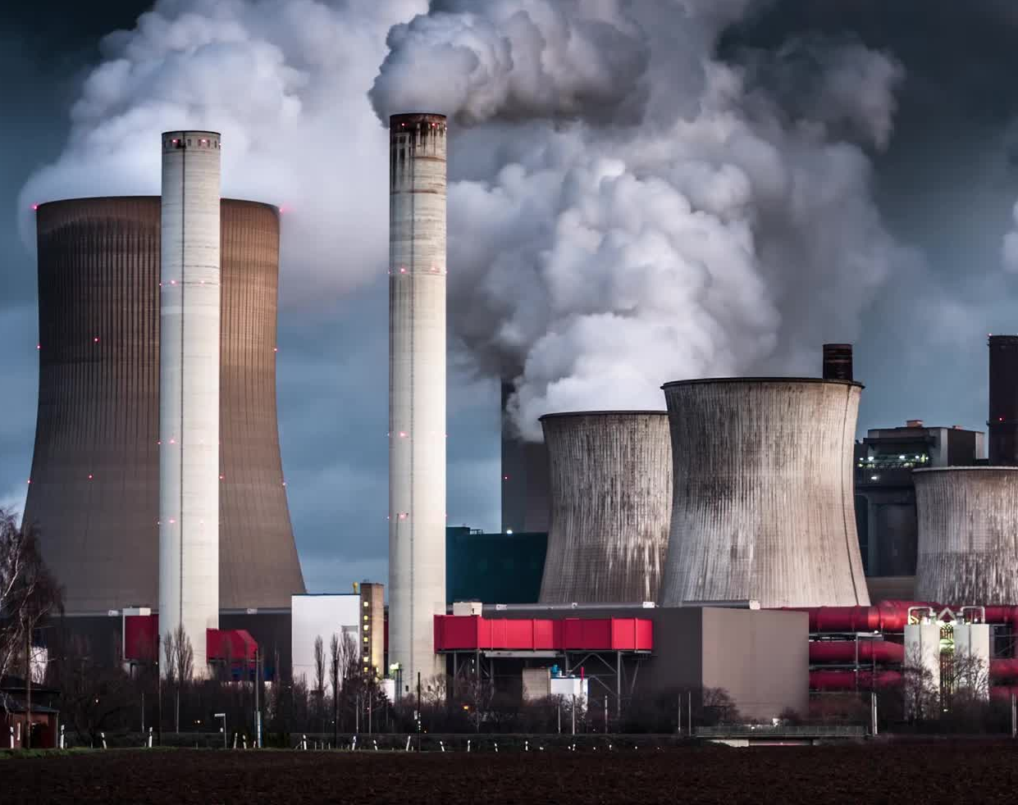
Introduction to
Nuclear Power

Slide 2
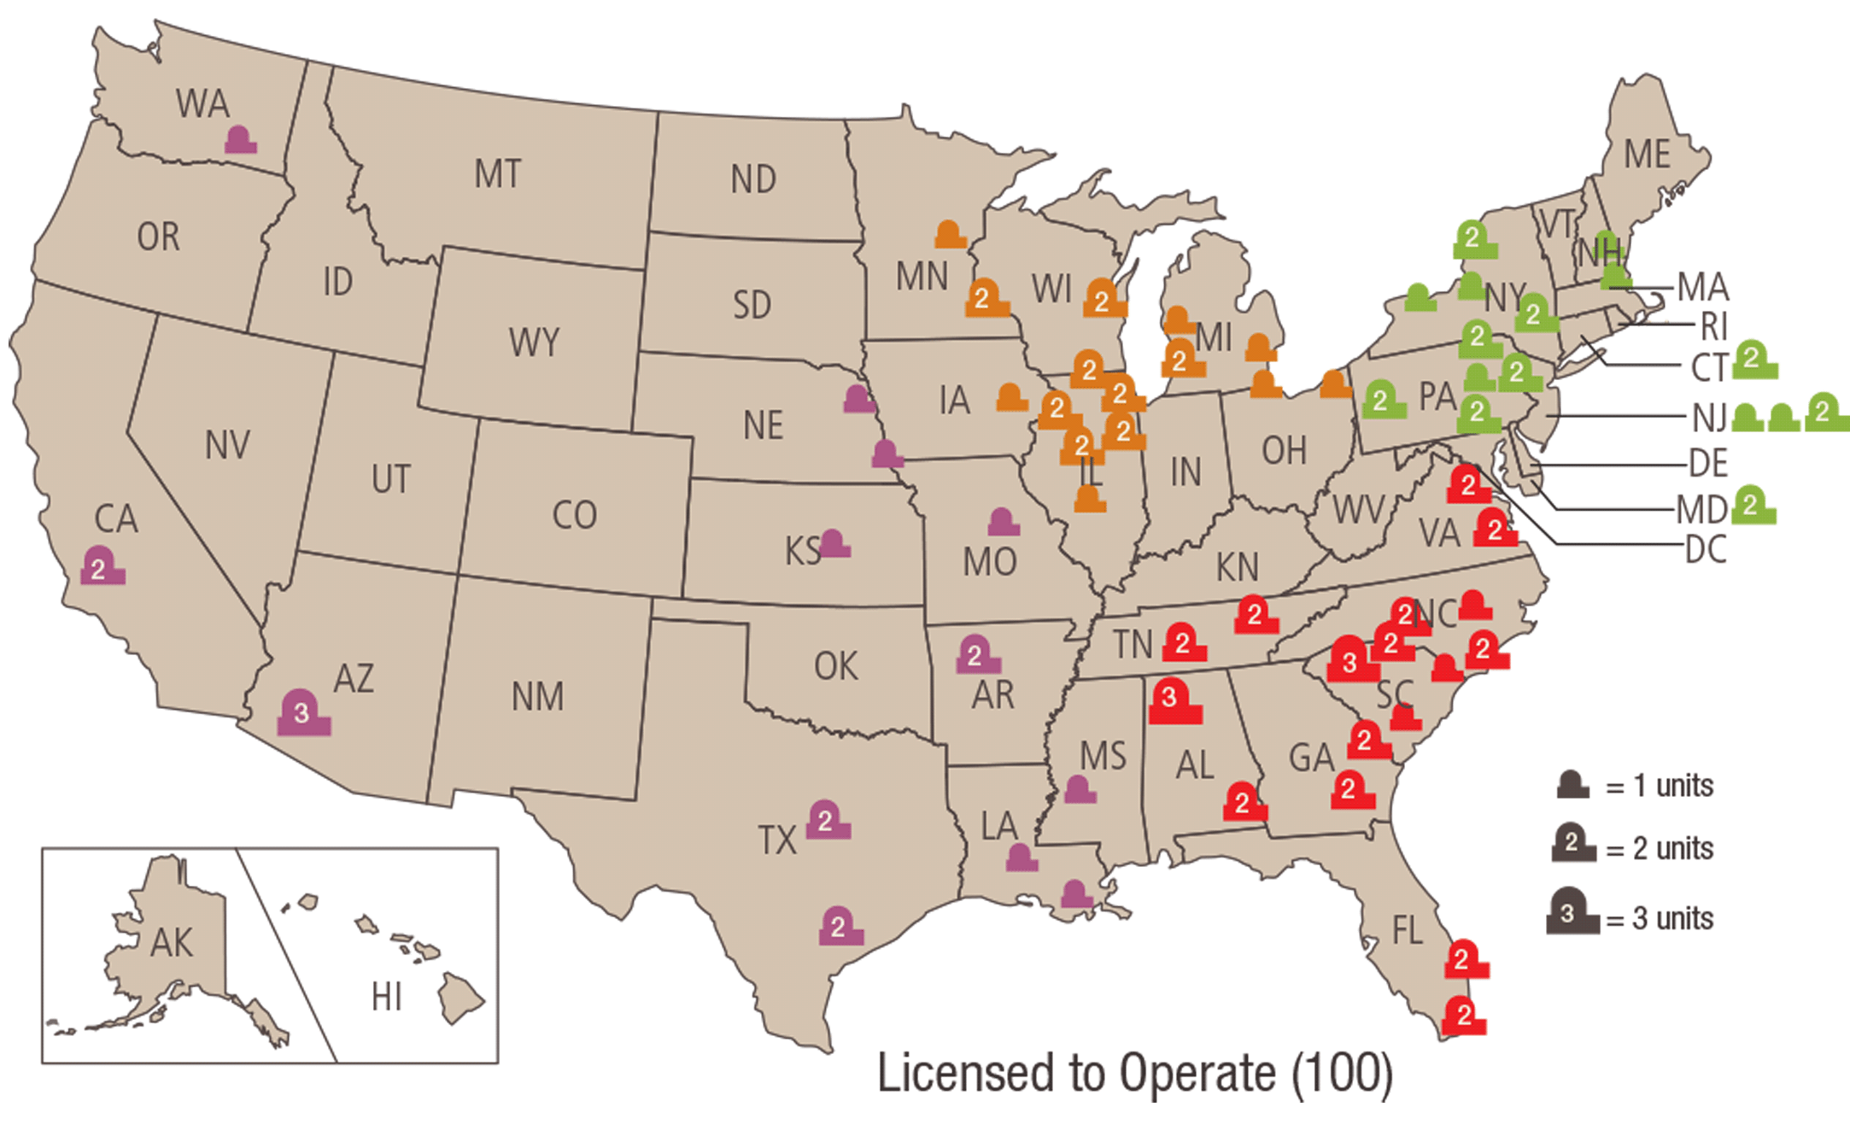
Nuclear Power Plants in America
Nuclear Power: Clean, Safe, and Effective

Slide 3
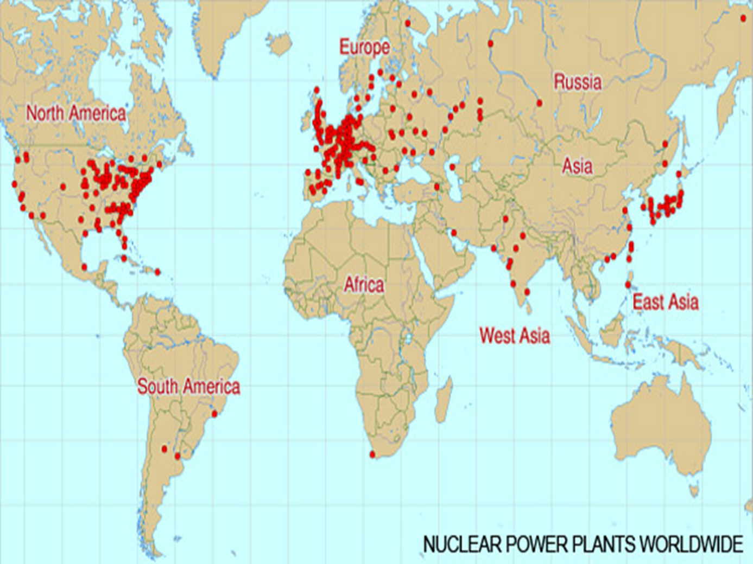
World Wide
Nuclear Power: Clean, Safe, and Effective

Slide 4
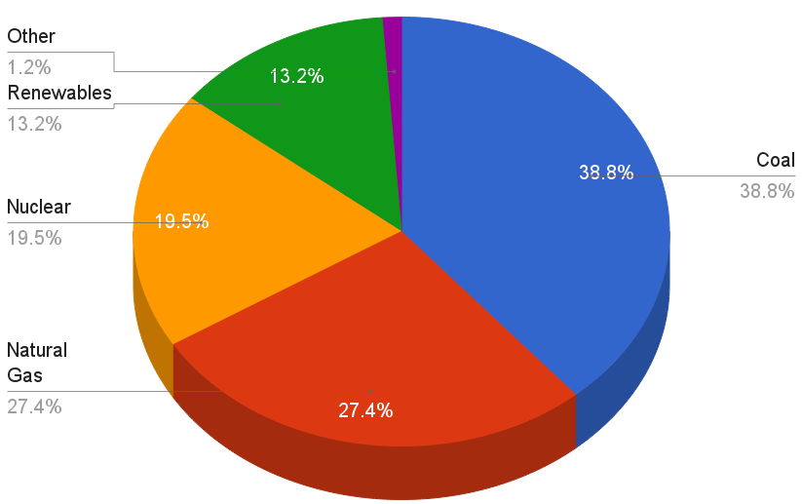
US 2014 Electricity Generation By Type
Nuclear Power: Clean, Safe, and Effective

Slide 5
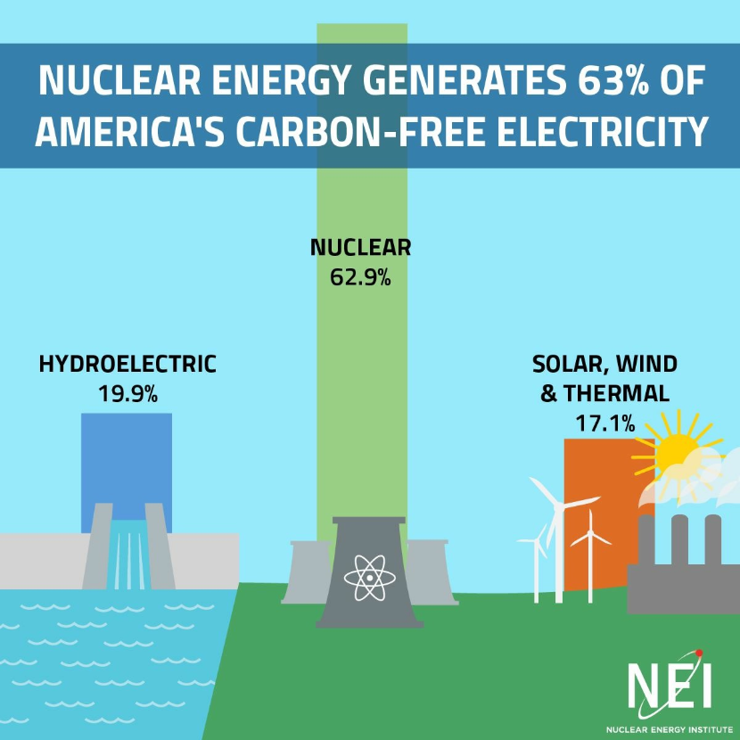
Nuclear Power: Clean, Safe, and Effective

Slide 6
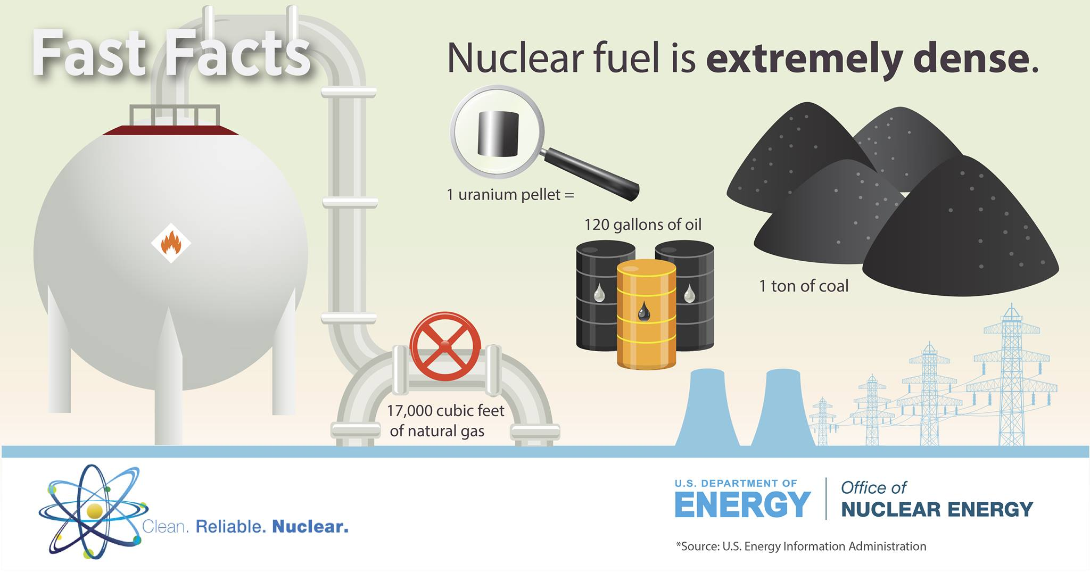
More Bang For Your Buck
1 Uranium Fuel Pellet weighs 10 grams or 0.35 oz or 0.02 lbs.
Nuclear Power: Clean, Safe, and Effective

Slide 7

A Closer View
Nuclear Power: Clean, Safe, and Effective

Slide 8
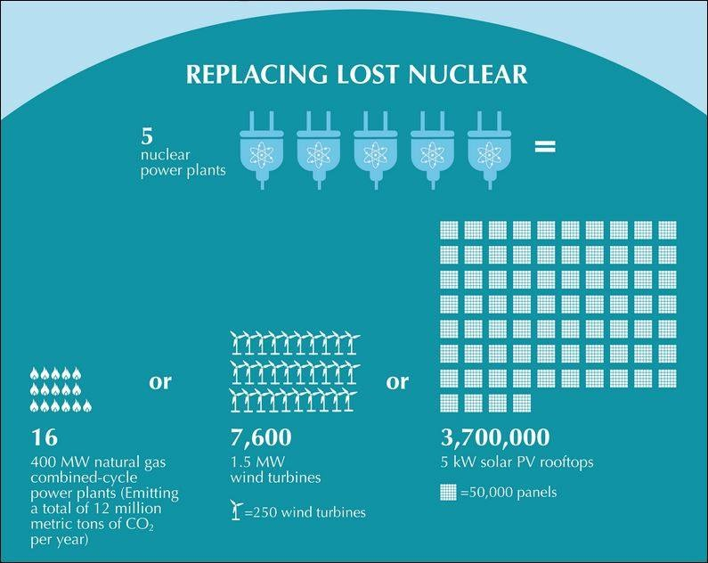
Nuclear Power Output
Nuclear Power: Clean, Safe, and Effective

Slide 9
A Bright Idea
One light bulb requires 876kW-hr to be powered for one year.
It takes 714 lbs of coal to produce 876kW-hr
  1lb to produce 1.23kW-hr to power the bulb for 12 hours
One gram of uranium produces 22,813 kW-hr
  Enough to power a 100W light bulb for 26 years
Nuclear Power: Clean, Safe, and Effective

Slide 10
Myths About Nuclear Power
Myth # 1: Americans get most of their yearly radiation dose from nuclear power plants.
  Truth: We are surrounded by naturally occurring radiation. Only 0.005% of the average American's yearly radiation dose comes from nuclear power; 100 times less than we get from coal, 200 times less than a cross-country flight, and about the same as eating 1 banana per year.
Myth # 2: A nuclear reactor can explode like a nuclear bomb.
  Truth: It is impossible for a reactor to explode like a nuclear weapon; these weapons contain very special materials in very particular configurations, neither of which are present in a nuclear reactor.
Myth # 3: Nuclear energy is not safe.
  Truth: Nuclear energy is as safe or safer than any other form of energy available. No member of the public has ever been injured or killed in the entire 50-year history of commercial nuclear power in the U.S. In fact, recent studies have shown that it is safer to work in a nuclear power plant than an office.
Nuclear Power: Clean, Safe, and Effective

Slide 11
Safety in Numbers
Energy Source | Mortality Rate (deaths/trillion kWhr) | Percentage of Electricy Produced
Coal – global average | 100,000 | 41% global electricity
Coal – China | 170,000 | 75% China’s electricity
Coal – U.S. | 10,000 | 32% U.S. electricity
Oil | 36,000 | 33% of energy, 8% of electricity
Natural Gas | 4,000 | 22% global electricity
Biofuel/Biomass | 24,000 | 21% global energy
Solar (rooftop) | 440 | < 1% global electricity
Wind | 150 | 2% global electricity
Hydro – global average | 1,400 | 16% global electricit
Hydro – U.S. | 5 | 6% U.S. electricity
Nuclear – global average | 90 | 11% global electricity (w/Chernobyl & Fukushima)
Nuclear – U.S. | 0.1 | 19% U.S. electricity

Slide 12
Who is more trusted to operate?
The 25 year old civilian
4-6 years to earn an applicable college degree (not required but recommended)
1.5-2 years for on site training and instruction to earn a license
1 year of supervised hands-on training and experience
The 21 year old Navy Nuke
1 year of accelerated classroom instruction
6 months of supervised hands-on training on a live nuclear reactor
1 year of qualifications and training to operate a nuclear reactor

Slide 13
Nuclear Power Industry
Operational Experience Hiring Preference
From the DTE Energy Hiring Department: Ask Them Yourself!
Careers@dteenergy.com
  Reactor Operators are hired:
    98% from the military (Navy Nuclear Enlisted Background Experience)
    2% from “Internal NO” (Nuclear Operator Non-Licensed Population)
    “Depending on the job classification, military are pretty much the only ones that can qualify”
  Senior Reactor Operator Positions (Operational Management)
    Preferred Employment Consideration
      Navy Nuclear Officer
      4-Year Degree with operational experience (Prior Enlisted)
  Engineering
    “The leadership team is very adamant on everyone having a 4-year degree.”
      Engineers with operational experience are preferred over those with only 4-year degrees

Slide 14

The US Navy Track Record –
Batting Average: 1.000
Currently operating 82 active platforms, and with a history in excess of 50 years of operating Nuclear Reactors, the United States Navy has NEVER had a nuclear reactor accident.
  11 Aircraft Carriers, 71 Submarines
Nuclear Power was invented by the United States Navy in 1954. Since it’s invention, we have maintained a perfect record. But how?
  Military Discipline Instilled in All Operators
  Multiple Testing Schedules and High Standard Maintenance Practices
  Extensive World-Class Training (training continues after qualification)
  Routine Inspection Schedules
  Multi-Million Dollar Safety Systems / Multi-Billion Dollar Engineering Designs

Slide 15
