Slide 1
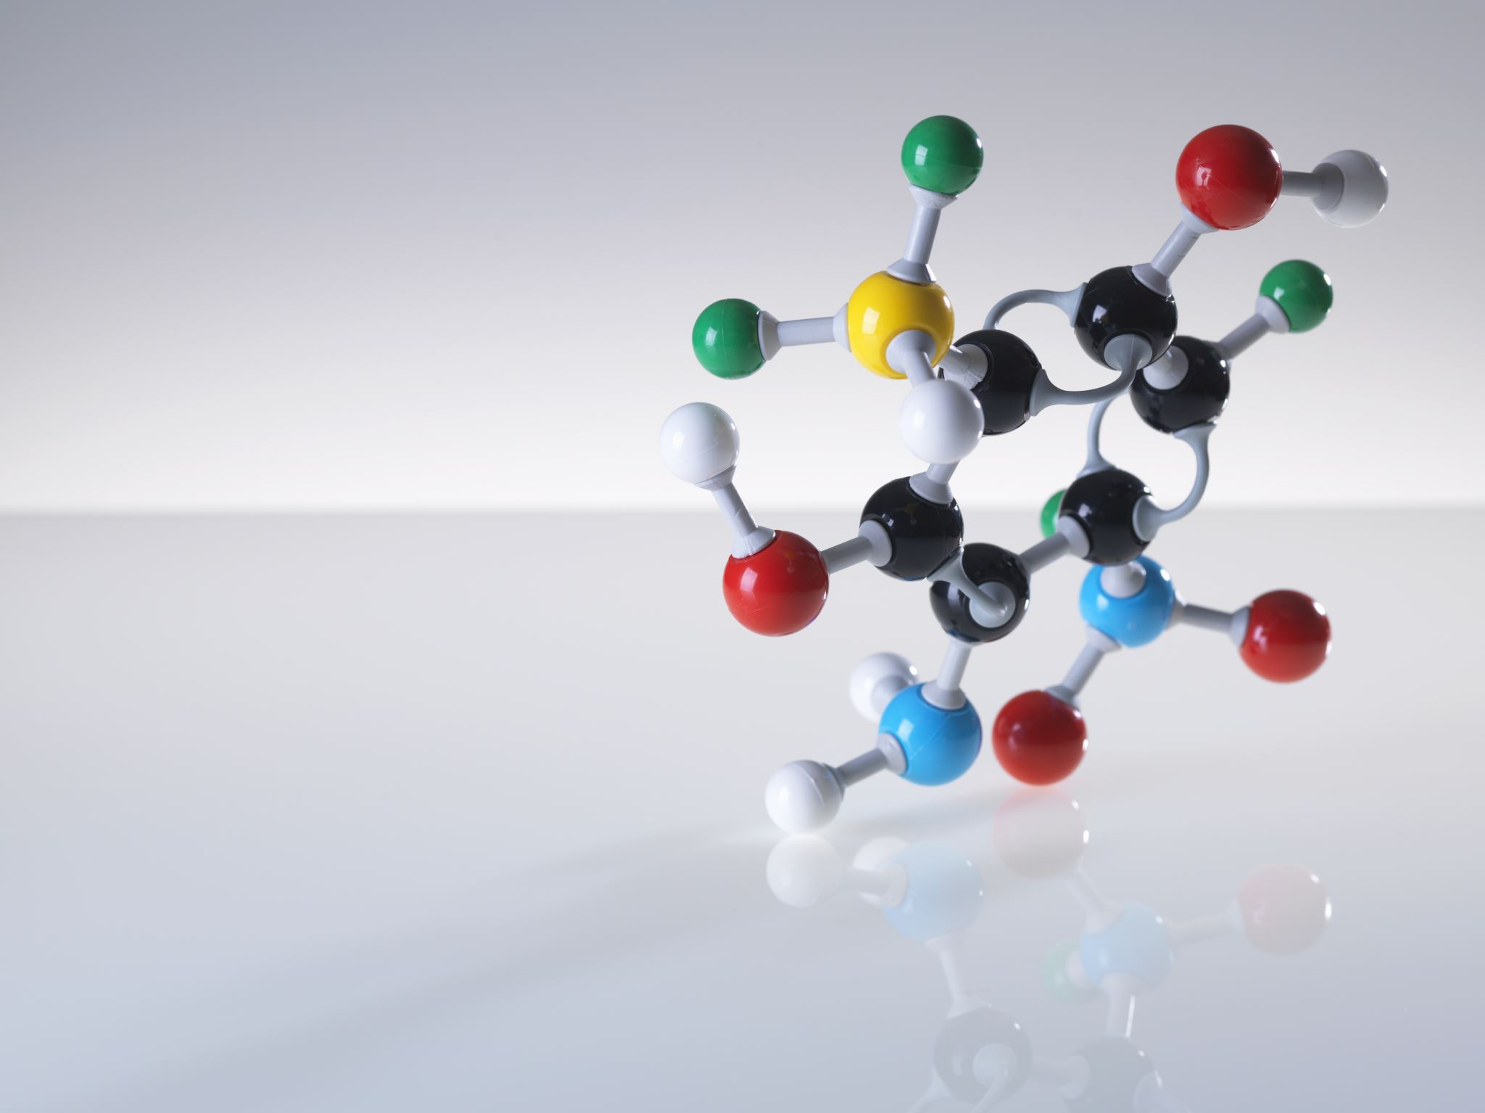
Introduction to Fission-Induced Nuclear Particle Physics
(Explained and Simplified by a USN Reactor Operator)

Slide 2
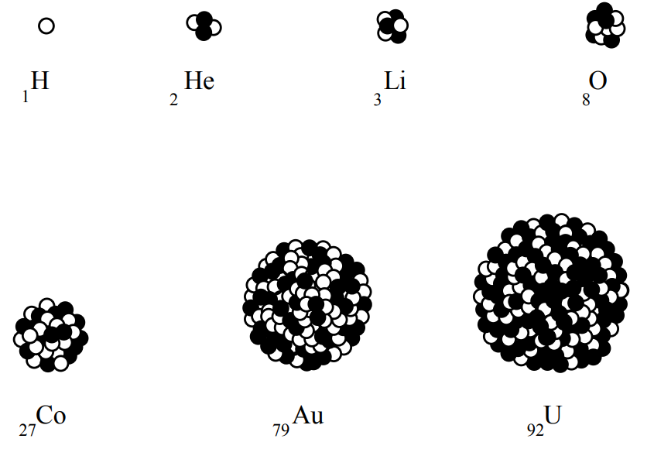
Atomic Number = Protons

Slide 3
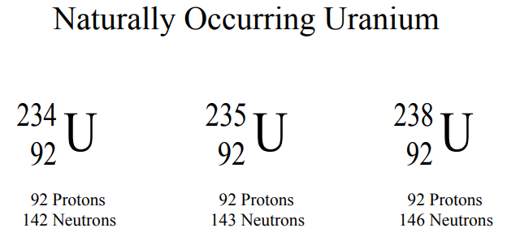
Isotope = Protons + Neutrons

Slide 4
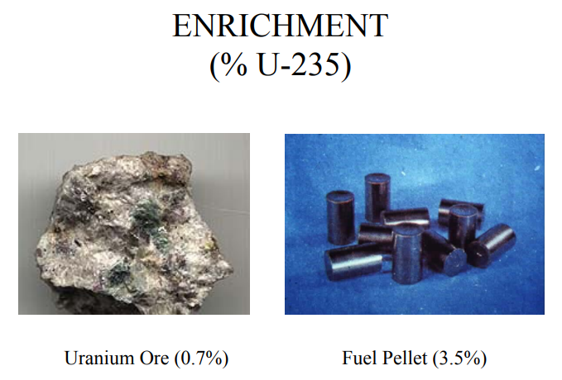
Not just any rock will do…
We need more isotopes that produce controllable fission.

Slide 5
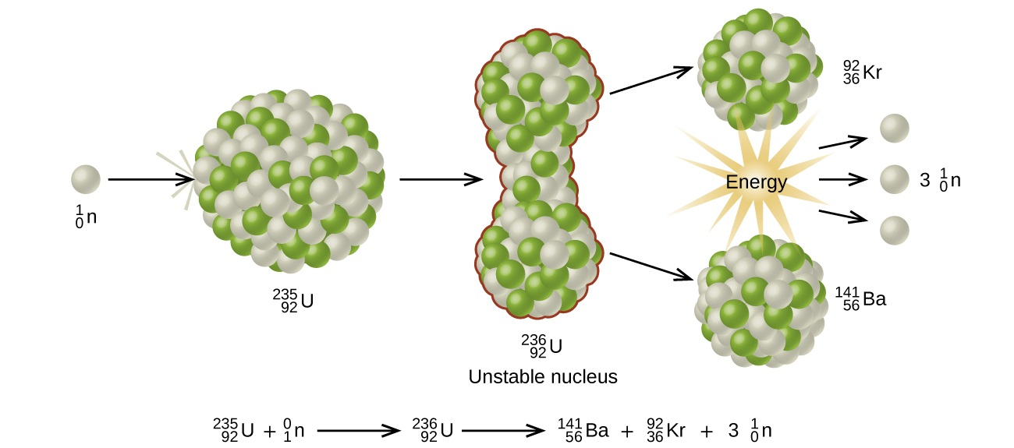
Fission (Liquid Drop Model)

Slide 6
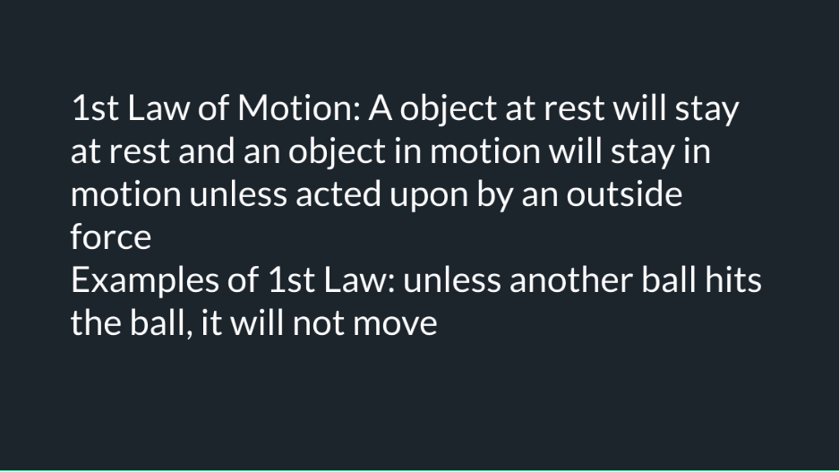

Slide 7
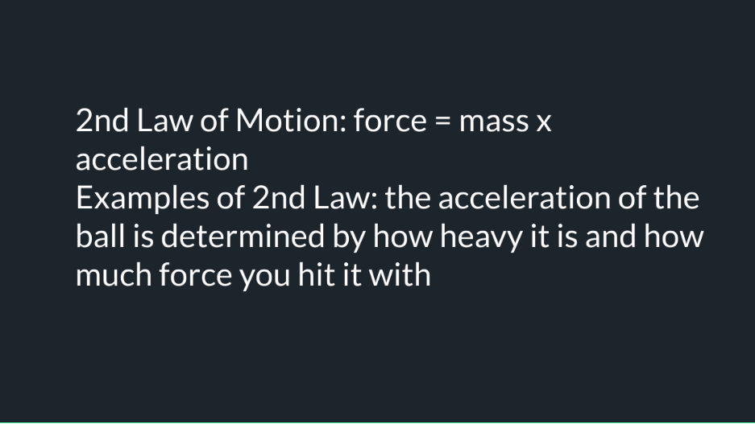

Slide 8
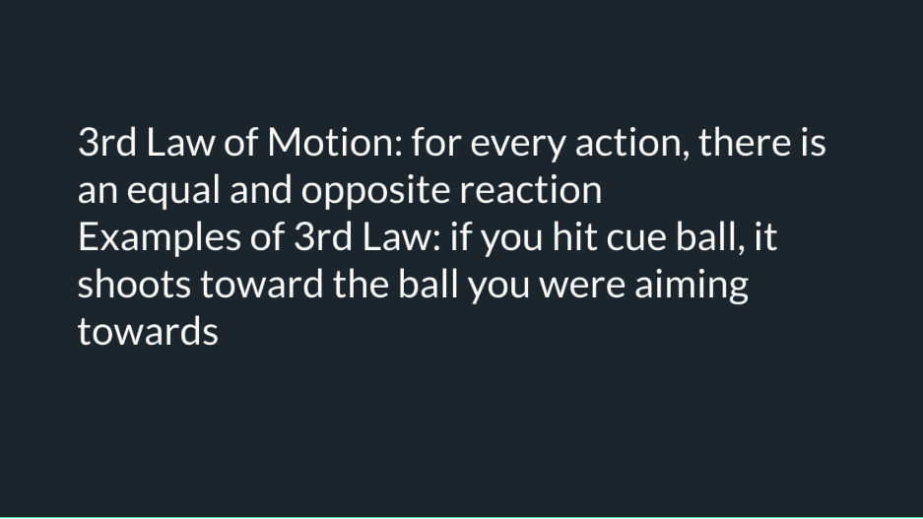

Slide 9
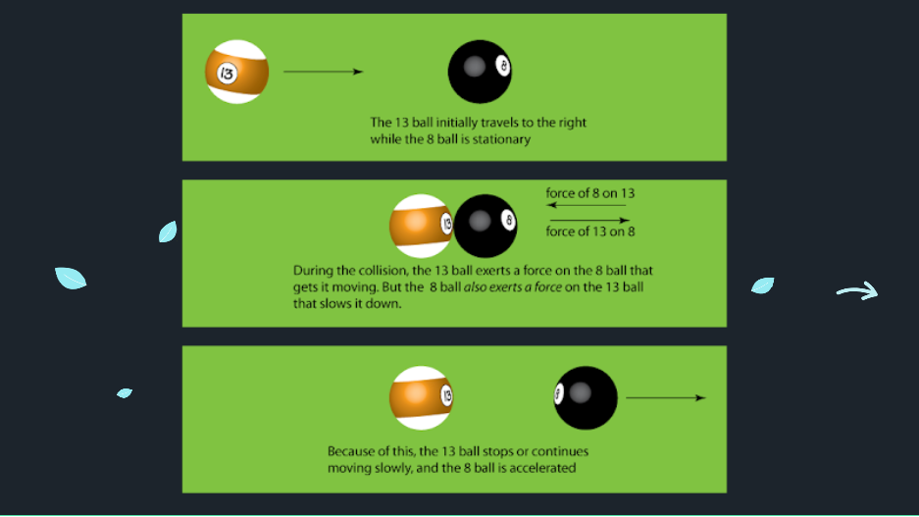
Newton’s Laws At Work

Slide 10
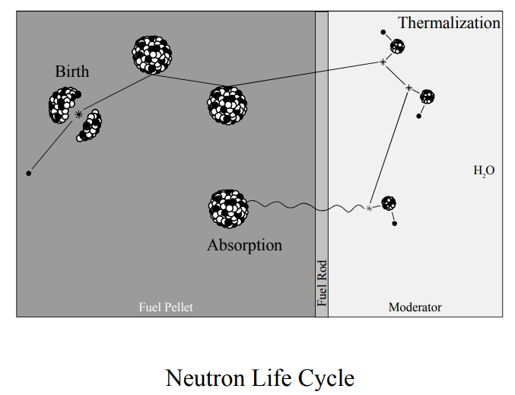
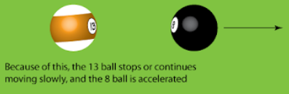
Fission creates “fast” neutrons.
Fast neutrons are not readily absorbed by the U235.
Fast neutrons transfer their energy through similar sized particles (Hydrogen)
Neutron = 1.008665 amu
H Atom = 1 amu
n
H
A “slow” (thermal) neutron creates fission by becoming absorbed by U235
After enough collisions, the neutron becomes “slow” (thermal).
The neutron is at a resting energy level and cannot realistically slow any further.
A “slow” (thermal) neutron creates fission by becoming absorbed by U235

Slide 11
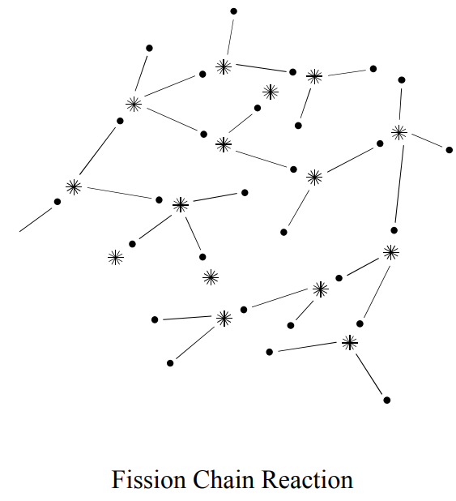
A
Self-Sustaining Chain Reaction

Slide 12

Definitions and
Key Concepts
Joule - the SI unit of work or energy, equal to the work done by a force of one newton when its point of application moves one meter in the direction of action of the force, equivalent to one 3600th of a watt-hour.
Calorie - the energy needed to raise the temperature of 1 kilogram of water through 1 °C, equal to one thousand small calories and often used to measure the energy value of foods.
Water has to absorb 4,184 Joules of heat, or 1 calorie, to increase in temperature of 1 kilogram of water by 1 degree Celsius.
Electron Volt - a unit of energy equal to the work done on an electron in accelerating it through a potential difference of one volt.
The total binding energy released in fission of an atomic nucleus varies with the precise break up, but averages about 200 MeV* for U-235 or 3.2 x 10⁻¹¹ joule.

Slide 13
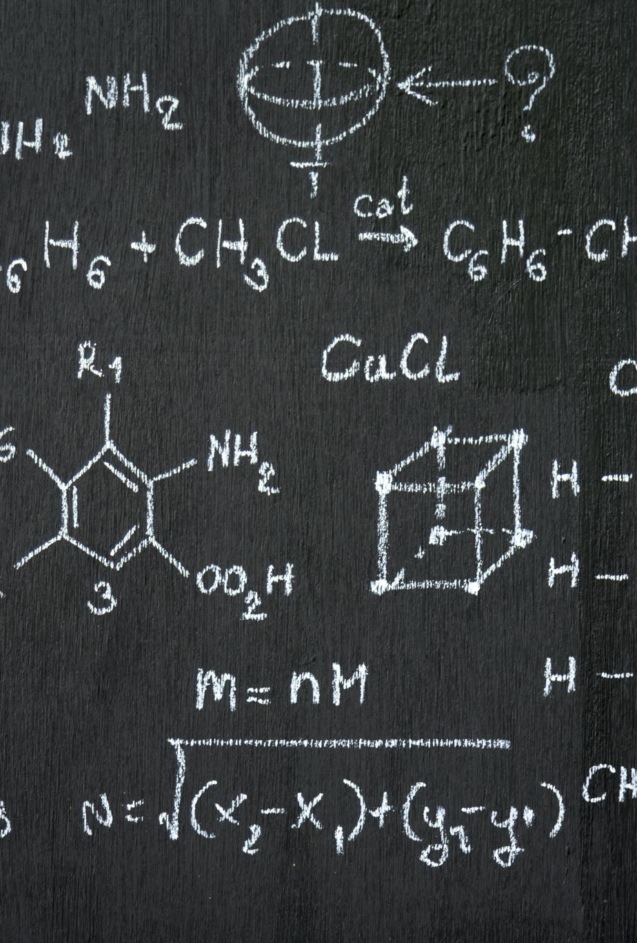
Particle Physics in a Nutshell
If fission of an atomic nucleus makes 200 MeV of energy, producing 3.2x10^-11 joules, and 1 joule is 6.242x10^+18 electron volts, how many fissions does it take to raise the temperature of 1kg of water 1C?
4184 (Joules) x 6.242x10^+18 (ev/Joule) = 2.612x10^+22 (ev)
2.612x10^+22 (ev) / 2.0x10^6 (eV/fission) = 1.306x10^16 fissions
1,306,000,000,000,000 Fissions
Trillions of fissions per second are required to raise temperature!
There are approximately 1.2x10^18 atoms in a grain of salt
120,000,000,000,000,000

Slide 14
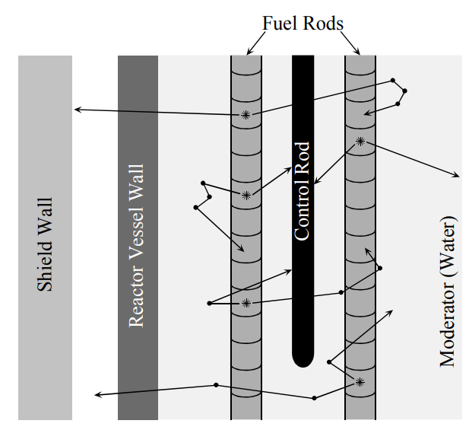
What rods do I move?
What does a Reactor Operator control?
Here is a quick example!
How much fuel should I expose?
How much water do I use?
What temperature am I trying to maintain?

