Slide 1
Estimating Your Value
What value do you place in yourself?
ETN1 Moses Ortiz

Slide 2
Dollars per Hour?
Before taxes are taken out, this is a very simple way to measure the amount of value you receive.
  40 hours worked per week
  52 weeks per year
  No overtime
Everyone understands that the US National minimum wage ($7.25/hour) is not enough to live on your own
Everyone understands that $30/hour is a pretty decent sounding salary to support yourself and your future family
What if someone was paying you a wage of $40/hour to earn a college degree after high school over an 8 year period?
  You don’t need a single day of experience. Do you take the job?

Slide 3
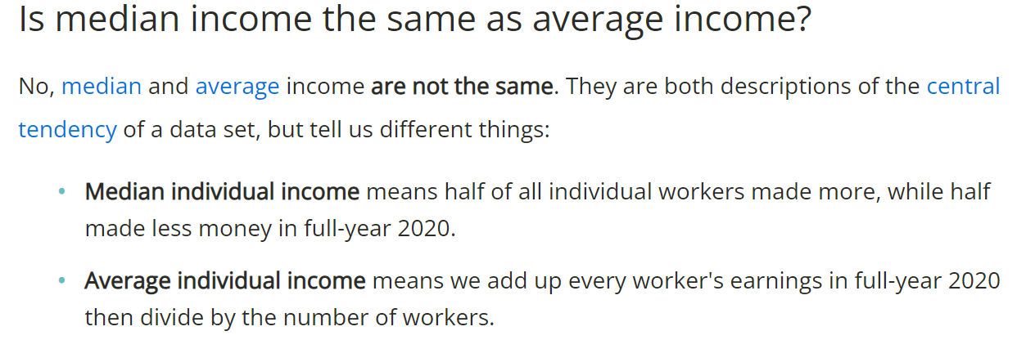
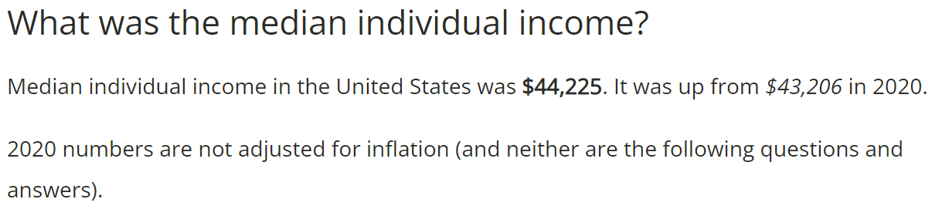
Question:
“Why can’t we use the average income?”
Answer:
If you are accounting for Jeff Bezos, Bill Gates, Elon Musk, and
Mark Zuckerberg into the average of
ALL INCOMES, that is
not an accurate representation of the other
99% of the United States
But this takes into account every working person in the USA
(ages 16-75). What if we only look at yourself in the next 8 years?

Slide 4
The Million Dollar Question
8 Years after High School Graduation, why does 50% of the US population (age 26) make $35,000 or less?
  60% of high school students enter college after high school, and we are told the average wage of a bachelor’s degree recipient is $55,000/year
  15% of high school students elect to perform a trade skill after high school, and we are told the average wage of a journeyman electrician is $55,000/year
  Another 23% enter the work force directly after high school
Where does the wage distribution go if 75% of the population had a foolproof plan?

Slide 5
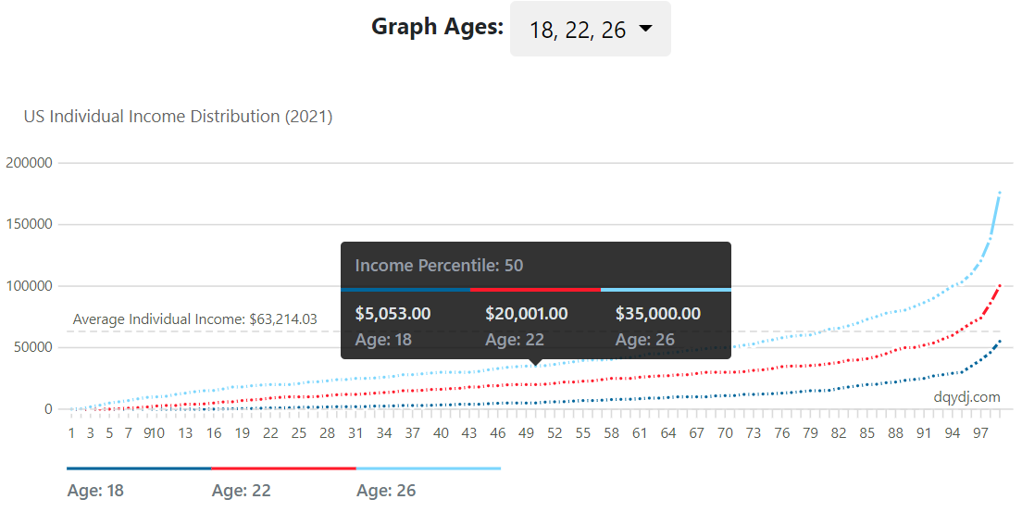
Half of these individuals earn less than the listed amount.
MEDIAN INCOME:
$9.62/hour
MEDIAN INCOME:
$16.83/hour

Slide 6
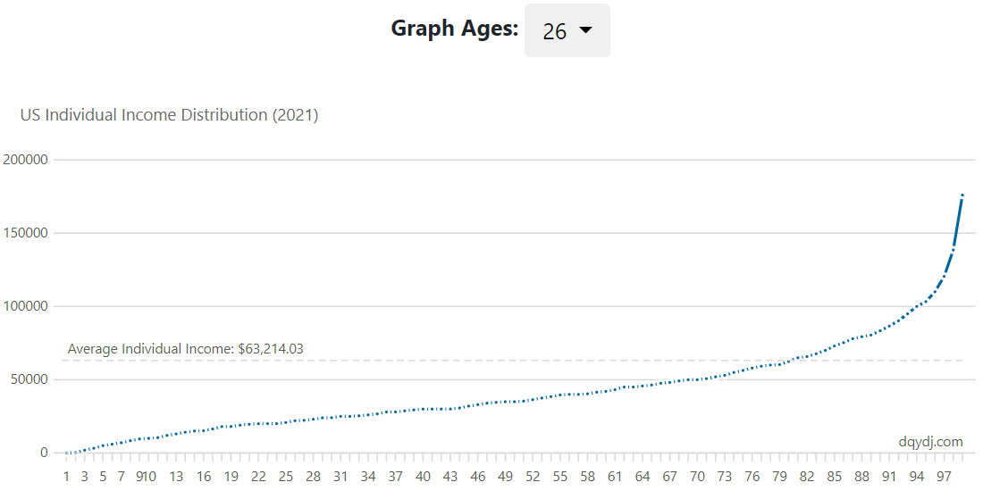
Do you always expect things to go smoothly?
40% underemployment rate for college graduates
4% unemployment rate for college graduates
55% of 4-year bachelor’s degree recipients have ~$30,000 of college debt
40% drop out rate for college students
15% of high school students enroll into a trade school
60% of high school students enroll into college/university
23% of high school students enter the work force directly after graduation
30% of individuals age
26 years old ACTUALLY earn $50,000/year or more
75% of High Schools students had foolproof plans to earn an average of $55,000/year or more
7% Unemployment Rate
60% (45/75) of ALL high school students that HAD A PLAN are NOT earning what they were told they would be making!
30th Percentile
$24,100.00/year
50th Percentile
$35,000.00/year
70th Percentile
$50,100.00/year

Slide 7
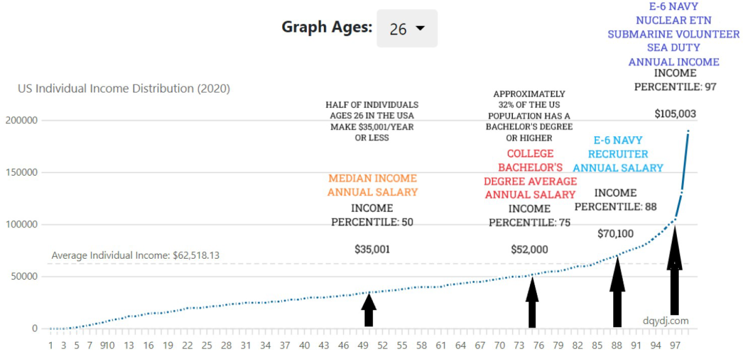
Remember, things can always be different…

Slide 8
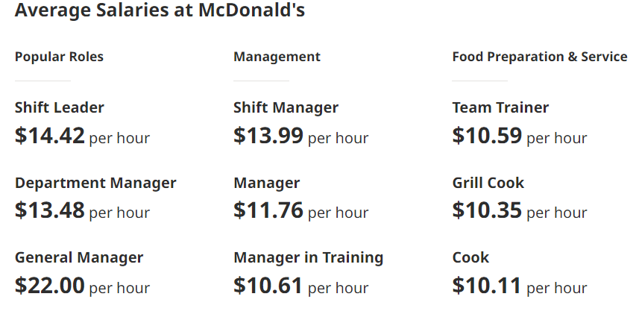
How Do Businesses Measure Your Value?
If you started full-time at a fast-food restaurant, they will pay you a certain dollar amount/per hour
You are paid based on the value that you can provide to the organization
When you are interviewed, you are NOT hired based on your potential, you are hired based on your value you can generate
As you gain more experience, your value to the company rises due to your efficiency and the lack of cost necessary to train someone new
A fast-food restaurant thinks that you as a person are worth:
  Grill Cook: $10.59/hour ($21,528/year)
  Shift Manager: $13.99/hour ($29,022/year)
  General Manager $22.00/hour ($47,760/year)

Slide 9
Raising Your Value
Learn a desired skill
(or trade)
Society needs construction workers, electricians, and mechanics.
Fulfill the need.
Provide a service or product that others cannot easily give
If you are the only person that can give people what they want, they will pay you for your service or product
Gain work experience to become dependable to an employer
Build a resume that is provable to employers so you can negotiate for a higher salary and make yourself more competitive for other employers
Receive an education to make you capable of learning a skill
People do not normally hire those who don’t know what they are talking about for a complicated job/position

Slide 10
What if you only had to worry about the PROS?
PROS COLLEGE CONS
Your expected salary average is $55,000
  This is higher than the median wage high school graduates in the US by $14k-$15k ($40,000)
Networking at college can lead to life-long connections for future employment opportunities
35% of all jobs in the US require a bachelor’s degree or higher
  30% of jobs require “some college” or an associate’s degree
  35% of the remaining jobs do not require education past
  a high school diploma or less education
College is more likely to last up to 5-6 years long
  (3 out of 5 individuals graduate in 5-6 years instead of the “expected” 4 years)
The cost is $84,000 on average for a 4 year education
(Expected $20,000 of interest added if you pay it off over a 10 year period)
College graduates are employed 6 months on average after graduation, NOT immediately
College graduates experience a 40% chance of underemployment and a experience a 4% unemployment rate
2 out of 5 individuals drop out of college
  Mainly due to financial concerns
4 out of 5 individuals change their major during college
COLLEGE + US NAVY WORK EXPERIENCE + FOREVER G/I BILL
Earn college credits through the Navy, get a head start to minimize the time you will spend at college (TA, CLEP, JST, NCPACE)
The Forever G/I Bill covers up to $180,000 for tuition/room/board/books
90% of employers prefer candidates with work experience. You have 4 years of respected experience and an honorable discharge.
If you need a career, use your degree and become a Naval Officer
The ASVAB shows you what jobs you have an aptitude to excel in.
College is more likely to last up to 5-6 years long
$84,000 on average for a 4 year education
(Expected $20,000 of interest added if you pay it off over a 10 year period)
College graduates are employed 6 months on average after graduation, NOT immediately
College graduates experience a 40% chance of underemployment and a experience a 4% unemployment rate
2 out of 5 individuals drop out of college
4 out of 5 individuals change their major during college

Slide 11

If you weren’t talking to a military recruiter, would you take this job offer after High School?
You DO NOT need any prior work experience or college education to apply
Paid travel expenses for worldwide travel. If we need to put you in a hotel, it will be paid for.
Your housing and food will be completely paid for at all times.
  If you have a family, you will receive additional money to ensure that your family has food and housing.
You will receive full coverage health and dental care.
  If you have a family, they will receive the same free of charge.
We will pay for your college degree of your choice. (Up to $25,000/year), but you MUST work for us for 4 years first
  We will give you money directly to your bank account to live on or off campus during your time. (Up to $9,000 per semester, $18,000/year)
  We will give you $1,000 in books per year.
We will give you the opportunity to earn a trade skill certification if you qualify for it.
You will earn 4 years of work experience in a job that is recognized and respected worldwide.
You will earn a minimum of $112,000 over the course of 4 years ($28k/year on average).

Slide 12
US Navy Sailor - Nuclear Enlisted (College Degree After) – 6 Year Commitment
  Net Value - $618,000 / Gross Profit: $340,000 after 6 years
US Navy Officer (College Degree Before) – 9 Year Commitment
  Net Value - $618,000 / Gross Profit: $398,000 after 9 years
US Navy Sailor (College Degree After) – 4 Year Commitment
  Net Value – (E-1 Start) $347,000 / Gross Profit: $112,000 after 8 years (no debt)
  Net Value - (E-3 Start) $365,000 / Gross Profit: $130,000 after 8 years
US Navy Sailor (Career in the USN) – Two Separate 4 Year Commitments
  Net Value – (E-1 Start) $612,000 / Gross Profit: $357,000 after 8 years
College ($84,000 Student Debt) (Start at $23.27/hour full time, $1 raise per year)
  Net Value - $102,000 / Gross Profit: $206,000 after 8 years (debt?)
Trade School (Apprentice start at $16/hour full time, $1 raise per year for 4 years)
(Journeyman start at $25/hour full time, $1 raise per year for 4 years)
  Net Value - $351,000 / Gross Profit: $366,000 after 8 years
Work Force (McDonalds) (Start at $11/hour full time, $1 raise per year)
  Net Value – $241,000 / Gross Profit: $241,000 after 8 years
Gross Profit =
Money (before taxes) that is expected to be deposited to your bank account for personal spending
Net Value Assumptions:
College: -$84,000
College Loan Interest: -$20,000
(4.5% APR 10 Year Loan)
Trade School: -$15,000
Gross Profit Added for Final Total
Navy Net Value Assumptions:
G/I Bill / ROTC Scholarship: $180k
Full Coverage Healthcare/Dental: $5k/year
Worldwide Travel: $5k/year
Certification Training Programs: $15k
Gross Profit Added for Final Total
The Navy Sailor DOES NOT pay for a housing or food until he is an E-5. (3-5 years)
Once E-5, the Navy pays for Basic Housing Allowance (BAH) which is based on locational cost of living.
($1,575/month in Norfolk, VA) ($2,319/month in San Diego, CA)
Housing (utilities) and food provided by the USN are estimated to be a $40k-60k value over 4 years
Add it in yourself to be fair!
Navy Benefits:
Free Full Coverage Healthcare/Dental
401K (TSP)
20 Year Pension/Retirement
Life Insurance
Guaranteed 4 Week/Year Vacation Time
Free Family Support Programs
An 8-year E-6 in the Navy earns $70k-$75k/year.
Master Electricians earn $70k/year without health insurance taken out.
For the purpose of comparison, value losses due to housing, gas, food, utilities, vehicle expenses, and extracurricular activities are not included

Slide 13
Does the Math Add Up? (Gross Profit)
Check it yourself! All information concerning the average career for these choices are readily available online.
Surface Warfare Officer
Electronics Technician Nuclear
Navy Officer | Time | Annual Salary
 |  |  | $/hour
ROTC ($250/month) | Year 1 | 1500
ROTC ($300/month) | Year 2 | 1800
ROTC ($350/month) | Year 3 | 2100
ROTC ($400/month) | Year 4 | 2400
O-1 | Year 5 | 62760 | 30.17
O-1 | Year 6 | 62760 | 30.17
O-2 | Year 7 | 76944 | 36.99
O-2 | Year 8 | 87204 | 36.99
O-3 | Year 9 | 100416 | 48.28
 | Total | 397884
Sub Nuke ET | Time | Annual Salary
 |  |  | $/hour
E-3/E-4 $38k Bonus | Year 1 | 64860 | 31.18
E-4 BAH (Prototype) | Year 2 | 39556 | 19.02
E-4 | Year 3 | 35052 | 16.85
E-5 (BAH Start) | Year 4 | 61812 | 29.72
E-5 | Year 5 | 68196 | 32.79
E-6 | Year 6 | 71316 | 34.29
 | Total | 340792
O-1/O-2/O-3 BAH Zip Code 23701 (Norfolk, VA)
<2% of all Navy officers are on submarines (NUPOC)
Assume officer career is at sea
6 months of BAH Zip Code 29445 while training at prototype (Charleston SC)
E-5/E-6 BAH Zip Code 23701 (Norfolk, VA)
30% of nuclear field applicants volunteer for submarine service

Slide 14
The Average 4-Year College/University
AVERAGE COST OF COLLEGE
-$40,000 TUITION
-$40,000 ROOM & BOARD
-$4,000 BOOKS
= -$84,000
Interest Rate 4.5% Monthly APR 10 Year Loan
Total Interest over 10 years = $20,467.52
Expected Monthly Payments = $870/month
Total after 120 Payments with Interest Included= $104,467
COST OF LIVING AFTER COLLEGE
Average 1 BR apartment with utilities $800/month)
= $38,400 over 48 months
Cell Phone ($60/month), Food ($200/month), Gas ($80/month)
= $16,320 over 48 months
Debt: $104,467 + Housing: $38,400 + Living: $16,320 + Profit: $206,083
Net Profit Over 8 Years
(4 Years College, 4 Years Workforce)
= $46,896
$2.82/hour of profit averaged over 8 years
(before taxes)
EXPECTED EARNINGS AFTER COLLEGE
Expected Salary after Graduation (Based on US Census Data)
Year 1 - $48,400 - $23.27/hour (Expected Starting Salary)
Year 2 - $50,481 - $24.27/hour
Year 3 - $52,561 - $25.27/hour
Year 4 - $54,641 - $26.27/hour
Total Gross Earnings over 48 months = $206,083

Slide 15
Gross Profit =
Money (before taxes) that is expected to be deposited to your bank account for personal spending
US Navy Sailor - Nuclear Enlisted (College Degree After) – 6 Year Commitment
  Net Value - $618,000 / Gross Profit: $340,000 after 6 years
  Resume Bullets After 9 years –
    College Bachelors Degree (of your choice)
    4 Years of Operational Experience of a Nuclear Reactor and Related Systems
    Multiple Certifications with Hands-On/Logged Experience Based on Rating Specialty
      Electronics Technician – Reactor Operation, Electronic Component Troubleshooting, Fiber Optics
      Machinist Mate – Quality Assurance, Refrigeration, Gage Calibration, Emergency Welding, Water Treatment Operator, Machinery Mechanic, Industrial Maintenance
      Electrician’s Mate – Electrical Journeyman’s License, Power Plant Operator, Electric-Motor Repair
      Machinist Mate (Engineering Laboratory Technician) – Radiation Detection, Engineering Plant Chemistry Control
    Salary Negotiation: “If I continue with the Navy, I would have made excess of 6 figures by the 10 year mark with full benefits”
US Navy Officer (College Degree Before) – 9 Year Commitment
  Net Value - $618,000 / Gross Profit: $398,000 after 9 years
  Resume Bullets After 9 years –
    College Bachelors Degree (Based on ROTC Application Acceptance)
    5 Years of Service Upon a Navy Vessel with Direct Management of Supporting Personnel
    Salary Negotiation: “If I continue with the Navy, I would have made excess of 6 figures by the 10 year mark with full benefits”
US Navy Sailor (College Degree After) – 4 Year Commitment
  Net Value – (E-1 Start) $347,000 / Gross Profit: $112,000 after 8 years
  Net Value - (E-3 Start) $365,000 / Gross Profit: $130,000 after 8 years
  Resume Bullets After 8 years:
    College Bachelors Degree (of your choice)
    4 Years of Work Experience in the United States Navy
    Multiple Certifications with Hands-On/Logged Experience Based on Rating Specialty
      (Over 90+ Ratings, 70+ Trade Skill Certification Programs)
Net Value Assumptions:
G/I Bill / ROTC Scholarship: $180k
Full Coverage Healthcare/Dental: $5k/year
Worldwide Travel: $5k/year
Certification Training Programs: $15k
Gross Profit Added for Final Total
Full Benefits:
Free Full Coverage Healthcare/Dental
401K (TSP)
20 Year Pension/Retirement
Life Insurance
Guaranteed 4 Week/Year Vacation Time
Free Family Support Programs

Slide 16
Gross Profit =
Money (before taxes) that is expected to be deposited to your bank account for personal spending
College ($84,000 Student Debt) (Start at $23.27/hour full time, $1 raise per year)
  Net Value - $102,000 / Gross Profit: $206,000 after 8 years
  Resume Bullets After 8 years –
    College Bachelors Degree (of your choice)
    4 Years of Work Experience in your Field of Choice
Trade School (Apprentice start at $16/hour full time, $1 raise per year for 4 years)
(Journeyman start at $25/hour full time, $1 raise per year for 4 years)
  Net Value - $351,000 / Gross Profit: $366,000 after 8 years
  Resume Bullets After 9 years –
    Certifications Based on your Trade Specialty
    8 Years of Work Experience in your Trade
Work Force (McDonalds) (Start at $11/hour full time, $1 raise per year)
  Net Value – $241,000 / Gross Profit: $241,000 after 8 years
  Resume Bullets After 8 years:
    8 Years of Work Experience
Net Value Assumptions:
College: -$84,000
College Loan Interest: -$20,000 (4.5% APR 10 Year Loan)
Trade School: -$15,000
Gross Profit Added for Final Total
For the purpose of comparison, value losses due to housing, gas, food, utilities, vehicle expenses, and extracurricular activities are not included

Slide 17
US Navy Sailor - Nuclear Enlisted (STAR REENLISTMENT) – 8 Year Commitment
  Net Value - $885,000 / Gross Profit: $607,000 after 8 years
  Resume Bullets After 8 years –
    4 Years of Operational Experience of a Nuclear Reactor and Related Systems, 8 years of Navy Work Experience in Total
    Multiple Certifications Based on Rating Specialty
      Electronics Technician – Reactor Operation, Electronic Component Troubleshooting, Fiber Optics
      Machinist Mate – Quality Assurance, Refrigeration, Gage Calibration, Emergency Welding, Water Treatment Operator, Machinery Mechanic, Industrial Maintenance
      Electrician’s Mate – Electrical Journeyman’s License, Power Plant Operator, Electric-Motor Repair
      Machinist Mate (Engineering Laboratory Technician) – Radiation Detection, Engineering Plant Chemistry Control
    Salary Negotiation: “If I continue with the Navy, I would have made excess of 6 figures by the 10 year mark with full benefits”
US Navy Sailor - Nuclear Enlisted (STAR REENLISTMENT) – 10 Year Commitment (2 year extension)
  Net Value - $1,038,000 / Gross Profit: $760,000 after 10 years
  Resume Bullets After 10 years –
    Same as above but 10 years of military experience
US Navy Sailor (Career in the USN) – Two Separate 4 Year Commitments
  Net Value – (E-1 Start) $612,000 / Gross Profit: $357,000 after 8 years
  Resume Bullets After 8 Years
    8 Years of Work Experience in the United States Navy
    Certifications Based on your Rating Specialty (Over 90+ Ratings, 70+ Trade Skill Certification Programs)
    Salary Negotiation: “If I continue with the Navy, I would have made an average of $80,000/year by the 10 year mark with full benefits”
Gross Profit =
Money (before taxes) that is expected to be deposited to your bank account for personal spending
Net Value Assumptions:
G/I Bill / ROTC Scholarship: $180k
Full Coverage Healthcare/Dental: $5k/year
Worldwide Travel: $5k/year
Certification Training Programs: $15k
Net Profit
Full Benefits:
Free Full Coverage Healthcare/Dental
401K (TSP)
20 Year Pension/Retirement
Life Insurance
Guaranteed 4 Week/Year Vacation Time
Free Family Support Programs

Slide 18
United States Navy (Nuclear Propulsion Program)
Pros
  High employability in electrical power generation careers following the completion of your contract
  Your G/I Bill can be used on ANY degree plan after your contract, with the housing allowance delivered directly to your bank account (apartment, dorms, or mortgage)
  Special pay and bonuses exclusive to the NF
  Fast-Track promotion programs (immediate E-3, E-4 within 3-6 months, high advancement rate compared to all branches)
  Officer Programs are encouraged
    Prior to Enlistment (ROTC/Naval Academy Dual Enrollment)
    During Enlistment (STA-21)
    After Enlistment (OCS)
Cons
  You must use college credits from your JST to finish your degree, you are not awarded a degree automatically
  Extended - 6 year contract (normally 4 for enlisted contracts)
  Withdrawal from the program will still maintain your contract obligation to 6 years and in another Navy rating
  You are only allowed to serve on a Submarine or an Aircraft Carrier
  You cannot specify your rating prior to enlistment (ET/EM/MM (ELT in prototype))
  You are not given a DOE reactor operator license for completion of qualifications during your time in the USN
$180,000 - G/I Bill (Tuition/Room/Board)
$20,000 – Worldwide Travel Expenses
$20,000 – Full Coverage Healthcare/Dental
$38,000 - Enlistment Bonus
$42,000 - 60 College Credits (77 obtainable) awarded from JST from the first 2 years of education, “Room and Board” during school is paid for
$303,000 – Start at E-3, Accelerated to E-4, 6 Year Career, Average Submarine Career
$15,000 Optional Trade Skill Certification
TOTAL VALUE
$618,000 over 6 Years
Overall Profit over 6 Years = $340,000
$27.24/hour averaged over 6 years if you remove all other value

Slide 19
United States Naval Officer (ROTC/Academy)
Pros
  You MUST have a college degree prior to commissioning
  Allowed to serve on any class of ship if you are chosen for it
    (exceptions for specialty programs like NUPOC, WC, Medical, Pilot)
  1st year is free, regardless of withdrawal status
Cons
  College choice is limited, you must attend a specified college for the NROTC program or the Naval Academy (Annapolis)
  Room/Board fund is NOT provided to your bank account, but given directly to the college instead by the USN
  Your specialty/assignment and location is based upon the needs of the Navy, your college performance, and degree plan
  Tier 1/2/3 degrees may influence the job you choose and where you are stationed
    Not allowed to have a degree outside of these tiers
  Required classes in college (1 year of calculus, 1 year of calculus-based physics, Naval Science, etc.) on top of your normal required credit hours necessary for graduation
  Withdrawal after the first year will incur charges upon the student for tuition/room/board
  Any degree plan over 4 years will be paid for out of pocket by the student (scholarships/grants acceptable)
$180,000 – College ROTC Scholarship
$7,800 – (Total NROTC stipend amount during college given to midshipmen)
$20,000 - Full Coverage Healthcare/Dental
$20,000 - Worldwide Travel
$390,000 - Average 5-Year Officer Career
TOTAL VALUE
$618,000 over 9 Years
Overall Profit over 9 years = $398,000
$21.26/hour averaged over 9 years if you remove all other value

Slide 20
United States Navy (College After Service)
The Value Provided by the USN
$180,000 – Forever GI Bill
  (Covers Tuition/Room/Board/Books)
$112,000 – Average Navy Career (E-1 Start)
  (Not Including Bonuses)
$20,000 Worldwide Travel
$15,000 Optional Trade Skill Certification
$20,000 Full Coverage Health/Dental
  (No Co-Pay)
  = $347,000 of Value Over 4 Years
  without trade skill certification ($332,000 / $39.90/hour)
  ($20.85/hour over an 8 year period to complete a college degree and no part time job)
The G/I Bill covers room/board but is delivered to your bank account. If you have roommates or find a cheaper place, you keep the profit
  Cover your cell phone/food/rent/utilities/gas at college completely
REMEMBER, the Navy sailor DOES NOT PAY for housing and food during this entire 8 year period.
Cell Phone ($60/month), Gas ($80/month)
= $3,900 over 48 months
Net Profit Over 8 Years
(4 Years Navy, 4 Years College)
= $112,000 ($108,000 after expenses taken out)
$6.73/hour of profit average over 8 years
(before taxes)
At E-4, average monthly salary of ~$36k/year ($17.30/hour) (before taxes)
(BAH is tax free)

Slide 21
United States Navy (8 Years, 1 reenlistment)
The Value Provided by the USN
$180,000 – Forever GI Bill
  (Covers Tuition/Room/Board/Books)
$327,000 – Average Navy Career (E-1 Start, 8 years) (BAH is tax free)
$30,000 – Reenlistment Bonus
$20,000 Worldwide Travel
$15,000 Optional Trade Skill Certification
$40,000 Full Coverage Health/Dental
  (No Co-Pay)
  TOTAL VALUE
  $612,000 over 8 Years
If you enlist up to 10 years, you may elect to give your G/I bill to your spouse or children
Total Profit Over 8 Years
(4 years Navy )
= $357,000
$21.45/hour over 8 years on average (before taxes)
At E-6, average monthly salary of ~$73k/year ($35.10/hour) (before taxes)
(BAH is tax free)

Slide 22
My Opinion (If I could do it all over again)
#1 Choice: Specialty Officer Program (Medical, NUPOC, Pilot, SPECWAR, etc.)
  You have outstanding civilian translatability and an impeccable resume at the price of a highly competitive entrance requirement. If you get accepted, the benefits are amazing, but acceptance is not guaranteed.
#2 Choice: Nuclear Enlisted
  Your employability even without a degree after the completion of your contract makes you invaluable. But if Nuclear Engineering (or any other type of Engineering) is not your preference, use your G/I Bill to obtain any other degree. Use the profit you made during your time in the USN to give yourself a great start to life, and enjoy your college experience.
#3 Choice: General US Navy Officer
  People normally do not realize that you will be in the USN for effectively 9 years in total. 4 years of college (ROTC or Naval Academy) will be heavily influenced by the USN on a daily basis to include weekends and summer breaks. If you desire to become an officer, I recommend 13 weeks of OCS to skip 4 years of stress.
#4 Choice: US Navy Sailor
  Start college off right. No need to worry about debt or a place to live. Start your next career with work experience and a college degree, with the added ability to deal with actual stressful situations and people. And if you want to make it a career, the yearly salary earnings statistically outperform the average tradesperson and college bachelor’s degree recipient.
#5 Choice: Trade School
  You are paid to earn the skills you need to obtain a great salary. The job may include long hours and several requirements to earn the next certification, but once you have obtained a skill, it is NOT difficult to find work.
#6 Choice: College/University
  The juice is worth the squeeze if you are <1% of the population that has a full-ride scholarship. You aren’t guaranteed a well-paying job, you aren’t guaranteed to graduate, and you aren’t guaranteed to like what you invested 4 years (or more!) of your life into.
#7 Choice: Work Force

Slide 23
The Best of Both Worlds: Enlisted+NUPOC
If you truly desire to become an officer, choose the path of least resistance. Skip the stress of juggling college and the Navy simultaneously while earning a monthly salary to graduate college!
Read about the best deal in the Navy for yourself!: https://www.keeganleary.com/nupoc/
1. Enlist into the Nuclear Navy (18 years old)
($340,000 overall profit)
Figure out if the challenges and lifestyle of an officer is the right fit for you by witnessing it firsthand
If it isn’t, apply to a Nuclear Engineering Plant or finish your college degree
2. Start a 4-year college degree (24 years old)
(use the college credits from the Navy from your JST)
Tuition/Room/Board/Books are paid, keep the remainder of the housing stipend that you do not use
3. Apply to the NUPOC program 30 months before graduation (25 years old)
You are paid an E-6/E-7 salary every month until graduation ($205,000 potential profit)
You are not in an ROTC, you may enjoy your college experience with no added stress or distraction
4. Go to OCS, become a Naval Officer (Nuclear) (28 years old)
Use your experience overcome hardest challenges for a new officer
You have earned respect and confidence from all Navy sailors
You have earned $545,000 to become an officer

Slide 24
What do people in the Navy make?
Assume Zip Code: 23701 for BAH (Bachelor’s Allowance for Housing)
E-4 (<=4 years) – ~$36k/year
  (It takes 1 year to get here in the Nuke Program, 3 years normally)
E-5 (>4 years) – ~$55k/year
  (2 years to get to E-5 in the Nuke Program if you STAR reenlist, 5 years normally)
E-6 (>8 years) - ~$70k-$75k/year (depending on sea pay)
  (4-5 years to get to E-6 in the Nuke Program, 8 years normally)
E-6 Navy Nuke at Sea (Submarine) (>8 years) – $100k-$108k depending on submarine vs surface
  This assumption includes reenlistment bonus averages.
O-1 - $62k/year
O-3 (>4 years) - $97k-$100k/year (more dependent on sea pay)
O-1E (Prior Enlisted Navy Officer, >6 years) - $81k/year
O-3E (Prior Enlisted Navy Officer, >10 years) - $112k/year
Average Salary of Bachelor’s Degree Graduates (~$55,000/year)
Average Salary of Trades Journeymen (~$55,000/year)
Median Income Salary USA ($44k/year)

Slide 25
Sources (Navy Focused)
NROTC
  https://www.navy.com/education-opportunities/college-options-and-scholarships/nrotc?q=nrotc&activity=1228857&cid=ppc_gg_b_stan_general&gclid=Cj0KCQjwrs2XBhDjARIsAHVymmSlmWrtJV2Kuf-hWwkzTdZmi9Ife6IXeMpGSMc8GbvtPodgECPuJDwaAtqkEALw_wcB&gclsrc=aw.ds
G/I Bill Calculator
  https://www.va.gov/education/gi-bill-comparison-tool/
Pay (Military)
  https://www.navycs.com/charts/2022-military-pay-chart.html
  https://veteran.com/career-sea-pay/
  https://www.navycs.com/submarine-pay-chart.html
  https://www.dfas.mil/militarymembers/payentitlements/Pay-Tables/
  https://www.defensetravel.dod.mil/site/bah.cfm
All remaining sources
  whatisyourplan101.org

