Slide 1



Why the United States Navy?
“Nothing is more expensive than a missed opportunity.”
- H. Jackson Brown, Jr.

Slide 2
What do High School Students Want after Graduation?
Enrollment
~60% of students intend on enrolling in college after graduation
Approximately 2 out of 5 dropout (Mainly due to Financial Instability)
~15% of students elect to perform a trade skill after graduation
Scholarships and Grants
0.1% of students are awarded a full-ride scholarship
1.5% of students are awarded a full-tuition scholarship
The average cost of an in-state 4-year university is $80,000-$100,000
The average amount of aid-per-student is $10,000/year
Employment
23% of students enter the work force directly after graduation.
The US Median Salary for individuals age 20-24 earn $16,000-$30,000/year
https://educationdata.org/scholarship-statistics
https://research.com/research/scholarship-statistics

Slide 3
How Do Your Students Define Success?
E-5 is a rank in the US Navy, on average taking 5 years or less to achieve with no prior formal education or experience. Most achieve this in 5 years, be it a chef or an engineer.
US Median Individual Income - $44,000/year
High School Diploma Average Income - $41,057/year
Bachelor’s Degree Recipient Average Salary - $51,985/year
Journeyman Electrician Average Salary - $61,467/year
E-5 US Navy Sailor Salary (Any Job) - $55,000-$79,000/year (Area Dependent / Cost of Living)
But Money isn’t Everything…
US Population Home Ownership Rate (All Ages) – 61% - (6 out of 10)
US Population Home Ownership Rate (25-41) – 48% - (5 out of 10)
US Population Military Veteran Home Ownership Rate (All Ages) – 78% (8 out of 10)
https://www.ziprecruiter.com/Salaries
https://dqydj.com/income-percentile-by-age-calculator/

Slide 4





Forever G/I Bill
Benefits:
Up to $25,162/year for tuition
Up to $3,081/month for room/board
Up to $1,000/year for books
Benefits DO NOT EXPIRE with non-use.
https://www.va.gov/education/gi-bill-comparison-tool/
Requirements:
36 Months Active Duty Service = 100%
30 Months Active Duty Service = 90%
24 Months Active Duty Service = 80%
18 Months Active Duty Service = 70%
6-18 Months Active Duty Service = 60%
90 Days Active Duty Service = 50%
All Branches
Active Duty

Slide 5
Forever G/I Bill
Yellow Ribbon Schools Provide up to 100% TUITION COVERAGE
  MIT (MASSACHUSETTS)
  HARVARD (MASSACHUSETTS)
  YALE (CONNECTICUT)
  DARTMOUTH (NEW HAMPSHIRE)
  COLUMBIA (NEW YORK)
  CORNELL (NEW YORK)
  BROWN (RHODE ISLAND
  PRINCETON (NEW JERSEY)
The Education Grant will apply to:
Colleges/Universities
Trade Schools
Technical/Vocational Schools
How many students have 100% of their expenses covered to these Universities?
University of Michigan
Wayne State University
Michigan State University
Grand Valley State University
All Branches
Active Duty

Slide 6
USMAP – Trade Skill Programs
70+ Trade Skill Certification Jobs (US Navy)
https://usmap.osd.mil/
Unlike Most Apprenticeship Programs:
-Full-Time Benefits on Day One
-All Equipment/Materials Paid For
-College is Always an Option
Requirements:
-Active Duty Enlisted
-12 Months Remaining on Contract
-Work in your Trade Full Time
-Report Hours Worked in Trade
(Monthly)
-One Trade/Occupation at a Time
All Branches
Active Duty

Slide 7
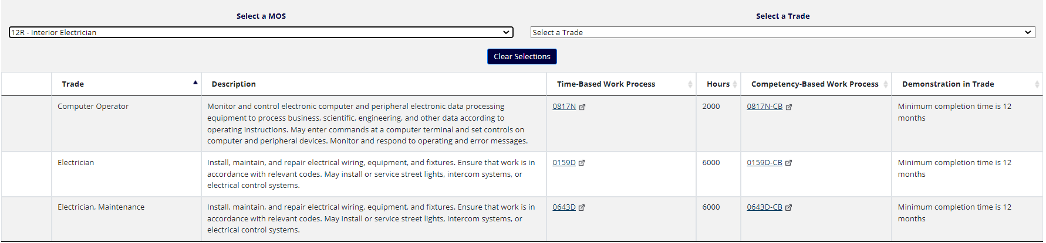
USMAP – Trade Skill Programs
US Army – MOS: 12R – Interior Electrician – 3 Certifications Available
All Branches
Active Duty

Slide 8
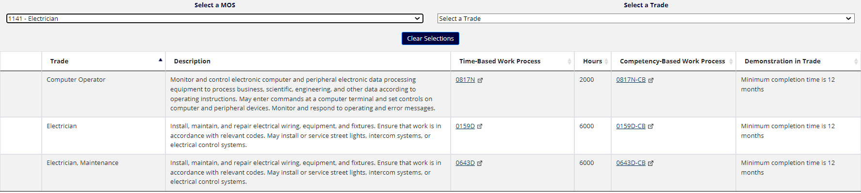
USMAP – Trade Skill Programs
US Marine Corps – MOS: 1141 – Electrician – 3 Certifications Available
All Branches
Active Duty

Slide 9
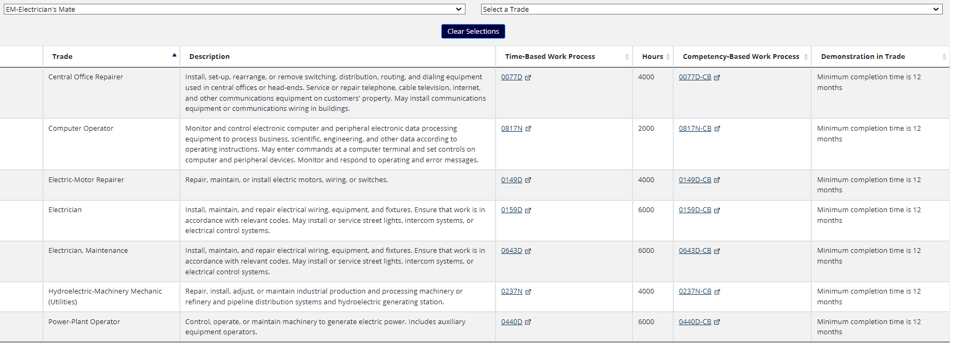
USMAP – Trade Skill Programs
US Navy – Rating: Electrician’s Mate – 7 Certifications Available
US Navy Specific
Active/Reserve Duty

Slide 10
Other Ways to Earn College Credits
College Level Examination Program (CLEP)
A series of 33 standardized subject exams that can be taken for recommended college credit introductory-level classes taken in the first two years of college. Recognized at over 2,900 participating colleges and universities. All first attempts on exams are funded by the US Military
https://www.navycollege.navy.mil/sailors/resources.htm
Joint Service Transcript (JST)
Earn college credit recommendations by The American Council on Education (ACE) for participating in Navy training for your career, advancing in rank, and earning certifications.
https://jst.doded.mil/jst/
Tuition Assistance (TA)
Pay up to 100% of tuition charged by education institutions after your second year of service in the Military using online courses or “brick and mortar” institutions local to your base.
https://www.navycollege.navy.mil/sailors/tuition-assistance-ncpace.htm
All Branches
Active Duty

Slide 11
Other Ways to Earn College Credits
Navy College Program for Afloat College Education (NCPACE)
If you are on deployment, how do you go to school?
NCPACE courses are offline, distance-learning courses designed to allow students to continue their education while deployed and without reliable, consistent Internet access.
Students complete their assignments independently using texts, study guides and other materials. There is no mentor interaction for NCPACE courses.
Pays up to 100% of tuition charged by education institutions while serving aboard a ship at sea.
https://www.navycollege.navy.mil/sailors/tuition-assistance-ncpace.htm
US Navy Specific
Active Duty

Slide 12
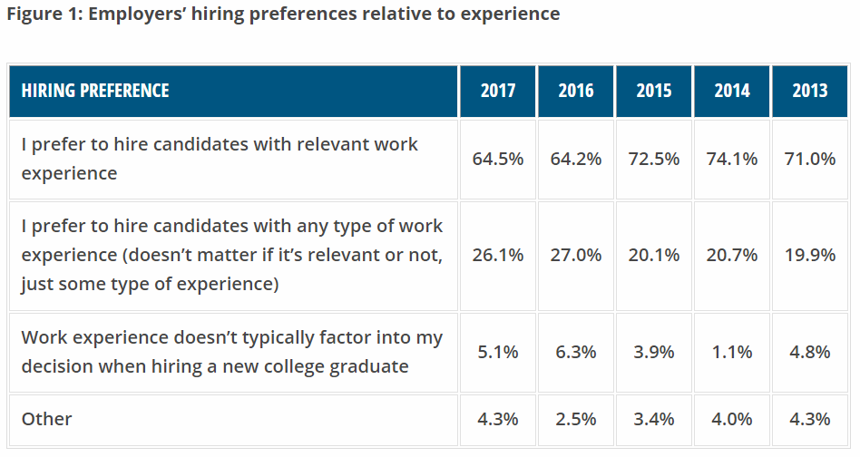
Military Reserves
Internships / Work Studies / Job Experience
How do employers find the answer to these common questions?
Work Experience
“Will you be on time?”
“Are you reliable?”
“Are you a hard worker?”
“Do you work well with teams?”
https://www.naceweb.org/talent-acquisition/candidate-selection/employers-prefer-candidates-with-work-experience/
All Branches
Reserve Duty

Slide 13
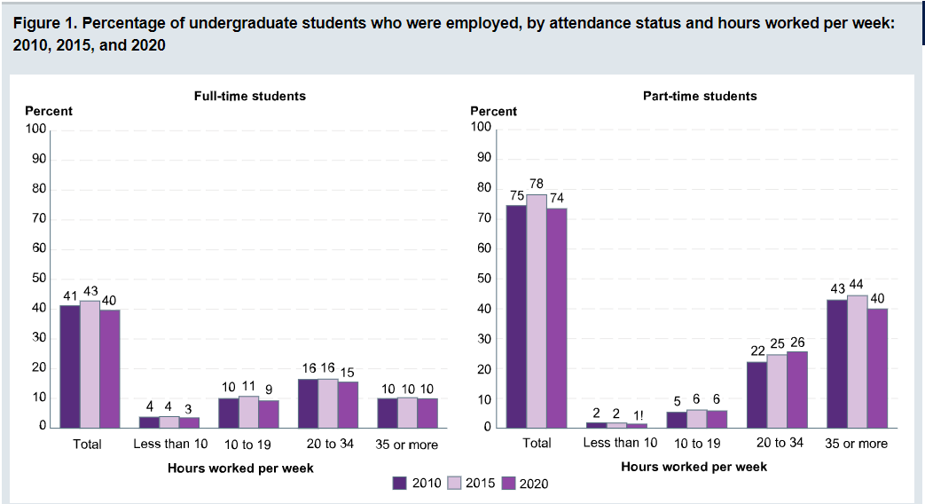
Military Reserves
Internships / Work Studies / Job Experience
Full-Time College Students
7 out of 10 College Students Stress About Finances
3 out of 10 College Students Reduce their Class Load due to amount of Money Owed
How do student’s supplement their college expenses?
Part Time Employment
https://nces.ed.gov/programs/coe/indicator/ssa/college-student-employment
https://news.osu.edu/70-percent-of-college-students-stressed-about-finances/
All Branches
Reserve Duty

Slide 14
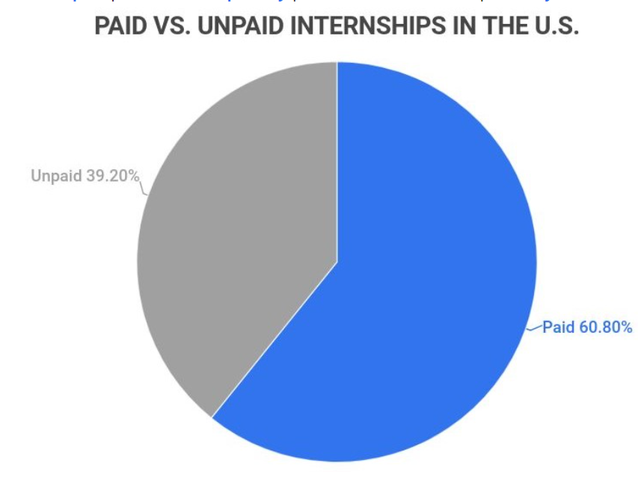
Military Reserves
Internships / Work Studies / Job Experience
There is an estimated 300,000 Interns in the US Annually
Approximately 40% of Internships are Unpaid
31% of Internships Begin after Graduating from College
https://www.zippia.com/advice/internship-statistics/#:~:text=It's%20estimated%20that%20300%2C000%20people,of%20internships%20are%20paid%20positions.
https://financesonline.com/internship-statistics/
All Branches
Reserve Duty

Slide 15
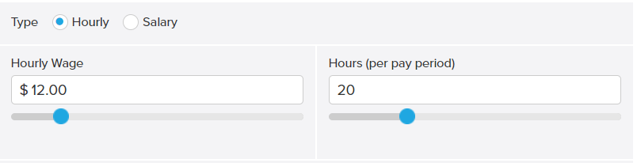
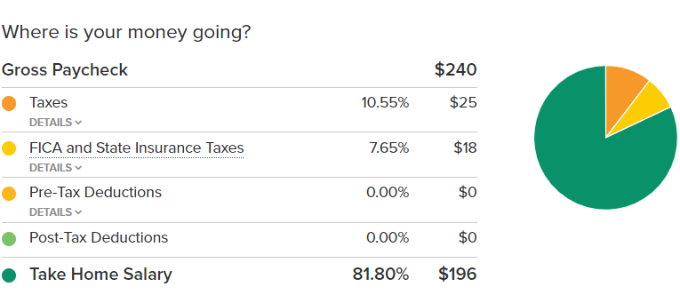
Military Reserves
Internships / Work Studies / Job Experience
70% of College Students Work While Enrolled in College
Example: Working 20 Hours/week
Part-Time Barista / $12.00/hour
https://smartasset.com/taxes/paycheck-calculator#Le0h7f25Un
O | Work Experience
O | Supplemental Income
X | Scholarship / Grant Funds
X | Skill Certification Training
X | Company Sponsored Travel
All Branches
Reserve Duty

Slide 16
Military Reserves
Internships / Work Studies / Job Experience
ONE WEEKEND A MONTH = 4 DAYS OF PAY
BATTLE CREEK (MI), GREAT LAKES (IL), INDIANAPOLIS (IN), HARRISON TWP (MI)
GAS AND LODGING PROVIDED
TWO WEEKS A YEAR
TRAVEL OPPORTUNITIES WORLDWIDE
40+ NAVAL BASES / 400+ ACTIVE SHIPS
GI BILL (SELECTIVE RESERVE)
UP TO $4,500 PER FISCAL YEAR
UP TO $9,000/YEAR (Yellow Ribbon Schools)
70+ TRADE SKILL CERTIFICATION PROGRAMS
Military Reserves
Example: 1 “Drill Weekend”
E-3 (<2 Years of Experience)
$320 / Drill Weekend (2 Days of Work)
https://militarypay.defense.gov/Pay/Basic-Pay/Reserve-Drill-Pay/
https://www.navy.com/forward
O | Work Experience
O | Supplemental Income
O | Scholarship / Grant Funds
O | Skill Certification Training
O | Company Sponsored Travel
All Branches
Reserve Duty

Slide 17
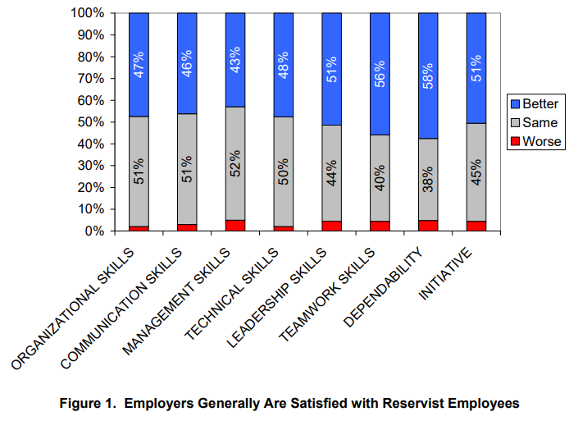
Military Reserves
Internships / Work Studies / Job Experience
Reservists are seen as assets to employers.
Even with a commitment to participate in monthly drills, a reservist brings value to employers due to the skills and experience they offer the business.
Why wouldn’t an employer hire the most qualified individual for the job?
https://apps.dtic.mil/sti/pdfs/ADA624615.pdf
All Branches
Reserve Duty

Slide 18
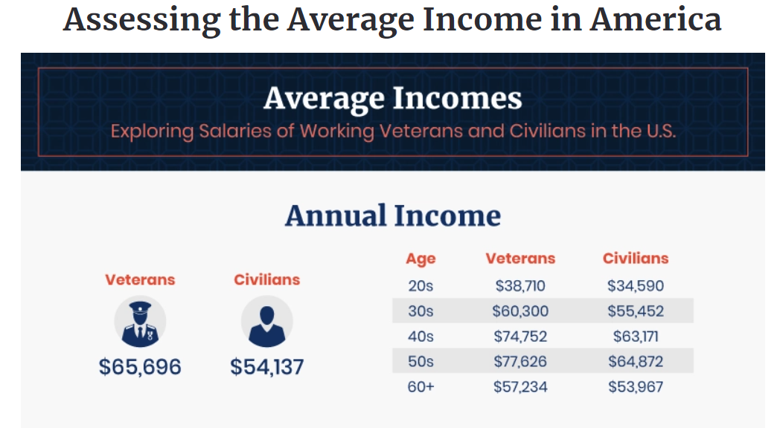
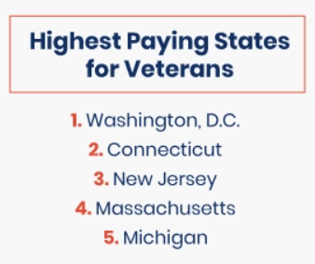
Military Reserves
Internships / Work Studies / Job Experience
In Michigan, veterans make 64.9% more a year than civilians.
https://www.hillandponton.com/veteran-civilian-pay-statistics/
All Branches
Reserve Duty

Slide 19
Military Reserves
Internships / Work Studies / Job Experience
Not every service is created equal.
Living Conditions
Unless volunteered with your chosen specialty, drill weekends don’t require ruck marches or outdoor survival
Advancement and Promotion
Advancement is tied directly with skill certification and responsibility. The same career in a different branch could lead to a very different outcome.
Travel Opportunities
The USN has over 40+ Bases in the USA and 30+ Bases/Support Centers Overseas
Pay-Grade (Rank) | Weekend Drill Pay (<2 Years) | United States Army National Guard | United States Navy Reserves
E-1 | $255 | 1 out of 30 3.81% / 11,061 out of 290,281 | 1 out of 72 1.52% / 683 out of 44,745
E-2 | $286 | 1 out of 10 10.30% / 29,909 out of 290,281 | 1 out of 50 1.88% / 843 out of 44,745
E-3 | $320 | 1 out of 29 14.15% / 41,082 out of 290,281 | 1 out of 15 6.85% / 3,067 out of 44,745
E-4 | $350 | 1 out of 3 34.39% / 99,821 out of 290,281 | 1 out of 9 15.80% / 7,017 out of 44,745
E-5 | $388 | 1 out of 5 20.14% / 58,459 out of 290,281 | 1 out of 3 34.59% / 15,477 out of 44,745
E-6 | $437 | 1 out of 10 10.77% / 31,260 out of 290,281 | 1 out of 4 28.08% / 12,564 out of 44,745
E-7 | $501 | 1 out of 16 6.46% / 18,755 out of 290,281 | 1 out of 12 8.35% / 3,738 out of 44,745
E-8 |  | 1 out of 40 2.40% / 6,963 out of 290,281 | 1 out of 45 2.27% / 1,017 out of 44,745
E-9 |  | 1 out of 145 0.67% / 1,971 out of 290,281 | 1 out of 112 0.76% / 339 out of 44,745
US Navy Specific
Reserve Duty
https://download.militaryonesource.mil/12038/MOS/Reports/2020-demographics-report.pdf

Slide 20
Career Choice
Career Choice is 100% Voluntary
Choose Your Career Before you Enter the United States Navy
Your Contract Choice Will Not Change Without Your Consent
3 Considerations
Availability (First Come / First Serve on Available Careers)
Ship Date (When do you want to leave?)
ASVAB Scores (What do you qualify for?)
US Navy Specific
Active/Reserve Duty

Slide 21
Worldwide Travel – Worldclass Experience
Official Naval Bases (Europe):
Naval Support Activity Souda Bay (Greece)
Naval Air Station Sigonella (Sigonella, Italy)
Naval Support Activity Naples (Gricignano di Aversa, Italy)
Naval Support Activity Naples Department Geta (Gaeta, Italy)
Naval Station Rota (Rota, Spain)
Naval Support Activity (Bahrain)
Naval Support Facility (Diego Garcia)
Official Naval Bases (Asia):
Commander Fleet Activities Sasebo (Japan)
Fleet Activities Okinawa (Japan)
Fleet Activities Yokosuka (Japan)
Navy Region Singapore (Singapore)
Fleet Activities Chinhae (Republic of Korea)
And Many More Territories and Foreign Port Visits, Ask Any Recruiter!
US Navy Specific
Active/Reserve Duty

Slide 22
Advanced Programs
Nuclear Engineering
All branches claim to have a “Nuclear Engineering” program (normally reserved for Officers), but only one that trains and certifies Nuclear Reactor Operators due to the need to operate Aircraft Carriers and Submarines
Intense Academic Training - Over +77 college credits earned in the first two years
Unmatched Skillset – Nationally Recognized Training and Certification Curriculum at All US Commercial Power Plants (Nuclear and Non-Nuclear)
Highest Compensated Salary and Fastest Rank Advancement in the US Military
US Navy Specific
Active Duty

Slide 23
Advanced Programs
SEALS / EOD / SWCC / DIVER
AIR RESCUE SWIMMER / CORPSMAN ATF
Every branch has it’s own form of Special Forces. The US Navy is different in part for it’s “Warrior Challenge Program”. Other branches may have a time requirement as an active duty enlisted member prior to attempting to join the program.
If you are qualified, the US Navy Guarantees your contract in writing.
Train with US Navy Special Warfare Operators prior to shipping.
US Navy Specific
Active Duty

Slide 24
Advanced Programs
NROTC / Naval Academy
Officer Programs
Surface / Aviation / Subsurface / Nursing / Medical / Support / Special Warfare
Earn a $180,000 Scholarship including a monthly stipend and books
No risk of commitment - Exiting the program within the first year incurs zero financial penalty / recoupment
Over 60+ Universities (including 20+ HBCU, HHE, MSI)
Guaranteed Employment upon Program Completion
Application Deadlines by January of an Individual’s Senior Year
US Navy Specific
Active Duty

Slide 25
Life is Dangerous, but is the US Navy?
Top 3 Most Dangerous Jobs in the United States
1. – Delivery Drivers – In 2018 there were 966 Losses
2. – Construction Workers - In 2018 there were 259 Losses
3. – Farmers - In 2018 there were 257 Losses
Dangerous Roads in the United States
1. I-75 – In 2019 there were 167 Accidents (354 Fatal Crashes from 2015-2019)
2. I-65 – In 2019 there were 84 Accidents (210 Fatal Crashes from 2015-2019)
3. I-94 – In 2019 there were 54 Accidents (133 Fatal Crashes from 2015-2019)
The last 6 military conflicts combined (1990-2021) for the US Navy have resulted less loss of life due to COMBAT LOSSES in direct comparison to just <2 years in a common profession, let alone due to other common factors and occurrences. (160 combat losses over 21 years)
U.S. Bureau of Labor Statistics Census of Fatal Occupational Injuries
https://sgp.fas.org/crs/natsec/RL32492.pdf
https://www.nhtsa.gov/file-downloads?p=nhtsa/downloads/FARS/2019/National/
US Navy Specific
Active/Reserve Duty

