Slide 1

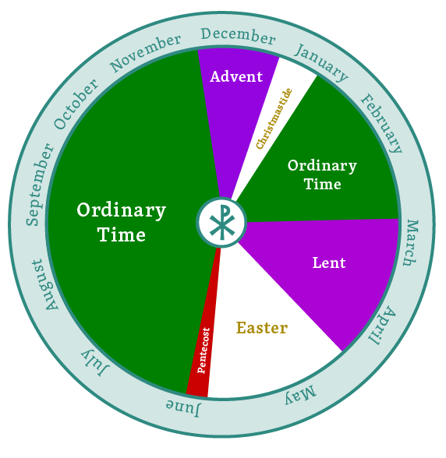
Christian Denominations and
Liturgical Calendar

Slide 2

Devotion
https://d365.org/

Slide 3

•Bible Text: Matthew 16:13-20; John 17:6-21; Ephesians 2:1-22
•Lesson Focus: Christian denominations share core beliefs.
•Big Question: Where did all of the different “churches” come from?

Slide 4
Key Words
PROTESTANT: refers to the multiple reform movements started within the Roman Catholic Church of the 15th and 16th centuries. These reform movements resulted in many denominations within the Christian church.
CATHOLIC: with a capital “C,” refers to the Roman Catholic Church; with a small “c,” refers to the union of all believers in Jesus Christ.
ORTHODOX: means “correct” or “true” belief. The Eastern Orthodox Church began the process of Christian councils to determine which teachings were true to the Christian faith and which would be considered outside the faith or heretical.
CREED: a statement of faith. “Creed” comes form the Latin word “credo,” meaning “I believe.” Three ecumenical creeds are accepted among Christian denominations—the Apostles’ Creed, the Nicene Creed, and the Athenasian Creed.
ECUMENICAL: a reference to partnerships, joint discussions, and shared ministries among Christian denominations.
INFALLIBLE: means that it cannot be wrong. This term is used to describe certain teachings from the papal office and also to describe the teachings of the Bible.
INERRANT: means that there are no errors. Similar to the idea of infallibility, this term is used to describe scripture as handed down from God without any human mistakes included.

Slide 5

Christian Denominations
https://youtu.be/gXls5M8wxLQ

Slide 6
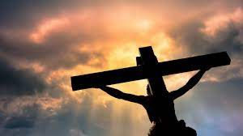
What is similar between denominations?
What is different between denominations?
What are you curious about in other denominations?
Is there one right denomination?

Slide 7
Liturgical Calendar
Unlike the secular calendar, the church year starts on the first Sunday in Advent. Each “season” of the church is marked by a different color that is symbolic of the season.
You will notice these colors in the pastor’s stoles, the church wall hangings, and candles.

Slide 8
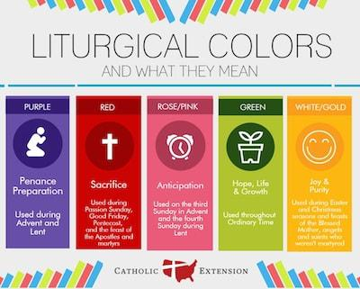

Slide 9
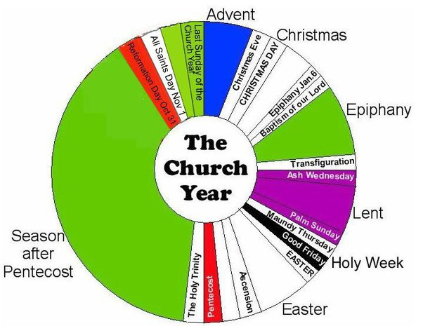

Slide 10
Read this for deeper understanding. . .
https://download.elca.org/ELCA%20Resource%20Repository/What_is_the_meaning_and_use_of_liturgical_colors.pdf
Then color your Liturgical Calendar!

Slide 11
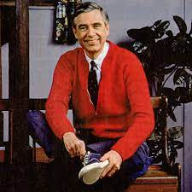
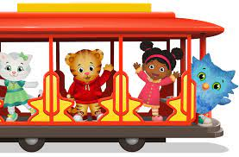
Activity
Next Time: Bring a picture of a neighbor who is hard to think of as a neighbor.

Slide 12



