Slide 1


Law and Gospel
Sinner and Saint

Slide 2

Devotion
https://d365.org/

Slide 3

•Bible Text: Romans 5:1-11; Matthew 22:34-40
•Lesson Focus: We are always both sinner and saint, and we need both law and gospel.
•Big Question: Am I good enough to be a Christian?

Slide 4
Key Words
LAW: what we should and should not do to be safe and live peacefully in community. God’s law is designed to be impossible to keep perfectly.
GOSPEL: because we cannot keep the law, God gives us the gospel. Gospel means “good news”; it is the good news that, through Christ, we are freely saved, loved, and forgiven.
SIMUL IUSTUS ET PECCATOR: Latin phrase meaning justified (saint) and sinner at the same time.
SAINT: all baptized Christians are saints, regardless of how good or bad they are.
SINNER: all baptized Christians are sinners, regardless of how good or bad they are. It is an inescapable part of being human.

Slide 5
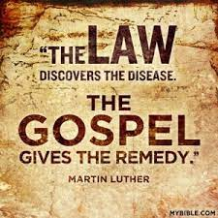
Law and Gospel
“The law shows us our sin. The gospel shows us our Savior.”
Old Lutheran Saying
Purpose of laws
How is God’s justice different from human justice?
Are Christians above the law?
P. 188 in Student Book

Slide 6
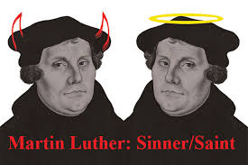
Sinner and Saint
https://youtu.be/G5N6jEesDIY
What does this mean?
Am I good enough to be a Christian?
Prayer partner activity

Slide 7
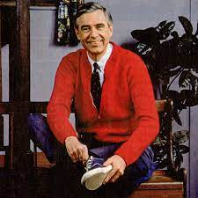
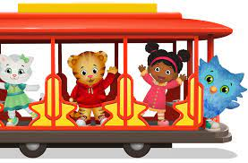
Activity
Who is the neighbor?

Slide 8
Quiz Time!
https://create.kahoot.it/share/law-gospel-sinner-saint/4a85bcf6-211b-4bad-a684-62f1ef19f778

