Slide 1
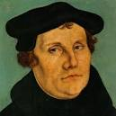
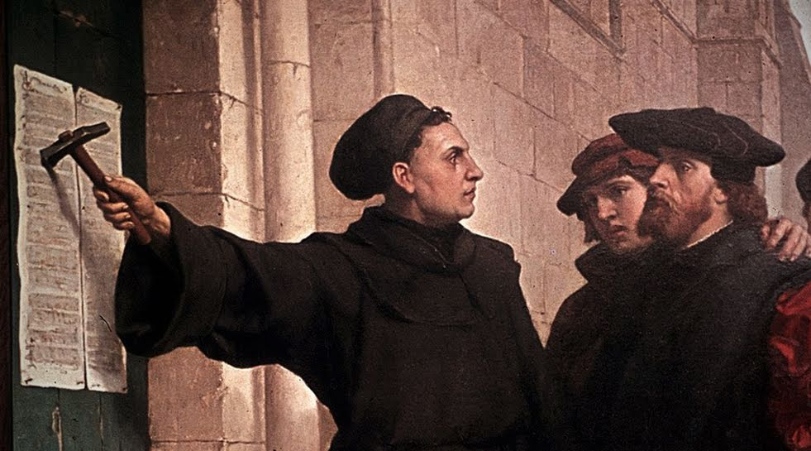
Mentor Night
Martin Luther &
The Reformation
Sunday, September 25, 2022

Slide 2
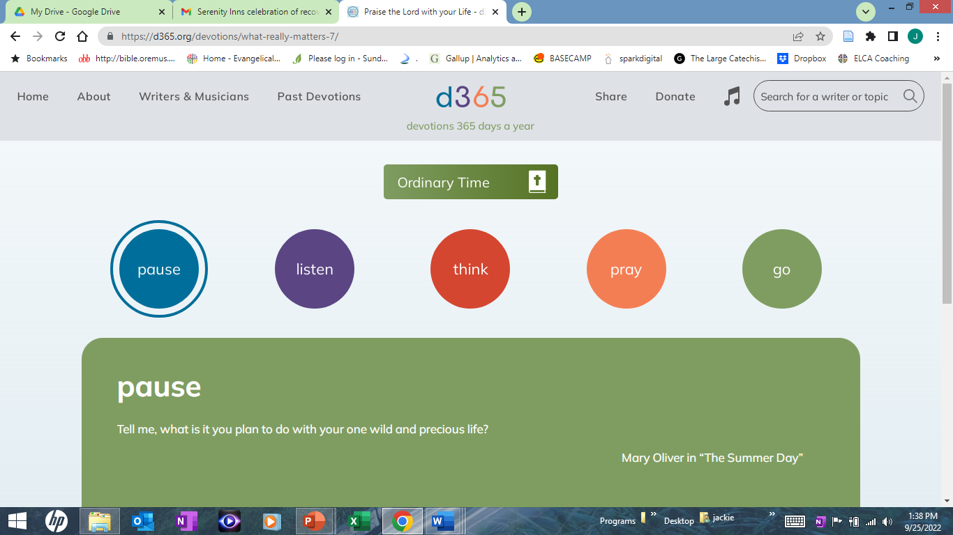

Slide 3

Today’s Story
Bible Text: Matthew 16:13-20; Luke 4:18-19; Romans 3:21-26; Ephesians 2:8-9
Lesson Focus: Christians continually reform the church to spread the good news to every generation and culture.
Big Question: Who is Martin Luther, and what does it mean to be a Lutheran?

Slide 4
CHANGE—OUT WITH THE OLD (option 1)
POSITIVE NEGATIVE qualities of a cassette tape
iPods, MP3 players, or CD players.
What positive aspects of cassettes are still found in the new devices?
Are there other advantages to the new technology?
Are there any disadvantages to the new technology? How has the change from cassettes to MP3s or CDs made listening to music easier, or harder, for music lovers?

Slide 5
CHANGE—OUT WITH THE OLD (option 1)
• Everything in our world changes over time.
Martin Luther and the reformers were working to change the bad things without losing the good things within the church?

Slide 6
Defining Terms
MARTIN LUTHER: a German monk and priest who worked to make changes in the church during the 16th century. He became known (not by his choice) as the founder of a new movement that became the Lutheran Church.
REFORMATION: time period in the 16th century when church leaders attempted to change the way the Roman Catholic Church functioned.
CATHOLIC: with a capital C, refers to the Roman Catholic Church, or the traditions of the Western European church before the Reformation. With a lowercase c, refers to all Christians in the universal Christian church; this is the “catholic” we speak of in the Christian creeds.

Slide 7
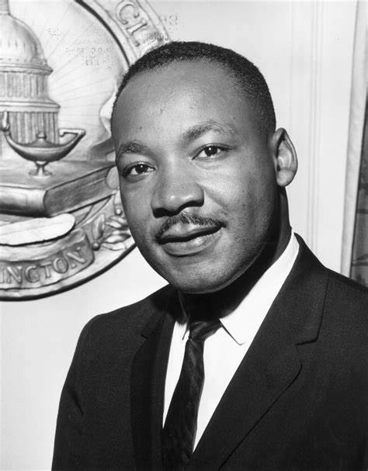
Martin Luther…
Lived 1483-1546
Was a German monk, priest and leader in the Protestant Reformation of the church
Martin Luther King, Jr.
Lived 1929-1968
Was an American Baptist minister and activist who became the most visible spokesperson and leader in the civil rights movement from
1955 until his assassination in 1968.

Slide 8
Defining Terms
GRACE: the free and unearned favor of God
THESIS: a statement made to provoke an argument or discussion. Luther posted “95 Theses” (plural) on the door of Wittenberg Church in hopes of engaging church leaders in a conversation about his concerns.
RECANT: To withdraw a statement or belief. Luther was asked to recant what he stated at the Diet of Worms in 1521. He did not recant.

Slide 9
Video
Take notes and listen for:
Describe Martin Luther’s life
What are some of the disagreements Luther has with the church?
What are some of the changes brought about by Luther’s 95 thesis and the Reformation?

Slide 10
Reformation and Martin Luther
https://www.youtube.com/watch?v=7x7y2qqtaq8

Slide 11
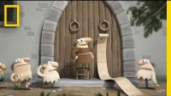

Slide 12
Debrief video
What new things did you hear in this video?
What surprised you?
What do you think about earning your place in heaven?

Slide 13
Ecclesia semper reformanda est
The church must always reform

Slide 14
--What changes in the church have you seen?
--Have they all been changes for the better?
--What changes would you like to see made in the way the church functions? If you have experienced a change that resulted in a split of some kind, tell the students about that change and how you responded to it.
---How have changes in the church affected your faith journey?
---Do you think it is difficult for the church to keep “reforming itself,” as Luther hoped it would?
Discussion

Slide 15
In your Bibles, look up Ephesians 2:4-10 and highlight verse 8
For by grace you have been saved through faith, and this is not your own doing; it is the gift of God
-Ephesians 2:8
(Assignment is to memorize this verse!)

Slide 16
Grace means—create a list
think of times when they have experienced God’s grace in one of the ways you listed.
How do you feel when someone shows you grace?
How can you show grace to people you meet during the week?

Slide 17
LSB p 1923-Luth Perspective sidebar
The Luther rose.
“God always takes the initiative in forgiving and recreating us”

Slide 18
Romans 3:21-26
What would you think if you and your mentor needed to put this in your own words—as if they were writing a letter to someone and explaining how that person could be made right with God./the righteousness of God.?
Luther’s experience grappling with this idea -- Luther’s “tower experience”

Slide 19
LSB p. 1857: Luth Perspective Sidebar
“How are people made right with God?”
How does Luther’s explanation clarify what those events mean for you?
Is there anything you could do to make Jesus love you even more? Even less?
Why or why not?

Slide 20
Luke 4:18-19
--Prior to the Reformation, people were told that God was angry and would judge them harshly or condemn them because of their sins.
--The good news of God’s love, mercy, grace, and forgiveness was heard for the first time and the people were given hope.
--Do you know someone who needs to hear the good news?
--How can you share a word of hope with them this week (and maybe again after that)?

Slide 21
Student Sheet handout
Bible Connection
Read Together
Student Handbook
Finish page as homework

Slide 22

Quiz Show

Slide 23

1. The Reformation took place in the _________ century.
sixteenth

Slide 24
2. The era before the Reformation was known as the _________ era.
medieval

Slide 25
3. Martin Luther taught that believers are saved by _________ through faith.
grace

Slide 26
4. Martin Luther was born, lived, and died in _________ .
Germany

Slide 27
5. Martin Luther and others who worked to change practices of the Roman Catholic Church are called _________ .
reformers

Slide 28
6. Prior to the Reformation, the _________ determined what religion the people would have and what god they would worship.
ruler or prince

Slide 29
7. Martin Luther translated the Bible from its original languages into _________ .
German

Slide 30
8. The Diet of Worms was a _________.
trial or hearing

