Slide 1
Parent Conversations
Bible Stories

Slide 2
Devotion
https://d365.org/

Slide 3
Working with your family, turn to page 23-25 of Here We Stand
Pick three verses to read together
One that is significant/special to you
Two that are less familiar

Slide 4
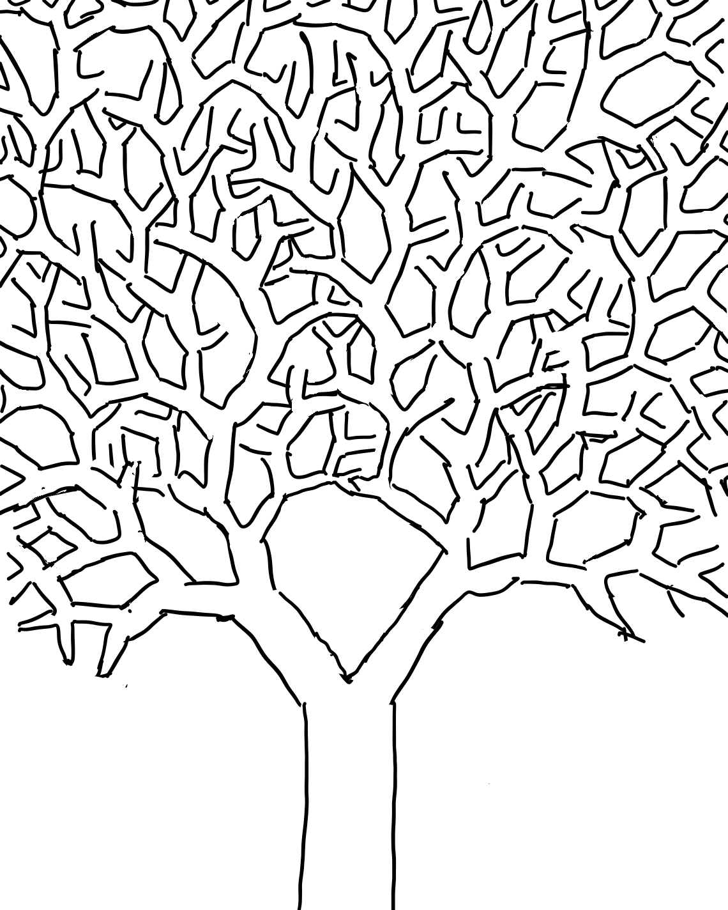
Creative Project
Make a creative project to represent one of the verses you chose
Ideas
Draw a picture
Make a painting
Write a poem
Write a song
Make a mosaic/collage
bake/cook something
Create a video
Sew something
Rewrite your verse using modern language/setting

Slide 5
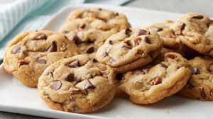
Your creative project does not have to be “professional” - don’t overthink this!
The purpose of this activity is to get you thinking about a Bible verse in a different way
Be creative
Don’t stress about this!
Bring to class on January 22 to share with the group and mentors

Slide 6
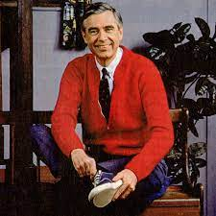
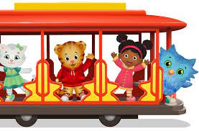
Activity
Next Time: Bring a picture of a neighbor who is hard to think of as a neighbor.

Slide 7
