Slide 1
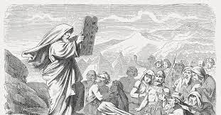
The 10 Commandments

Slide 2
Devotion
https://d365.org/

Slide 3
Activity
What/who do you love?
What’s in your heart?
What’s important to you?

Slide 4
••Bible Text: Exodus 20
•Lesson Focus: The Ten Commandments are a gift from God intended to help us live with one another.
•Big Question: Are the Ten Commandments around just to trip us up and make us feel bad?

Slide 5
Key Words
GUIDELINES: standards or principles that provide direction and support.
GIFT: something voluntarily passed to someone without compensation.
THRESHOLD: an entrance or beginning point.

Slide 6
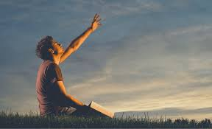
The First Three Commandments
Focus on relationship with God
Leading to healthy/balanced life
Promote good order
Fear?

Slide 7
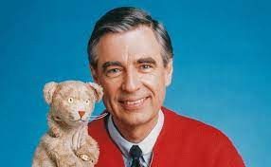
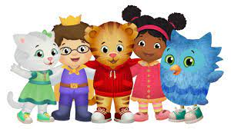
The Next Seven Commandments
Focus on relationship with the neighbor
Who is the neighbor?
Who isn’t the neighbor? TRICK QUESTION!!

Slide 8
Listen
https://youtu.be/AL8chWFuM-s?feature=shared

Slide 9
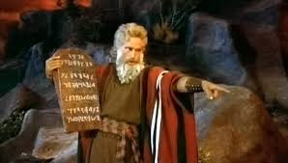
Open the Bible
•Proverbs 2:1-6
•Exodus 20:1-11
•Lutheran Study Bible page 153
•Exodus 20:12-17
•Lutheran Study Bible page 154
•Exodus 20:18-26

Slide 10
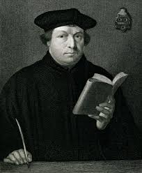
Open the Catechism
Here We Stand Student Book page 296

Slide 11
The Small Catechism
P.296
The First Commandment
You shall have no other gods.
What is this or what does this mean?
We are to fear, love, and trust God above all things.

Slide 12
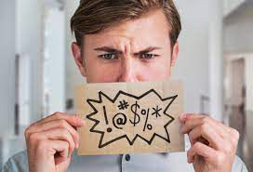
The Second Commandment
You shall not make wrongful use of the name of the Lord your God.
What is this? Or what does this mean?
We are to fear and love God, so that we do not curse, swear, practice magic, lie, or deceive using God’s name, but instead use that very name in every time of need to call on, pray to, praise, and give thanks to God.

Slide 13
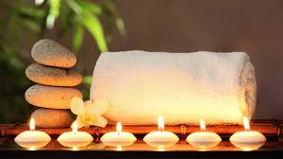
The Third Commandment
Remember the sabbath day, and keep it holy.
What is this? Or what does this mean?
We are to fear and love God, so that we do not despise preaching or God’s word, but instead keep that word holy and gladly hear and learn it.

Slide 14
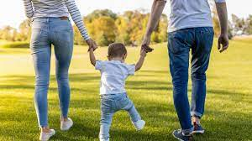
The Fourth Commandment
Honor your father and your mother.
What is this? Or what does this mean?
We are to fear and love God, so that we neither despise nore anger our parents and others in authority, but instead honor, serve, obey, love, and respect them.

Slide 15
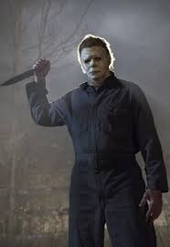
The Fifth Commandment
You shall not murder.
What is this? Or what does this mean?
We are to fear and love God, so that we neither endanger nor harm the lives of our neighbors, but instead help and support them in all of life’s needs.

Slide 16
The Sixth Commandment
You shall not commit adultery.
What is this? Or what does this mean?
We are to fear and love God, so that we lead pure and decent lives in word and deed, and each of us loves and honors his or her spouse.

Slide 17
The Seventh Commandment
You shall not steal.
What is this? Or what does this mean?
We are to fear and love God, so that we neither take our neighbors’ money or property nor acquire them by using shoddy merchandise or crooked deals, but instead help them to improve and protect their property and income.

Slide 18
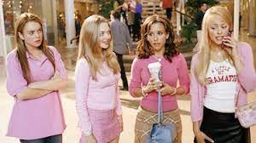
The Eighth Commandment
You shall not bear false witness against your neighbor.
What is this? Or what does this mean?
We are to fear and love God, so that we do not tell lies about our neighbors, betray or slander them, or destroy their reputations. Instead we are to come to their defense, speak well of them, and interpret everything they do in the best possible light.

Slide 19
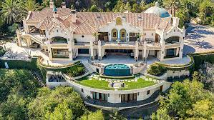
The Ninth Commandment
You shall not covet your neighbor’s house.
What is this? Or what does this mean?
We are to fear and love God, so that we do not try to trick our neighbors out of their inheritance or property or try to get it for ourselves by claiming to have a legal right to it and the like, but instead be of help and service to them in keeping what is theirs.

Slide 20
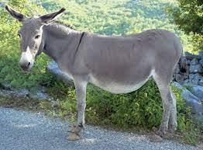
The Tenth Commandment
You shall not covet your neighbor’s wife, or male or female slave, or ox, or donkey, or anything that belongs to your neighbor.
What is this? Or what does this mean?
We are to fear and love God, so that we do not entice, force, or steal away from our neighbors their spouses, household workers, or livestock, but instead urge them to stay and fulfill their responsibilities to our neighbors.

Slide 21
Quiz Time
https://play.kahoot.it/v2/?quizId=495a4a66-a587-495f-a8b1-6153867a071a

