Slide 1
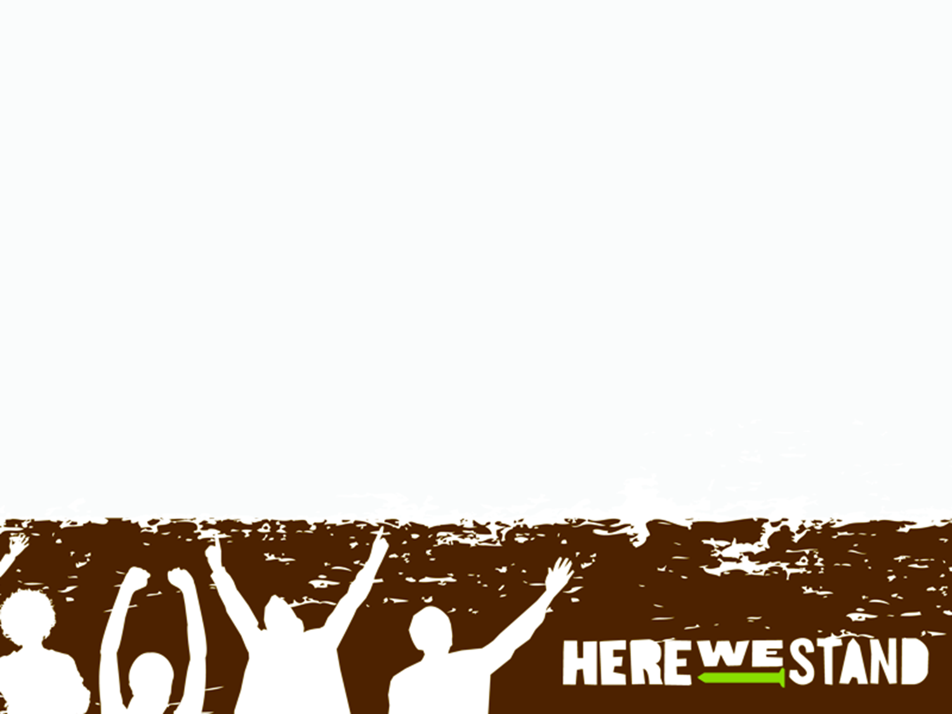
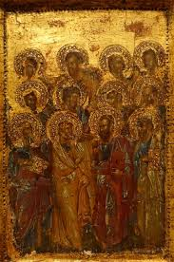
The Apostles Creed
Part 1

Slide 2

Devotion
https://d365.org/

Slide 3



Slide 4
•Bible Text: Genesis 1:1—2:25
•Lesson Focus: God’s creative work in the world is ongoing.
•Big Question: How do we know God is still creating stuff today?

Slide 5
Key Words
CREATE: to make from nothing.
CREATION: all that exists; all that God has made.
SUSTAIN: to keep, preserve, and maintain.
EX NIHILO: Latin for “out of nothing.”
STEWARDSHIP: responsibility for care and proper use.

Slide 6
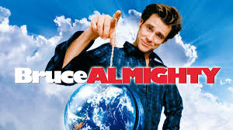
The First Article
I believe in God, the Father Almighty, creator of heaven and earth.”

Slide 7
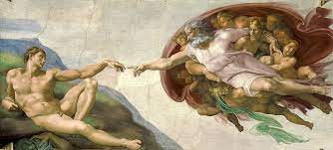
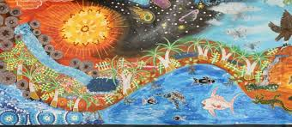
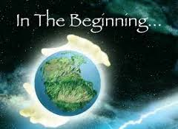
What is this statement about?
Creation
Present tense
God is at work in the world now, in the past, and in the future
Triune God

Slide 8
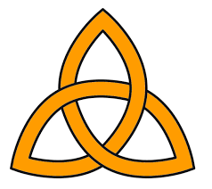
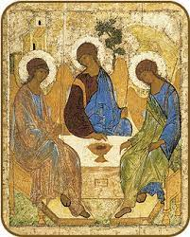
Triune God
P. 299

Slide 9
Genesis 1

Slide 10
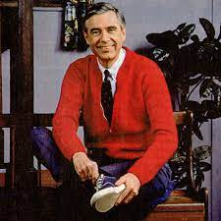
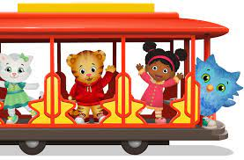
Activity
Who is the neighbor?

Slide 11
Quiz Time!
https://create.kahoot.it/share/the-apostles-creed-part-1/3506e47a-68d9-4cbb-ba54-e416a7fbca6a

