Slide 1

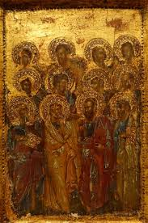
The Apostles Creed
Part 2

Slide 2

Devotion
https://d365.org/

Slide 3

•Bible Text: Matthew 1:18-25
•Lesson Focus: Jesus came to teach us how to live and to free us from sin and death.
•Big Question: Wait, God became human?

Slide 4
Key Words
CRUCIFIED: executed on a cross.
RESURRECTION: returned to life, raised to life.
ASCENDED: gone up, as in Jesus has gone up to heaven.
LORD: ruler of all.
REDEMPTION: rescue from sin and death.

Slide 5
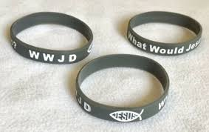
The Second Article
Page 299 in your Student Book.
Read the 2nd article.
Read Luther’s Explanation.
Are we supposed to try our hardest to do things the way Jesus would have done them?

Slide 6
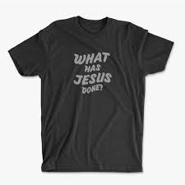
Actually, we’re invited to belong to, live under, and serve Jesus.
This is why the 2nd article is so long - it is showing us what Jesus has done for us.
The bracelets should say WHJD (What has Jesus Done)

Slide 7
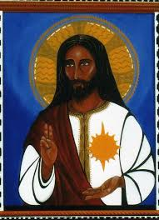
What has Jesus done?
Read
Matthew 1:18-25
Luke 5:27-6:5
Acts 1:2-22
Page 1607 of your Lutheran Study Bible
  First World of the Bible
  Bible Concepts
  Lutheran Perspectives
How would you describe Jesus? What has Jesus done?

Slide 8
•Bible Text: John 14:15-17
•Lesson Focus: The Holy Spirit nurtures us and advocates for us.
•Big Question: The Holy Spirit works in my life every day?

Slide 9
Key Words
HOLY SPIRIT: the third person of the Trinity, sometimes called the Paraclete.
COUNSELOR: an advisor or teacher.
PENTECOST: the day that comes 50 days after Easter, the coming of the Holy Spirit, and the birthday of the church,
CHURCH: the community of believers, or the “community of saints.”

Slide 10
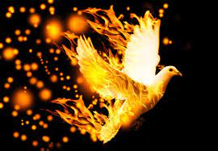
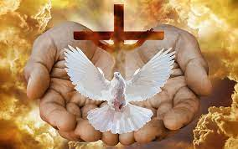
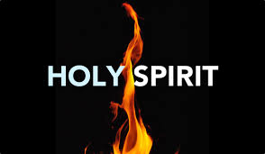
Article 3
P. 300 of the Student Book
Read the Third Article
Read Luther’s explanation
Who is the Holy Spirit?
How does everything listed in the 3rd article go together?

Slide 11
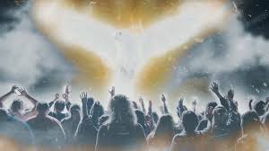
How is the Holy Spirit active in our everyday lives?
When have you experienced the Holy Spirit?
Think of one way you can look for the Holy Spirit in your life.

Slide 12
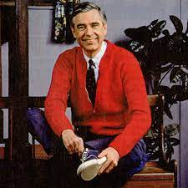
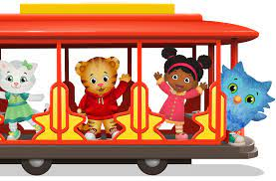
Activity
Who is the neighbor?
Next Time: Bring a picture of a neighbor who is different from you.

Slide 13

Thank you! Have a great - Holy Spirit-filled - week!

