Slide 1
Prophets
A PROPHET SPEAKS THE WORD OF GOD.

Slide 2
ICE BREAKER
Put yourselves in numerical order
No holding up fingers or talking. Can jump, snap, clap, stop or communicate in another way
What does it feel like to communicate in a way that feels awkward or unconventional?

Slide 3
Deuteronomy 18:15-22
Why is it necessary for God to raise up a prophet in this situation?
What does God promise the people about the prophet?

Slide 4
Deuteronomy 18:22
“If a prophet speaks in the name of the Lord but the thing does not take place or prove true, it is a word that the Lord has not spoken. The prophet has spoken it presumptuously; do not be frightened by it.”

Slide 5
Ezekiel 37: 1-14
What do you think “dry bones” is supposed to mean?
Why would God want Ezekiel to prophesy to those bones?
What did Ezekiel’s prophecy mean?

Slide 6
Problem Statement
“I don’t understand what qualifies someone to be a prophet.”

Slide 7
God’s Story
The Prophets
https://www.youtube.com/watch?v=sumaXbjP2Kg

Slide 8
Who are the prophets in the Hebrew Bible?
Major:
Isaiah, Jeremiah, Lamentations, Ezekiel, Daniel,

Slide 9
Who are the prophets in the Hebrew Bible?
Minor:
Hosea, Joel, Amos, Obadiah,
Jonah, Micah, Nahum, Habakkuk, Zephaniah, Haggai, Zechariah, Malachi

Slide 10
Prophet
Do you think the advice was always something the kings and people wanted to follow?

Slide 11
Selection Process for Prophets
There was no official selection process and this led to skepticism (doubts) about the credentials (belief/trust in) for those who claimed to speak for God.

Slide 12
How does one recognize if a prophet is a true one?
True prophets are known by their fruit.
Discern: Do the prophets’ words point to justice, mercy, and peace, or something else?
If the prophets’ words came true (after the fact) then the prophet was truly from God.
Notes:
False Prophets Matthew 7:15-20
You will know a tree by it’s fruit

Slide 13
Up to this point in history
Moses was the leader of the Israelites.
Now leadership was passing over to others – just as God lifted up Moses as a leader, God would call others to speak to God’s people on God’s behalf.
God provided prophets as a way to continue to guide the people.
Notes:
Calling by God, message to give to a community, consequence for not following…prophets often scorned and even rejected by their own communities.

Slide 14
Lab—Explore the Infographic

Slide 15
Student Handbook page 37
If you had to make a statement about God, what would it be? Write it like graffiti on the bricks.
What are reasons to accept this job, what are reasons to decline it?

Slide 16
Prophet (DVD?)
Throughout the Old Testament, God used prophets to call out rulers, nations, and communities for their disobedience and to warn them of the consequences for continuing to move away from God.
These weren’t exactly easy messages to proclaim. Nevertheless, the prophets courageously communicated God’s word to the people.
.

Slide 17
Four Characteristics of a prophet
Calling
Content
Community
Conscience

Slide 18
Calling
A prophet is appointed by God (often at a very young age) to speak on behalf of God.
Prophets informed the kings about what God wanted for the people.
How does a prophet know if it is God calling? Does God call us today?

Slide 19
p. 38 Bottom right corner
Does benefits always mean a message that will be received willingly?
(Rest in small group)

Slide 20
Orate—making meaning

Slide 21
Metaphors
figure of speech containing an implied comparison, in which a word or phrase ordinarily and primarily used of one thing is applied to another.
For example: the fog is like pea soup

Slide 22
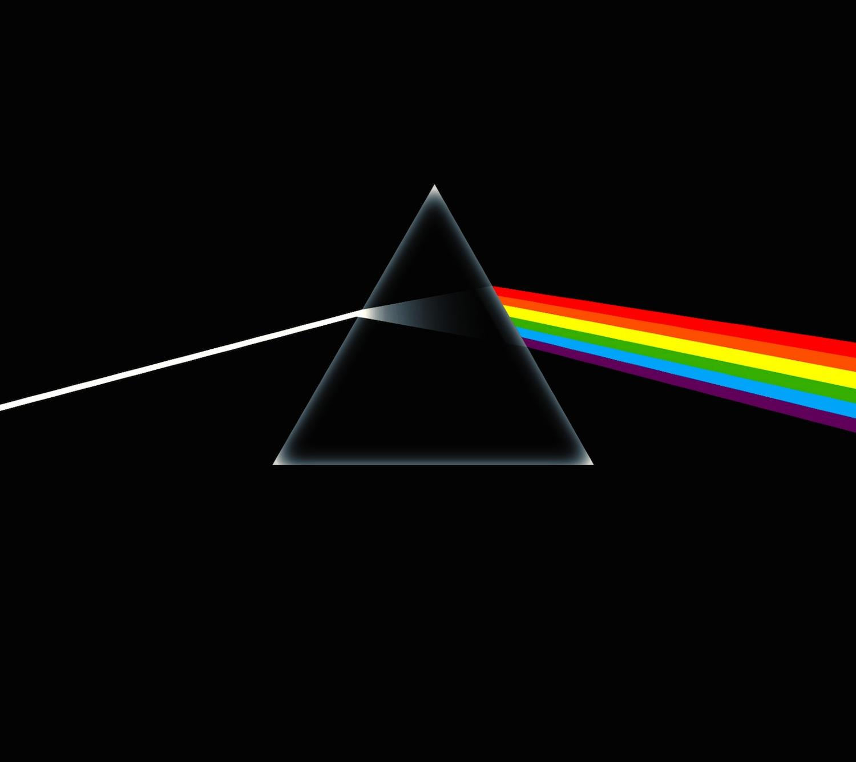
What happens when light shines through a Prism?

Slide 23
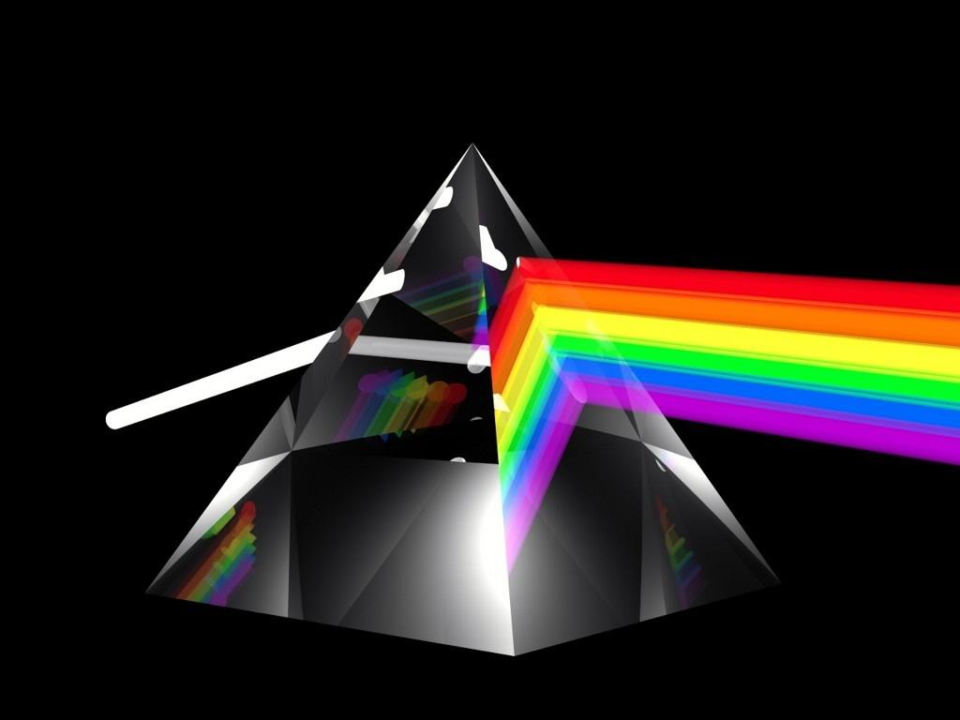
What happens when light shines through a prism?
Perception of reality shifts revealing something distinct, new and ultimately more true.

Slide 24
What does a Gardener do?
Tils the soil
Retils the soil
Planting
Care for
Harvest

Slide 25
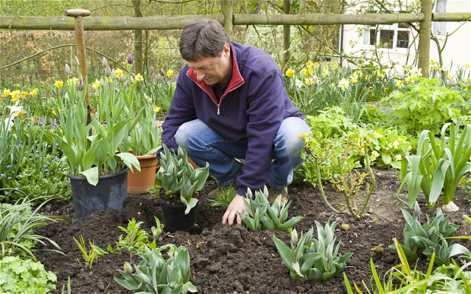
Prophets work with the soil of people’s hearts and lives – disturbing, with hopes of good growth happening

Slide 26
Prophets—Take Away
A Prophet speaks the word of God
specific role in the community – they never worked for their own gain, but for the good of the community.
people were warned that turning away from God would have devastating consequences. Also spoke words of comfort
Foretold the coming of Jesus

Slide 27
Amos
Amos was a prophet from the northern kingdom of Israel around 750 BCE
At that time, the Jewish community was divided between rich and poor. Israel’s leaders had forgotten their duty to care for the poor, and so many were struggling to survive.

Slide 28
God’s original vision
Everyone takes care of one another and no one goes hungry.

Slide 29
Amos
Called listeners to take responsibility for their actions and invited them to live differently.
Previous prophets had only addressed the king. Amos was given a message for everyone – God urged the community, through Amos, to acknowledge their failures and turn to God for healing and direction and to care for one another.

Slide 30
putting faith into action – caring for others
Like Amos’ community, people today also struggle with how to live out their faith.
Following God’s example: befriend the lonely, visit the sick, give food to the hungry, share God’s story so others may come to know, love, serve, and praise God in all things.

Slide 31
Amos 5:23-23
Let justice roll down like waters, and righteousness like an ever-flowing stream

Slide 32
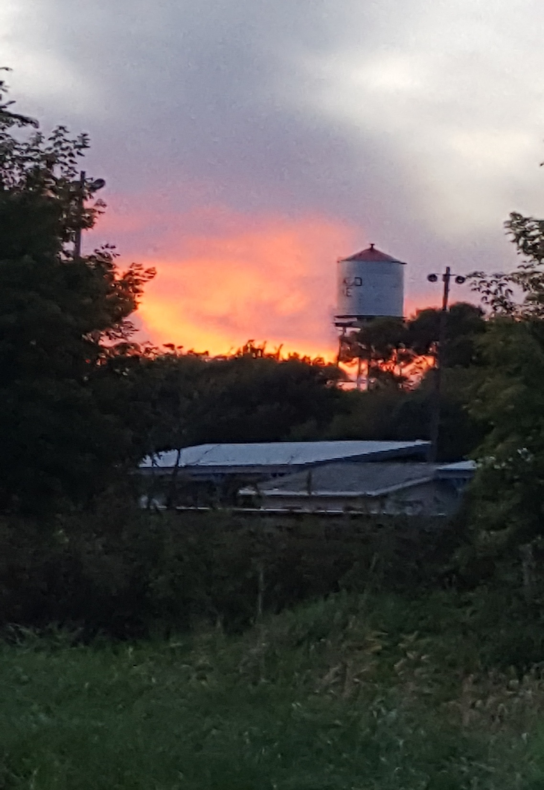
Who are our prophets today?
How may your
voice and vision
be used today
to reflect
God’s life
in the community
you live in?

Slide 33
Gracious God, Thank you for the many and various ways you have spoken to us through the prophets, and now through Jesus, your Son. Strengthen and encourage us by your Holy Spirit to be a people who center our lives on you and live out your vision of justice and peace. Amen.

Slide 34
Homework finish workbook pages not finished in small group and p. 40 Option 1 plus bottom

