Slide 1
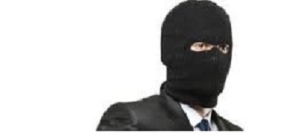
Visit: www.fraudsdetection.com
Stop fraud
detect fraud
prevent fraud

Slide 2
Definition of fraud
Fraud is wilful representation of a fact knowing it to be false and with an intention to make profit and to cause loss to the other party-”victim” who replied on the other.it is breach of trust.

Slide 3
Types of fraudsters
ACCIDENTAL FRAUDSTERS
HE IS HONEST,SINCERE,LONG SERVING,NORMALLY MALE ,
SUCH AN EMPLOYEE COMMITS FRAUD DUE TO MONEY NEEDS.
PREDATORS
HE MAY OR NOT BE HIGHLY EDUCATED.KEEPS CHANGING JOBS
.HAS APAST CRIMINAL RECORD
AGE35-45,GOOD EDUCATION&FIRST TIME OFFENDER.
HE IS NOT THE FIRST TIME OFFENDER.
LOOKS FOR AN OPPURTUNITY TO COMMIT FRAUD

Slide 4
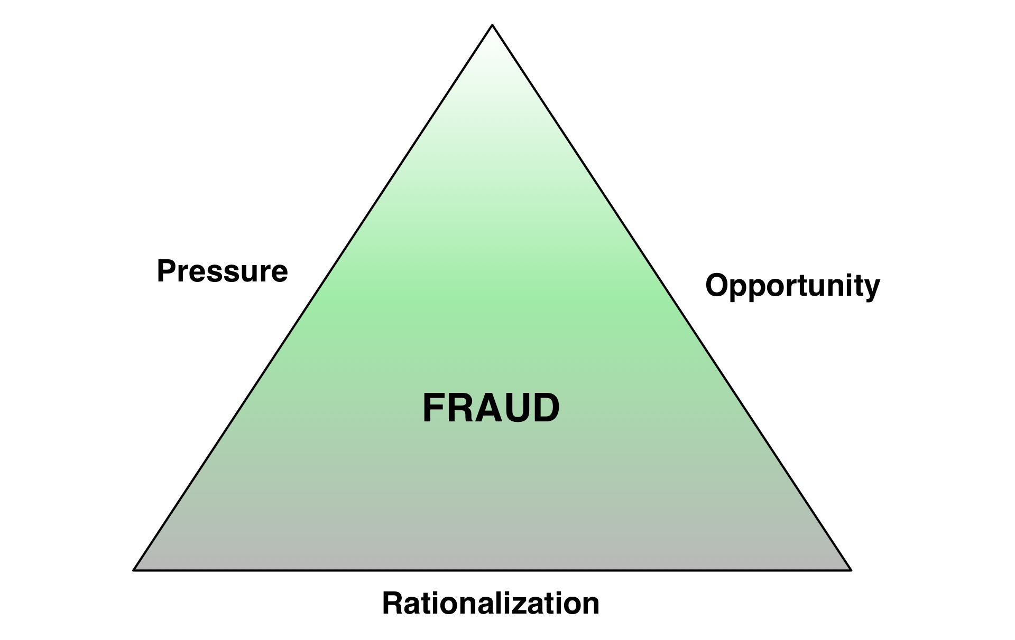
WHY EMPLOYEES COMMIT FRAUDS-FRAUD TRIANGLE

Slide 5

Fraud triangle explained
opportunity:
the employee is honest, long serving but looks for opportunity
to commit fraud or embezzlement.
pressures:
an employee may commit fraud due to financial,health,education,
addiction-drugs, gambling, drinking habits
rationalisation:
the employee rationalises his fraudulent actions-boss DOES NOT give a pay rise or managements are taking big bonuses but employees not adequately compensated etc

Slide 6
Types of frauds
THE FOLLOWING ARE THE SEVERAL TYPES OF FRAUD:
FINANCIAL STATENMENTS FRAUDS
bank LOAN frauds & money laundering
insurance frauds& HEALTH CARE
SECURITIES & STOCK MARKET SCAMS
online & social scams
PUMP AND DUMP-THINLY TRADED SHARES
ASSET MISAPPROPRIATION
CYBER FRAUDS
E-COMMERCE FRAUDS-BEC-BUSINESS E-MAIL COMPROMISE
INTELLECTUAL PROPERTY FRAUDS
WORKPLACE FRAUD-THE ENEMY WITHIN

Slide 7

EMPLOYEE BEHAVIOURAL RED FLAGS
FOLLOWING ARE THE VARIOUS BEHAVIOURAL RED FLAGS OF AN EMPLOYEE COMMITTING FRAUD:
Living beyond means
not taking vacation for long period
closeness with vendors and suppliers and bankers
financial problems-health-education- divorce-addiction
Pressures of work
Lack of authority and frequent complaints

Slide 8
COMPANY RED FLAGS INDICATORS
COMPANY CULTURE
INDUSTRY HAS REPUTATION FOR CORRUPTION
EXCESSIVE miscellaneous AND UNSUPPORTED EXPENSE
CHARGING PERSONAL EXPENSES TO COMPANY ACCOUNT
CUSTOMER COMPLAINTS & VENDOR COMPLAINTS
OVERRIDING INTERNAL CONTROLS
PRESSURE FROM MANAGEMENT “ TO MAKE THE NUMBERS”
OFFSHORE BANK ACCOUNTS AND TRANSACTIONS

Slide 9
FRAUD EXAMINATION VS. FORENSIC EXAMINATION
FORENSIC ACCOUNTING IS THE USE OF PROFESSIONAL SKILLS.IT IS LITIGATION SUPPORT IN ACCOUNTING.
FRAUD EXAMINER MAY OR MAY NOT BE A PROFESSIONAL. FRAUD EXAMINATION RELEATES ONLY TO FRAUD MATTERS AFTER THE FRAUD HAS OCCURRED.
MOST FRAUD EXAMINATION INVOLVE FORENSIC ACCOUNTING BUT ALL FORENSIC EXAMINATION IS NOT FRAUD EXAMINATION.

Slide 10
AREAS OF FORENSIC ACCOUNTING
BANKRUPTACY,INSOLVENCY & REORGANISATION
WORK FRAUD INVESTIGATIONS
COMPUTER FORENSICS
PROFESSIONAL NEGLIGENCE
VALUATION OF BUSINESSES
EMPLOYEE EMBEZZELMENTS
VENDOR & CUSTOMER FRAUDS
MANAGEMENT FRAUDS & STOCK MARKET SCAMS.
SOCIAL MEDIA FRAUDS-FACEBOOK ETC
ONLINE DATING FRAUDS.
INTELLECTUAL PROPERTY RIGHTS FRAUDS

Slide 11
FORENSIC INVESTIGATIVE TECHNIQUES
INTERVIWES WITH ALL PERSONS CONCERNED
PUBLIC DOCUMENTS REVIEW
CONFIDENTIAL SOURCES
ANALYSIS OF FINANCIAL TRANSACTIONS
ELECTRONIC SURVEILLANCE & UNDERCOVER OPERATIONS

Slide 12
AREA OF FRAUD EXAMINATION
FRAUD EXAMINATION IS CONDUCTED ON THE ASSUMPTION THAT A FRAUD HAS OCCURRED AND ALITIGATION WILL FOLLOW.
HE THUS COLLECTS ALL FACTS & EVIDENCE TO HELP ESTABLISH WHAT HAPPENED,IDENTIFY THE RESPONSIBLE PARTY AND SUGGEST REMEDIAL MEASURES.
Fraud theory approach involves:
Analysing data
creating & testing a hypothesis
refining the hypothesis
collect all evidence and determine the allegations
CONCLUSIONS.

Slide 13
CHAIN OF CUSTODY-MEANING
MOST IMPORTANT IN FORENSIC SCIENCES IS CHAIN OF CUSTODY.
RECORD KEEPING
USE OF STRONG & RELIABLE TOOLS AND TECHNIQUES
ISOLATING AND KEEPING SECURE ALL EVIDENCE GATHERED
CLEARLY INDICATING WHO GATHERED THE EVIDENCE AND TO WHOM IT IS PASSED FOR FURTHER VERIFICATION.

Slide 14
MEANING OF MONEY LAUNDERING
Money laundering is the disguise of the existence,nature,source ,ownership, location and disposition of property derived from a criminal activity.
Money laundering process takes the following steps:
Placement
LAYERING
INTEGRATION
IN PLACEMENT THE ILLEGALLY LAUNDERED MONEY IS PUT WITH FINANCIAL INSTITUTIONS OR BANKS,INLAND OR OFFSHORE .THIS IS THE FIRST DIFFICULT STEPS WHERE THERE ARE CHANCES OF DETECTING THE FRAUD.
LAYERING IS THE SECOND STEP WHERE THE MONEY THAT IS PLACED IS DIVIDED OVER DIFFERENT BANKS,INSTITUTIONS ETC MAKING ITY MORE DIFFICULT TO TRACE THE MONEY.THE MORE THE NUMBER OF LAYERS THE MORE DIFFICULT IS THE DETECTION.
INTEGRATION HAPPENS WHEN THE MONEY LAUNDERER SUCEEDS IN THE FIRST TWO STEPS THAT THE ILLEGAL MONEY NOW BECOMES LEGAL AND COMES BACK TO THE OWNER.

Slide 15
METHODS OF MONEY LAUNDERING
THE MOST COMMON PRACTICE OF HIDING THE ILLEGAL MONEY IS BY MONEY
LAUNDERING INN “SHELL COMPANIES” AT OFFSHORE COUNTRIES WITH NON
TRANSPARENT LAWS & THE COMPANIES EXIST ONLY WITH A MAILING ADDRESS.
THE TAXHEAVENS OFFSHORE COMPANIES ARE LOCATED MOSTLY AT:
Guatemala ,EL SALVADOR, PANAMA, MEDELLIN ,BERMUDA, SWISS BANK ACCOUNTS,BAHAMAS,ANITGUA AND SOME GULF COUNTRIES.IN THESE COUNTRIES THERE IS COMPLETE LAK OF TRANSPEARENCY OR FULL FREEDOM WITH NO QUESTIONS ASKED.
VARIOUS OTHER MODES OF MONEY LANDERING IS THROUGH-
CRYPTOCURRENCIES,BITCOINS, CASHIER CHEQUES ,PHYSICALLY CARRYING MONEY,BULLION ETC,
IN MONEY LAUNDERING NOT ONLY MONEY IS ILLEGALLY TRANSFERRED BUT ALSO INVOLVES REAL ESTATE TRANSACTIONS,PRECIOUS AND SEMI PRECIOUS STONES,ETC.

Slide 16
FRAUD DETECTION & PREVENTIONRMETHODS
INTERNAL AUDIT BYPROFESSIONAL ACCOUNTANTS AT REGULAR INTERVALS
FRAUD RISK MANAEME
SUSPICIOUS TYRANSACTIONS REPORTING
WHISTLE BLOWER POLIC
CORPORATE SECURIT
TIPS
BY ACCIDEN
BY LAW ENFORCEMENT AUTHORITIES
DIVISION OF RESPONSIBILITIES & DUTIE
PASSWORDS POLICY AND SAVING DATA EXTERNALLY AT MORE THAN ONE PLA
KNOW YOUR EMPLOYEE –BACKGRAOUND CHECK
CCTV SURVEILANCE AT ALL IMPORTANT LOCATIONS OF THE COMPANY
STRONG SECURITY MEASURES BY A RECONGNISED SECIRITY FIRM.

Slide 17
SOME TOP FRAUDS
BERNARD MADOFF: PONZI SCHEME
HEALTH SOUTH CORPORATION: FICTITIOUS TRANSACTIONS
SATYAM COMPUTER SERVICES: COOKING OF BOOKS
WORLDCOM: FRAUDULENT ACCOUNTING
PANAMA PAPAERS : SHELL COMPANIES
e n r o n: fraudulent accounting
p n b –bank-fraud: l o u –fraud
T Y C O IMPROPER ACCOUNTING PRACTICES
SIEMENS AG: BRIBERY & CORRUPTION
HARSHAD MEHTA STOCK MARKET SCAM CHEATING THE BANKS
THE FOLLOWING ARE THE VARIOUS OTHER INDIAN SCAMS:
1. FODDER SCAM INVOLVING FORMER RAILWAY MINISTER.
2. SUBRATA ROY-SECURITIES VIOLATIONS & CHEATING
3. SARADHA SCAM-PONZI SCHEME
4. N S E L- NATIONAL SPOT EXCHANGELIMITED.INSIDER TRADING
THE COAL SCA
2G SPECTRUM SCAM
7. COUNTERFIET STAMP PAPAERS SCAM-ABDUL KARIM TELGI.

Slide 18
ponzi scheme the Bernard Madoff- u s a.
The largest ponzi scheme in history.
Over $50 billions cheating for personal gains &luxurious living. about 5000 clients were affected due to his fraud.
The fraud continued for 20 years
Bernie pleaded guilty without trial & was sentenced to 150 years prison, finally in 2009.
The fraud involved false promises of high returns
Bernard Madoff was a stockbroker, investment advisor & financer.
Similarly in India there was a big Ponzi scam during 1991-1996 by roop BhansalI ponzi scam. he duped to the extent of rs.400 crores of public deposits * debentures.overs.200 crores inter corporate deposits,rs.90 crores to banks ,RS.252 CRORES TO CRB CAPITAL MARKETS.

Slide 19
fictitious transaction & bribery
Health south corporation
Fictitious transactions and bribery by c e o , Richard marin scrushy
$1.4 billion ,by window dressing the accounts -1996-2003.
E & Y auditors were also involved and settled a class action suit
for $109 million for their gross negligence for not detecting the
fraud.
The c e o was charged to pay 2.8 billion to shareholders
He pleaded not guilty but was he was sentenced in a separate case
for political corruption, money laundering, obstruction& bribery.

Slide 20
Cooking of books, funds diversion satyam computer services-fraud
The chairman of the company admitted of cooking and manipulating the books to the tune of Rs.7,000 crores.
PWC auditors also helped him in this fraud process.
THE ACCOUNTS WERE MANIPULATED TO SHOW A BETTER POSITION THAN THE REAL-WINDOWDRESSING.
THE CHAIRMAN,HIS BROTHERS,THEPARTNERS OF PWC INVOLVED WRE ALL SENTECED TO PRISON OF VARIOUS TERMS.

Slide 21
SHELL COMPANIES –THE HIDDEN WEALTH
PANAMA PAPERS leaks-panama city
THE”ALLEGED“ leakage of confidential information from a law firm ,famous for forming offshore shell companies .
he alleged law firm is “mossack & fonesca”—panama city.
The leakage consisted of 11.1 million documents, relating to more than 215,000 clients of the law firm speard over 100 countries,
The names that were revealed go from corporates to top politicians, arms delares,tax evaders, financial fraudsters, drug lords etc.
All over the world various investigations and probes are launched and the truth will come once the investigators come out with evidence.

Slide 22
Biggest accounting fraud-2001 enron corporation- houstan, Texas,u s a.
The use of accounting loopholes & poor financial reporting were able to hide billions of dollars of debt from failed projects and deals.
The share value of the company fell from $90 to $0.50.
Assets and profits inflated –even non existent and fraudulent.
The fraud has resulted in $30 million in self dealings by cfo,$700 million net earnings disappeared ,$1.2 billion of shareholder’s equity disappeared and $4.1 billion were in hidden assets.
Many executives were .the auditors Arthur Anderson was found guilty of illegally destroying documents relevant to the investigators.

Slide 23
FRAUDULENT ACCOUNTING PRACTICES
WORLD COM-U S A
WORLDCOM WAS THE SECOND LARGEST LONG DISTANCE PHONE COMPANY.
THE FRAUD INVOLVED FRADULENT ACCOUNTING METHODS AND INFLATING THE COMPANY FINANCIALS.
THE INTERNAL AUDITOR’S REPORT FOUND THAT $3.8 BILLION IN FRAUDULENT ACCOUNTS &$11 MILLION BY INFLATING ASSET VALUES WAS IMPROPERLY RECORDED IN THE BOOKS TO HIDE THE COMPANY’S DECLINING POSITION.
WORLD COM C E O, BERNIE EBBERS WAS SENTENCED TO A 25 YEAR PRISION SENTENCE.

Slide 24
Bank fraud –letter of undertaking- fraud
Punjab national bank-INDIA
NIRAV MODI OF GITANJILI GROUP OF COMPANIES,BILLIONAIRE JEWELLER REPORTED BY PNB OF FRADULENT TRNSACCTIONS.14.02.2018.
THE REPORTED FRAUD WAS ESTIMATED TO BE RS.11,400 CRORES. ($ 1.77 BILLION )WORTH OF FRADULENT TRANSACTIONS.
TWO PNB EMPLOYEES HAVE UNAUTHORISEDLY ISSUED LOUs-LETTER OF UNDERTAKINGS TO FOREIGN BRANCHES OF INDIAN LENDERS ON BEHALF OF NIRAV MODI COMPANIES,
THE NIRAV MODI COMPANIES USED THESE LOUs (LIKE A BANK GURANTEE) TO PAY FOR THEIR IMPORTS.
THE EMPLOYEES OF THE BANK MADE THE LOUs without a collateral security and without credit limits by passing the CBS-core banking system software used by the b
This fraud went undetected for seven years starting in 2011
THE FRAUD IS BEING INVESTIGATED AND NIRAV MOD FLED THE COUNTRY.

Slide 25
IMPROPER ACCOUNTING PRACTICES
TYCO-DIVERSIFIEDMANUFACTURING & SERVICE COMPANY.
CEO & CFO STEALING MONEY AS EXECUTIVE COMPENSATION AT SHARE HOLDERS EXPENSE.
DENNIS KOZLOWSKI,CEO & H.SWARTZ CFO WERE FOUND GUILTY OF STEALING $600 MILLION.
IMPROPER ACCOUNTING PRACTICES & MISLEADING INVESTORS.
FROM 1996 TO 2002 THERE OF VIOLATION OF FEDERAL SECURITY LAWS.
ACQUIRED700 COMPANIES ,PURSUANT TO THEM BECOMING GLOBAL GIANTS.THE COMPANY OVERSTATED ITS OPERATING INCOME BY ABOUT ONE BILLION DOLLARS.

Slide 26
CHEATING THE BANKS & STOCK MANIPULATIONS
HARSHAD MEHTA-STOCK MARKET SCAM
HM –”BIG BULL” HE WAS FAMOUSLY KNOWN IN 1990s.
STOCK MANIPULATIONS & MISSUE OF BANK FUNDS AT HIS DISPOSAL WRONGLY GIVEN TO HIM.
SKY ROCKET SHARE PRICES,INCLUDING PENNY STOCKS,AND THUS CHEATING THE BANKS AND THE INVESTORS.
AMOUNT INVOLVED WAS ESTIMATED TO BE Rs.4,200 crores
27 criminal charges were filed.
Banks involved were state bank of India , state bank of saurashtra, s b i capital.
Similarly there was ketan parekh stock market scam-investors lost
Rs.4,000 crores.

Slide 27
BRIBERY CORRUPTION
SIEMENS AG
BRIBERY AND CORRUPTION.
SIEMENS & THE GREEK GOVT. WERE UNDER FIRE FOR BRIBING & CORRUPTION CHARGES.
AMOUNT INVOLVED WAS ESTIMATED TO BE $100 MILLION.
THE FRAUD WAS IN CONNECTION WITH 2004 OLYMPICS GAMES AT ATENS-DEAL FOR SECURITY SYSTEMS AT THE GAMES.

Slide 28

“GODFATHER” movie-VERY APT QUOTE.!!!

Slide 29
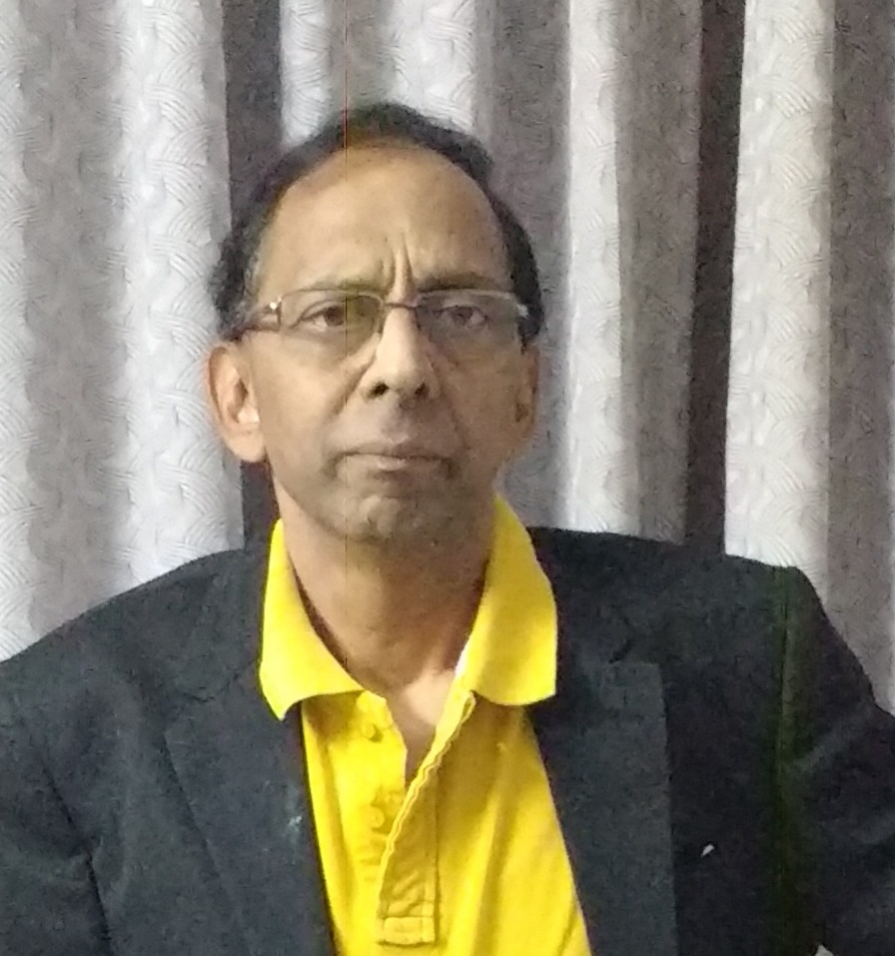
NARAYANARAO.K. b.com; FCA. CFFE-(IFS-PUNE)
ASSOCIATE MEMBER ACFE-USA
WEST VIRGINIA UNIVERSITY CERTIFICATECOURCE-FAFE

Slide 30

WWW.FRAUDSDETECTION.COM
KOLLURURAO@GMAIL.COM

