Slide 1
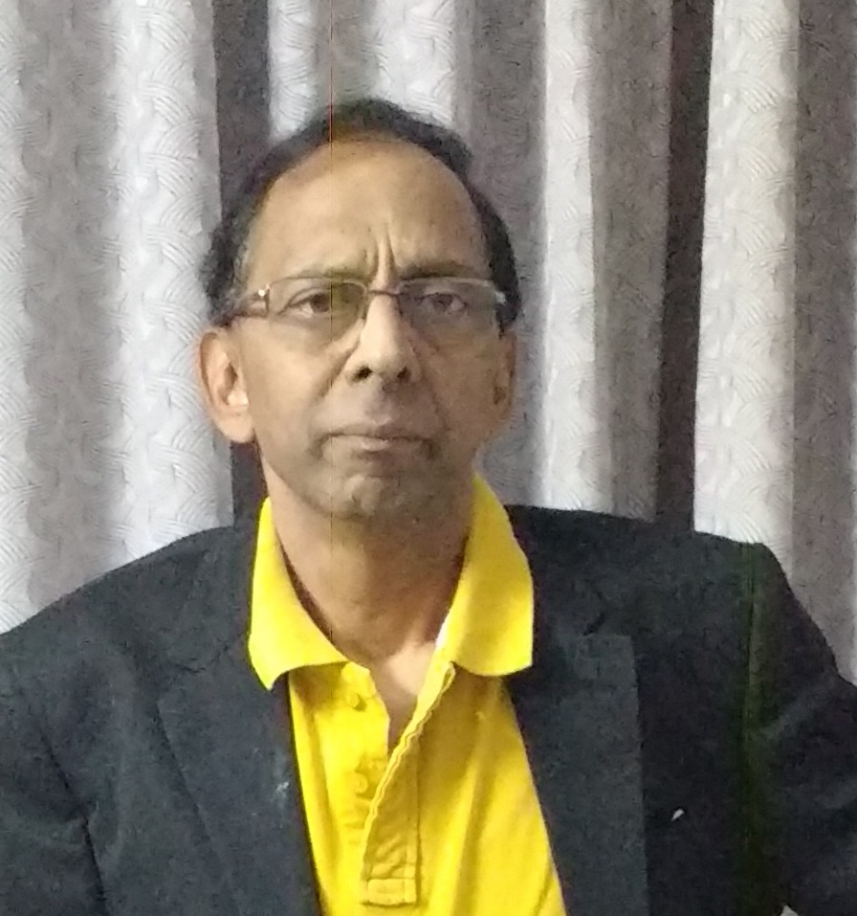
AUTHOR:
NARAYANARAO.K.B.COM.FCA;CFFE-IFS(PUNE)
MEMBER-ASSOCIATION OF CERTIFIED FRAUD EXAMINERS-ACFE-USA.

Slide 2

WWW.FRAUDSDETECTION.COM
YouTube: kollururao_fraudsdetection

Slide 3

“Honesty pays, but it doesn’t seem to pay enough to suit some people..” F. M.Hubbard, about Employee Frauds.

Slide 4
What is Fraud?
First one should always understand the meaning of “FRAUD”
Fraud is wilful representation of a fact knowing it to be false and with an intention to make profit and to cause loss to the other party, “victim” who relied on the fraud perpetrator.it is thus a breach of trust ,placed by one party ,on the other.
The fraudster can be of any type and similarly the “victim” can be any one person or group of persons ,depending on the nature of fraud.

Slide 5
The Various Types Of Work Place Frauds
1.Stealing of Inventory
2.Stealing of cash and cheques
3.Manipulation of accounting entries
4.Manipulation of Invoices
5.Collusion with vendors, suppliers and bankers
6. Manipulation of travel bills
7. Bribery and corruption to get benefits for self

Slide 6
The Psychological angle of Employee Frauds:
There is a Psychological angle that explains why Employees commit frauds.
It is better explained by the concept of Fraud Triangle-
Fraud Triangle explains how an otherwise honest employee commits fraud:
1.Pressure:Finacial & Health, Work related, children’s education, need for
money due to addiction to alcohol, drugs or gambling or high style of living.
2.Oppurtunity: An employee who is long standing and is in control of various
activities and job responsibilities may resort to stealing taking advantage of
his position over a period of time. It is simply a human weakness to steal.
3.Rationlisation: An employee rationalises his act of fraud –not happy with
the employer, not getting a salary hike or bonus etc and thus feels he is
justified.

Slide 7

Red Flags-Warning Signs –Work Place Frauds
1.When it is found that the employee is living beyond his means
2. When it is observed that there are issues concerning reconciliation of
accounts.
3. There are complaints against an employee by customers and vendors.
4. Unadjusted and long pending IOUs ,advances ,suspense accounts.
5.The employee never takes a vacation or holiday, though he is eligible.
6. When there is no division of duties and responsibilities among various
employees.
7.Where it is observed there is a poor or ineffective internal control system.

Slide 8
Preventive steps of Work Place Frauds
1. Know your Employee-KYE- Back ground checks-Previous jobs history-
authenticity of education certificates.
2. Training programmes- Giving employee training programmes from time to
time and warn on the consequences of committing frauds.
3. Strong Whistle Blower Policy –and encouraging “Tips” of any fraud
committed by a co-worker . Providing Hotlines for giving information
in strict confidence.
4. Installing a strong internal control system and internal audit .
5. Surprise checks by management
6. Open door Policy of discussions with employee grievances and giving
solutions.
7. Fraud Risk assessment by forensic accountant from time to time.
8. Strong assets control mechanisms

Slide 9
VISIT:
WWW.FRAUDSDETECTION.COM
YouTube: kollururao_fraudsdetection
STOP FRAUD DETECT FRAUD PREVENT FRAUD.

Slide 10

FINAL DESTINATION OF ANY FRAUDSTER

Slide 11


