Slide 1
Lessons on Fraud Awareness -(CYBER CRIME _ FRAUDS) LESSON – I V
Author
Narayanarao Kolluru
B .Com ; FCA; CFFE-(IFS-Pune),CFE-(West Virginia university)
www.fraudsdetection.com & LinkedIn
YouTube Channel: CA Narayanarao Kolluru
(All information on my ppts. Is from web ,my research articles, internet news and some related books, put in a concise form into points for easy understanding)

Slide 2
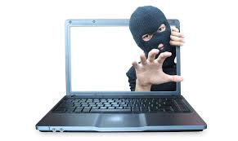
Motto of a CYBER CRMINAL*********************
I CAN ACCESS YOUR DATA!!

Slide 3
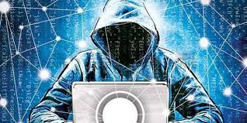
CYBER CRIME FRAUDS –LESSON FOUR Cyber Frauds have become a global challenge specially with the development of Technology
Lesson One: Frauds in an overall perspective.
Lesson Two: The concept of Frauds In Financial statements.
Lesson Three: Whistle Blowers

Slide 4
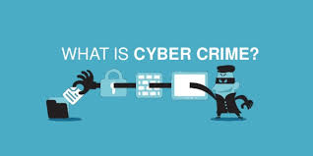
Definition of Fraud & Cyber Crime & Frauds:
Definition of Fraud:
A Fraud is a deception by a person or group of persons to secure unfair or unlawful gain at the cost of “VICTIM” who Trusted such a person viz. the Fraudster. A false representation of a material fact, either a misstatement or omission, with knowledge that the representation is false with total disregard for truth.

Slide 5
Contd.…..Definition of Cyber Crime Frauds
Definition of Cyber Crimes:
Cyber is the most modern weapon of choice, “in this age of Information & Technology and Digitisation and online transacting and total dependency on computers and Global networks and availability of personal information as well organisation’s information on the web and other social media freely accessible to one and all.”
Cybercrimes though a new concept evolved with the technological development all over the world.
Thus it means any crime that is related to computer or such other devise like mobile phones ,Internet etc.

Slide 6
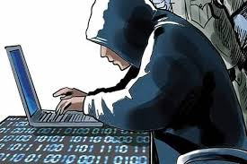
Stages of Cyber Attacks…..
Understanding these stages will help the organization to defend better:
1.Survey 2.Delivery 3.Breach and 4.Affect.
Survey: Investigating and analyzing available information and identify vulnerabilities.
Delivery: Getting to the point in a system where a vulnerability can be exploited.
Breach: Exploiting the vulnerability to gain some form of unauthorized access.
Affect : Carrying out activities within a system that achieve the attacker’s goal.

Slide 7
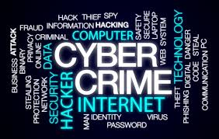
Various Types of Cyber Frauds/Crimes: The weakest link in the security chain is “People”
The following are the various types of Cyber Crimes/ Frauds and how they are done:
1.COVID 19 Frauds online
2.Social Engineering
3.Phishing e-mails/ Smising / Vishing
4.Synthetic Identity Theft
5.Cyber stalking
6.Virus,Worms,Logic Bombs
7.Malware
8.DoS attacks
9.Hacking

Slide 8
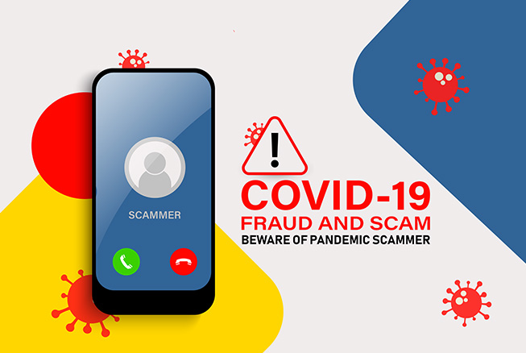
Brief description of Cyber frauds: 1. COVID 19 RELATED FRAUDS
The deadly pandemic that broke out in December 2019 ,has given an opportunity to fraudsters to make use of the fearful situation by trying to sell at less rates safety items, equipment etc. even without stocks .COVID19 is a Pandemic that as spread to all the countries across the world and as on date 18.8 Million cases with deaths of about 70K.
NGOs and other religious groups are engaged in providing relief to the needy and it has become easier for the new type of frauds to be perpetrated by fraudsters by misrepresenting such organizations and duping people by way of collecting donations.
There are job hunting scams ,as the pandemic has displaced ,many people, of their jobs, due to lack of business; the scamsters collect monies with promise to give jobs and disappear into thin air.
As many governments have announced relief measures, differing bank loans etc, there started fake “Agents” collecting money in the guise of doing the LYC and other paper work for availing such benefits.
Insider frauds, as many employees are not getting paid salaries, or cut in salaries or loosing jobs.
Fake medicines and fake anti-corona medicines or only sale & no delivery.
By hacking into mobiles, laptops, sextortion crimes on the younger generation using various apps. Instagram etc.

Slide 9
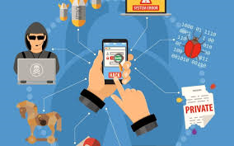
Brief description of Cyber frauds: 2.SOCIAL ENGINEERING –PSYCHOLOGICAL MANIPULATION
Social Engineering:
This is one of the most widely used technique to commit cyber frauds-the vulnerable categories of Victims include, Elderly , Younger generation individuals.
Social engineering involves manipulating individuals, to part with personal information, which can be used, for fraudulent purposes. It is an art by the criminals and thus exploit by manipulating individuals
Social engineering is one of the main method by which cyber frauds/crimes are perpetrated. Insiders of an organisation are also responsible for assisting cyber criminals for committing these crimes.

Slide 10
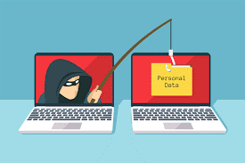
Brief description of Cyber frauds: 3.PHISHING e-mails/ SMISHING / VISHING
Phishing Attacks: E-mails :
These attacks are the underlying driving force for many internal data breaches and most of the external ones which lead to billions of dollars I finance losses each year.
No individual or organization is exempt from phishing frauds.
Phishing remains the most commonly exploited of all vector attacks and accounts for 90-95% of all cyber attacks.
Are responsible for most data breaches.
Smishing: SMS :
Under this mode the fraudsters try to get victims through SMS on mobiles, directing the victims to give a phone call or visit a website ,where by the personal information is extracted by social engineering techniques.
Vishing: Under this mode the fraudsters contact by telephone or text messages of an offer or prize etc and try to extract personal information like debit/card info/ bank info etc.

Slide 11
Brief description of Cyber frauds: 4.SYNTHETIC IDENTITY THEFT:
Synthetic Identity Fraud : Difficult to detect in the initial stages till damage is done.
Is defined as when the fraudster combines real and fake identities to create a new identity.
They creates fake accounts -makes purchases by use of credit cards and other means .
The fraudsters also use this type of fraud to fake driver’s licenses, open deposit accounts and
fake passports.
Synthetic identity fraud accounts for 80% -85%of all identity frauds.
Fraudsters secure inactive social security numbers or infrequently used cards .
Such numbers are used by fraudsters to wrongly use or secure vital information and
thus resort to unlawful activities.
Fraudsters secure information from data banks of credit rating agencies who have the data of millions of people that deal with banks & other NBCs and take loans.

Slide 12
Brief description of Cyber frauds: 5. CYBER STALKING
Cyber Bullying /Cyber stalking
Cyber stalking is an online stalking by repeated use of the internet or other electronic media as a means to harass, frighten, intimidate by use of e-mail, phone, text messages SMS messages .At times the fraudsters may hack onto your systems extract personal information and demand money or else threaten to expose on social media.
This is another very rampant crimes on the social media and internet. It is a form of bullying carried over the internet and a very serious issue on the internet. It is using technology 0ver internet and hurting someone By rumours/gossip, making fun of the person and sending mean and hurtful messages.
Mainly the young generation from 15-25 years of age are more likely to get bullied on the internet by faceless unidentifiable strangers on the net.

Slide 13
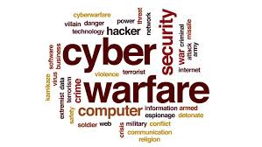
Brief description of Cyber frauds: 6.CYBER WARFARE & ESPIONAGE
Cyberwarfare means and includes use of computers and internet, objective being, to attack the defence systems and other secret data pertaining to defence strategic planning in order to cripple another country’s defence operations and also involves espionage and counter espionage leading to important data theft by agents and spies. It also at times cripple’s data servers and stealing financial information data.
Cyberwarfare also includes intruding into the systems of oil & gas, underground rail systems, waste management, Petroleum whose operations are all system driven by computers and are targeted to disrupt opponent countries operations and cause chaos. These attacks are made possible by “bot network”.
Cyber warfare also includes intruding into the systems of oil & gas, underground rail systems, waste management, Petroleum whose operations are all system driven by computers and are targeted to disrupt opponent countries operations and cause chaos. These attacks are made possible by “bot network”.
These words are used to signify computer or network security threats. These can be good bots or bad bots. Bad bots perform malicious tasks attaching the intended Victim’s computer and networks. They perform repetitive tasks. Worldwide there may be 1000 million computers and at least 25% get effected by these bots malware from time to time. At times, difficult to detect such malicious bots and the owners may not notice them except that they observe the computers running slow.

Slide 14
Brief description of Cyber frauds: 7.Ransomeware, DDoS Attack, Botnets
Ransomware:
It is most destructive malware. It will enter computers and networks and encrypts information, files. In 2017, over $5billion is lost due to global ransomware.
DDOS Attack:
Distributed Denial of Service Attack is one of the most popular methods of hacking. These attacks interrupts servers and networks temporarily or completely and make websites unavailable.
Botnets:
Are controlled by remote attackers by sending spams and malware. Mostly happens with businesses and Governments.

Slide 15
Brief description of Cyber frauds: 8.Virus, Trojan horse,
Virus:
A computer virus is a malicious software programme loaded onto a user’s computer without the users’ knowledge and performs malicious actions. It can self-replicate by inserting into other programmes, files, infecting them in the process. However, all viruses may not be destructive.
Trojan Horse:
Is a programme that claims to rid your computer systems of viruses but instead introduces several viruses onto your systems. The term comes from the Greek story of Trojan war. It thus seemingly hides programmes that look harmless or trick you into installing in the system.

Slide 16
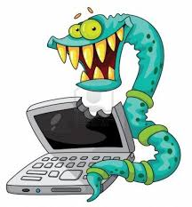
Brief description of Cyber frauds: 9. Logic Bombs, Worms,
Logic Bombs:
A logic Bomb is a piece of code intentionally inserted into a software system that will set off a malicious function when the specified conditions are met.
Worms:
A computer worm is a standalone malware computer programme that replicates itself in order to spread to other computers. They do cause some problem to the network of the systems. It has thus the ability to spread from computer to computer. The worms often get into the systems through e-mails.

Slide 17
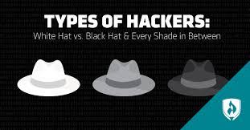
Brief description of Cyber frauds: 10.HACKING & HACKERS
The damage caused in 2016 statistics is $3 Trillion and growing year by year and expected to go up o $6 Trillion by the year 2021.
HACKING: Means breaching the computer systems and networks security and steal data and information. It is thus invading the privacy. Hacking may take place from a individual to corporates and Government and defence systems of the Nations.
HACKERS: i. White Hats ii. Black Hats iii. Grey Hats iv. Blue Hats v Green vi Red Hat
Hackers work for good or bad cause.
………………..Contd………………………..

Slide 18
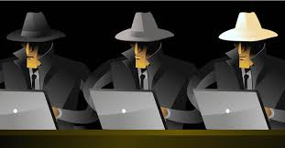
10.HACKING & HACKERS……Contd…..
I. White Hat Hackers :
Are ethical hackers. They are employed by the organizations to check for any vulnerabilities or weakness in the systems, connectivity, firewalls etc. They abide by the rules.
ii. Black Hat Hackers:
This the hackers do for fun and without the permission of the owners. It is unlawful to do so. It may be at times some one getting paid to trick the systems and search engines for extracting information on behalf of others thus black hat hacking is punishable. In fact Back Hats are criminal in nature.
iii. Grey Hat Hackers:
These hackers in between the White Hats and Black Hats. Thus they are ethical like white hats but have knowledge of the tricks of the trade like Black Hats. They may do check and when any vulnerabilities are found they bring to the attention of the owners and do the repair for a fee.
Blue Hat Hackers :
Basically Blue Hats are a third party technicians who are called upon by a company to test their product before implementing. They do the checking for any bugs and review and fix a new product before its launch.
Green Hat Hackers : They are basically Novices with little knowledge and new to hacking.
Red Hat Hackers : They are like white hats, but their methodology is different .They too seek to disarm Black Hats.

Slide 19
CYBER-SECURITY: Be safe on the internet and pay attention to the precautions and be sure not to become a “Victim” sooner or later to cybercrime.
Objective of cyber security:
Main objective of Cyber security is :
1.Protect data
2.Guard against privacy breaches
3. Install measures & processes to prevent cyber attacks
4.Improve cyber resilience
Cyber resilience is ability to anticipate, withstand, recover and adapt to adverse conditions , stresses, attacks or compromises on cyber resources. Thus an organisation’s ability to defend against all cyber attacks.

Slide 20
SAFETY TIPS AGAINST CYBER FRAUDS
The following are some of the safety measures against cybercrimes:
1.A very strong password. Avoid date of birth, family names and such familiar hints.
2.Never disclose or correspond on the internet about your personal details etc to unknown persons.
3.Avoid giving details of your travel plans and family photos etc on the social media and the details may move from your contact persons on the social media to another and another and it is endless.
4.Avoid to keep your location is “ON” all the time.
5.Use strong trusted and original anti-virus software to protect your systems.
6.Never do financial transactions etc on unsecured public Wi-Fi at airports/hotels/restaurants /railway stations etc just because it is free. You may regret latter!!
7.Keep an eye on children using internet at home.
8. Never send your credit and debit card details over internet to unknown or unsecure websites. Double confirm whether the websites are genuine.
9.Report any cybercrime immediately to police.
10.Get your computers and hardware checked from time to time.
11.Never share your passwords with anyone, even the most known and dear friends or relations.
12. Always protect your data in external storage devises.
13. Do net get carried away by e-mails from supposed to be known or unknown persons asking for monies or open attachments purported to be from your bankers/suppliers or customers unless otherwise the same double checked

Slide 21
Cyber Law In India and abroad…
Cyber law is the legal right dealing with mass communications via internet. It dictated ethics on internet. Also it deals with unethical practices and brings an awareness about unethical practices over internet against any form of threats. Deals with Cyber terrorism ,credit card frauds ,pornography etc.
According to UNCTAD 79% countries have legislation to deal with cyber crimes,13% have no legislation are-Belarus,Syria,Libya,Chad,Eritrea,CentralAfricanRepublic,Congo,Gabon,Somalia,Namibia,Suriname,Gyuana and Bolivia, Liberia, Guinea-Bissau . There are 5% with Draft legislation.
Thus there are appropriate laws in 79% country to deal with the Cyber crimes and Frauds.
In India mainly there is Information & Technology Act. However there are other acts that deal with Frauds involving Cyber crime like Money Laundering Act, Negotiable instruments Act and other State rules and regulations for monitoring CCTV etc all which are related in some context to cyber crimes and frauds.

Slide 22
End of Lesson FOUR CYBER FRAUDS & Crimes

