Slide 1
PART-II Lessons on Fraud Awareness
Author
K. Narayanarao
B .Com ; FCA; CFFE-(IFS-Pune),CFE-(West Virginia university)
www.fraudsdetection.com. LinkedIn

Slide 2
PART-II- Fraudulent Financial Statements
This PART-II topic was mentioned in the Introduction to Fraud awareness- Part-I. discussion.
In PART-II the concept of “Fraudulent Financial Statements” under “Corporate Frauds” is explained.

Slide 3
Frauds are Global Phenomena and any smart person with an understanding of basics of business & Terminology can commit. Fraud is not Rocket science !!
Fraudsters’ chief characteristic is the ability to tell a” Good Story”
Fraudsters are greedy and they steal more money than one can steal at
gun point!!
Fraudsters have no mercy, no remorse ,no sympathy and no pity, no soul and no guilt.

Slide 4
Fraudulent Financial Statements
Fraudulent financial statements are those statements which are deliberately cooked up to misrepresent the true financial position with an intention to deceive the users by Managements.
The above act of cooking up the business transactions is briefly
discussed in this Part-II presentation.
Are committed by Employees of the organisation and covered up by subsequent false entries in the books of account.
Fraudulent financial statements is one of the major Corporate Frauds.

Slide 5
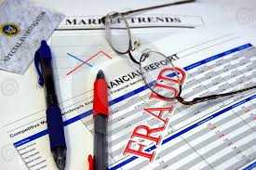
Financial Statements Definition…..
Financial Statements Definition…..
One should first understand “What are Financial statements?”
Definition:
Financial statements are those that are drawn to show the organisations’ activity and reflect the activities and financial position of an entity.
They are –The profit & Loss account, Balance Sheet, Cash flow statements and Statement of shareholders’ equity.
The financial statements are drawn up through several types of journal entries, cash and bank transactions with supporting external evidence.
These financial statements are used by Management, shareholders, Government, Tax authorities, Banks, Stock exchanges – SEBI, and various external agencies etc.

Slide 6
Four Important Elements-of Financial Frauds………
Four Important Elements-of Financial Frauds………
1. A material false statement
2. Knowledge that the statement was false when it was uttered
3.Reliance of the victim on the false statement
4.Damages resulting from the victim’s reliance on the false statement
(Ref: Dr. Joseph T Wells-Corporate Fraud Hand Book)

Slide 7
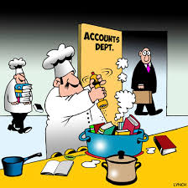
Different modes of cooking up the Financial statements:
There are several methods of cooking the books and thus create Fraudulent Financial Statements and do window dressing by the management. Employees too misappropriate assets of the company by falsifying books of account and by passing false entries.
Some examples are:
1.Fictitious revenues & receipts
2.Timing schemes-Deferring Revenue or inflating expenses
3.Asset valuation schemes
4.Underreporting of liabilities or expenses
5.Improper Disclosure
6. Expense reimbursement schemes
7. Assets misuse by employee or employer
8. Concealed liabilities
9. Bogus claims etc.

Slide 8
Skimming & Cash Larceny
It is relevant to understand these terms :
Skimming:
Is the misappropriation of cash from a victim entity before the entry is made in the books of account. Thus initially it is a off book fraud. Normally performed at the employee level, and difficult to detect as subsequently the fraud is covered up by bringing into the books. Happens when there are poor or ineffective internal controls.
Larceny :
Is the act of misappropriating funds of the employer.<theft, alterations, reversing transactions, false entries in sales and receivables, lapping. etc.

Slide 9
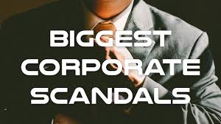
Major Financial Statements Frauds:
1.Enron
2. World Com
3.Tyco
4.Satyam Computers
5. Toshiba
6.HealthSouth Fraud
7.Bernie L Madoff
8.Parmalat
9.Banco Intercontinental Baninter
10.HIH Insurance
11.PNB Fraud

Slide 10
Brief Case study of Financial Frauds:
Brief Case sof Financial Frauds:
Brief case study of five corporates which are involved in financial frauds is discussed.
They are:
1.ENRON CORPORATION
2.WORLD COM
3.SATYAM COMPUERS
4.PUNJAB NATIONAL BANK
5. TOSHIBA

Slide 11
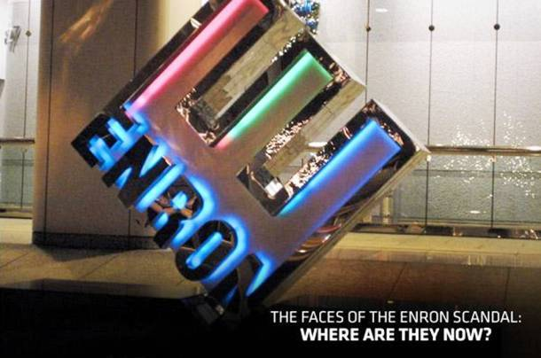
Enron- Energy, commodities& Services
The Fraud was discovered in 2001.
The Top Management-CEO & CFO, kept billions of dollars debt off balance sheet and toxic assets by cooking the books.
Pressured Arthur Anderson, Auditors, fr
om disclosing.
CEO, Jeff skilling was sentenced to 24 years in prison-in 2006.Though subsequently the sentence was reduced to 12 years.
Total losses about $74 Billion to the company.
The price of Enron’s shares fell from $$90 to $0.26.

Slide 12
WorldCom. Telecommunications
WorldCom. Telecommunications
WorldCom. Telecommunications
The Biggest accounting scandal in 2002,after ENRON, in 2001.
Biggest bankruptcy in American history-went bankrupt in 2002.
The charges against management include, Fudging of books of account ,cheating ,forgery.
Fraudulent accounting methods to hide declining financial position.
Assets were inflated. Improperly booked expenses. Revenue expenses booked as capital.
CFO- Bernie Ebbers was sentenced to 25 years in prison.

Slide 13
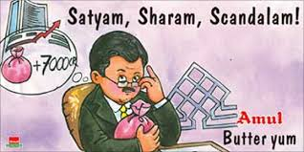
Satyam computers: Fudging Books
Biggest financial fraud in Indian Corporate history.
The books of accounts were cooked up to cover fictitious assets with real ones.
The fraud was perpetrated from 2004 till 2008 when the Chairman confessed in 2009 the fraud
amounting to Rs.7,800/ crores.
He quoted that it was “like riding a Tiger and he cant get off”!!
Manipulation of books of account to show a better position than real for the acquisition of Myatas-and the deal fell through due to opposition by investors.
PWC auditor was also involved in helping - fudging and cooking of the books of account.
Inflated cash & Bank balances, Over statement of debtors, wrong reporting of the revenues ,inflating the Employee numbers by creating Ghost employees,
The founder & Chairman Mr. Ramalinga Raju, was given a 7 year prison sentence.

Slide 14
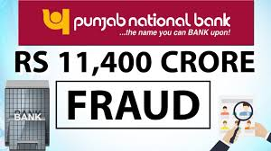
Punjab National Bank Fraud:
The fraud was organized by Jewelers and designer Nirav Modi and his maternal uncle and mentor Mehul Choksi, with the help of some employees of the PNB.
PNB Employees issued fake LoUs, on the bank of which foreign branches of a few Indian banks-including Axis and Allahabad Bank-gave dollar loans to PNB.
They gave dollar loans to PNB. These foreign currency loans were used to fund PNB’s Nostro accounts and from these accounts funds moved to certain overseas parties.
The fraud again high lights system failures ,collusion and failure on the part of various inspection audits ,Internal auditors and statutory auditors too and weak internal controls.
Nirav Modi escaped with his relatives to, UK early, in 2018, days before the news of the scam broke out. However finally he was arrested in 2019 and is in judicial remand till August 6th. His uncle is still hiding in Antigua ,Judicial proceedings and cornification of assets of Nirav Modi by Enforcement directorate are in progress.

Slide 15
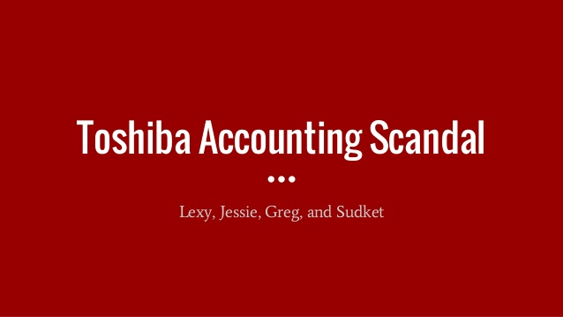
Toshiba scandal- Diversified electronic products… Cooking of books to cover losses & show profits.
Toshiba scandal- Diversified electronic products…Cooking of books to cover losses & show profits.
The company can be traced back as far as 1875.
2008 global financial crisis has started to effect the company profits.
In 2015 it was a shocking news by the company that it is investigating
an accounting scandal to revise its last three years’ profits.
Toshiba committed $1.22 billion fraud for three years to show a profit
though it was suffering losses .
The inappropriate accounting techniques like-booking future profits, pushing back losses, overstating charges by pushing back charges.
The share prices fell to their lowest point, Toshiba lost about $8Billion off its market value.
On 21st July 2015, the CEO, Hisao Tanaka announced his resignation ,including two previous CEOs.
The reason was Toshiba’s corporate culture of obedience to the superiors that the employees involved in the accounting fudging did not say no to their bosses.

Slide 16
Red Flags- <Indicators of a possible fraud>
1.Negative cash flows
2.Inability to generate cash flows
3.Compared to peers unusual financial figures with respect to sales returns, gross margins, figures based on estimates, related party, transactions, variation in comparative statements over different periods
4.Withholding important financial information from auditors
5.Domination of top management by a single person
6. Known history of security violations on stock exchanges
7.Obsolete inventory, bad debts provision
8.Analysis of accounting ratios –current ratio, quick ratio, receivables turnover, inventory turnover, debt-equity ratio.

Slide 17
End of part Two- Financial Statements Frauds

