Slide 1
Lessons On Fraud Awareness- PART 1
Author
K. Narayanarao
B .Com ; FCA; CFFE-(IFS-Pune),CFE-(West Virginia university)
www.fraudsdetection.com. LinkedIn

Slide 2
Fraud is a global problem; Frauds and fraudsters have no geographical boundaries.
Books and Records don’t commit fraud-people commit frauds!!
When everything is connected, everyone is vulnerable.

Slide 3
PART 1
Introduction-A Glimpse into the world of Frauds

Slide 4
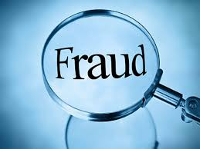
Introduction-A glimpse into world of frauds.
* MEANING OF FRAUD
* EVOLUTION OF FRAUDS
* VARIOUS TYPES OF FRAUDS
* PSYCHOLOGY OF A FRAUDSTER
* WHO IS A FRAUD EXAMINER
* QUALITIES OF A FRAUD EXAMINER
* WHAT IS FORENSIC ACCOUNTING
* AUDITOR-FRAUD EXAMINER-FORENSIC ACCOUNTANT
* WHAT IS INTERNAL CONTROL
* RED FLAGS –MEANING & SIGNIFICANCE
Notes:
THIS SLIDE SHOW PRESENTATION INITIALLY EXPLAINS CONCEPTS NEEDED TO UNDERSTAND ABOUT FRAUD EXAMINATION

Slide 5
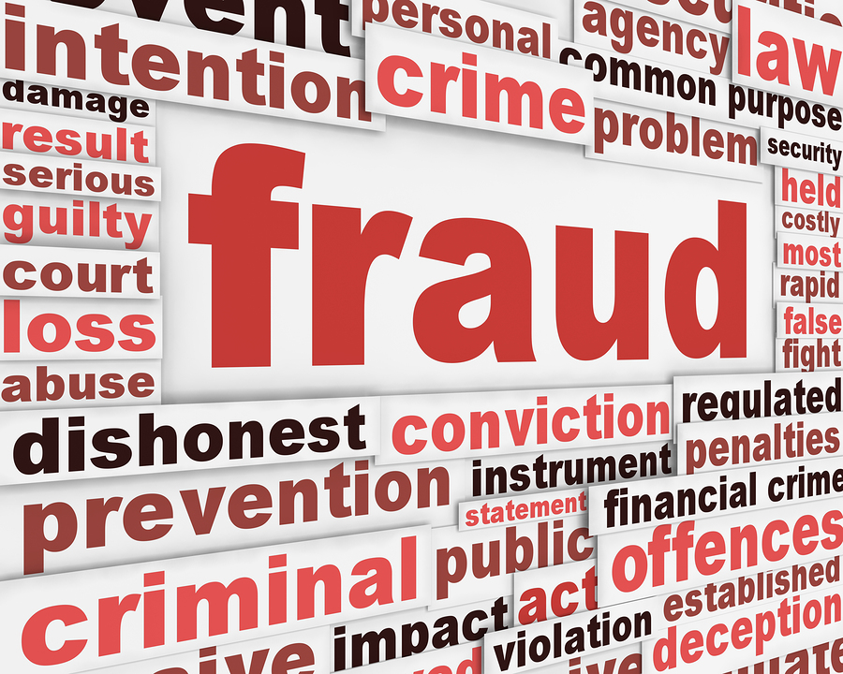
Meaning of Fraud
*A Fraud is a deception by a person or group of persons to secure unfair or unlawful gain at the cost of “VICTIM” who Trusted such a person viz. the Fraudster or the Con Man.
*“A false representation of a material fact, either a misstatement or omission, with knowledge that the representation is false with total disregard for truth”
*“Fraud can be simply explained -Behaviour of one person, to gain by dishonest means an advantage over another person.
*“Cheating the public with misleading and false promises…”

Slide 6
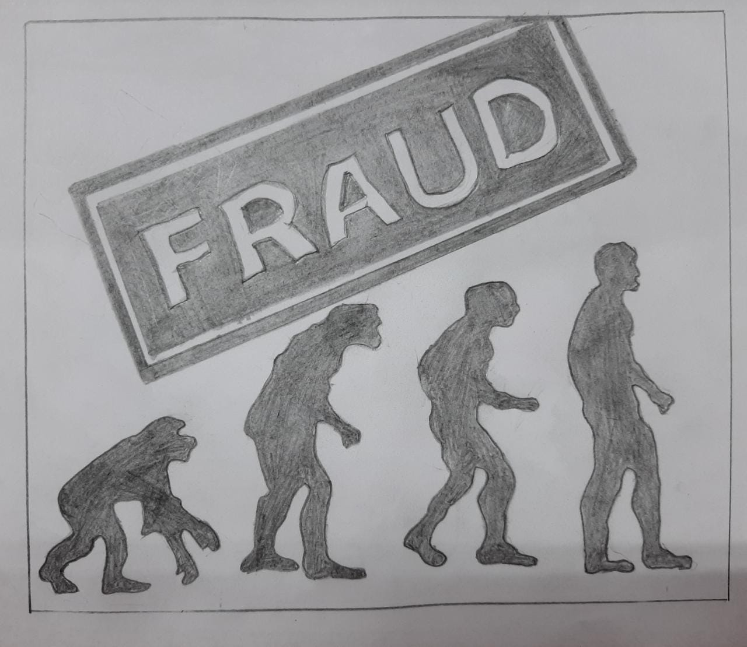
Evolution Of Frauds-1
*Frauds existed since 17th Century. Thus Frauds are not new but have a long history . At any given opportunity there are fraudsters who perpetrated or committed a fraud by cheating another.
*1770-Philip Alston-Counterfeit of coins
*1840-William Thompson-”Con Man”, confidence man-
*1874-James Reavis-American Fraudster & Forger-$5.3 Million cash
*1903-1920-Charles Ponzi-the most infamous American Italian Swindler
involved in Ponzi schemes-offering10% interest /pm!!

Slide 7
Evolution Of Frauds-2
*1964-1969-Frank Abangale -Movie-”Catch me if you can” He was One of the biggest con artists and a legendary imposter-expert in cheque manipulation.
*1991-2009-Allen Stanford-He is a financial fraudster and ran a $7 Billion 20-year scheme through his Antigua based Bank. He was given 110 years prison sentence!!
*2001-ENRON Scandal- The Massive and the Biggest Accounting Fraud. The CEO & CFO responsible for ENRON’s fall were held guilty of the fraud.
*2005-2012-Berene L Madoff-The biggest con artist of Ponzi scheme- has cheated one and all to the tune of US $70 Billion. 150 years’ prison sentence.
*2009-Satyam Computers-Ramalinga Raju-Rs.7000 crores fudging accounts.
*2015-Volkwagon Emissions scandal:
2018-PNB-Nirav Modi $2 Billion LOU scam.
2019-PMC Bank Fraud-Rs.6500 Crores……..and so on…on…!!

Slide 8
Who Is a Fraud Examiner?
A Fraud examiner is one, who is trained in the various aspects of frauds, their detection, prevention.
A fraud examiner is called in to catch the “thief “ after a fraud has happened.
A fraud examiner will go deep into the examination of book, records, analysis and applies various fraud examination techniques ,interviews
of people and finally submits a report on his findings .
A Fraud examiner should have a keen eye for details and keep his ears open for information.
The fraud examiner should be well versed with all laws at international level as fraudsters have become more intelligent in their activities exploiting loopholes in the statutes and laws across the world.
Data analytics play a critical role for fraud examiner investigations. The role involves in investigate, identify, prevent both financial and legal crimes and frauds.
Fraud examiner’s role not only includes unearthing a fraud but also to find out why the fraud occurred.
A fraud examiner is like Sherlock Holmes-.Most famous Adventure detective-Novels-by Sir Arthur Conan Doyle.

Slide 9
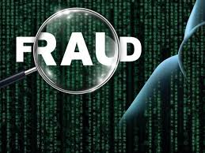
Various Types Of Fraud----- (Ref:slide12)
Various Types Of Frauds-(Ref:12)
The following are, broadly, the various categories of Frauds:
1.Corporate frauds
2. Bank Frauds
3. Insurance Frauds
4.Cyber crimes
5.Securities frauds
6.Consumer frauds

Slide 10
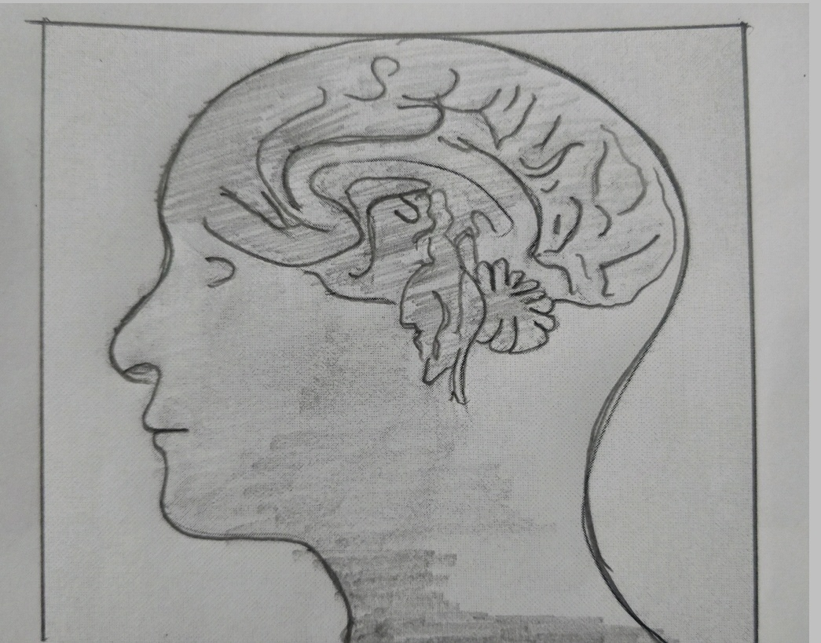
Psychology of A Fraudster>>>>>>>>->
The following Concepts best explain the Psychology of a Fraudster:
1.Donald Cressy Fraud Triangle
2.Executive fraud triangle
3.Fraud Diamond
4.Crow Horwath's Fraud Pentagon
5.Steve Albrecht-Fraud Scale
6.Fraud Circle
7.Hollinger Clark’s theory

Slide 11
Psychology of A Fraudster…..(Contd..)
All the concepts identify the following as the reasons for a person to commit fraud…whether an employee or Manger or Management:
1.Pressure,Attitude & Opportunity-(P+A+O)
2.Greed,Pride,Entitlement
3.P+A+O +Capability
4.P+A+O+Competence,Arrogance
5.P+O+Integrity is High & Integrity is Less = Occupational Fraud Occurs
6.Where there is Money->Chances of fraud High
7.Employee dissatisfaction

Slide 12
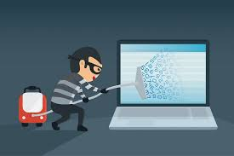
Various Categories Of Frauds……(Ref:slide-9)…..
Briefly the following are the various categories and what type of fraud is perpetrated under the category::
1.Corporate Frauds :
Corruption ,Money laundering, Asset misappropriation, Fraudulent financial statements
2.Bank Frauds :
Identity theft, electronic wire frauds, credit/debit card ,cheque, ATM frauds, Money laundering, Loan frauds
3.Insurance Frauds:
Premium diversion, Fee Churning, Asset diversion, workers compensation, Fraudulent claims.
4.Cyber Crime Frauds:
Hacking, Networks, Anything connected with net-Computers/Mobiles, Social media apps.
5.Secuities frauds-
Stock market frauds, penny stock frauds, Insider Information,
6.Consumer Frauds:
Deceptive business practices where by consumers suffer losses as they believe that the transaction is legal but in fact defrauded.-Online shopping, online offers-mainly targeting older and younger generations.

Slide 13
Forensic Accounting: Very Important Concept: A brief note:cont..
It is relevant to understand during fraud examiner discussion about the term Forensic accountant:
It is in its simplest form Forensic accounting is the application of accounting techniques and concepts in issues concerning legal matters. The requirement comes, due to, high rate, of white-collar crimes like embezzlement, fraudulent financials and various other financial wrong doings.
A forensic accountant is a qualified accountant and is called upon to examine books of account for various purposes which may include or help the legal & Statutory regulators. Also he may be called upon to investigate any suspicion of fraud of any department or a corporation.

Slide 14
Forensic Accounting: Very Important Concept: A brief note:
Forensic Accountants help is needed in price fixations, stock market manipulations and at times even manipulation of the financial figures by the managements to window dress the balance sheet and profit and loss account figures to hide real facts from the stake holders and general public, for the funds misused or misappropriated by the top managements.
Thus in a forensic accounting assignment there need not be a fraud involved but in case of a fraud examination the assignment involves investigation into a fraud that occurred. Where a forensic accountant is given assignment into investigation his report is admissible as a evidence in a court of law hence forensic examiner should exercise utmost care in his investigation and reporting.

Slide 15
Internal Control: Meaning & Brief Description.
Internal control is defined as a process for assuring of an organization's objectives in operational effectiveness and efficiency, reliable financial reporting, and compliance with laws, regulations and policies. It includes internal auditing
(Wikipedia-definition).
Internal controls in an organization Prevent, Detect and helps in taking corrective action.
Internal accounting controls include:
Separation of Duties. ...
Access Controls. ...
Required Approvals. ...
Asset Audits. ...
Templates. ...
Trial Balances. ...
Reconciliations. ...
Data Backups.

Slide 16
Red Flags:>>>>>>>>
Red flags are various indications or alerts that may arise ones’ suspicion with respect to a transaction, person or persons. The fraud examiner or forensic accountant or the auditor must have a keen eye for such indicators to probe deep into the matter .
Top 10 Red Flag Warnings of fraud:
https://www.accountingweb.com/aa/auditing/top-10-red-flag-warnings-of-fraud
10 ways Insurance Agents spot fraudulent claims:
http://autoinsurancesecretsandtips.blogspot.in/2016/10/10-ways-insurance-agents-spot.html
3.How to protect yourself from credit card frauds:
http://www.marketwatch.com/story/5-ways-to-protect-yourself-from-credit-card-fraud-2014-06-25
4.Online banking fraud- customer is safe if reported within 3days-RBI-India
http://www.firstpost.com/business/online-banking-frauds-rbi-says-no-loss-to-customer-if-fraudulent-transaction-reported-in-3-days-3783491.html

Slide 17
End of part one-introduction

