Slide 1
Transit Driver’s Seat Base Electrical Terminals
Customer Connection Points (CCP) Left Hand Drive
FORD Transit & E-Transit
Body and Equipment Mounting Manual
Youtube video: https://www.youtube.com/watch?v=sJ7qv5A7jgs
Only on Transit, NOT on E-Transit

Slide 2
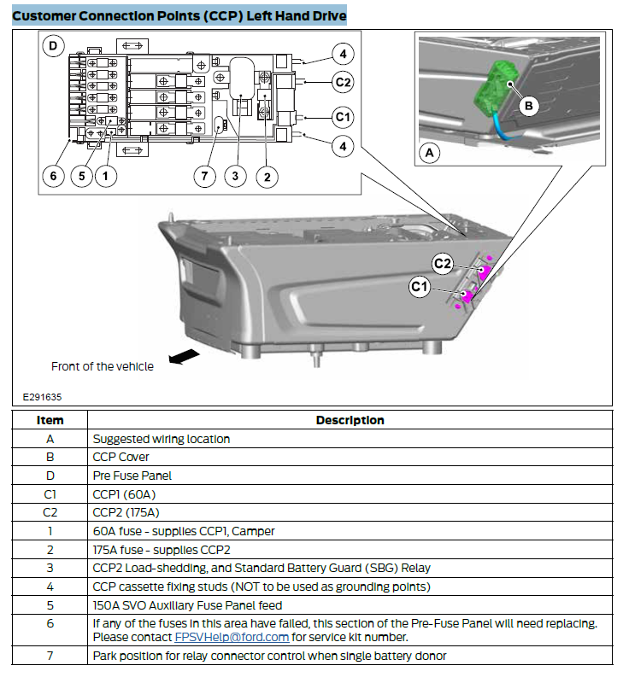
Constant (B+)
Accessory

Slide 3
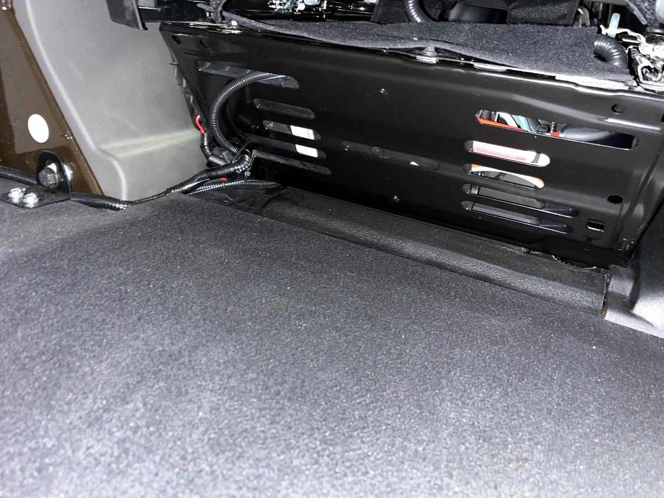
Bottom rear of driver’s seat
NFS uses for cargo light and RFID power

Slide 4
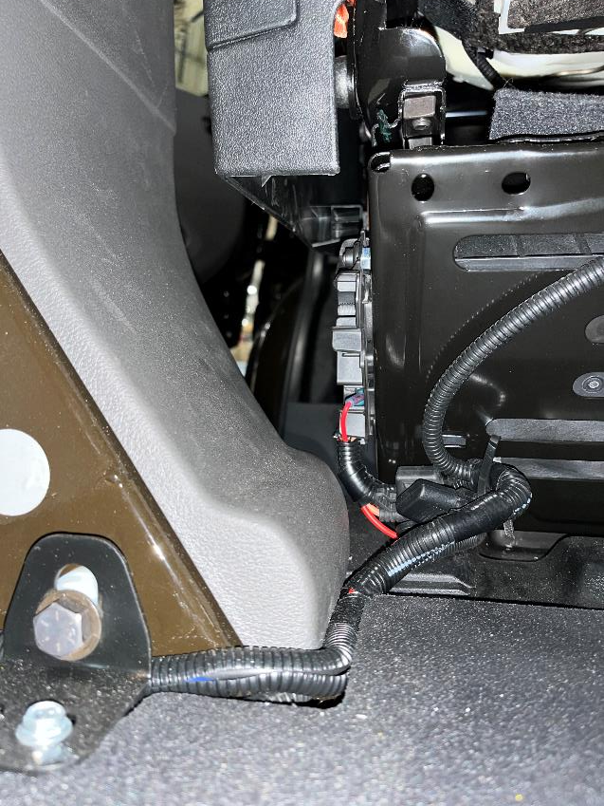
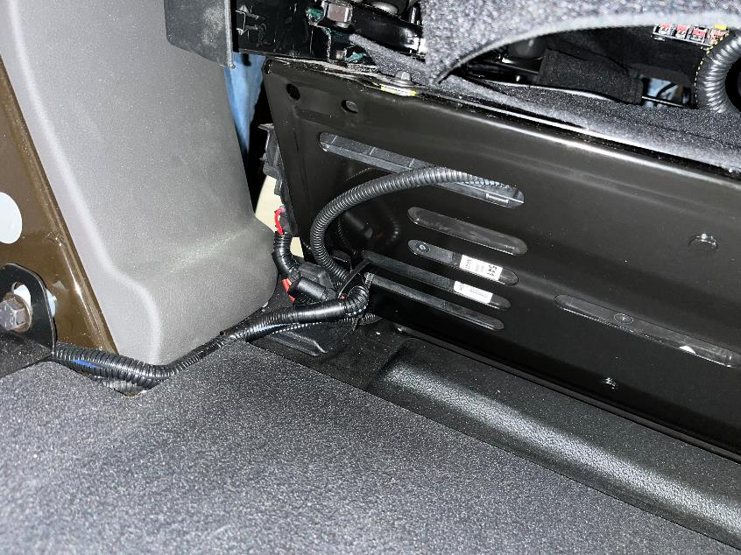
Bottom rear of driver’s seat
NFS uses for cargo light and RFID power

Slide 5
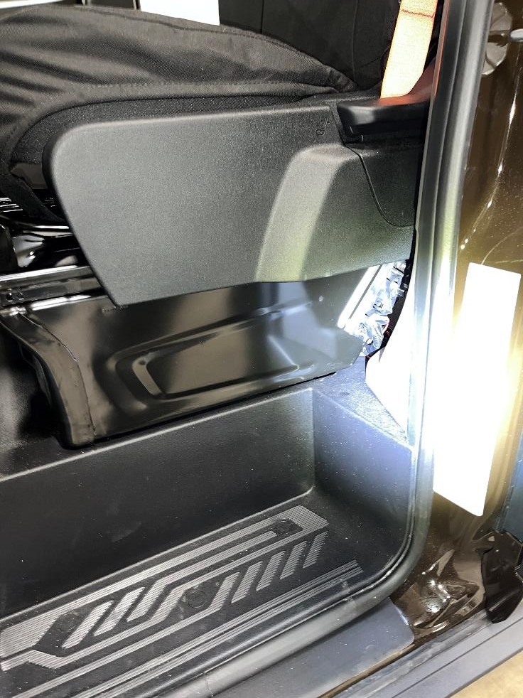
Bottom side of driver’s seat
NFS uses for cargo light and RFID power

Slide 6
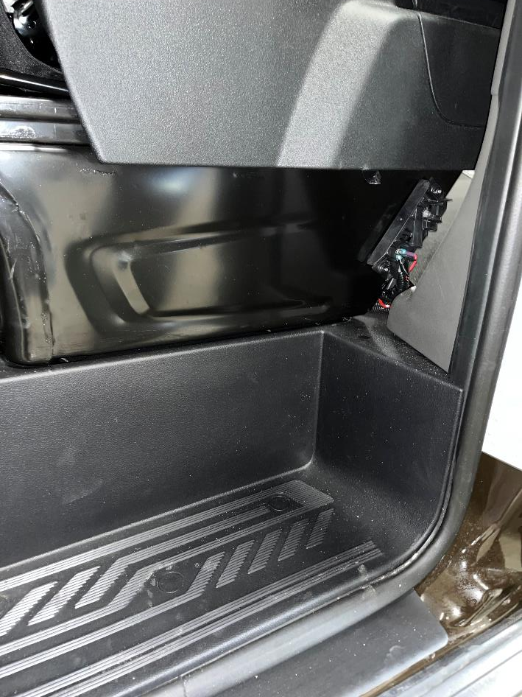
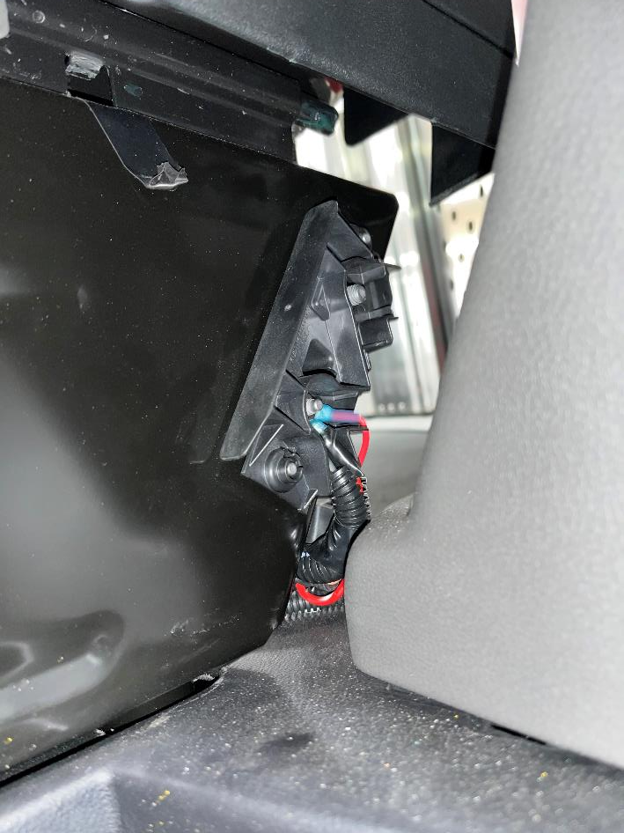
Bottom side of driver’s seat
NFS uses for cargo light and RFID power

Slide 7
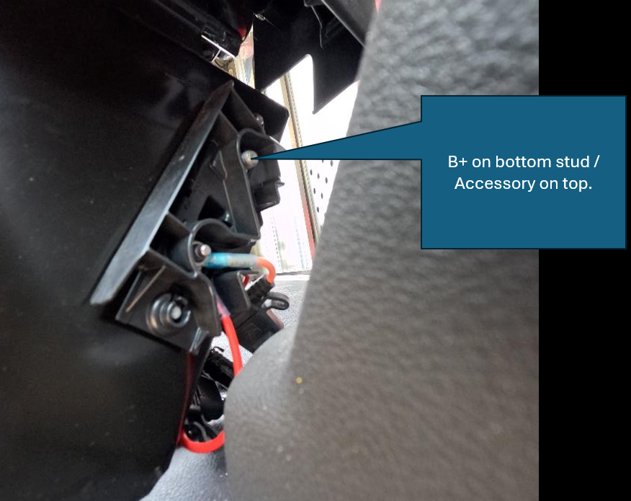
Bottom side of driver’s seat
NFS uses for cargo light and RFID power

