Slide 1
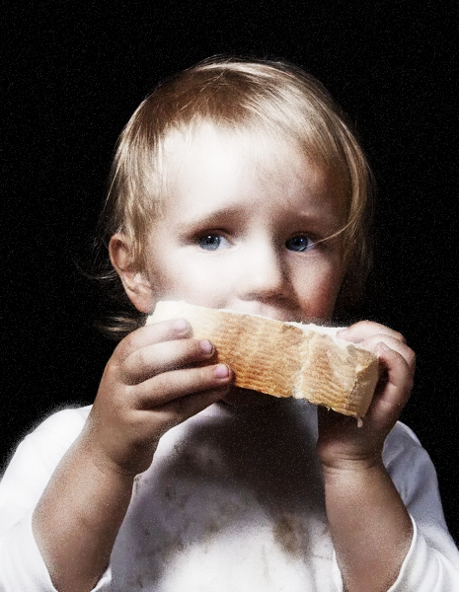
Our Lady of The Cedars of Mount Lebanon
Maronite Catholic Church
Parish Food Drive 2022
November 1, 2022 – November 22, 2022
Please give generously for this year’s non-perishable
Parish Food Drive to help those less fortunate.
The donations you make will help individuals and families in our immediate, local and greater communities. Collection Boxes will be located in the church foyer starting
November 1, 2022.
“I am not capable of doing big things, but I want to do everything, even the smallest things, for the greater
glory of God.”
St. Dominic Savio
The rich man who gives to the poor does not bestow alms but pays a debt. -St. Ambrose of Milan
For it is in giving that we receive. -ST. Francis of Assisi
“whatever you did for one of these least brothers of mine, you did for me”. – Matthew 25:40
“If you can’t feed a hundred people, then feed just one.” – Mother Teresa
“I have given you a model to follow, so that as I have done for you, you should also do” - John 13:15
“If you are what you should be, you will set the whole world ablaze!”
St. Catherine of Siena
“If God sends you many sufferings it is a sign that He has great plans for you, and certainly wants to make you a saint.” St. Ignatius of Loyola
Non-Perishable Food
NO MEATS, MILK PRODUCTS, EGGS, FRESH FRUITS OR VEGETABLES
WE WILL ACCEPT Canned or Dried Meats, Canned Tuna and Salmon, Peanut Butter, Jelly , Canned or Dry Soups, Canned Stews and Chili, Tea Bags, Coffee (ground no beans), Canned Pasta, Canned Vegetables, Canned Fruit, Canned Pasta (Spaghetti “O’s”), Hot and Cold Cereals, Rice, Cake Mixes, Pancake Mix, Syrup, Powdered Milk, Packaged Pasta (Macaroni & Cheese, etc.), Juice Boxes, Canned Juices, Canned Beans, Spam, Canned Gravy, Granulated Sugar, Baby Food & Cereal (glass jars accepted), Baby Formula (Enfamil/Similac), Granola Bars, Cereal Bars

