Slide 1
Home Library Database
Elizabeth Levi​
CIT 170: Database Design Fundamentals
MCTC: Spring 2023 Semester

Slide 2
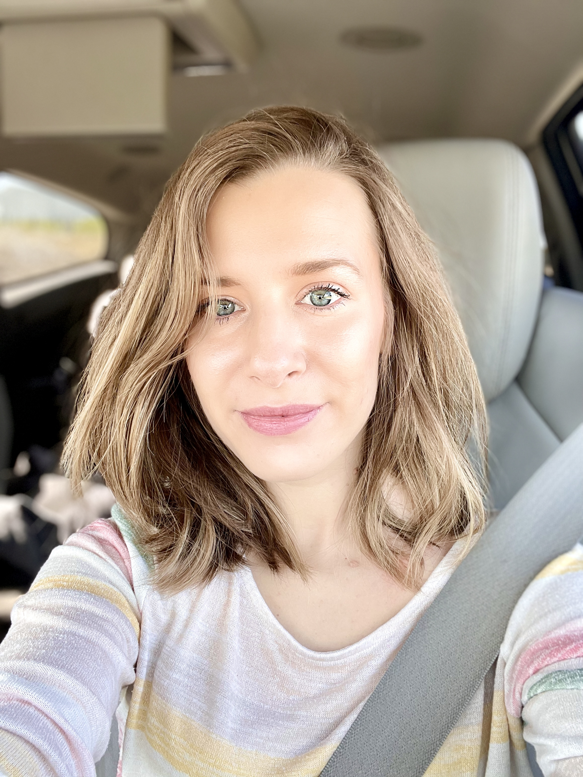
Home Library
My database final project is a home library. We are a family of 5 and have an always growing collection of books. The goal of this database is to help us easily find books we need for certain criteria for a school assignment or for recreational reading. It will also help us keep track of what books we have so we don’t end up with multiple copies of the same book.

Slide 3
l

