Slide 1
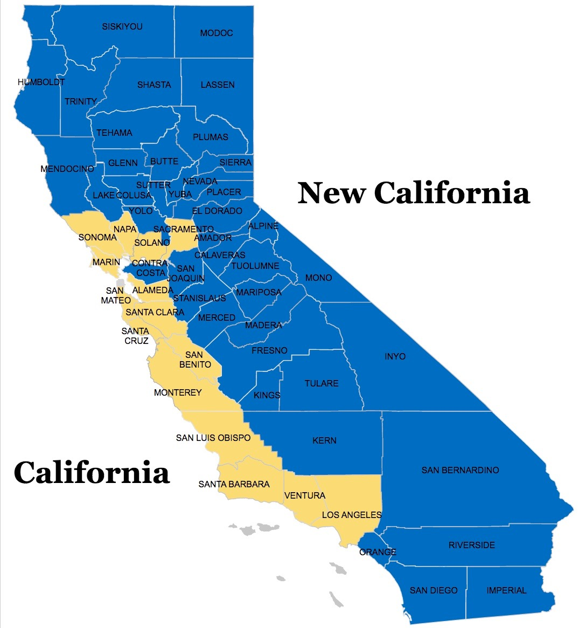

New California State

Slide 2
New California State
Delegates Convention
January 13, 2018

Slide 3
Declaration of Independence
December 16, 2017 Workshop Marysville, CA
January 13, 2018 Delegates’ Convention Marysville, CA
January 15, 2018 Declaration of Independence 11:00 am
January 16, 2018 Grievance 1 11:00 am
January 23, 2018 Grievance 2 11:00 am
January 30, 2018 Grievance 3 11:00 am
Grievances 4-40 to follow each Tuesday at 11:00 am

Slide 4
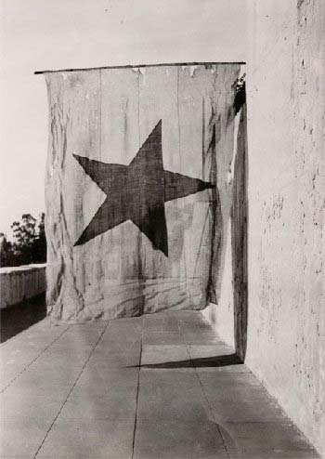
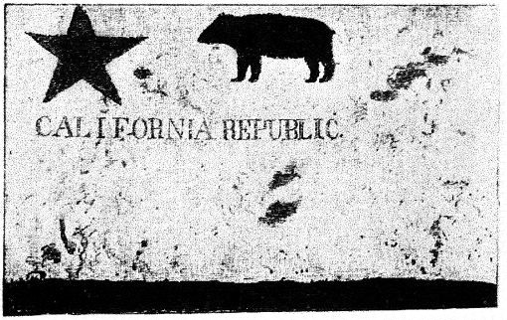

Declarations
1776 Declaration of Independence
1836 Californio Declaration of Independence
1846 Bear Flag Rebellion William Ide Proclamation
Nevada County
Sutter County
Yuba County
Kern County*

Slide 5
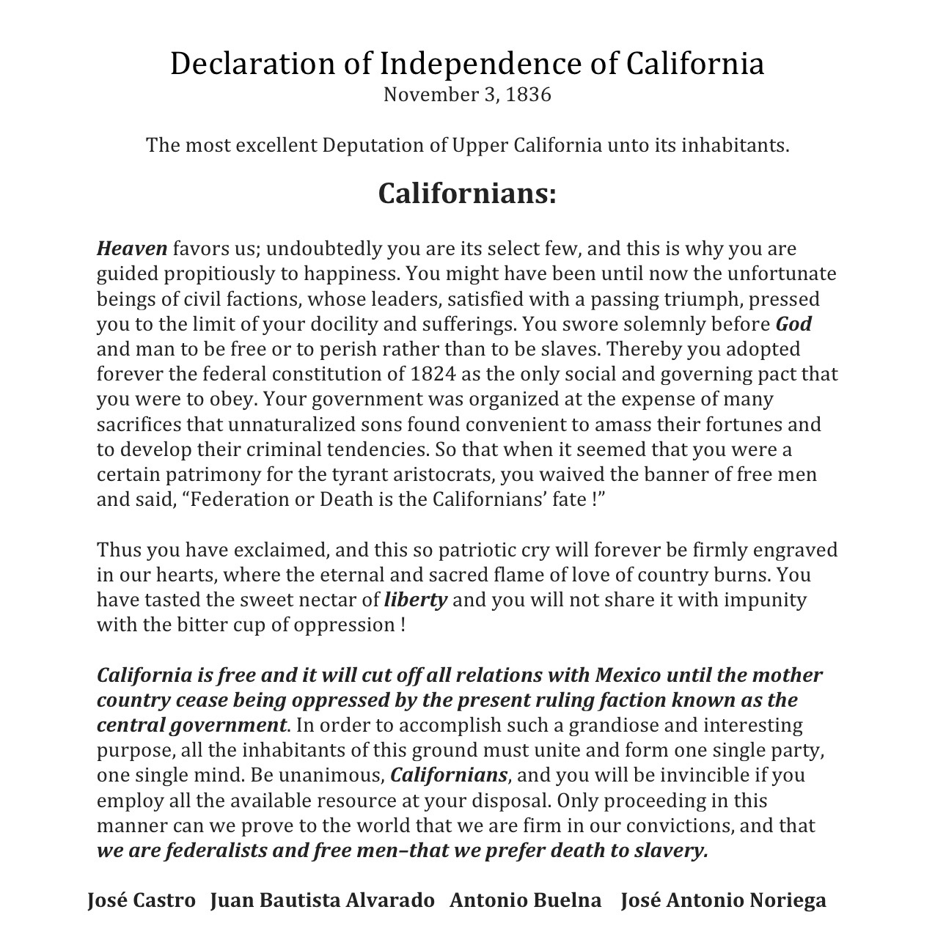
1836 Californio Declaration of Independence

Slide 6
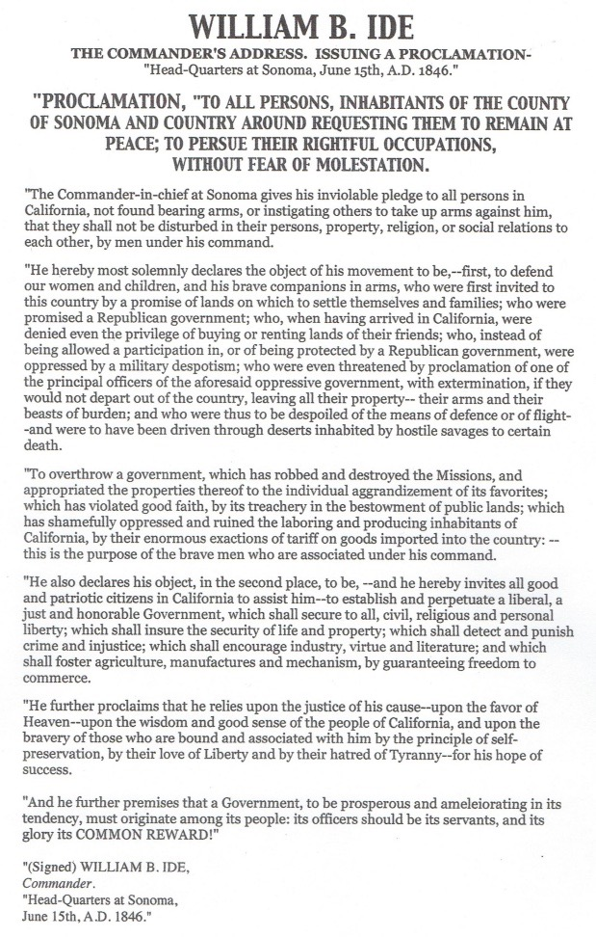
1846 Bear Flag Rebellion William Ide Proclamation

Slide 7
New California
Declaration of Independence
December 16, 2017 Draft Agreement
January 13, 2017 County Delegates Finalize Declaration
Certified Counties to Send a Delegate
Delegates will agree on Declaration plus 1st Grievance
January 15, 2017 Reading of the Declaration of Independence for New California 11:00 am 3 Locations
January 16, 2017 Grievance 1 11:00 am 3 Locations

Slide 8
January 13, 2018
Welcome, Prayer, Pledge
Goal Develop Declaration Documents
Declaration of Disclaimers Who we are and who we are not
Declaration of Allegiance to the United States “Preamble”
Declaration of Separation
Declaration of Independence
Grievance # 1 Kern County Example

Slide 9
Delegates Convention
Declaration Documents
Schedule
9:00-9:30 am Welcome Introductions
9:30-10:30 am Declaration of Disclaimers Who we are and who we are not
10:30-11:30 am Declaration of Allegiance to United States “Preamble”
11:30 -12:30 pm Lunch
12:30-1:30 Declaration of Separation from California
1:30-3:00 pm Declaration of Independence from California
3:00-3:30 pm Grievance # 1 Kern County Example Article 4 Section 4
3:00-4:00 pm Reading of Documents

Slide 10
Separation
Definition of separation
1: the act or process of separating : the state of being separated
2a : a point, line, or means of division
b : an intervening space : gap
the separation between wheel spokes
3a : cessation of cohabitation between a married couple by mutual agreement or judicial decree
b : termination of a contractual relationship (such as employment or military service)

Slide 11
independence
Definition of INDEPENDENCE
1 : freedom from outside control or support : the state of being independent
They are fighting for independence from colonial rule.
Her ambition is to achieve financial independence. [=to earn all the money she needs; to not depend on money given by anyone else]
She asserted her independence from her parents by getting her own apartment.
He has shown a fierce independence of spirit/thought.
2 : the time when a country or region gains political freedom from outside control

Slide 12
U.S. constitution
Article IV Section 3
New States may be admitted by the Congress into this Union; but no new States shall be formed or erected within the Jurisdiction of any other State; nor any State be formed by the Junction of two or more States, or parts of States, without the Consent of the Legislatures of the States concerned as well as of the Congress.

Slide 13
U.S. constitution
Article IV SECTION 4
Article IV
Section 4.
The United States shall guarantee to every state in this union a republican form of government, and shall protect each of them against invasion; and on application of the legislature, or of the executive (when the legislature cannot be convened) against domestic violence.

Slide 14
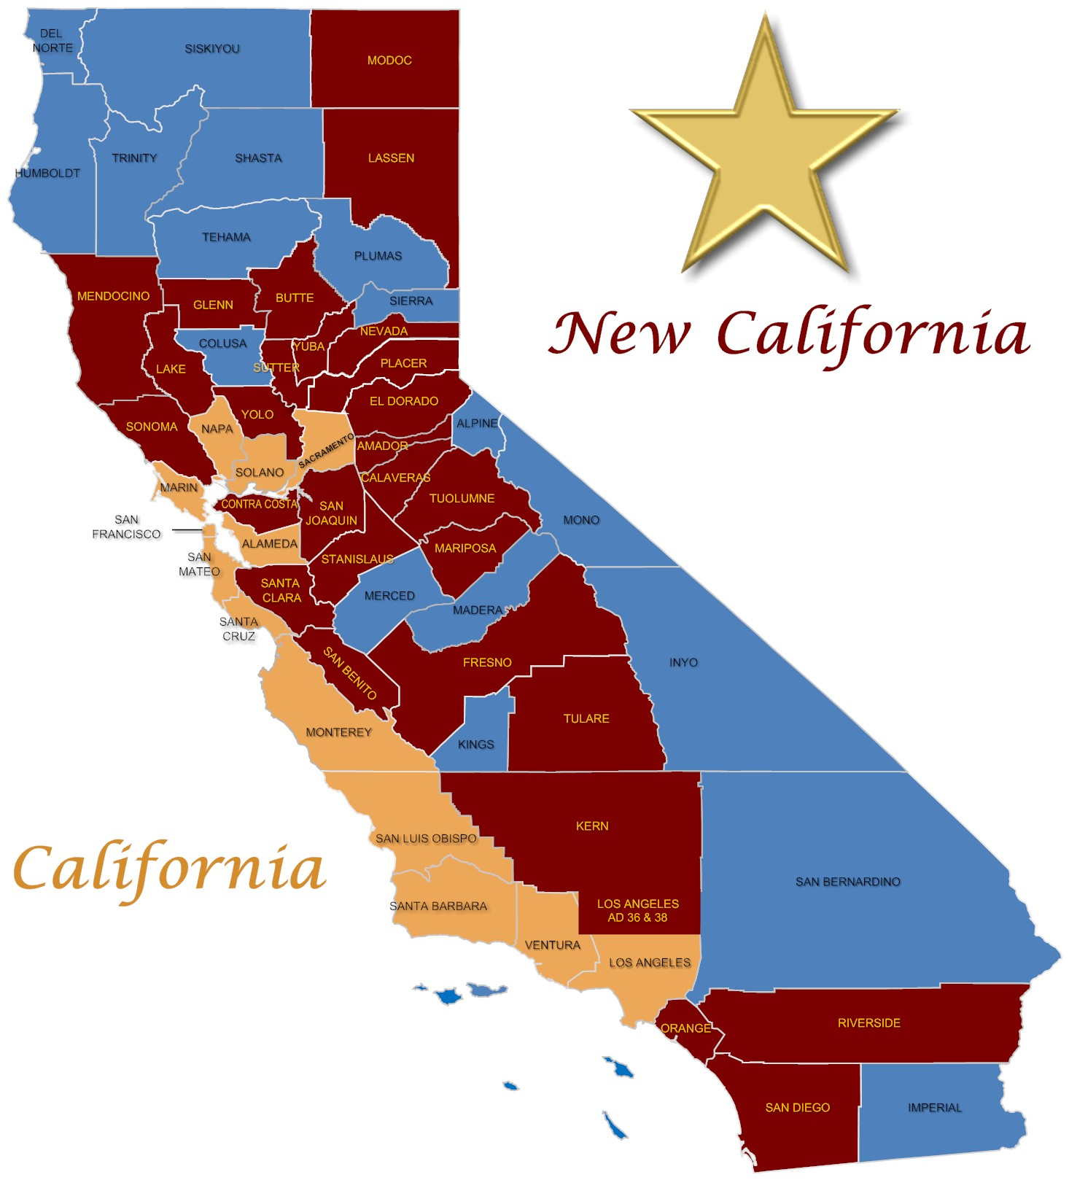
New California State

