Slide 1
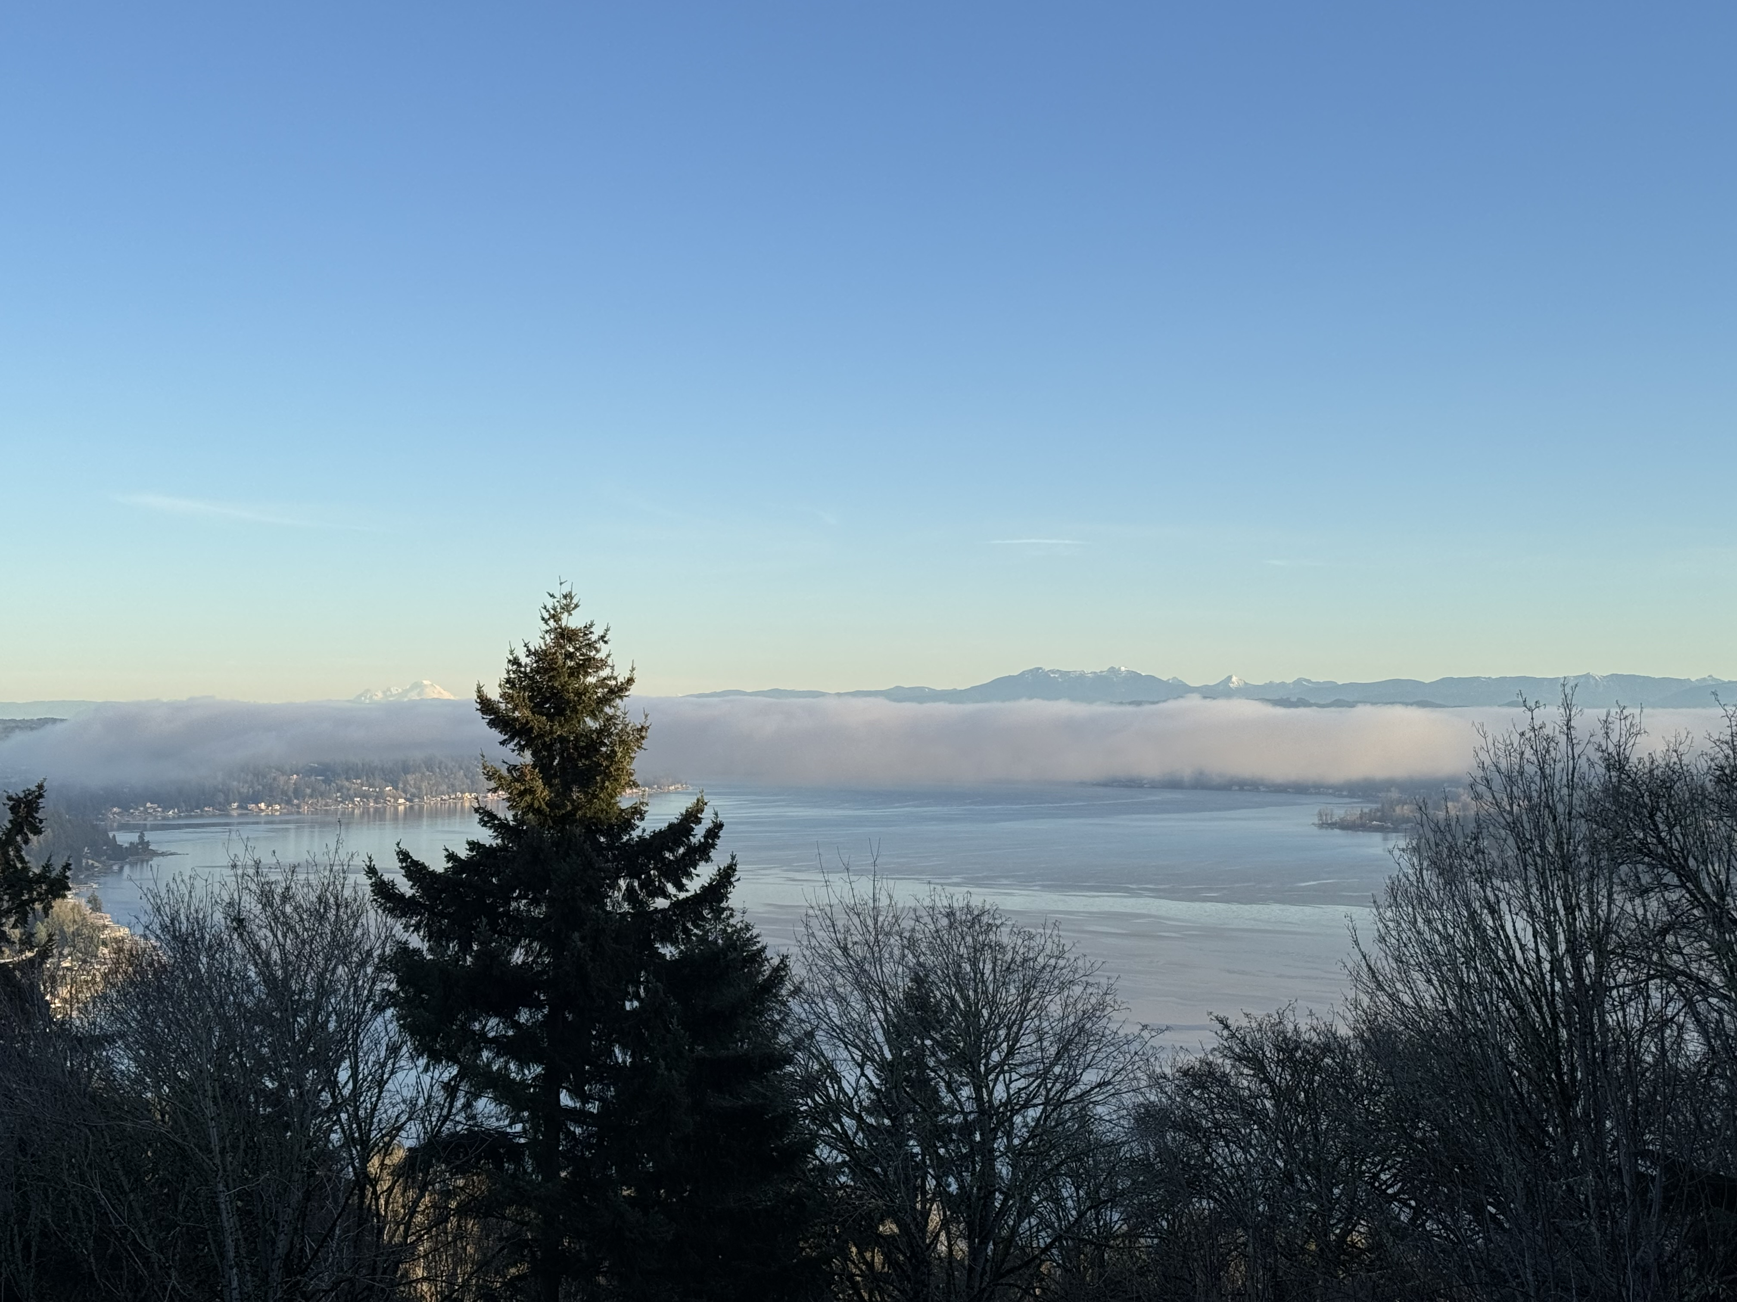
Vuemont Annual Meeting
January 29, 2025

Slide 2
PRESIDENT’S WELCOME & AGENDA
Welcome & Introductions – President: Katie Teplicky
Approval of Previous Minutes – on website www.vuemont.org
Committee Reports:
a. Architectural Review – Steve Rolfe
b. Landscaping – Katie Teplicky
c. Vegetation Management – Katie Teplicky
d. Treasurer’s Report – Nicolette Hortsch/Elizabeth McIntyre
e. Communications & Concerns – Yanmei Zhao
Old Business
New Business
Election of New Board Members for 2025

Slide 3
INTRODUCTIONS
Current Board Members:
President: Katie Teplicky
Vice President: Ben Piper
Treasurer: Nicolette Hortsch
Secretary: Rick Valdes
Complaints/Communications: Yanmei Zhao
Landscape Chair: Katie Teplicky
Architectural Review Chair: Steve Rolfe
Vegetation Management Chair: Katie Teplicky

Slide 4
ARCHITECTURAL REVIEW
Repainting: 5
Reroofing: 3
Driveway: 0
Remodel: 0
Landscape: 0
Please remember to give the ARC Committee plenty of time to review applications. Forms available at www.vuemont.org

Slide 5
LANDSCAPING UPDATE
2024 Activities:
Green areas management continued (areas include: vegetation around Vuemont signs on 164th and SE 46th, median along SE 46th, bump-outs on 171st, 171st cul-de-sac green belt, and dip area).
Irrigation system maintained and winterized
Thatched, replanted and watered this year on SE 46th Median
Spring and fall plantings at signs
Storm/broken branch clean up at greenbelt dip several times
Special Projects:
Bump-outs on 171st trimmed back, thinned, trimmed, maintained
Several valves replaced on sprinkler system
Misc:
Pet waste station management continues in 2 locations, includes monthly waste pick-up and waste bag replenishment.

Slide 6
VEGETATION MANAGEMENT
Did work in all zones across the greenbelt for view recovery and maintenance in June 2024, which included communicating with rim neighbors re: priorities, several trips into the greenbelt, meeting with contractors and the creation of a “state of the greenbelt” report for the City of Bellevue (COB).
More view recovery trimming will be done in 2025 under same permit that is valid for 2 more years.
All removed view offending trees are replanted at the COB’s strict “remove 1; replant with 3” ratio (lower growing species) and reinspected by the COB in order to keep the hillside stable and thriving.
Work will be done in spring/early summer, and replanted trees have time to establish before the hot summer months.

Slide 7
CONCERNS & COMMUNICATIONS
Concerns:
Neighbors not maintaining home appearance
Overgrown lawn/weeds/hedges, roof replacement/paint needed, wildlife concerns, trees in greenbelt being dangerous
Automobiles may not be parked on City of Bellevue streets for more than 24 consecutive hours
Communications:
Vuemont Spring Newsletter 2024 sent on May 8, 2024
Vuemont Autumn Newsletter 2024 sent on October 28, 2024
Please update your contact information by filling out the form at:
PAY Annual Dues (vuemont.org)

Slide 8
TREASURER’S REPORT
Vuemont Homeowners' Association
Balance Sheet
As of December 31, 2024
 | Total
ASSETS
Current Assets
Bank Accounts
PayPal | 3,872.30
Union Bank Checking #8688 | 9,193.58
Union Bank Money Market | 56,836.41
Total Bank Accounts | $ 69,902.29
Accounts Receivable
Accounts Receivable | 23,380.80
Total Accounts Receivable | $ 23,380.80
Other Current Assets
A/R Misc | -542.00
Undeposited Funds | 0.00
Total Other Current Assets | -$ 542.00
Total Current Assets | $ 92,741.09
TOTAL ASSETS | $ 92,741.09
LIABILITIES AND EQUITY
Liabilities
Current Liabilities
Accounts Payable
Accounts Payable | 1,726.70
Total Accounts Payable | $ 1,726.70
Other Current Liabilities
To be Refunded | 13.50
Total Other Current Liabilities | $ 13.50
Total Current Liabilities | $ 1,740.20
Total Liabilities | $ 1,740.20
Equity
Opening Balance Equity | 37,161.42
Retained Earnings | 56,498.01
Net Income | -2,658.54
Total Equity | $ 91,000.89
TOTAL LIABILITIES AND EQUITY | $ 92,741.09

Slide 9
TREASURER’S REPORT
 | YTD
 | Actual | Budget | Variance
INCOME
Dues Vuemont 1 & 2 | 40,610.00 | 40,610.00 | 0.00
Dues Vuemont 3 & Eastmont | 5,220.00 | 5,220.00 | 0.00
Late / Transfer Fees | 902.00 | 0.00 | 902.00
Interest | 141.86 | 24.00 | 117.86
Sky Mountain Shared Expenses | 10,467.80 | 7,000.00 | 3,467.80
Total Income | 57,341.66 | 52,854.00 | 4,487.66
EXPENSES
Administration | 2,796.36 | 2,264.00 | 532.36
Bookkeeping | 3,770.00 | 3,300.00 | 470.00
Insurance | 7,000.00 | 6,277.00 | 723.00
Landscaping | 30,770.09 | 28,500.00 | 2,270.09
Legal Fees | 0.00 | 0.00 | 0.00
Major Repair | 0.00 | 0.00 | 0.00
Storage Unit | 0.00 | 0.00 | 0.00
Taxes | 38.14 | 420.00 | (381.86)
Utilities | 302.02 | 360.00 | (57.98)
Vegatation Management | 15,323.59 | 10,500.00 | 4,823.59
Contingency | 0.00 | 1,000.00 | (1,000.00)
Total Expenses | 60,000.20 | 52,621.00 | 7,379.20
NET | (2,658.54) | 233.00 | (2,891.54)

Slide 10
OLD BUSINESS:
Nothing outstanding at this time
NEW BUSINESS:
Comments, questions, concerns

Slide 11
ELECTION OF OFFICERS
Terms Expiring:
Ben Piper
Rolling off to “consultant” role:
Steve Rolfe
1 year remaining and continuing on the Board:
Katie Teplicky, Rick Valdes, Yanmei Zhao, Nicolette Hortsch
NOMINATIONS: We would love to have you join us!
Thank you for coming!

