Slide 1




Mastering Cyber Resilience:
Real World Application of the NIST Cybersecurity Framework
akylade.com
January 16, 2025
InfraGard Meeting

Slide 2
Presentation Overview
  Introduction
  NIST Cybersecurity Framework (2.0)
  CR-MAP Process
  Building Cyber Resilience
  Conclusion
  Q & A
akylade.com

Slide 3


I. Introduction
Jason Dion
Founder and Chief Product Officer, AKYLADE
akylade.com
Alyson Laderman
Chief Executive Officer and Chief Legal Officer, AKYLADE

Slide 4

Real World Examples of Cyber Resilience Gone Wrong
akylade.com
Source: https://www.cisa.gov/news-events/news/attack-colonial-pipeline-what-weve-learned-what-weve-done-over-past-two-years
Image: https://www.ecicomfort.com/blog/colonial-pipeline-cyber-attack-what-will-happen

Slide 5
What is Cyber Resilience?
Cyber resilience is an organization's ability to protect its systems and data from cyberattacks and quickly resume operations after an attack
akylade.com

Slide 6
Brief Overview of Today’s Discussion
1. Nationwide Cybersecurity Review (NCSR)
2. NIST CSF and its applications
3. CR-MAP process as a practical implementation tool
4. Case studies to inspire action
akylade.com

Slide 7
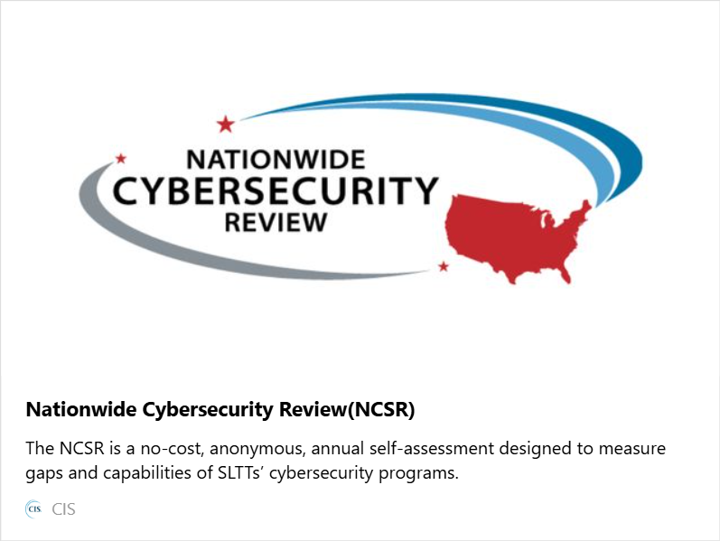
Nationwide Cybersecurity Review (NCSR)
akylade.com
Source: https://www.cisecurity.org/ms-isac/services/ncsr
Notes:
1. A no-cost, anonymous, annual self-assessment
2. All states, local governments, and tribal nations are encouraged to participate
3. Designed to measure gaps and capabilities of your cybersecurity programs and is based on the NIST CSF
4. Fulfill the NCSR assessment requirement for the Homeland Security Grant Program (HSGP) which has over $1 billion in funding available
Website: cisecurity.org/ms-isac/services/ncsr

Slide 8
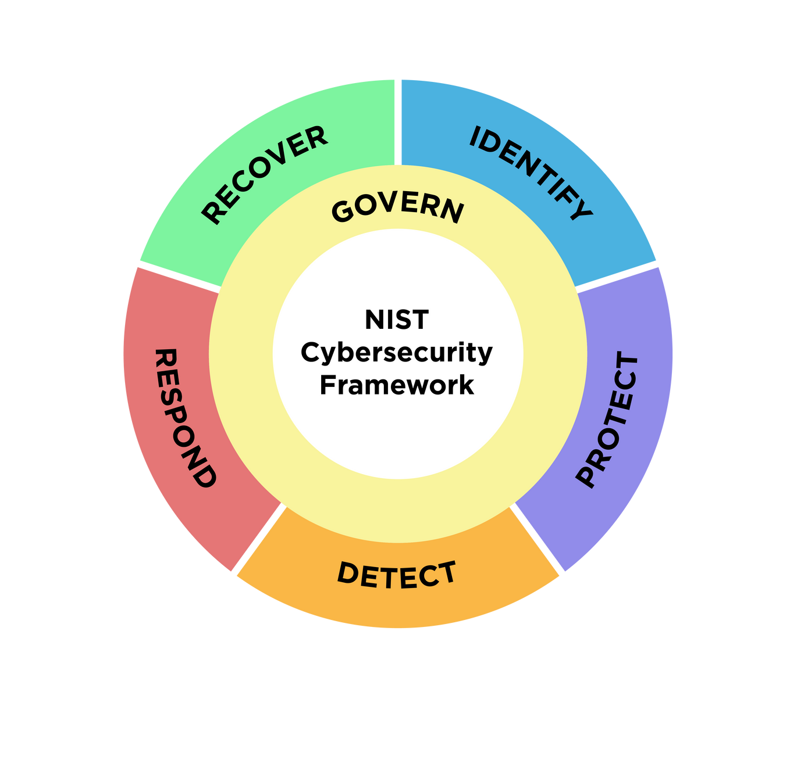
NIST Cybersecurity Framework (2.0)
akylade.com
6 Functions
22 Categories
106 Subcategories

Slide 9
NIST Cybersecurity Framework (2.0)
akylade.com
Govern establishes cybersecurity policies, roles, and accountability to align cybersecurity efforts with organizational goals and regulatory requirements.

Slide 10
NIST Cybersecurity Framework (2.0)
akylade.com
Identify helps organizations understand their cybersecurity risks by identifying assets, data, systems, and vulnerabilities.

Slide 11
NIST Cybersecurity Framework (2.0)
akylade.com
Protect implements safeguards to ensure critical infrastructure, data, and systems are secured against potential cyber threats.

Slide 12
NIST Cybersecurity Framework (2.0)
akylade.com
Detect enables the timely discovery of cybersecurity incidents through continuous monitoring and analysis of security events.

Slide 13
NIST Cybersecurity Framework (2.0)
akylade.com
Respond defines actions to contain and manage the impact of detected cybersecurity incidents, minimizing damage to operations.

Slide 14
NIST Cybersecurity Framework (2.0)
akylade.com
Recover focuses on restoring operations and services to normal after a cybersecurity incident to ensure resilience and continuity​​.

Slide 15

Implementation Tiers
Tier 4:
Adaptive
The organization has a proactive, continuously improving cybersecurity program that adapts to emerging threats, informed by real-time risk intelligence.
Tier 3:
Repeatable
Cybersecurity risk management processes are established, consistently applied, and regularly improved with clear roles and responsibilities across the organization.
Tier 2:
Risk-Informed
Cybersecurity practices are defined and implemented based on risk assessments, but coordination across the organization is inconsistent.
Tier 1: Partial
Cybersecurity practices are informal and reactive, with limited awareness of risks and no established processes for managing them.

Slide 16
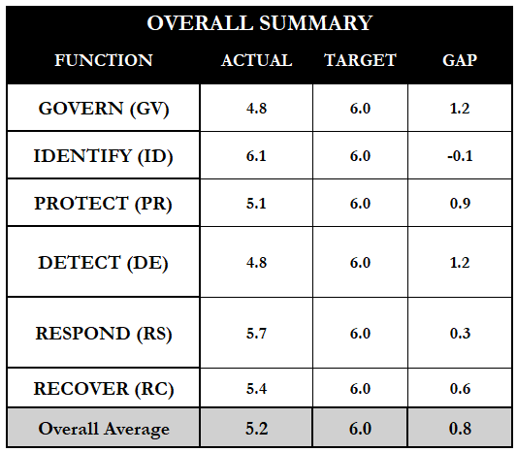
PROFILES
Current Profile
A snapshot of an organization’s existing cybersecurity posture, detailing the outcomes it is currently achieving across the CSF functions, categories, and subcategories.
Target Profile
A desired future state of an organization’s cybersecurity posture, outlining the specific outcomes it aims to achieve based on its risk management goals, priorities, and business needs.
Sample Organization Scorecard

Slide 17
CR-MAP Process
What is a CR-MAP?
CR-MAP standards for cyber risk management action plan. There are three phases.
What is the purpose of a CR-MAP?
akylade.com
This cyber resilience blueprint helps an organization safeguard against reasonable threats and protect you during potential acquisitions and investigations.

Slide 18
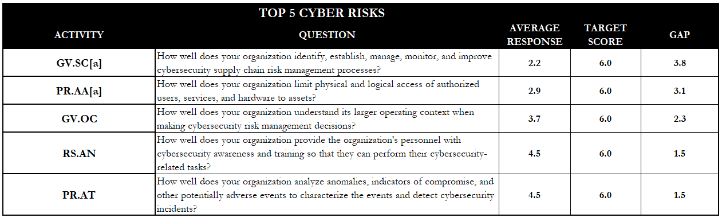
3 Phases of CR-MAP
Phase One: Discovering Top Cyber Risks
1 Widen your scope
2 Get buy in
3 Select interviewees
4 Generate the questionnaire
5 Determine your target scores
6 Conduct the interviews
7 Compile and average the scores
8 Communicate your top five cyber risks

Slide 19
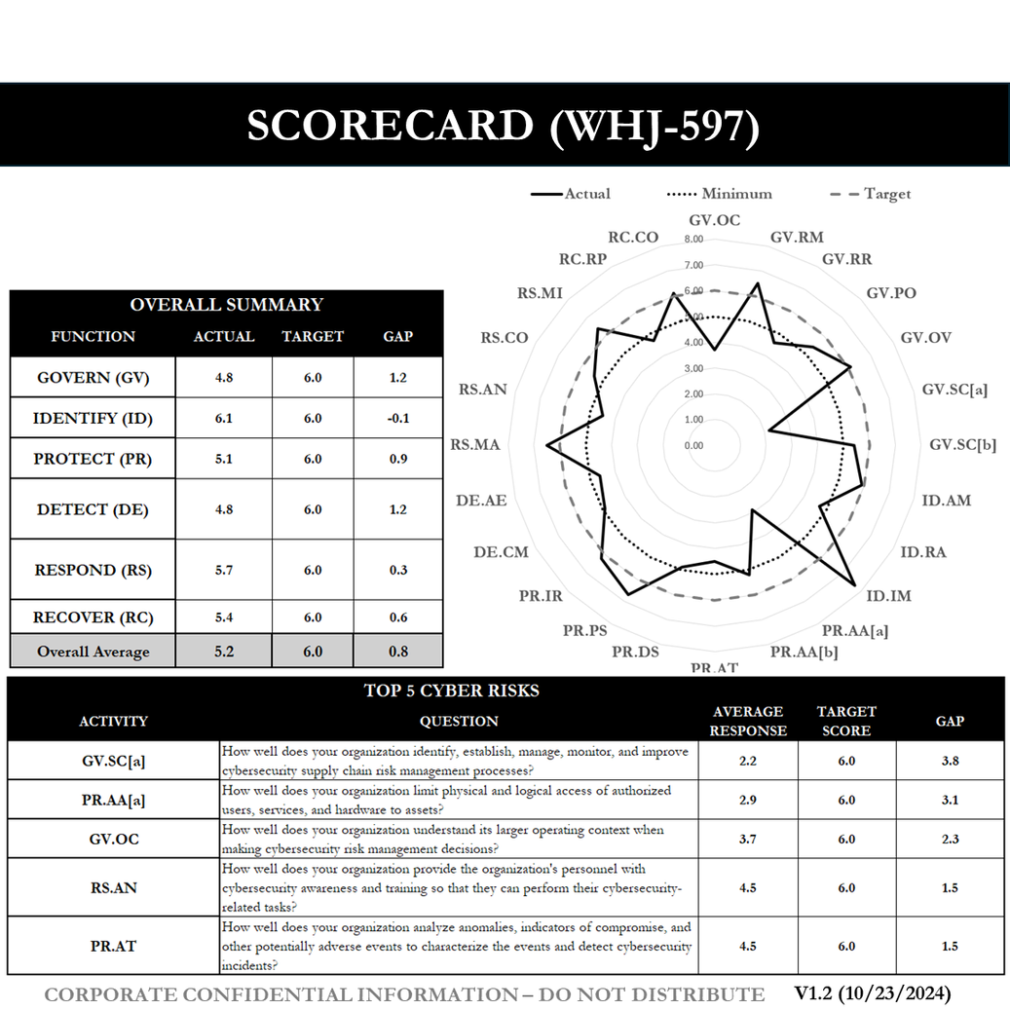
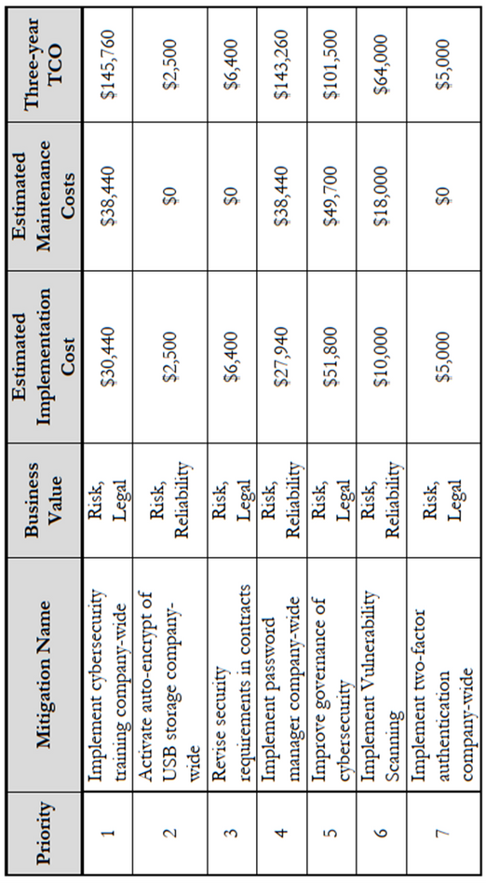
Phase Two: Creating a CR-MAP
  Close the identified gaps
  Conduct a business value analysis
  Create a dashboard and roadmap
  Conduct internal marketing
  Conduct external marketing

Slide 20

Phase Three:
Maintenance and Updates
  Continually update your scorecards
  Monthly check-ins
  Schedule quarterly reviews
  Schedule an annual cybersecurity summit
akylade.com

Slide 21
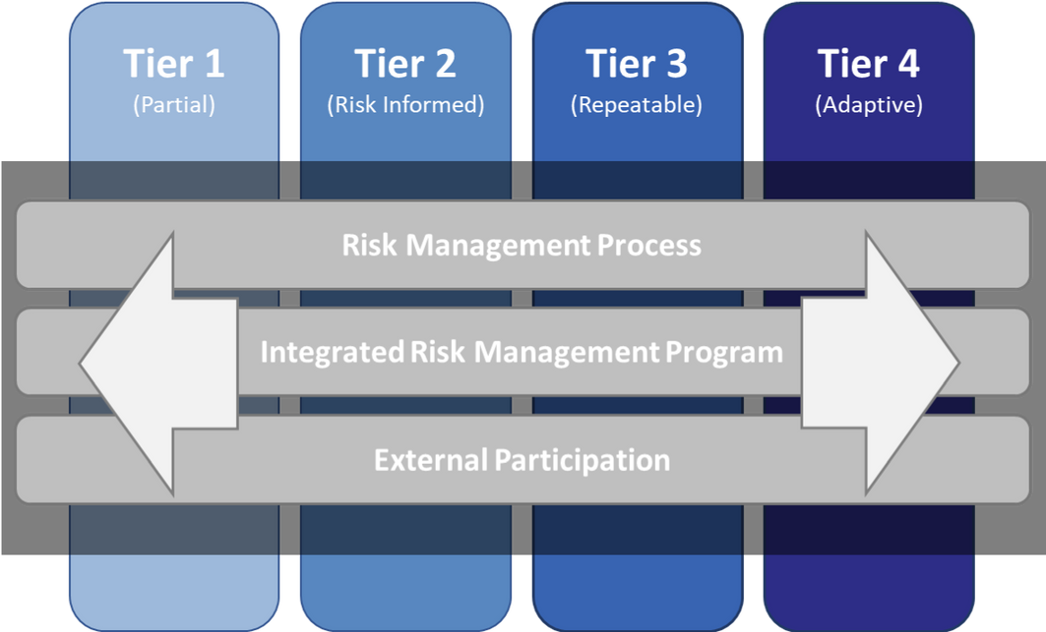
Building Cyber Resilience:
Actionable Steps for Your Organization
  Assess your current implementation tier and maturity level.
akylade.com
Source: https://www.nist.gov/image/tierspng
Notes:
1. Assess your current implementation tier and maturity level.

Slide 22
Building Cyber Resilience:
Actionable Steps for Your Organization
2. Leverage tools like the NCSR survey and the NIST CSF
akylade.com
Notes:
2. Leverage tools like the NCSR survey and the NIST CSF

Slide 23
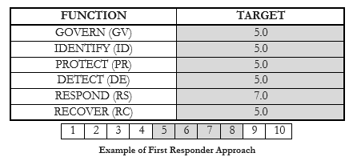
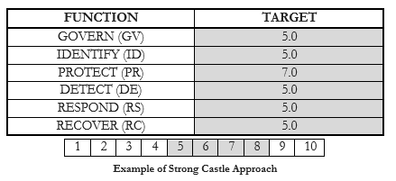
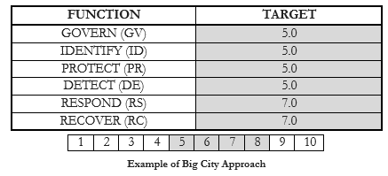
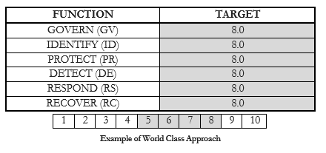
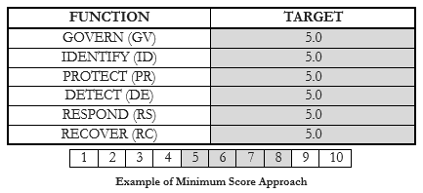
Building Cyber Resilience:
Actionable Steps for Your Organization
3. Adapt and tailor the NIST CSF to your organization using a target profile.
Notes:
3. Adapt and tailor the NIST CSF to your organization using a target profile.

Slide 24

Building Cyber Resilience:
Actionable Steps for Your Organization
4. Start small and scale up smartly
Begin with one function, category, or subcategory, then expand the scope
akylade.com
Notes:
4. Start small and scale up smartly.

Slide 25
Building Cyber Resilience:
Actionable Steps for Your Organization
5. Communicate the value to your stakeholders
6. Train your staff on the NIST CSF so that everyone is “speaking the same language”
Notes:
5. Communicate the value to your stakeholders
6. Train your staff on the NIST CSF so that everyone is "speaking the same language"

Slide 26
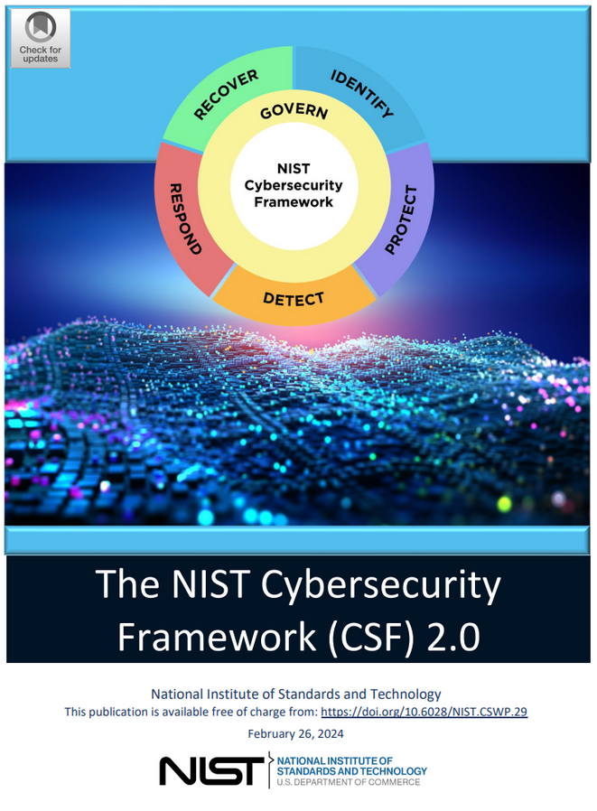
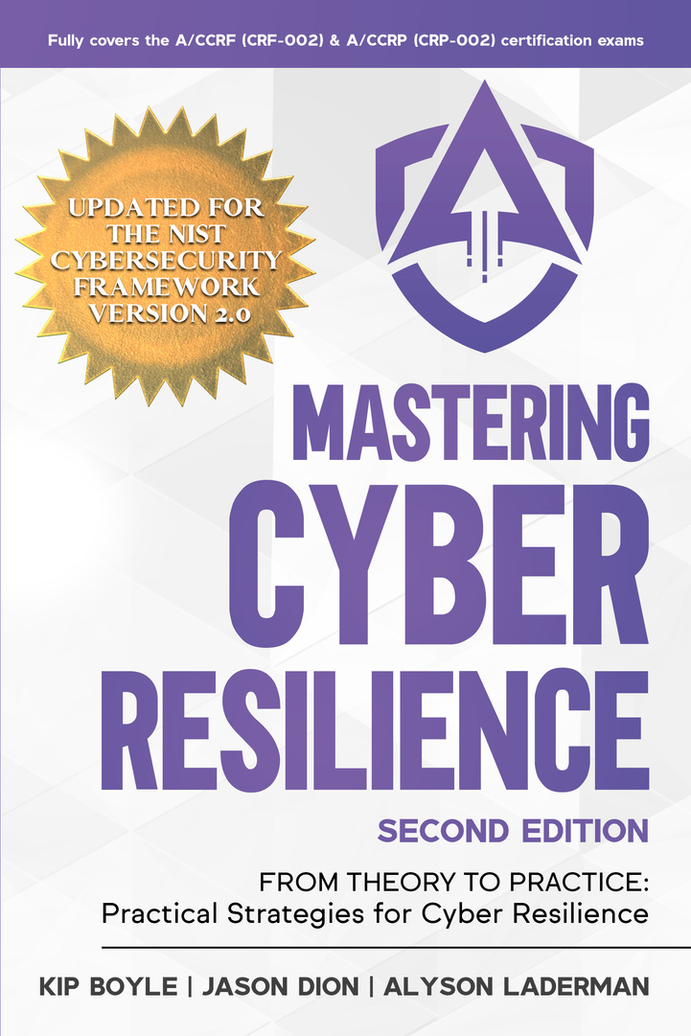
Conclusion
akylade.com
Notes:
1. Review the definition of Cyber Resilience
2. Recommend adopting the NIST CSF as a practical tool to achieve cyber resilience
3. Recommend resources (textbook and certifications)
4. Provide contact info if they need assistance

Slide 27

Questions?
akylade.com
Contact Us:
jason@akylade.com
alyson@akylade.com

