Slide 1
Please respect the Word of God as it is being taught by shutting off all cell phones and electronics, giving your undivided attention while service is in session.
Thank you! SLBM

Slide 2
Salt and Light Bible Ministries
‘A Daily Cross with Thee’ # 034 –
Understanding the Divine Love Complex –
The Impersonal Divine Love of God depends on Who and What HE is!
Pastor Jason Kauranen
Sunday October 5, 2025

Slide 3
Rebound - 1John 1:9 states,
“ If we confess our sins,
He is faithful and righteous to forgive us our sins and to cleanse us from all unrighteousness”.

Slide 4
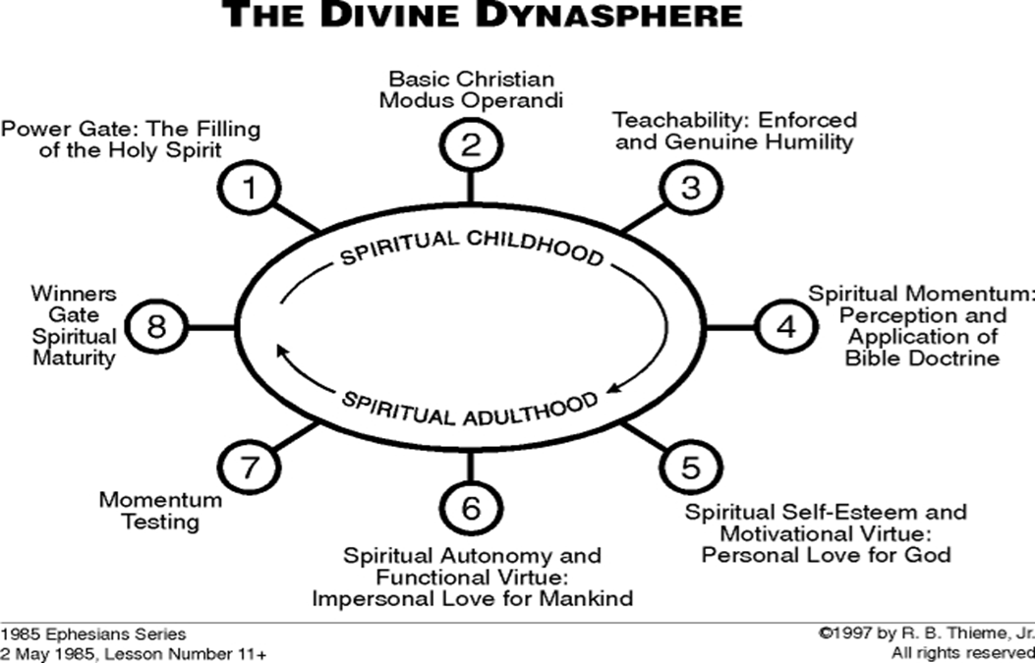

Slide 5
The 3 Categories in the Divine
Love of God
1. Divine Personal love, Eph 1:5,
Eph 2:4,7,10.
2. Divine Impersonal love, Jo 3:16, 1Jo 4:7-12, 15-21.
3. Divine self-esteem, that comes from His essence.

Slide 6
Divine self-esteem is the pattern for spiritual self-esteem of the positive believer who is advancing to spiritual maturity.

Slide 7
Phi 3:16 however, let us keep living by that same standard to which we have attained.

Slide 8
Phi 3:17 Brethren, join in following my example, and observe those who walk according to the pattern you have in us.

Slide 9
Phi 3:18 For many walk, of whom I often told you, and now tell you even weeping, that they are enemies of the cross of Christ,

Slide 10
Mat 16:24 Then Jesus said to His disciples, “If anyone wishes to come after Me, he must deny himself, and take up his cross and follow Me.

Slide 11
Mat 16:25 For whoever wishes to save his life will lose it; but whoever loses his life for My sake will find it.

Slide 12
Mat 16:26 For what will it profit a man if he gains the whole world and forfeits his soul? Or what will a man give in exchange for his soul?

Slide 13
Deu 4:23 So watch yourselves, that you do not forget the covenant of the LORD your God which
He made with you, and make for yourselves a graven image in the form of anything against which the LORD your God has commanded you.

Slide 14
Deu 8:11“Beware that you do not forget the LORD your God by not keeping His commandments and His ordinances and
His statutes which I am commanding you today;

Slide 15
Deu 8:19 It shall come about if you ever forget the LORD your God and go after other gods and serve them and worship them,
I testify against you today that you will surely perish.

Slide 16
Phi 3:20 For our citizenship is in heaven, from which also we eagerly wait for a Savior, the Lord Jesus Christ;

Slide 17
Phi 3:21 who will transform the body of our humble state into conformity with the body of His glory, by the exertion of the power that He has even to subject all things to Himself.

Slide 18
Proverbs 23:7 For as he
(a man) thinks within himself, so he is.

Slide 19
Rom 5:5 … and hope does not disappoint, because the love of God has been poured out within our hearts through the Holy Spirit who was given to us.

Slide 20
Rom 15:12 Again Isaiah says,
“THERE SHALL COME
THE ROOT OF JESSE,
AND HE WHO ARISES TO RULE OVER THE GENTILES,
IN HIM SHALL THE GENTILES HOPE.”

Slide 21
Rom 15:13 Now may the God of hope fill you with all joy and peace in believing, so that you will abound in hope by the power of the Holy Spirit.

Slide 22
Tit 2:13 looking for the blessed hope and the appearing of the glory of our great God and Savior, Christ Jesus,

Slide 23
Heb 3:6 but Christ was faithful as a Son over His house--whose house we are, if we hold fast our confidence and the boast of our hope firm until the end.

Slide 24
We are to walk in the Light, as He Himself is the Light, continuing in what Jesus Christ has purchased and established for us, taking advantage of the provisions from the Father, through His marvelous unselfish acts of love and grace.

Slide 25
The 3 Categories in the Divine Love of God
1. Divine Personal love, Eph 1:5, 2:4,7,10.
2. Divine Impersonal love,
John 3:16, 1Jo 4:7-12,15-21.
3. Divine self-esteem, that comes from His essence.

Slide 26
Agapē = a self-giving divine love which emanates from God and is to be reflected in believers; an impersonal love that is concern for others rather than self and should govern over the practices of all spiritual gifts within the believer, as the Apostle Paul taught.

Slide 27
Jam 2:8 If, however, you are fulfilling the royal law according to the Scripture, “YOU SHALL LOVE YOUR NEIGHBOR AS YOURSELF,” you are doing well.

Slide 28
Mat 22:37 And He said to him, “ ‘YOU SHALL LOVE THE LORD YOUR GOD WITH ALL YOUR HEART, AND WITH ALL YOUR SOUL, AND WITH ALL YOUR MIND.’
Mat 22:38 This is the great and foremost commandment.

Slide 29
Mat 22:39 The second is like it, ‘YOU SHALL LOVE YOUR NEIGHBOR AS YOURSELF.’
Mat 22:40 On these two commandments, depend the whole Law and the Prophets.”

Slide 30
Gal 3:22 But the Scripture has shut up everyone under sin, so that the promise by faith in Jesus Christ might be given to those who believe.

Slide 31
Gal 3:23 But before faith came, we were kept in custody under the law, being shut up to the faith which was later to be revealed.

Slide 32
Gal 3:24 Therefore the Law has become our tutor to lead us to Christ, so that we may be justified by faith.

Slide 33
Gal 5:13 For you were called to freedom, brethren; only do not turn your freedom into an opportunity for the flesh, but through love serve one another.

Slide 34
Gal 5:14 For the whole Law is fulfilled in one word, in the statement, “YOU SHALL LOVE YOUR NEIGHBOR AS YOURSELF.”

Slide 35
Divine impersonal love of God always emphasizes the virtue of the subject and places all the merit on the subject, that being a Holy and Righteous God.

Slide 36
John 3:16 “For God so loved the world, that He gave His only begotten Son, that whoever believes in Him shall not perish, but have eternal life.

Slide 37
Isa 64:6 For all of us have become like one who is unclean,
And all our righteous deeds are like a filthy garment;

Slide 38
Rom 3:25 whom God displayed publicly as a propitiation in His blood through faith.
This was to demonstrate His righteousness, because in the forbearance of God He passed over the sins previously committed;

Slide 39
John 6:46 Not that anyone has seen the Father, except the One who is from God;
He has seen the Father.

Slide 40
John 14:9 Jesus said to him, “Have I been so long with you, and yet you have not come to know Me, Philip?
He who has seen Me has seen the Father; how can you say, ‘Show us the Father’?

Slide 41
John 14:10 Do you not believe that I am in the Father, and the Father is in Me? The words that I say to you I do not speak on My own initiative, but the Father abiding in Me does His works.

Slide 42
John 14:11 Believe Me that I am in the Father and the Father is in Me; otherwise believe because of the works themselves.

Slide 43
With Christ as our example, Divine impersonal love becomes the pattern for impersonal love in believers.

Slide 44
Jesus’ command - Mat 5:44 But I say to you, love your enemies and pray for those who persecute you,
Jesus’ actions - Luke 23:34 ‘Father forgive them; for they know not what they are doing’.

Slide 45
John 3:3 Jesus answered and said to him, “Truly, truly, I say to you, unless one is born again, he cannot see the kingdom of God.”

Slide 46
Rom 5:8 But God demonstrates His own love toward us, in that while we were yet sinners, Christ died for us.

Slide 47
Rom 5:9 Much more then, having now been justified by His blood, we shall be saved from the wrath of God through Him.

Slide 48
2 Co 5:21 He (God the Father) made Him (Jesus) who knew no sin to be sin on our behalf, so that we might become the righteousness of God in Him (Jesus Christ).

Slide 49


Slide 50
Salt & Light Bible Ministries
Help, Letters, Prayer & Donations write to us: SLBM@gmail.org visit our website: SLBM.org -*paypal watch us youtube @SaltandLightBibleMinistries or mail: Salt and Light Bible Ministries c/o Pastor Jason Kauranen
2 Dianne Drive
East Wareham, Mass 02538

