Slide 1
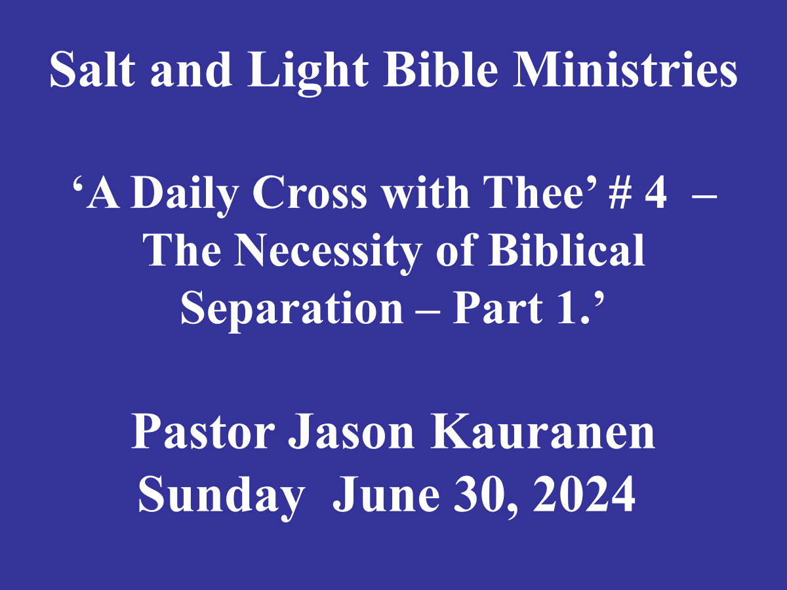

Slide 2
1JO 1:6 If we say that we have fellowship with Him and yet walk in the darkness, we lie and do not practice the truth;

Slide 3
1JO 4:1 Beloved, do not believe every spirit, but test the spirits to see whether they are from God, because many false prophets have gone out into the world.

Slide 4
1JO 4:3 and every spirit that does not confess Jesus is not from God; this is the spirit of the antichrist, of which you have heard that it is coming, and now it is already in the world.

Slide 5
1JO 4:6 We are from God; he who knows God listens to us; he who is not from God does not listen to us. By this we know the spirit of truth and the spirit of error.

Slide 6
2Th 2:11 For this reason
God will send upon them a deluding influence so that they will believe what is false,

Slide 7
Jam 1:22 But prove yourselves doers of the word, and not merely hearers who delude themselves.

Slide 8
Biblical Separation is described as:
A biblical principle for removing oneself from people or ideas that hinder your advancement in the Plan of God.
- RB Thieme dictionary

Slide 9

EPH 5:7 Therefore do not be partakers with them;
EPH 5:8 for you were formerly darkness, but now you are
Light in the Lord; walk as children of Light

Slide 10
EPH 5:11 Do not participate in the unfruitful deeds of darkness, but instead even expose them;

Slide 11
2CO 6:14 Do not be bound together with unbelievers; for what partnership have righteousness and lawlessness, or what fellowship has light with darkness?

Slide 12
2Co 6:17 “Therefore, COME OUT FROM THEIR MIDST AND
BE SEPARATE,” says the Lord.
“AND DO NOT TOUCH WHAT IS UNCLEAN;
And I will welcome you.

Slide 13
2Co 7:1 Therefore, having these promises, beloved, let us cleanse ourselves from all defilement of flesh and spirit, perfecting holiness in the fear of God.

Slide 14
2Ti 3:5 holding to a form of godliness, although they have denied its power;
Avoid such men as these.

Slide 15
1. God was the originator of Separation, as the
Light from the darkness,
Gen 1:4.

Slide 16
Gen 1:4 And God saw the light, that it was good: and God divided (H914, H996) the light from the darkness. KJV

Slide 17
bâdal – (H914 baw-dal’)
A primitive root; to divide
(in various senses literally or figuratively, separate, distinguish, differ, select) = to make or put a difference, divide (asunder), make self-separation, sever (out)

Slide 18
bêyn – (H996 bane).
Sometimes in the plural masculine or feminine; properly the constructively contracted form of an otherwise unused noun from H995; a distinction; but used only as a preposition = between

Slide 19
bı̂yn – (H995 Bene)
A primitive root; to separate mentally (or distinguish), that is, (generally) understand: - diligently, discern, inform, instruct, perceive, and be prudent.

Slide 20
Heb 4:12 For the word of God is living and active and sharper than any two-edged sword, and piercing as far as the division of soul and spirit, of both joints and marrow, and able to judge the thoughts and intentions of the heart.

Slide 21
The Triune God, all 3 members of the God Head, made a prudent decision to mentally discern and make a specific distinction of making a self-separation from Satan and Himself.

Slide 22
Satan’s accusation against God shows that his thoughts were a misinterpretation of doctrine and a direct attack of God’s very Essence, God’s nature.

Slide 23
Isa 14:13 “But you said in your heart,
‘I will ascend to heaven;
I will raise my throne above the stars of God,
And I will sit on the mount of assembly In the recesses of the north.

Slide 24
Unbelievers and Apostates, who are outside of the proven character of God, have and will reject the Truth setting up alternative sets of belief, ie : other gods or idols.

Slide 25
Psa 16:8 I have set the LORD continually before me;
Because He is at my right hand, I will not be shaken.

Slide 26
Psa 55:22 Cast your burden upon the LORD and
He will sustain you;
He will never allow the righteous to be shaken.

Slide 27
Psa 62:6 He only is my rock and my salvation,
My stronghold;
I shall not be shaken.

Slide 28
2. God separated man from the garden or presence of God at the fall of mankind,
Gen 3:22-24.

Slide 29
Gen 3:22 Then the LORD God said,
“Behold, the man has become like one of Us, knowing good and evil; and now, he might stretch out his hand, and take also from the tree of life, and eat, and live forever”—

Slide 30
Gen 3:23 therefore the LORD God sent him out from the garden of Eden, to cultivate the ground from which he was taken.

Slide 31
Gen 3:24 So He drove the man out; and at the east of the garden of Eden He stationed the cherubim and the flaming sword which turned every direction to guard the way to the Tree of Life.

Slide 32
Principle - The doctrinal error of listening to and believing false doctrine, has its consequences of being Separated from God.

Slide 33
Misery loves company!
Satan lies and manipulates to accomplish the goal of = Deception.
Satan’s own arrogance has deceived himself.

Slide 34
Mat 7:13 “Enter by the narrow gate; for the gate is wide and the way is broad that leads to destruction, and many are those who enter by it.

Slide 35
Rev 20:12 And I saw the dead, the great and the small, standing before the throne, and books were opened; and another book was opened, which is the book of life; and the dead were judged from the things which were written in the books, according to their deeds.

Slide 36
The Believer’s receipts are excepted by God the Father, (propitiation) as seen through the righteous acts of our Savior, who paid the debt on the cross, Rom 3:25, Heb 2:17, 1Jo 2:2, 4:10… with the result of wiping out sin and iniquity,
Heb 8:12, Jer31:34, Psa 103:12.

Slide 37
Heb 8:12 “For I will be merciful to their iniquities, and I will remember their sin no more.”
PSA 103:12 As far as the east from the west, So far has He removed our transgressions from us.

Slide 38
homologeo – (3670 hom-ol-og-eh) to agree with God by confession or acknowledgment of sin.

Slide 39
F.B. Meyer - Our one aim should be to maintain such a walk with God that the union with God may be unimpaired.
But thanks be to God, because if there are still sins of ignorance, the blood of Jesus will continue to remove them.

Slide 40
3. God separated ‘a people for
His own possession’;
The Abrahamic Covenant –
Israel from other nations and Believers from unbelievers,
Gen 17:1-6, Deu 7:1-6, 1 Pe 2:4-10.

Slide 41
Gen 17:7 I will establish My covenant between Me and you and your descendants after you throughout their generations for an everlasting covenant, to be God to you and to your descendants after you.

Slide 42
We, as Believing Gentiles, are grafted into the Royal Family of God under the Mystery doctrine of the Church-age, Rom 11:17.

Slide 43
F.F Bruce - These promises were made to Abram, being yet uncircumcised, when he was yet a Gentile, proving that they were irrespective of any mere Hebrew interpretation. But the rite was the sign and seal of the national covenant with the Jewish race.

Slide 44
Circumcision was the way Jews could identify or pledge the belief in God which He made a sign of the covenant, Gen 17:11,
“And you shall be circumcised in the flesh of your foreskin, and it shall be the sign of the covenant between Me and you.”

Slide 45
Spiritual circumcision or baptism stands for the separation of the believer from unbeliever; the spiritual significance is made to be permanent in the
‘new creature’, Col 2:11-12.

Slide 46
Deu 7:6 For you are a holy people to the LORD your God; the LORD your God has chosen you to be a people for His own possession out of all the peoples who are on the face of the earth.

Slide 47
1PE 2:9 But you are A CHOSEN RACE, A royal PRIESTHOOD,
A HOLY NATION, A PEOPLE FOR God’s OWN POSSESSION, so that you may proclaim the excellencies of Him who has called you out of darkness into His marvelous light;

Slide 48
1PE 2:10 for you once were
NOT A PEOPLE, but now you are
THE PEOPLE OF GOD; you had NOT RECEIVED MERCY, but now you have RECEIVED MERCY.

Slide 49
The fellowship that God longs to have with us, and continue in forever, has everything to do with Believing in and executing the PMA of bible doctrine.
Union with God and Separation from the apostate world!

