Slide 1
Please respect the Word of God as it is being taught by shutting off all cell phones and electronics, giving your undivided attention while service is in session. Thank you! SLBM

Slide 2
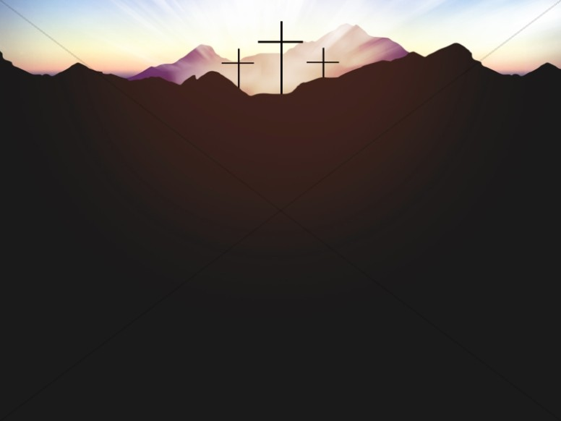
Salt and Light Bible Ministries Resurrection Sunday 2026 Jesus Christ is Alive … Raised Through the Power of His Resurrection. ~ Pastor Jason Kauranen ~ Sunday April 5, 2026

Slide 3
Rebound - 1John 1:9 states, “ If we confess our sins, He is faithful and righteous (just) to forgive us our sins and to cleanse us from all unrighteousness”.

Slide 4
‘ He is not here, Jesus who has been crucified,’ ‘ He has risen just as He said He would,’ ‘ The living is not among the dead…’ ‘ He has risen, go tell His disciples…’

Slide 5
Mat 20:18 “Behold, we are going up to Jerusalem; and the Son of Man will be delivered to the chief priests and scribes, and they will condemn Him to death,

Slide 6
Mat 20:19 and will hand Him over to the Gentiles to mock and scourge and crucify Him, and on the third day He will be raised up.”

Slide 7
Luke 9:22 (Jesus) saying, “The Son of Man must suffer many things and be rejected by the elders and chief priests and scribes, and be killed and be raised up on the third day.”

Slide 8
John 2:19 Jesus answered them, “Destroy this temple, and in three days I will raise it up.” John 2:21But He was speaking of the temple of His body.

Slide 9
John 14:19 “After a little while the world will no longer see Me, but you will see Me; because I live, you will live also”.

Slide 10
John 11:25 Jesus said to her, “I am the resurrection and the life; he who believes in Me will live even if he dies, John 11:26 and everyone who lives and believes in Me will never die. Do you believe this?”

Slide 11
Resuscitation is often associated with healing or returning life to what it was, whereas Resurrection implies a complete transformation and a new beginning.

Slide 12
John 11:42 I knew that You always hear Me; but because of the people standing around I said it, so that they may believe that You sent Me.”

Slide 13
Mat 27:52 The tombs were opened, and many bodies of the saints who had fallen asleep were raised; Mat 27:53 and coming out of the tombs after His resurrection they entered the holy city and appeared to many.

Slide 14
1Co 15:45 So also it is written, “The first man, Adam, became a living soul.” The last Adam (Jesus Christ) became a life-giving spirit.

Slide 15
Rom 8:2 For the law of the Spirit of life in Christ Jesus has set you free from the law of sin and of death.

Slide 16
John 5:21 For just as the Father raises the dead and gives them life, even so the Son also gives life to whom He wishes.

Slide 17
The Resurrection Power that Jesus Christ first displayed rising from the tomb, was so He could be the first-fruits of many royal family members, 1Co 15:20,23; Rom 8:23,29, 11:16; Phi 3:20-21 Jam 1:18…etc

Slide 18
Rom 8:11 But if the Spirit of Him who raised Jesus from the dead dwells in you, He who raised Christ Jesus from the dead will also give life to your mortal bodies through His Spirit who dwells in you.

Slide 19
Phi 3:10 that I may know Him and the power of His resurrection and the fellowship of His sufferings, being conformed to His death;

Slide 20
Eph 1:19 and what is the surpassing greatness of His power toward us who believe. These are in accordance with the working of the strength of His might

Slide 21
Eph 1:20 which He brought about in Christ, when He raised Him from the dead and seated Him at His right hand in the heavenly places,

Slide 22
1Co 15:13-20 But if there is no resurrection of the dead, not even Christ has been raised; … you are still in your sin … your faith is worthless … therfore perishing, we are to be pitied.

Slide 23
Rom 4:25 says, Jesus was delivered up for our trespasses and raised for our justification.

Slide 24
Isa 26:19 Your dead will live; Their corpses will rise. You who lie in the dust, awake and shout for joy, For your dew is as the dew of the dawn, And the earth will give birth to the departed spirits.

Slide 25
Dan 12:2 Many of those who sleep in the dust of the ground will awake, these to everlasting life, but the others to disgrace and everlasting contempt.

Slide 26
Dan 12:3 Those who have insight will shine brightly like the brightness of the expanse of heaven, and those who lead the many to righteousness, like the stars forever and ever.

Slide 27
Hos 13:14 Shall I ransom them from the power of Sheol? Shall I redeem them from death? O Death, where are your thorns? O Sheol, where is your sting?

Slide 28
C.S. Lewis – “…Christ’s achievement in rising from the dead was the first event of its kind in the whole history of the universe. He is the first fruits, the pioneer of life. He has forced open a door that has been locked since the death of the first man. He has met, fought, and beaten the king of death. Everything is different because He has done so. This is the beginning of the new creation. A new chapter in cosmic history has begun.”

Slide 29
For the Believer - The same power that raised Jesus from the dead is available today to bring dead aspects of our lives back to life. Phi 4:13 “I can do all things through Christ (Him) who strengthens me.”

Slide 30
1Pe 5:10 After you have suffered for a little while, the God of all grace, who called you to His eternal glory in Christ, will Himself perfect, confirm, strengthen and establish you.

Slide 31
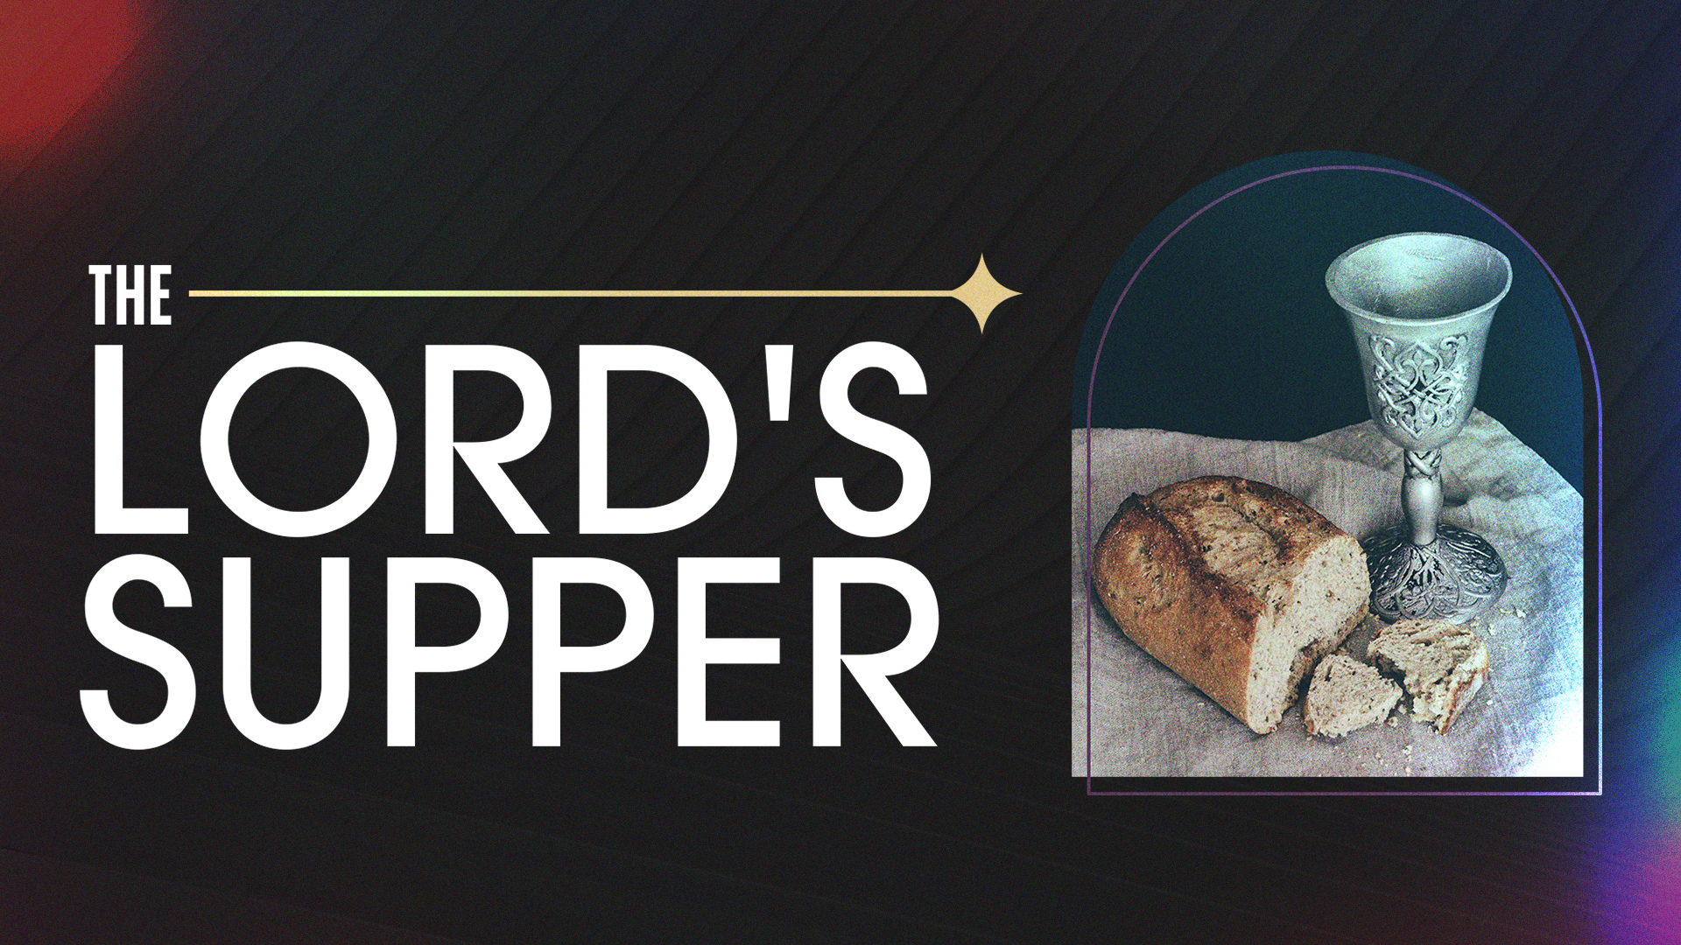

Slide 32
Salt & Light Bible Ministries Help, Letters, Prayer & Donations write to us: SLBM@gmail.org visit our website: SLBM.org -*paypal watch us youtube @SaltandLightBibleMinistries or mail: Salt and Light Bible Ministries c/o Pastor Jason Kauranen 2 Dianne Drive East Wareham, Mass 02538

Slide 33
Salt and Light Bible Ministries Resurrection Sunday 2026 Jesus Christ is Alive … Raised Through the Power of His Resurrection. Pastor Jason Kauranen Sunday April 5, 2026

