Slide 1
Salt and Light Bible Ministries
‘A Daily Cross with Thee’ # 17 – The Necessity of Biblical Separation – Part 14
Pastor Jason Kauranen
Sunday February 9, 2025

Slide 2
Separation from friends and family members may be required, if the intake of bible doctrine is being compromised.
This is a matter of correct priorities and proper relationships as measured to God’s standards.

Slide 3
Mat 10:34 “Do not think that
I came to bring peace on the earth; I did not come to bring peace, but a sword.

Slide 4
God always gives ample opportunity (grace) to all of us, before the consequences of our actions become clear to the intentions of our own heart (motivated thoughts).

Slide 5
Heb 4:12 For the word of God is living and active and sharper than any two-edged sword, and piercing as far as the division of soul and spirit, of both joints and marrow, and able to judge the thoughts and intentions of the heart.

Slide 6
Psalm 12:6 The words of the Lord are pure words, like silver refined in a furnace on the ground, purified seven times.

Slide 7
Psalm 33:4 For the word of the Lord is upright, and all His work is done in faithfulness.

Slide 8
Acts 4:36 Now Joseph, a Levite of Cyprian birth, who was also called Barnabas by the apostles
(which translated means
Son of Encouragement),
Acts 4:37 and who owned a tract of land, sold it and brought the money and laid it at the apostles’ feet.

Slide 9
In the early times of the formation of the Church, numerous false prophets and false teachers were very much present among them; active in misinformation, and deceptive with every form of evil which needed to be rooted out.

Slide 10
Acts 11:19 So then those who were scattered because of the persecution that occurred in connection with Stephen made their way to Phoenicia and Cyprus and Antioch, speaking the word to no one except to Jews alone.

Slide 11
Acts 11:20 But there were some of them, men of Cyprus and Cyrene, who came to Antioch and began speaking to the Greeks also, preaching the Lord Jesus.

Slide 12
Acts 11:21 And the hand of the Lord was with them, and a large number who believed turned to the Lord.

Slide 13
Acts 11:24 for he was a good man, and full of the Holy Spirit and of faith. And considerable numbers were brought to the Lord.
Acts 11:25 And he left for Tarsus to look for Saul;

Slide 14
‘to look’ - anazēteō
( G327 an-ad-zay-teh'-o)
From ana (G303 an-ah') – severally, repetition, intensity and zēteō (G2212 dzay-teh'-o) – endeavor, enquire for,
= to search or seek out that which is hidden
= to make a diligent search.

Slide 15
Acts 11:26 and when he(Barnabas) had found him(Saul), he brought him to Antioch. And for an entire year they met with the church and taught considerable numbers; and the disciples were first called Christians in Antioch.

Slide 16
The naming the disciples and followers of Jesus as ‘Christians’ gave title to:
1. One who was ‘Of the party of Christ’ or ‘Christ (Jesus) people or ones’;
2. Devoted disciples of Christ that would be worthy of His name.

Slide 17
‘ian’ – All soldiers under particular generals in the Roman army identified themselves by their general’s name by adding ‘ian’ to the end.
Ie: Caesarian or likewise as soldiers for Christ you would be called ‘Christians’

Slide 18
Proverbs 27:17
Iron sharpens iron, So one man sharpens another.

Slide 19
Acts 12:12 And when he (Peter) realized this, he went to the house of Mary, the mother of John who was also called Mark, where many were gathered together and were praying.

Slide 20
Acts 12:24 But the word of the Lord continued to grow and to be multiplied.
Acts 12:25 And Barnabas and Saul returned from Jerusalem when they had fulfilled their mission, taking along with them John, who was also called Mark.

Slide 21
COL 4:10 Aristarchus, my fellow prisoner, sends you his greetings; and also Barnabas’s cousin Mark (about whom you received instructions; if he comes to you, welcome him);

Slide 22
Acts 13:46 Paul and Barnabas spoke out boldly and said,
“It was necessary that the word of God be spoken to you first; since you repudiate it and judge yourselves unworthy of eternal life, behold, we are turning to the Gentiles.

Slide 23
Acts 13:47 For so the Lord has commanded us,
‘I HAVE PLACED YOU AS A LIGHT FOR THE GENTILES,
THAT YOU MAY BRING SALVATION TO THE END OF THE EARTH.’”

Slide 24
Isa 42:6 “I am the LORD, I have called You in righteousness,
I will also hold You by the hand and watch over You,
And I will appoint You as a covenant to the people,
As a light to the nations,

Slide 25
Isa 49:6 He says, “It is too small a thing that You should be My Servant
To raise up the tribes of Jacob and to restore the preserved ones of Israel;
I will also make You a light of the nations
So that My salvation may reach to the end of the earth.”

Slide 26
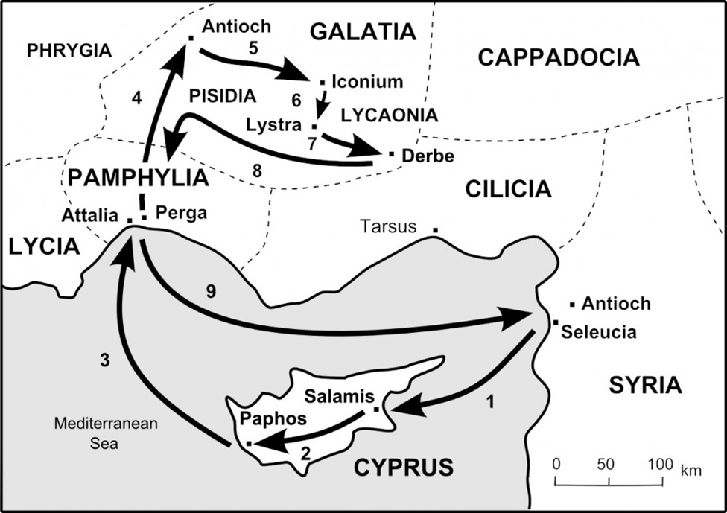

Slide 27
Acts 15:35 But Paul and Barnabas stayed in Antioch, teaching and preaching with many others also, the word of the Lord.

Slide 28
Acts 15:36 After some days Paul said to Barnabas, “Let us return and visit the brethren in every city in which we proclaimed the word of the Lord, and see how they are.”

Slide 29
Acts 15:39 And there occurred such a sharp disagreement that they separated from one another, and Barnabas took Mark with him and sailed away to Cyprus.

Slide 30
Acts 15:40 But Paul chose Silas and left, being committed by the brethren to the grace of the Lord.

Slide 31
Acts 15:41 And he (Paul) was traveling through Syria and Cilicia, strengthening the churches.

Slide 32
The Apostle Paul latter in his letters, mentions both Barnabas and JohnMark positively and that reconciliation had taken place, 1Co 9:6, 2Ti 4:11.

Slide 33
1Co 9:6 Or do only Barnabas and I not have a right to refrain from working?

Slide 34
2Ti 4:11 Only Luke is with me. Pick up Mark and bring him with you, for he is useful to me for service.

Slide 35
The process of separating correctly, will allow the believer, the ability of reconciliation for future changes that only God knows, so we must separate God’s way; especially when the separation is necessary from Royal family members.

Slide 36
Salt & Light Bible Ministries
Help, Letters, & Donations visit us: SLBM@gmail.org *paypal or mail to: Salt and Light Bible Ministries
2 Dianne Drive
East Wareham, Mass 02538

Slide 38
Salt & Light Bible Ministries - Financial Report 12/29/24
MAY 2024 – DEC 16, 2024
TOTAL DEPOSITS: $10,172.00
TOTAL WITHDRAWALS: - $957.35
BALANCE 12/29/24: $9,214.65

