Slide 1
Please respect the Word of God as it is being taught by shutting off all cell phones and electronics, giving your undivided attention while service is in session. Thank you! SLBM

Slide 2
Salt and Light Bible Ministries ‘A Daily Cross with Thee’ # 066 The Analogies of the Shadows; God’s Grace Is A Gain, Of The Fifth - Part 18. Pastor Jason Kauranen Sunday May 17, 2026

Slide 3
Rebound - 1John 1:9 states, “ If we confess our sins, He is faithful and righteous to forgive us our sins and to cleanse us from all unrighteousness”.

Slide 4
Heb 12:15 See to it that no one comes short of the grace of God; that no root of bitterness springing up causes trouble, and by it many be defiled;

Slide 5
2Co 9:8 And God is able to make all grace abound to you, so that always having all sufficiency in everything, you may have an abundance for every good deed;

Slide 6
2Co 9:9 as it is written, “He scattered abroad, he gave to the poor, His righteousness endures forever.” (Psa 112:9)

Slide 7
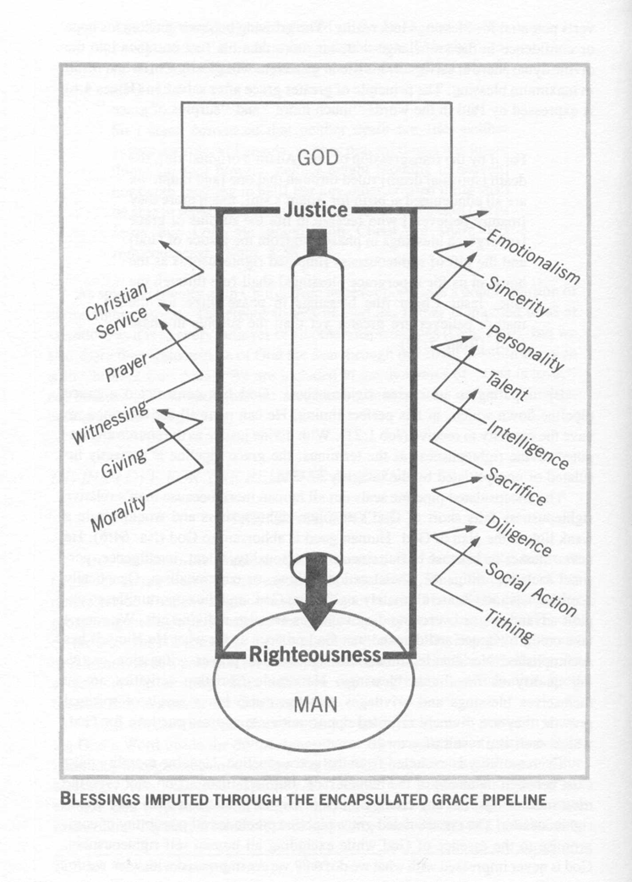
‘Grace pipeline’ – illustration by RB Thieme

Slide 8
Due to the righteousness and justice of God being met by works of Jesus Christ on the cross, the barrier of sin which separated God and man is fully removed. **In this way ANY BELIEVER can now ‘make restitution’ through rebound.

Slide 9
Lev 5:14 Then the Lord spoke to Moses, saying, *Remember dabar and amar, divine truth or doctrine is given for the purpose of the communication of doctrine.

Slide 10
Lev 5:15 “If a person commits a trespass (acts unfaithful) and sins unintentionally against the Lord’s holy things, then he shall bring his guilt offering to the Lord: a ram without defect from the flock, according to your valuation in silver by shekels, in terms of the shekel of the sanctuary, for a guilt offering.

Slide 11
‘Commits a trespass’ – ṯim·‘ōl ma·‘al – (H4603+H4604 teem - owl mah-al) = an unfaithful or treacherous act; = to cover up or commit a violation.

Slide 12
‘holy things’ – quodesh – (H6944 ko'-desh) = a sacred place or thing; dedicated or consecrated, sanctuary = holiness or a holy day. *This is seen as directly against God holiness.

Slide 13
Exo 30:12 “When you take a census of the sons of Israel to number them, then each one of them shall give a ransom for himself to the Lord, when you number them, so that there will be no plague among them when you number them.

Slide 14
Exo 30:15 The rich shall not pay more and the poor shall not pay less than the half shekel, when you give the contribution to the Lord to make atonement for yourselves.

Slide 15
1Pe 1:18 knowing that you were not redeemed with perishable things like silver or gold from your futile way of life inherited from your forefathers,

Slide 16
Redemption 1Pe 1:19 but with precious blood, as of a lamb unblemished and spotless, the blood of Christ.

Slide 17
Lev 5:15b … a ram without defect from the flock, according to your valuation in silver by shekels, in terms of the shekel of the sanctuary, for a guilt offering.

Slide 18
Shekel of sanctuary = 20 gerah, 20 x 11.25 grains barley = 225 grains, Lev 27:25. Lev 27:25 Every valuation of yours, moreover, shall be after the shekel of the sanctuary. The shekel shall be twenty gerahs.

Slide 19
Lev 5:16 He shall make restitution for that which he has sinned against the holy thing, and shall add to it a fifth part of it and give it to the priest. The priest shall then make atonement for him with the ram of the guilt offering, and it will be forgiven him.

Slide 20
1. Man gains by grace; as a believer who is wronged allows God to handle the situation rather than react in human power (vengeance, vindictive attitudes, etc…), Rom 12:19-20.

Slide 21
Rom 12:19 Never take your own revenge, beloved, but leave room for the wrath of God, for it is written, “Vengeance is Mine, I will repay,” says the Lord.

Slide 22
Rom 12:20 “But if your enemy is hungry, feed him, and if he is thirsty, give him a drink; for in so doing you will heap burning coals on his head.”

Slide 23
2. Man gains more by salvation than he lost in the original fall (Adam’s original sin), Heb 1:14.

Slide 24
Heb 1:3 And He is the radiance of His glory and the exact representation of His nature, and upholds all things by the word of His power. When He had made purification of sins, He sat down at the right hand of the Majesty on high,

Slide 25
Heb 1:4 having become as much better than the angels, as He has inherited a more excellent name than they.

Slide 26
Heb 1:14 Are they not all ministering spirits, sent out to render service for the sake of those who will inherit salvation?

Slide 27
Heb 2:9 But we do see Him who was made for a little while lower than the angels, namely, Jesus, because of the suffering of death crowned with glory and honor, so that by the grace of God He might taste death for everyone.

Slide 28
1Co 6:3 Do you not know that we will judge angels? How much more matters of this life?

Slide 29
3. Man gains more grace by the cross, Rom 8:32, to be free from the barrier of sin, justified and sanctified, Rom 6.

Slide 30
Rom 8:32 He [God the Father] who did not spare His own Son, but delivered Him [Jesus] over for us all, how will He not also with Him freely give us all things?

Slide 31
‘freely give’ – charizomai – (G5483 khar-ID-zom-ahee) = to grant as a favor; as in kindness to a pardon or rescue = freely forgive or deliver, willingly bestow upon where a debt is referred to.

Slide 32
True Christianity, faith alone in Jesus Christ alone, is the grace-based nature of God's gifts – Forgiveness of sin, His Righteousness granting us Salvation unto Eternal Life with God.

Slide 33
4. Man gains more through the rebound technique, not just obeying a command ritual performance, Rom 8:33-37.

Slide 34
Rom 8:34 who is the one who condemns? Christ Jesus is He who died, yes, rather who was raised, who is at the right hand of God, who also intercedes for us.

Slide 35
Rom 8:35 Who will separate us from the love of Christ? Will tribulation, or distress, or persecution, or famine, or nakedness, or peril, or sword?

Slide 36
Rom 8:37 But in all these things we overwhelmingly conquer through Him who loved us.

Slide 37
Psa 103:8 The Lord is compassionate and gracious, Slow to anger and abounding in lovingkindness.

Slide 38
Psa 103:11 For as high as the heavens are above the earth, So great is His lovingkindness toward those who fear Him.

Slide 39
“it will be forgiven”, which is in the passive voice noted by the Niphal stem of the Hebrew verb, Calach – (H5545 saw-lakh’) = to forgive, pardon, spare.

Slide 40
Jam 4:6 But He gives a greater grace. Therefore it says, “God is opposed to the proud, but gives grace to the humble.” (Psa 138:6, Pro 3:34)

Slide 42
Salt & Light Bible Ministries Help, Letters, Prayer & Donations write to us: SLBM@gmail.org visit our website: SLBM.org -*paypal watch us youtube @SaltandLightBibleMinistries or mail: Salt and Light Bible Ministries c/o Pastor Jason Kauranen 2 Dianne Drive East Wareham, Mass 02538

