Slide 1
Please respect the Word of God as it is being taught by shutting off all cell phones and electronics, giving your undivided attention while service is in session.
Thank you! SLBM

Slide 2
Salt and Light Bible Ministries
‘A Daily Cross with Thee’ # 033 –
Understanding the Divine Love Complex –
Self-esteem: The building of spiritual integrity prepares the believer for testing.
Pastor Jason Kauranen
Sunday Sept 28, 2025

Slide 3
Rebound - 1John 1:9 states,
“ If we confess our sins,
He is faithful and righteous to forgive us our sins and to cleanse us from all unrighteousness”.

Slide 4
Salt and Light Bible Ministries
‘A Daily Cross with Thee’ # 033 –
Understanding the Divine Love Complex –
Self-esteem: The building of spiritual integrity prepares the believer for testing.
Pastor Jason Kauranen
Sunday Sept 28, 2025

Slide 5
John 4:24 “God is spirit, and those who worship Him must worship in spirit and truth.”

Slide 6
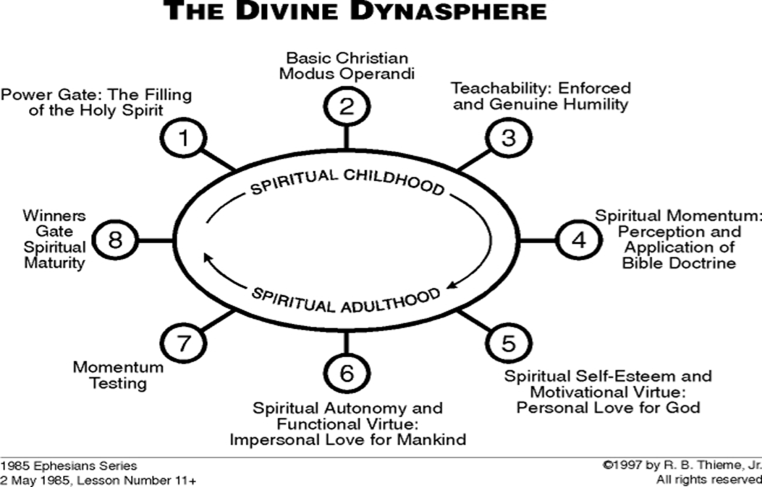

Slide 7
The 3 Categories in the Divine
Love of God
1. Divine Personal love, Eph 1:5,
Eph 2:4,7,10.
2. Divine Impersonal love, Jo 3:16, 1Jo 4:7-12, 15-21.
3. Divine self-esteem, that comes from His essence.

Slide 8
1Jo 1:7 but if we walk in the Light as He Himself is in the Light, we have fellowship with one another, and the blood of Jesus His Son cleanses us from all sin.

Slide 9
“With people or man, the ability to save or deliver is impossible, But WITH GOD ALL THINGS (including salvation)
ARE POSSIBLE.”
Mat 19:26; Mark 10:27;
Luke 18:27.

Slide 10
Walk – peripateó
(G4043 per-ee-pat-eh’-o)
= to tread all around; walk at large or deport oneself.
= to walk in a complete circuit; going full circle.

Slide 11
Phi 3:1 Finally, my brethren, rejoice in the Lord. To write the same things again is no trouble to me, and it is a safeguard for you.

Slide 12
Phi 3:7 But whatever things were gain to me, those things
I have counted as loss for the sake of Christ.

Slide 13
‘count-ed’[esteem] – hégeomai (G2233 hayg-eh'-om-ahee)
= to lead or rule, having command over.
= to be a guide, an expert in something
= to think or take into account, to consider.

Slide 14
‘Loss’ – zémia - (G2209 dzay-mee'-ah)
= damage or detriment
*The term functions in the Koine Greek to express material damage, financial loss, or personal disadvantage.

Slide 15
Phi 3:12 Not that I have already obtained it (the power of His resurrection) or have already become perfect, but I press on so that I may lay hold of that for which also I was laid hold of by Christ Jesus.

Slide 16
Phi 3:17 Brethren, join in following my example, and observe those who walk according to the pattern you have in us.

Slide 17
Gal 2:14 But when I saw that they were not straightforward about the truth of the gospel, I said to Cephas in the presence of all,
“If you, being a Jew, live like the Gentiles and not like the Jews, how is it that you compel the Gentiles to live like Jews?

Slide 18
Eph 4:20 But you did not learn Christ in this way,
Eph 4:21 if indeed you have heard Him and have been taught in Him, just as truth is in Jesus,

Slide 19
Gal 2:21 I have been crucified with Christ; and it is no longer
I who live, but Christ lives in me; and the life which I now live in the flesh I live by faith in the Son of God, who loved me and gave Himself up for me.

Slide 20
Phi 3:18 For many walk, of whom I often told you, and now tell you even weeping, that they are enemies of the cross of Christ,

Slide 21
We walk in newness of life … and according to the Spirit; Rom 6:4, 8:4, Gal 5:16
We walk by faith; 2Co 5:7.
We walk in wisdom; Col 4:5.

Slide 22
We walk in a manner worthy of our calling in Christ; Eph 4:1, 1Co1:10, 1Th 2:12, etc…
We walk in the Light; 1Jo 1:7, Eph 5:8.

Slide 23
We walk in God’s love;
Eph 5:2, 2Jo 1:6.
We walk in truth; 2Jo 1:4,
3Jo 1:3-4.
We walk in the Lord Jesus Christ; Col 2:6.

Slide 24
Virtue is cultivated through the accumulation of thousands of small, good decisions and actions over time, PVTD, throughout your Christan walk.

Slide 25
The Mind of Christ and the renewal of your thinking,
Rom 12:2, 2Co 4:16, Eph 4:23, Col 3:10-11, Tit 3:5, etc …

Slide 26
Pro 11:1 A false balance is an abomination to the LORD,
But a just weight is His delight.

Slide 27
Pro 11:2 When pride comes, then comes dishonor,
But with the humble is wisdom.
Pro 11:3 The integrity of the upright will guide them,
But the crookedness of the treacherous will destroy them.

Slide 28
Integrity = involves inward commitment to truth (BD) and righteousness (OAC), resulting in consistent, upright behavior that builds trust and serves as a testimony to your faith in Christ.

Slide 29
Psa 10:5 His ways prosper at all times; Your judgments are on high, out of his sight…
Psa 18:30 As for God, His way is blameless; The word of the LORD is tried; He is a shield to all who take refuge in Him.

Slide 30
Psa 25:9 He leads the humble in justice, And He teaches the humble His way.
Psa 37:23 The steps of a man are established by the LORD, And He delights in his way.

Slide 31
Psa 103:7 He made known His ways to Moses, His acts to the sons of Israel.
Psa 119:9 Beth. How can a young man keep his way pure?
By keeping it according to
Your word.

Slide 32
Psa 128:1 How blessed is everyone who fears the LORD,
Who walks in His ways.
Psa 145:17 The LORD is righteous in all His ways
And kind in all His deeds.

Slide 33
Rom 11:33 Oh, the depth of the riches both of the wisdom and knowledge of God!
How unsearchable are
His judgments and unfathomable
His ways!

Slide 34
Worldly Pride vs. Biblical Self-Esteem
Foundation: Accomplishments, possessions, and appearance vs. God's creation and unconditional love.
Focus: Self-promotion, personal interests vs. Serving God and others.
Attitude: Self-importance and boastfulness vs. Modesty and self-forgetfulness.
Motivation: Seeking external validation vs. Living out your God-given purpose.
Outcome/Result: Shame and destruction vs. Honor and exaltation by God.

Slide 35
2Co 4:17 For momentary, light affliction is producing for us an eternal weight of glory far beyond all comparison,

Slide 36
Amos 5:10 They hate him who reproves in the gate, And they abhor him who speaks with integrity.

Slide 37
John 3:16 “For God so loved the world, that He gave
His only begotten Son, that whoever believes in Him shall not perish, but have eternal life.

Slide 39


Slide 41
Salt & Light Bible Ministries
Help, Letters, Prayer & Donations write to us: SLBM@gmail.org visit our website: SLBM.org -*paypal watch us youtube @SaltandLightBibleMinistries or mail: Salt and Light Bible Ministries c/o Pastor Jason Kauranen
2 Dianne Drive
East Wareham, Mass 02538

