Slide 1
Salt and Light Bible Ministries
‘A Daily Cross with Thee’ # 030 –
Understanding the Divine Love Complex – The Necessity of Learning Humility, Submission in Spiritual Development of Self-Esteem.
Pastor Jason Kauranen
Sunday Sept 7, 2025

Slide 2
The 3 Categories in the Divine
Love of God
1. Divine Personal love, Eph 1:5,
Eph 2:4,7,10.
2. Divine Impersonal love, Jo 3:16, 1Jo 4:7-12, 15-21.
3. Divine self-esteem, that comes from His essence.

Slide 3
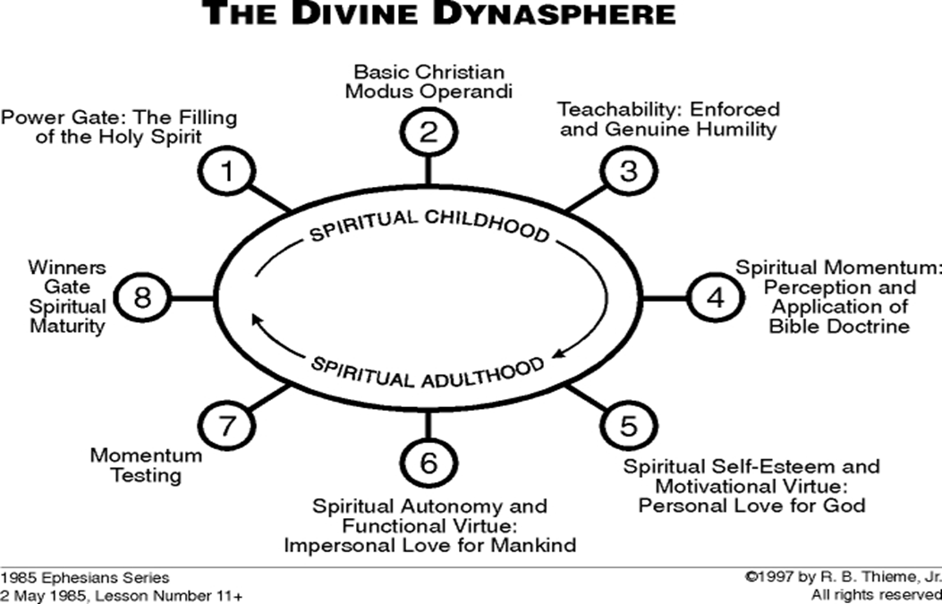

Slide 4
Heb 10:5 Therefore, when He comes into the world, He says,
“SACRIFICE AND OFFERING YOU HAVE NOT DESIRED,
BUT A BODY YOU HAVE PREPARED FOR ME;

Slide 5
Heb 2:9 But we do see Him who was made for a little while lower than the angels, namely, Jesus, because of the suffering of death crowned with glory and honor, so that by the grace of God He might taste death for everyone.

Slide 6
Heb 2:14 Therefore, since the children share in flesh and blood, He Himself likewise also partook of the same, that through death
He might render powerless him who had the power of death, that is, the devil,

Slide 7
Heb 2:15 and might free those who through fear of death were subject to slavery all their lives.

Slide 9
The 4 Divine Institutions allow for a balance of freedom and authority which is important for all human beings to achieve happiness, develop virtue, and allow prosperity.

Slide 10
Luke 2:40 The Child continued to grow and become strong, increasing in wisdom; and the grace of God was upon Him.

Slide 11
Luke 2:46 Then, after three days they found Him in the temple, sitting in the midst of the teachers, both listening to them and asking them questions.
Luke 2:47 And all who heard Him were amazed at His understanding and His answers.

Slide 12
Luke 2:49 And He said to them, “Why is it that you were looking for Me?
Did you not know that I had to be in My Father’s house?”

Slide 13
Luke 2:51 And He went down with them and came to Nazareth, and He continued in subjection to them; and His mother treasured all these things in her heart.

Slide 14
Luke 2:52 And Jesus kept increasing in wisdom and stature, and in favor with God and men.

Slide 15
Teachability = the capacity to listen, to learn, and to respond to authority without feeling threatened or inferior.

Slide 16
As believers following the Christian way of life, there are
2 types of humility we need to be concerned with:
Enforced Humility and
Genuine Humility.

Slide 17
Psa 25:8 Good and upright is the LORD;
Therefore He instructs sinners in the way.
Psa 25:9 He leads the humble in justice,
And He teaches the humble His way.

Slide 18
1. Enforced Humility – Being under a stable system of order and discipline administered from a source of legitimate authority,
Eph 6:1-3; Col 3:20.

Slide 19
Col 3:20 Children, be obedient to your parents in all things, for this is well-pleasing to the Lord.

Slide 20
Eph 6:1 Children, obey your parents in the Lord, for this is right.

Slide 21
Children are submitted, by an enforced system within the home, (consequence of discipline to keep in-line) which the child can learn humility and acquire virtue.

Slide 22
2. Genuine Humility – consist of a relax mental attitude in which a person becomes self-driven and responsive from the volition of their own soul, Jam 4:10.

Slide 23
Genuine humility is the main characteristic for having happiness and biblical blessing as a mandate from God.

Slide 24
Jam 4:10 Humble yourselves in the presence of the Lord, and He will exalt you.

Slide 25
Zeph 3:12 “But I will leave among you A humble and lowly people, And they will take refuge in the name of the LORD.

Slide 26
Mic 6:8 He has told you,
O man, what is good;
And what does the LORD require of you
But to do justice, to love kindness, And to walk humbly with your God?

Slide 27
Prov 11:2 When pride comes, then comes dishonor, But with the humble is wisdom.
Prov 29:23 A man’s pride will bring him low, But a humble spirit will obtain honor.

Slide 28
Phi 2:5 Have this attitude in yourselves which was also in Christ Jesus,

Slide 29
Phi 2:3 Do nothing from selfishness or empty conceit, but with humility of mind regard one another as more important than yourselves;

Slide 30
Phi 2:7 but emptied Himself, taking the form of a bond-servant, and being made in the likeness of men.

Slide 31
Phi 2:8 Being found in appearance as a man,
He humbled Himself by becoming obedient to the point of death, even death on a cross.

Slide 32
Phi 2:12 So then, my beloved, just as you have always obeyed, not as in my presence only, but now much more in my absence, work out your salvation with fear and trembling;

Slide 33
Phi 2:13 for it is God who is at work in you, both to will and to work for His good pleasure.

Slide 34
Jesus Christ’s life showed us the way to have a successful Spiritual life, of advancing to Super-Grace maturity, with the use of super-natural mechanics incorporating His Divine love, He did this in His humanity, without a sin nature, but with the same power available to us.

Slide 35
Heb 4:14 Therefore, since we have a great high priest who has passed through the heavens, Jesus the Son of God, let us hold fast our confession.

Slide 36
Heb 4:15 For we do not have a high priest who cannot sympathize with our weaknesses, but One who has been tempted in all things as we are, yet without sin.

Slide 37
Heb 2:18 For since He Himself was tempted in that which He has suffered, He is able to come to the aid of those who are tempted.
Deliverance and Redemption

Slide 38
Salt & Light Bible Ministries
Help, Letters, & Donations visit us: SLBM.org *paypal write to us: SLBM@gmail.org watch youtube @SaltandLightBibleMinistries or mail: Salt and Light Bible Ministries c/o Pastor Jason Kauranen
2 Dianne Drive
East Wareham, Mass 02538

