Slide 1
Please respect the Word of God as it is being taught by shutting off all cell phones and electronics, giving your undivided attention while service is in session. Thank you! SLBM

Slide 2
Rebound - 1John 1:9 states, “ If we confess our sins, He is faithful and righteous to forgive us our sins and to cleanse us from all unrighteousness”.

Slide 3
Salt and Light Bible Ministries ‘A Daily Cross with Thee’ # 048 Willful apostasy , Faith in the Work of Jesus Christ – Death or Life, We Have a Free-will Choice. Pastor Jason Kauranen Sunday February 1, 2026

Slide 4
Heb 10:1 For the Law, since it has only a shadow of the good things to come and not the very form of things, can never, by the same sacrifices which they offer continually year by year, make perfect those who draw near.

Slide 5
Heb 10:26 For if we go on sinning willfully after receiving the knowledge of the truth, there no longer remains a sacrifice for sins,

Slide 6
Heb 10:29 How much severer punishment do you think he will deserve who has trampled underfoot the Son of God, and has regarded as unclean the blood of the covenant by which he was sanctified, and has insulted the Spirit of grace?

Slide 7
1Co 11:27 Therefore whoever eats the bread or drinks the cup of the Lord in an unworthy manner, shall be guilty of the body and the blood of the Lord.

Slide 8
‘Willful sinning’ (apostasy) - A blatant disregard for GOD and a rejection of Jesus Christ as the true Messiah!

Slide 9
‘trample under foot’ – katapateó – (G2662 kat-ap-at-eh’-o) = to trample down, underfoot = (fig.) to reject with disdain = to spurn, treat with rudeness and insulting neglect. = to count as worthless, flagrant contempt.

Slide 10
Believers are called to remain savory and salty by preserving and sowing the knowledge of truth wisely, protecting what is sacred, as established by God.

Slide 11
‘Have insulted’ – enubrizó (G1796 en-oo-brid'-zo) = to treat shamefully, to outrage = insult by showing arrogance a deliberate, high-handed affront that goes beyond ordinary opposition and rises to insolent contempt.

Slide 12
Pro 12:23 A prudent man conceals knowledge, But the heart of fools proclaims folly. Pro 15:21 Folly is joy to him who lacks sense, But a man of understanding walks straight.

Slide 13
Actions of attacks made by willful sinners. 1. Blasphemy against the Holy Spirit, Mat 12:31-32. 2. High-handed sin under the law, Num 15:30-31.

Slide 14
3. Despising the covenant, Deu 29:19-21. 4. Falling away and impossibility of renewal, Heb 6:4-6. 5.Profaning holy things, Eze 22:26.

Slide 15
Mat 12:31 “Therefore I say to you, any sin and blasphemy shall be forgiven people, but blasphemy against the Spirit shall not be forgiven.

Slide 16
Mat 12:32 Whoever speaks a word against the Son of Man, it shall be forgiven him; but whoever speaks against the Holy Spirit, it shall not be forgiven him, either in this age or in the age to come.

Slide 17
Pro 26:11 Like a dog that returns to its vomit Is a fool who repeats his folly. They are the Hebrews, readers of this letter, that go back to the Law, Old covenant and sacrificial systems (Judaism), because they do not have faith in what God has shown them. Ritual without the reality!

Slide 18
Eze 22:26 Her priests have done violence to My law and have profaned My holy things; they have made no distinction between the holy and the profane, and they have not taught the difference between the unclean and the clean; and they hide their eyes from My sabbaths, and I am profaned among them.

Slide 19
Heb 10:38 But My righteous one shall live by faith; And if he shrinks back, My soul has no pleasure in him.

Slide 20
Hab 2:4 “Behold, as for the proud one, His soul is not right within him; But the righteous will live by his faith.

Slide 21
“Pride is a strange creature; it never objects to its lodgings. It will live comfortably enough in a palace, and it will live equally at its ease in a hovel. Is there any man in whose heart pride does not lurk?” – C. Spurgeon

Slide 22
In Heb 10:38, ‘Shrinking back’ in fear is the sign of an unbeliever, where ‘living by faith’ is that of positive believer.

Slide 23
‘shrinking back’ – hupostelló – (G5288 hoop-os-tel'-lo) ‘under’/’draw in’ = To conceal or withhold, cower or shrink; = shun or withdraw from declaring. = pulling back to retreat, to be timid.

Slide 24
Heb 10:39 But we are not of those who shrink back to destruction, but of those who have faith to the preserving of the soul.

Slide 25
‘destruction’- apóleia – (G648 ah-PO-lee-ah) From G622 apóllymi = “cut off ” = damnation, perdition, destruction = waste, ruin or loss

Slide 26
John 13:10 Jesus said to him, “He who has bathed needs only to wash his feet, but is completely clean; and you are clean, but not all of you.”

Slide 27
John 13:11 For He knew the one who was betraying Him; for this reason He said, “Not all of you are clean.”

Slide 28
John 17:11 I am no longer in the world; and yet they themselves are in the world, and I come to You. Holy Father, keep them in Your name, the name which You have given Me, that they may be one even as We are.

Slide 29
John 17:12 While I was with them, I was keeping them in Your name which You have given Me; and I guarded them and not one of them perished but the son of perdition, so that the Scripture would be fulfilled.

Slide 30
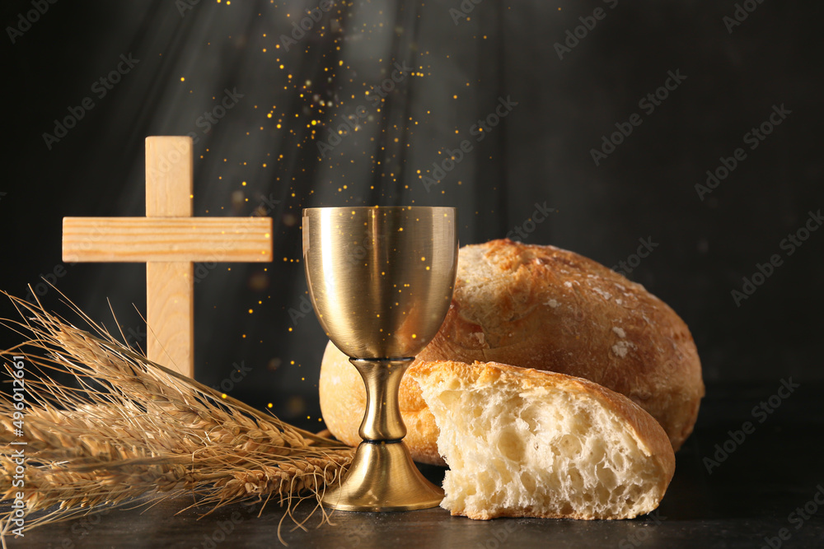
The Lord’s Supper

Slide 31
Salt & Light Bible Ministries Help, Letters, Prayer & Donations write to us: SLBM@gmail.org visit our website: SLBM.org -*paypal watch us youtube @SaltandLightBibleMinistries or mail: Salt and Light Bible Ministries c/o Pastor Jason Kauranen 2 Dianne Drive East Wareham, Mass 02538

