Slide 1
Please respect the Word of God as it is being taught by shutting off all cell phones and electronics; giving Your undivided attention while service is in session.
Thank you! SLBM

Slide 2
Salt and Light Bible Ministries
‘A Daily Cross with Thee’ # 032 –
Understanding the Divine Love Complex –
Humility is built, resulting in self-esteem as part your thought pattern.
Pastor Jason Kauranen
Sunday Sept 21, 2025

Slide 3
Rebound - 1John 1:9 states,
“ If we confess our sins,
He is faithful and righteous to forgive us our sins and to cleanse us from all unrighteousness”.

Slide 4
Salt and Light Bible Ministries
‘A Daily Cross with Thee’ # 032 –
Understanding the Divine Love Complex –
Humility is built, resulting in self-esteem as part your thought pattern.
Pastor Jason Kauranen
Sunday Sept 21, 2025

Slide 5
The Word of God is alive and powerful, sharper than any two-edged sword, piercing even to the dividing asunder of the joint and the marrow, and is a critic of thoughts and intents of the heart …
(Heb 4:12)

Slide 6
All Scripture is God-breathe, and is profitable for doctrine, for reproof, for correction, for instruction in righteousness; that the man (or woman) of God might be mature, thoroughly furnished unto all good works,
(1Ti 3:16-17)

Slide 7
Therefore, Study to show thyself approved unto God, a workman that needed not be ashamed, rightly dividing the word of truth.
(2Ti 2:15)

Slide 8
Evil knows no bounds, but God’s love and righteousness will always reign forever.

Slide 9
Mat 5:44 But I say to you, love your enemies and pray for those who persecute you,
Royal Family Honor Code – God’s divine love that goes beyond understanding.

Slide 10
"A martyrdom is always the design of God ... the true martyr is he who has become the instrument of God, who has lost his own will in the will of God, and who no longer desires anything for himself, not even the glory of being a martyr" – T.S. Elliot

Slide 11
As believers following the Christian way of life, there are
2 types of humility we need to be concerned with:
Enforced Humility and
Genuine Humility.

Slide 12
1. Enforced Humility – Being under a stable system of order and discipline administered from a source of legitimate authority,
Eph 6:1-3; Col 3:20.

Slide 13
2. Genuine Humility – consist of a relax mental attitude in which a person becomes self-driven and responsive from the volition of their own soul, Jam 4:10.

Slide 14
Phi 2:3 Do nothing from selfishness or empty conceit, but with humility of mind regard one another as more important than yourselves;

Slide 15
Phi 2:5 Have this attitude in yourselves which was also in Christ Jesus,

Slide 16
Phi 2:7 but emptied Himself, taking the form of a bond-servant, and being made in the likeness of men.

Slide 17
Phi 2:8 Being found in appearance as a man,
He humbled Himself by becoming obedient to the point of death, even death on a cross.

Slide 18
Phi 2:12 So then, my beloved, just as you have always obeyed, not as in my presence only, but now much more in my absence, work out your salvation with fear and trembling;

Slide 19
Phi 2:13 for it is God who is at work in you, both to will and to work for His good pleasure.

Slide 20
Jesus Christ’s life showed us the way to have a successful Spiritual life, of advancing to Super-Grace maturity, with the use of super-natural mechanics incorporating His Divine love, He did this in His humanity, without a sin nature, but with the same power available to us.

Slide 21
Phi 1:6 For I am confident of this very thing, that He who began a good work in you will perfect it until the day of Christ Jesus.

Slide 22
2Pe 3:9 The Lord is not slow about His promise, as some count slowness, but is patient toward you, not wishing for any to perish but for all to come to repentance.

Slide 23
Mat 10:29 Are not two sparrows sold for a cent? And yet not one of them will fall to the ground apart from your Father.
Mat 10:30 But the very hairs of your head are all numbered.
Mat 10:31 So do not fear; you are more valuable than many sparrows.

Slide 24
Zec 2:8 For thus says the LORD of hosts, … for he who touches you, touches the apple of His eye.

Slide 25
Heb 10:23 Let us hold fast the confession of our hope without wavering, for He who promised is faithful;
Heb 10:24 and let us consider how to stimulate one another to love and good deeds,

Slide 26
Heb10:25 not forsaking our own assembling together, as is the habit of some, but encouraging one another; and all the more as you see the day drawing near.

Slide 27
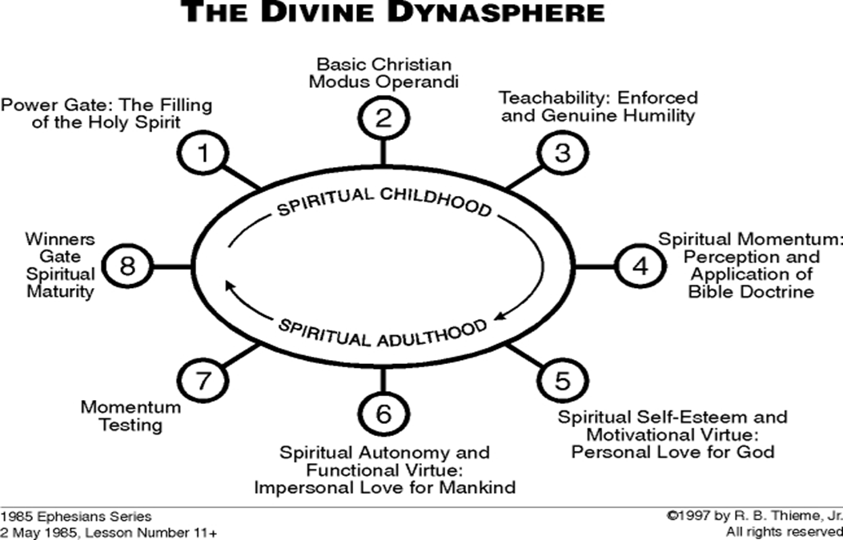

Slide 28
If Jesus Christ was rejected by the majority, so will you be rejected by most of the people you encounter daily, because of Him.
Are you ready for that?? … more persecution??

Slide 29
John 1:10 He was in the world, and the world was made through Him, and the world did not know Him.

Slide 30
John 15:18 “If the world hates you, you know that it has hated ME before it hated you.
1John 3:13 Do not be surprised, brethren, if the world hates you.

Slide 31
2Ti 3:12 Indeed, all who desire to live godly in Christ Jesus will be persecuted.

Slide 32
Mat 10:38 And he who does not take his cross and follow after Me is not worthy of Me.
Mat 10:39 He who has found his life will lose it, and he who has lost his life for My sake will find it.

Slide 34
The 3 Categories in the Divine
Love of God
1. Divine Personal love, Eph 1:5,
Eph 2:4,7,10.
2. Divine Impersonal love, Jo 3:16, 1Jo 4:7-12, 15-21.
3. Divine self-esteem, that comes from His essence.

Slide 35
1Jo 1:7 but if we walk in the Light as He Himself is in the Light, we have fellowship with one another, and the blood of Jesus His Son cleanses us from all sin.

Slide 36
Walk – peripateó
(G4043 per-ee-pat-eh’-o)
= to tread all around; walk at large or deport oneself.
= to walk in a complete circuit; going full circle.

Slide 37
We walk in newness of life … and according to the Spirit; Rom 6:4, 8:4, Gal 5:16
We walk by faith; 2Co 5:7.
We walk in wisdom; Col 4:5.

Slide 38
We walk in a manner worthy of our calling in Christ; Eph 4:1, 1Co1:10, 1Th 2:12, etc…
We walk in the Light; 1Jo 1:7, Eph 5:8.

Slide 39
We walk in God’s love;
Eph 5:2, 2Jo 1:6.
We walk in truth; 2Jo 1:4,
3Jo 1:3-4.
We walk in the Lord Jesus Christ; Col 2:6.

Slide 40
Salt & Light Bible Ministries
Help, Letters, & Donations visit us: SLBM.org *paypal write to us: SLBM@gmail.org watch youtube @SaltandLightBibleMinistries or mail: Salt and Light Bible Ministries c/o Pastor Jason Kauranen
2 Dianne Drive
East Wareham, Mass 02538

