Slide 1
Please respect the Word of God as it is being taught by shutting off all cell phones and electronics, giving your undivided attention while service is in session.
Thank you! SLBM

Slide 2
Salt and Light Bible Ministries
‘A Daily Cross with Thee’ # 078
The Spiritual Truth of Bible Doctrine Sets US Free, Human Arrogance is Deception.
Pastor Jason Kauranen
Wednesday July 1, 2026

Slide 3
Rebound - 1John 1:9 states,
“ If we confess our sins,
He is faithful and righteous to forgive us our sins and to cleanse us from all unrighteousness”.

Slide 4
2Co 3:17 Now the Lord is the Spirit, and where the Spirit of the Lord is, there is liberty.
2Co 3:18 But we all, with unveiled face, beholding as in a mirror the glory of the Lord, are being transformed into the same image from glory to glory, just as from the Lord, the Spirit.

Slide 5
Authority without freedom is tyranny; freedom without authority is anarchy. Both tyranny and anarchy destroy human freedom.
Freedom cannot exist without authority.

Slide 6
Rom 13:1 Every person is to be in subjection to the governing authorities. For there is no authority except from God, and those which exist are established by God.

Slide 7
Rom 13:5 Therefore it is necessary to be in subjection, not only because of wrath, but also for conscience’ sake.

Slide 8
Rom 13:8 Owe nothing to anyone except to love one another; for he who loves his neighbor has fulfilled the law.
Rom 13:10 Love does no wrong to a neighbor; therefore love is the fulfillment of the law.

Slide 9
John 14:15 “If you love Me, you will keep My commandments.
---- Fine lines are drawn -----
Acts 5:29 But Peter and the apostles answered, “We must obey God rather than men.

Slide 10
From the meetings of the Second Continental Congress a
Declaration of Independence
- In Congress, July 4, 1776

Slide 11
‘We hold these truths to be self-evident, that all men are created equal, that they are endowed by their Creator with certain unalienable Rights, that among these are Life, Liberty and the pursuit of Happiness.’

Slide 12
… ‘Such has been the patient sufferance of these Colonies; and such is now the necessity which constrains them to alter their former Systems of Government.’

Slide 13
… ‘appealing to the Supreme Judge of the world for the rectitude of our intentions, do, in the Name, and by Authority of the good People of these Colonies, solemnly publish and declare, That these United Colonies are, and of Right ought to be Free and Independent States;’

Slide 14
… ‘And for the support of this Declaration, with a firm reliance on the protection of divine Providence, we mutually pledge to each other our Lives, our Fortunes and our sacred Honor.’

Slide 15
1. Volition - The cornerstone of freedom. God gave every human free will, and with it, personal accountability. In this sphere, the individual is responsible for their own choices and spiritual life.

Slide 16
2. Marriage – The stabilizer of human society. Instituted by God, it is designed as a union between one man and one woman, operating under the delegated authority of the husband.

Slide 17
3. Family – The basis for an orderly society and the primary unit for passing on morality, perpetuation of the human race. It operates under the delegated authority of the parents, whose responsibility is to train and care for their children.

Slide 18
4. Nationalism – The structure is designed to protect rights, privacy, and freedom. It functions under the authority of human government to maintain law and order, notably holding the authority to punish evildoers.
A client nation to God.

Slide 19
1Pe 2:13 Submit yourselves for the Lord’s sake to every human institution, whether to a king as the one in authority,

Slide 20
1Pe 2:16 Act as free men, and do not use your freedom as a covering for evil, but use it as bondslaves of God.
1Pe 2:17 Honor all people, love the brotherhood, fear God, honor the king.

Slide 21
Gen 1:27 God created man in His own image, in the image of God
He created him; male and female
He created them.
*prelude of DoI … “that all men are created equal, endowed by their Creator with certain unalienable rights.”

Slide 22
Exo 18:21Furthermore, you shall select out of all the people able men who fear God, men of truth, those who hate dishonest gain; and you shall place these over them as leaders of thousands, of hundreds, of fifties and of tens.
*The idea of electing leaders based on specific character traits—such as being capable, God-fearing, trustworthy, and incorruptible.

Slide 23
Pro 14:34 Righteousness exalts a nation,
But sin is a disgrace to any people.
*Used in many sermons to justify the separating from British rule and to uphold men of integrity to offices that would govern a new nation.

Slide 24
Isa 33:22 For the Lord is our judge, The Lord is our lawgiver, The Lord is our king; He will save us⁠ —
*this was the base of the development of the 3 levels of government for checks and balances
(no one man with ultimate rule)

Slide 25
Gal 5:1 It was for freedom that Christ set us free; therefore keep standing firm and do not be subject again to a yoke of slavery.
*This was publicized frequently cited in political pamphlets to justify resistance to British overreach…but also used to boast the people confidence to the cause or you could say Patriotism.

Slide 26
2Co 3:17 Now the Lord is the Spirit, and where the Spirit of the Lord is, there is liberty.
2Co 3:18 But we all, with unveiled face, beholding as in a mirror the glory of the Lord, are being transformed into the same image from glory to glory, just as from the Lord, the Spirit.

Slide 27
Gal 4:19 My children, with whom I am again in labor until Christ is formed in you⁠ —
James 1:25 But one who looks intently at the perfect law, the law of liberty, and abides by it, not having become a forgetful hearer but an effectual doer, this man will be blessed in what he does.

Slide 28
1. Self-Deception:
Arrogance distorts reality, blinding individuals to their own spiritual faults and causing them to overestimate their righteousness.
The ultimate deception of pride is believing one is superior and does not need God's grace.

Slide 29
2. Self-Justification:
Pride deludes people into covering up, rationalizing, or excusing their own sins while harshly judging others.

Slide 30
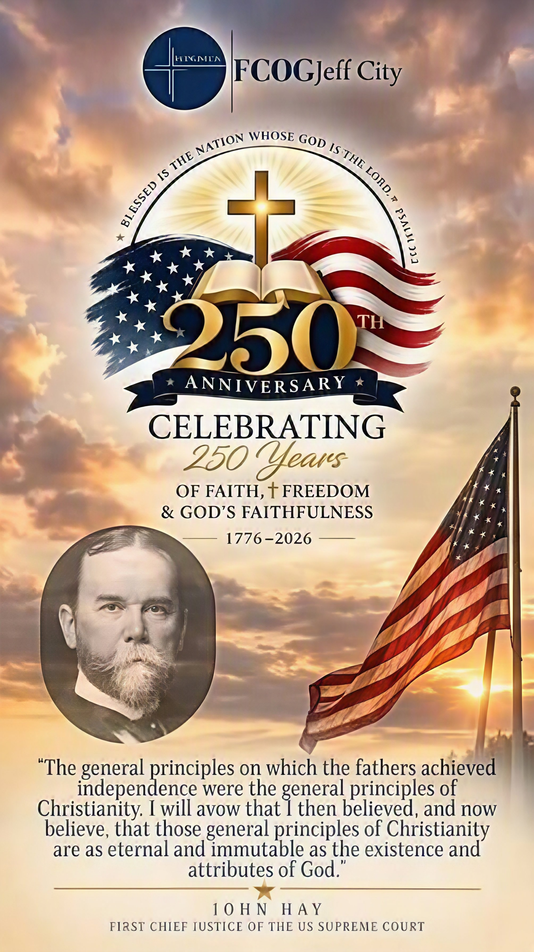

Slide 31
3. Self-Absorption:
The prideful individual becomes the center of their own universe, measuring their worth by comparing themselves to others instead of submitting to God.

Slide 32
Salt & Light Bible Ministries
Help, Letters, Prayer & Donations write to us: SLBM@gmail.org visit our website: SLBM.org -*paypal watch on YouTube @SaltandLightBibleMinistries or mail:
Salt and Light Bible Ministries c/o Pastor Jason Kauranen
2 Dianne Drive or 44A Troy Street
East Wareham, Ma 02538 Fall River, Ma 02720

