Slide 1
Salt and Light Bible Ministries
‘A Daily Cross with Thee’ # 7 – The Necessity of Biblical Separation – Part 4
Pastor Jason Kauranen
Sunday August 25, 2024

Slide 2
Fellowship = koinōnia (G2842 koy-nohn-ee'-ah From G2844) = partnership, participation, or intercourse, (to) communicate with, communion, fellowship.

Slide 3
The fellowship that God longs to have with us, and continue in forever, has everything to do with Believing in and executing the PMA of bible doctrine.
Union with God and Separation from the apostate world!

Slide 4
Mat 7:23 And then I will declare to them, ‘I never knew you; DEPART FROM ME, YOU WHO PRACTICE LAWLESSNESS.’

Slide 5
We must identify the error of false or opposing doctrine, only then can we be Separate unto God from the false cosmic system.

Slide 6
Ephesians 6:11, Put on the full armor of God, so that you will be able to stand firm against the schemes of the devil.

Slide 7
Spiritual soberness is required for utilizing the doctrine of Separation that enables the prevention and infiltration of error – Isa 52:11

Slide 8
Isa 52:11 Depart, depart, go out from there,
Touch nothing unclean;
Go out of the midst of her, purify yourselves,
You who carry the vessels of the LORD.

Slide 9
2 Ti 2:21 Therefore, if anyone cleanses himself from these things, he will be a vessel for honor, sanctified, useful to the Master, prepared for every good work.

Slide 10
Isa 32:11 Tremble, you women who are at ease;
Be troubled, you complacent daughters;
Strip, undress and put sackcloth on your waist,

Slide 11
A.W. Tozer –
Complacency is the deadly enemy of Spiritual Progress.
The content and idle soul is the stagnant soul.

Slide 12
Pro 1:32 “For the waywardness of the naive will kill them,
And the complacency of fools will destroy them.

Slide 13
Lev 10:10 and so as to make a distinction between the holy and the profane, and between the unclean and the clean,

Slide 14
1 Th 5:6 so then let us not sleep as others do, but let us be alert and sober.

Slide 15
2 Ti 4:5 But you, be sober in all things, endure hardship, do the work of an evangelist, fulfill your ministry.

Slide 16
1 Pe 4:7 The end of all things is near; therefore, be of sound judgment and sober spirit for the purpose of prayer.
1Pe 4:8 Above all, keep fervent in your love for one another, because love covers a multitude of sins.

Slide 17
1PE 5:8 Be of sober spirit, be on the alert. Your adversary, the devil, prowls around like a roaring lion, seeking someone to devour.

Slide 18
1. Separation is a technique of switching from personal love to impersonal love when dealing with friends, loved ones, or close relations in the cosmic system.

Slide 19

2. Separation involves the Believer to live by a standard of truth and permanent priorities by both: a) Establishing the correct priorities in life (ie: study or intake of BD # 1, effective prayer life # 2, etc…) b) Getting rid of the distractions that can affect your momentum in your daily walk, 1 Jo 2:15-17.

Slide 20
“Be ready for a bad name; be willing to be called a bigot; be prepared for the loss of friendships; be prepared for anything, so long as you can stand fast by Him who bought you with His precious blood.” (Spurgeon)

Slide 21
3. Separation has two connotations:
Separation “unto” and Separation “from”.

Slide 22
A. Separation “unto” - is the principle of perpetuation of momentum in the PPOG.

Slide 23
B. Separation ‘from’ –
Total avoidance which should be applied to both the Believer and Unbeliever in the cosmic system who seek to influence the Believer from leaving PPOG.

Slide 24
2Co 6:17 “Therefore,
COME OUT FROM THEIR MIDST AND BE SEPARATE,” says the Lord.
“AND DO NOT TOUCH WHAT IS UNCLEAN;
And I will welcome you.

Slide 25
Biblical Separation does not require Believers to have no contact with Apostate and Unbelievers, 1Co 5:9-11.

Slide 26
Do not expect godly behavior from ungodly people.
We should recognize that they are sinners, and we can see them as such, not approving of their sin.
Unconditional Love!

Slide 27
4. There are two Categories of Biblical Separation – a. Mental Separation. b.Physical Separation.

Slide 28
Positive Volition of bible doctrine = Divine thinking with the Mind of Christ that allow us to be ‘clean’ and maintain having fellowship with GOD.

Slide 29
Principle - No person or inanimate thing that is in or comes into your life is worth losing your intimate fellowship with God.
You Must Separate from them!

Slide 30
Deu 29:18 so that there will not be among you a man or woman, or family or tribe, whose heart turns away today from the LORD our God, to go and serve the gods of those nations; that there will not be among you a root bearing poisonous fruit and wormwood.

Slide 31
Poisonous fruit - ô'sh or rôsh (H7219 roshe) = a poisonous plant, probably the poppy (from its conspicuous head); generally poison (even of serpents)
= gall, bitter taste, poison, venom.

Slide 32
Wormwood - la‛ănâh = (H3939 lah-an-aw' ) From an unused root supposed to mean = to curse
(regarded as poisonous, and therefore accursed) - possibly from the hemlock plant.

Slide 33
Heb 12:14 Pursue peace with all men, and the sanctification without which no one will see the Lord.

Slide 34
Heb 12:15 See to it that no one comes short of the grace of God; that no root of bitterness springing up causes trouble, and by it many be defiled;

Slide 35
Lev 19:18 You shall not take vengeance, nor bear any grudge against the sons of your people, but you shall love your neighbor as yourself;
I am the LORD.

Slide 36
We can overcome the OSN to live a life ‘Separated unto God’ with the ministry of God the Holy Spirit, for that is the means of gaining and understanding impersonal love,
Rom 5:1-5; Gal 5:16-22.

Slide 37
Mat 10:34 “Do not think that I came to bring peace on the earth; I did not come to bring peace, but a sword.

Slide 38
Mat 10:38 And he who does not take his cross and follow after Me is not worthy of Me.

Slide 39
The Believer can understand love when God shows His impersonal love for David as a sinner, as David himself recorded in Psalms 32:1-2.

Slide 40
Psa 32:1 How blessed is he whose transgression is forgiven,
Whose sin is covered!
Psa 32:2 How blessed is the man to whom the LORD does not impute iniquity, And in whose spirit there is no deceit!

Slide 41
Impersonal love is a spiritual function of the royal family of God and cannot be duplicated by the unbeliever or the believer out of fellowship in the cosmic system.

Slide 42
Impersonal love allows the act of mental separation to occur, without involving emotions to interfere with Godly mandates.

Slide 43
1Sa 18:3 Then Jonathan made a covenant with David because he loved him as himself.

Slide 44
1Sa 18:4 Jonathan stripped himself of the robe that was on him and gave it to David, with his armor, including his sword and his bow and his belt.

Slide 45
The mental separation needed to occur was motivated by the personal love Jonathan had for God.

Slide 46
Both Jonathan and David were thoroughly submitted to the LORD, and His will.

Slide 47
1Sa 19:1 Now Saul told Jonathan his son and all his servants to put David to death. But Jonathan, Saul’s son, greatly delighted in David.

Slide 48
Exo 20:13 You shall not murder.
The Bible is clear, and Saul was now on record as saying that they should kill David as recorded in 1Sa 19:1.

Slide 49
Principle – We, believers, are never excused from sin because we obeyed an authority that told us to sin.

Slide 50
Jonathan is going to put impersonal love into action, to protect both David as God’s anointed and his father, King Saul from committing these acts against God.

Slide 51
The right thing takes action to Separate and not waiting to be voided from wrong situations or associations and alliances.
The Believer is to an active role in obedience to God.

Slide 52
1Sa 19:6 Saul listened to the voice of Jonathan, and
Saul vowed, “As the LORD lives, he shall not be put to death.”

Slide 53
Jonathan has such spiritual maturity that it allows him to use the impersonal love in a great way, biblical separation of the mentality.

Slide 54
1Sa 20:17 Jonathan made David vow again because of his love for him, because he loved him as he loved his own life.

Slide 55
The doctrine of impersonal love is described as “a royal law” for the royal family of God.
Basis for the Royal Family Honor Code, Gal 5:13-14; Jam 2:8.

Slide 56
Gal 5:13 For you were called to freedom, brethren; only do not turn your freedom into an opportunity for the flesh, but through love serve one another.

Slide 57
Gal 5:14 For the whole Law is fulfilled in one word, in the statement, “YOU SHALL LOVE YOUR NEIGHBOR AS YOURSELF.”

Slide 58
Jam 2:8 “If, however, you are fulfilling the royal law [You shall love your neighbor as you love yourself] on the basis of the Scripture, in this you are doing well.”

Slide 59
When the Believer reaches spiritual maturity, impersonal love allows us to not even react to anything that is done to you unjustly.
This is also a part of spiritual growth and learning when to separate properly.

Slide 60
Rom 13:8, “Owe nothing to anyone except to love one another; for when he loves the other, he has fulfilled the Law.”

Slide 61
Jonathan separated ‘unto’ the Lord and Separated ‘from’ the evil, yet still honored the authority God had established and place over him.

Slide 62
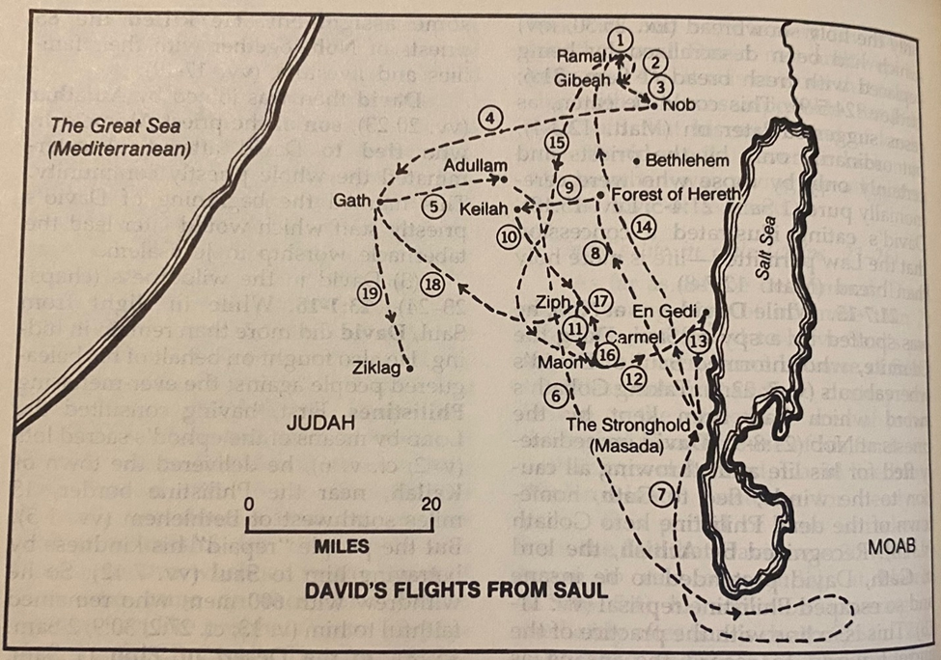

Slide 63
1Sa 23:14 David stayed in the wilderness in the Strongholds, and remained in the hill country in the wilderness of Ziph. And Saul sought him every day, but God did not deliver him into his hand.

