Slide 1
Please respect the Word of God as it is being taught by shutting off all cell phones and electronics, giving your undivided attention while service is in session.
Thank you! SLBM

Slide 2
Salt and Light Bible Ministries
‘A Daily Cross with Thee’ # 076
Illusions That Lead to Deception Keep Believers Away from True Doctrine.
Pastor Jason Kauranen
Wednesday June 24, 2026

Slide 3
Rebound - 1John 1:9 states,
“ If we confess our sins,
He is faithful and righteous to forgive us our sins and to cleanse us from all unrighteousness”.

Slide 4
1Jo 1:6 If we say that we have fellowship with Him and yet walk in the darkness, we lie and do not practice the truth;

Slide 5
1Jo 1:7 but if we walk in the Light as He Himself is in the Light, we have fellowship with one another, and the blood of Jesus His Son cleanses us from all sin.

Slide 6
1Jo 1:8 If we say that we have no sin, we are deceiving ourselves and the truth is not in us.

Slide 7
An illusion = a state or fact of being deceived, a misconception or false impression, in which the perception fails to give the true character of the object that is perceived.

Slide 8
Spiritual Self-deception
= the dangerous human tendency to justify sin, deny one's true spiritual condition, and believe one's own excuses
(self justification).

Slide 9
1. A Normal illusion is deceptive to the point of trivial unawareness to what is perceived, a trick of the senses.

Slide 10
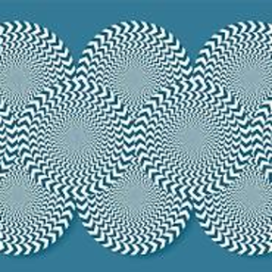

Slide 11
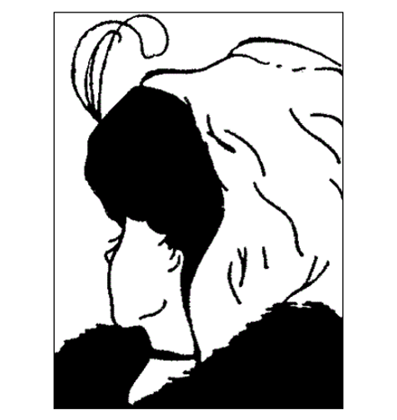
What do you see???

Slide 12
2. The Abnormal illusion is created in the mind to a series of thoughts containing false belief and ideologies, fragmented ideas to where the mind is trying to balance and protect itself from the false perception;

Slide 13
Evil, in the form of the depravity of man, will take any good invention or doctrine and turn it on its head to be used for personal gain or greed through a false system
(cosmic system thinking).

Slide 14
Mat 7:27 The rain fell, and the floods came, and the winds blew and slammed against that house; and it fell⁠ - and great was its fall.”

Slide 15
Mat 7:26 “Everyone who hears these words of Mine and does not act on them, will be like a foolish man who built his house on the sand.”

Slide 16
Reversionistic and apostate believers become deceived pawns and are called: enemies of the cross, enemies of God; contradicting the very thing they believe in, by defending and living in that illusion.
Phi 3:18-19; Jam 4:4; 1Jo2:18.

Slide 17
Phi 3:18 For many walk, of whom I often told you, and now tell you even weeping, that they are enemies of the cross of Christ,
Phi 3:19 whose end is destruction, whose god is their appetite, and whose glory is in their shame, who set their minds on earthly things.

Slide 18
Jam 4:4 You adulteresses, do you not know that friendship with the world is hostility toward God? Therefore whoever wishes to be a friend of the world makes himself an enemy of God.

Slide 19
Eph 4:11 And He gave some as apostles, and some as prophets, and some as evangelists, and some as pastors and teachers,
Eph 4:12 for the equipping of the saints for the work of service, to the building up of the body of Christ;

Slide 20
This Dominionism is:
A belief that Christians must take over the world before Christ will or can return. The church is God’s instrument to reclaim dominion over the earth that was lost to Satan.

Slide 21
Jam 4:4 You adulteresses, do you not know that friendship with the world is hostility toward God? Therefore, whoever wishes to be a friend of the world makes himself an enemy of God.

Slide 22
1Jo 2:19 They went out from us, but they were not really of us; for if they had been of us, they would have remained with us; but they went out, so that it would be shown that they all are not of us.

Slide 23
D. Guzik quote,
“ … the compromising and false Christian will not feel comfortable setting down roots in a healthy church – he will either get right with God or leave.

Slide 24
2Ti 1:7 For God has not given us a spirit of timidity, but of power and love and discipline.

Slide 25
2Ti 1:13 Retain the standard of sound words which you have heard from me, in the faith and love which are in Christ Jesus.

Slide 26
2Ti 1:14 Guard, through the Holy Spirit who dwells in us, the treasure which has been entrusted to you.

Slide 27
Col 2:3 (Christ Himself) in whom are hidden all the treasures of wisdom and knowledge.

Slide 28
Depravity of man - means that sin has "touched every part" of human nature, leaving people incapable of achieving salvation or perfectly pleasing God through their own efforts.

Slide 29
Depravity of Man
- a state of "spiritual death," where individuals are naturally blind or resistant to spiritual truth and lack the internal power to change their nature.

Slide 30
2Pe 1:2 Grace and peace be multiplied to you in the knowledge of God and of Jesus our Lord;
2Pe 1:3 seeing that His divine power has granted to us everything pertaining to life and godliness, through the true knowledge of Him who called us by His own glory and excellence.

Slide 31
We will one day be free from this OSN influence, and sin will be departed and man will be rid of the depravity that hangs within himself,
1Co 15:42, 53-54; Phi 3:20-21.

Slide 32
Phi 3:20 For our citizenship is in heaven, from which also we eagerly wait for a Savior, the Lord Jesus Christ;

Slide 33
Phi 3:21 (JC) who will transform the body of our humble state into conformity with the body of His glory, by the exertion of the power that He has even to subject all things to Himself.

Slide 35
Salt & Light Bible Ministries
Help, Letters, Prayer & Donations write to us: SLBM@gmail.org visit our website: SLBM.org -*paypal watch on YouTube @SaltandLightBibleMinistries or mail:
Salt and Light Bible Ministries c/o Pastor Jason Kauranen
2 Dianne Drive or 44A Troy Street
East Wareham, Ma 02538 Fall River, Ma 02720

