Slide 1
Please respect the Word of God as it is being taught by shutting off all cell phones and electronics, giving your undivided attention while service is in session. Thank you! SLBM

Slide 2
Salt and Light Bible Ministries ‘A Daily Cross with Thee’ # 040 Understanding the Divine Love Complex – c. Pastor Jason Kauranen Sunday November 23, 2025

Slide 3
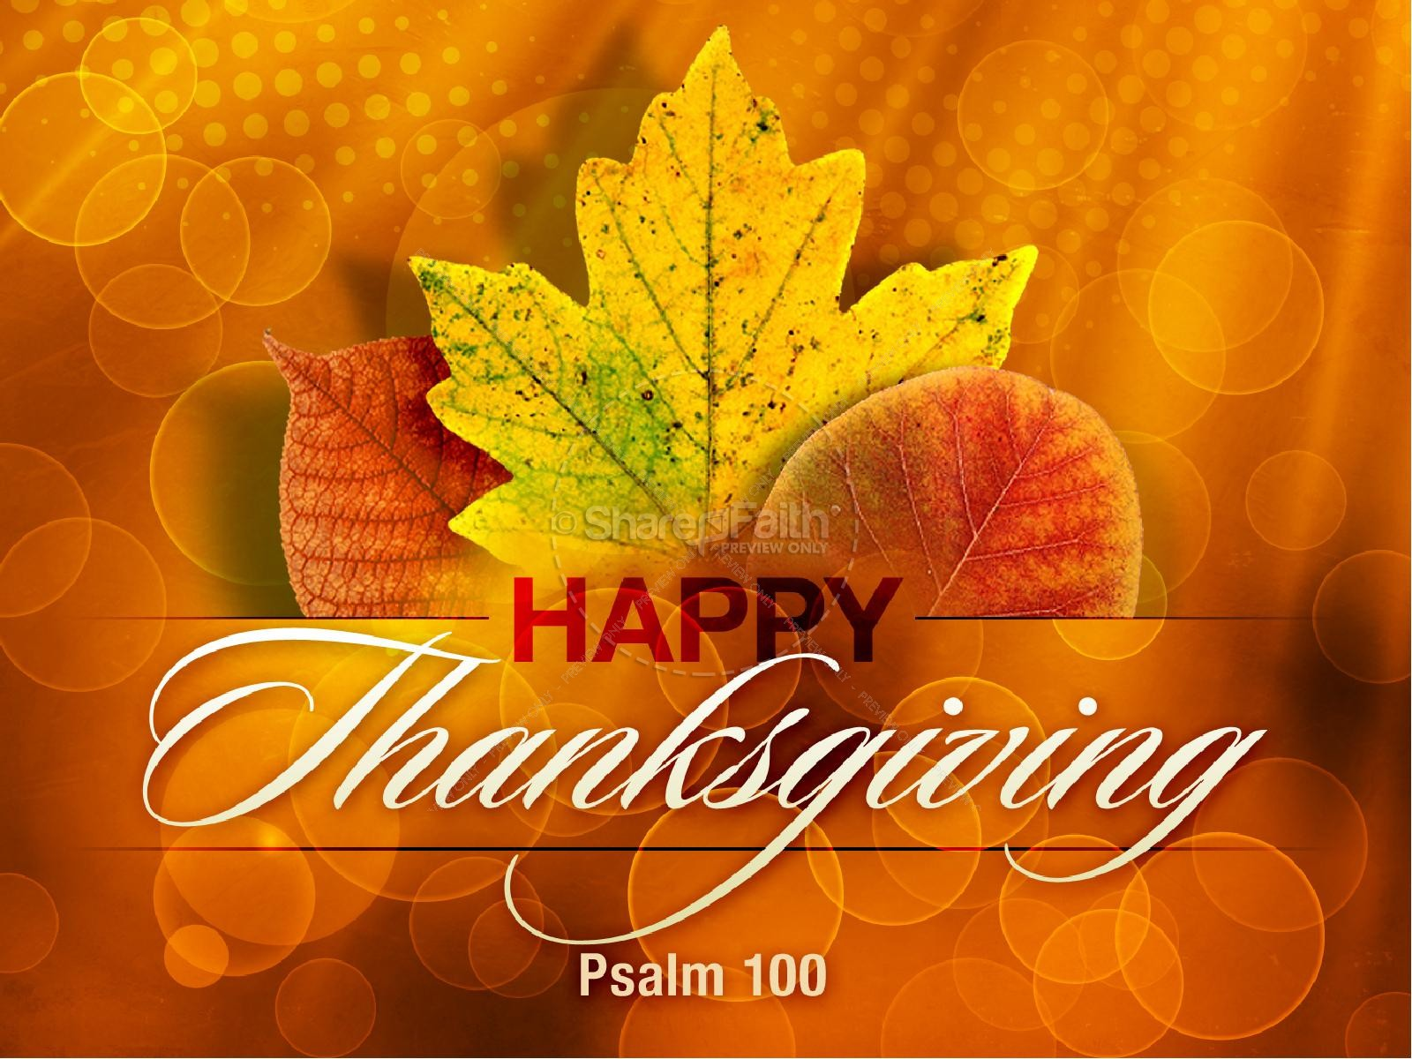
Welcome, we are glad you are here with us today! Salt and Light Bible Ministries

Slide 4
Rebound - 1John 1:9 states, “ If we confess our sins, He is faithful and righteous to forgive us our sins and to cleanse us from all unrighteousness”.

Slide 5
Proverbs 23:7a For as he (man/mankind) thinks within himself, so he is.

Slide 6
2 Ti 1:7 For God has not given us a spirit of timidity, but of power and love and discipline.

Slide 7
God’s divine laws, given to His people, include: His commands, statues, and ordinances.

Slide 8
The ultimate intent of all laws to the believer, both Old and New Covenant, is to glorify God and live in loving obedience.

Slide 9
Mat 5:23 Therefore if you bring your gift to the altar, and there remember that your brother has something against you, Mat 5:24 leave your gift there before the altar, and go your way. First be reconciled to your brother, and then come and offer your gift.

Slide 10
Rom 12:18: If it is possible, as much as depends on you, live peaceably with all men.

Slide 11
Gal 6:10 So then, while we have opportunity, let us do good to all people, and especially to those who are of the household of the faith.

Slide 12
Handling people with God’s impersonal love (application) is the only thing that can overcome the injustices of this life, and it is commanded we perform it as followers of Jesus Christ.

Slide 13
Rom 12:18 If possible, so far as it depends on you, be at peace with all men.

Slide 14
‘be at peace’- eiréneuó – (G1514 i-rane-yoo’-o) = living in the condition of God's peace (gift of wholeness with integrity of being). = To live or be at peace, tranquility.

Slide 15
Jesus Christ’s ‘peace’ is both a divine gift and a believer’s responsibility that is to be enacted within the local community and extended outward to the world.

Slide 16
Jesus Christ is the supreme Peacemaker, reconciling sinners to God the Father and to one another through the Cross, Eph 2:14-17.

Slide 17
Mark 9:50b “… Have salt in yourselves, and be at peace with one another.”

Slide 18
John 14:15 “If you love Me, you will keep My commandments.

Slide 19
“The essence of obedience lies in the hearty love (impersonal) which prompts the deed rather than in the deed itself.” (C. Spurgeon)

Slide 20
John 14:23 Jesus answered and said to him, “If anyone loves Me, he will keep My word; and My Father will love him, and We will come to him and make Our abode with him.

Slide 21
John14:27 Peace I leave with you; My peace I give to you; not as the world gives do I give to you. Do not let your heart be troubled, nor let it be fearful.

Slide 22
John 14:29 Now I have told you before it happens, so that when it happens, you may believe.

Slide 23
All that He has done for us; we all should show gratitude with praise and be thankful! A Grateful Heart.

Slide 24


Slide 25

1Th 5:16 Rejoice always; 1Th 5:17 pray without ceasing; 1Th 5:18 in everything give thanks; for this is God’s will for you in Christ Jesus.

Slide 26

Psalm 100:1 Shout joyfully to the LORD, all the earth. Psalm 100:2 Serve the LORD with gladness; Come before Him with joyful singing.

Slide 27
Psalm 100:3 Know that the LORD Himself is God; It is He who has made us, and not we ourselves; We are His people and the sheep of His pasture.

Slide 28
Psalm 100:4 Enter His gates with thanksgiving And His courts with praise. Give thanks to Him, bless His name.

Slide 29
Psalm 100:5 For the LORD is good; His lovingkindness is everlasting And His faithfulness to all generations.

Slide 30

Col 3:14 Beyond all these things put on love, which is the perfect bond of unity.

Slide 31
Col 3:15 Let the peace of Christ rule in your hearts, to which indeed you were called in one body; and be thankful.

Slide 32
Col 3:16 Let the word of Christ richly dwell within you, with all wisdom teaching and admonishing one another with psalms and hymns and spiritual songs, singing with thankfulness in your hearts to God.

Slide 33
Col 3:17 Whatever you do in word or deed, do all in the name of the Lord Jesus, giving thanks through Him to God the Father.

Slide 34

Heb 13:15-16 Through Him then, let us continually offer up a sacrifice of praise to God, that is, the fruit of lips that give thanks to His name. And do not neglect doing good and sharing, for with such sacrifices God is pleased.

Slide 35
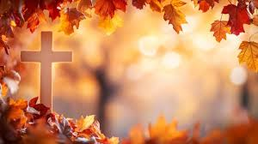
Jam 1:17 Every good thing given and every perfect gift is from above, coming down from the Father of lights, with whom there is no variation or shifting shadow.

Slide 36

Psalm 103:2 Bless the LORD, O my soul, And forget none of His benefits;

Slide 37
Salt & Light Bible Ministries Help, Letters, Prayer & Donations write to us: SLBM@gmail.org visit our website: SLBM.org -*paypal watch us youtube @SaltandLightBibleMinistries or mail: Salt and Light Bible Ministries c/o Pastor Jason Kauranen 2 Dianne Drive East Wareham, Mass 02538

Slide 38
Parking Code for Lot Across the Street is 9000 (also available are some in the bank parking lot) * please do not park on the left side of Troy Street, EMS and Fire only!

