Slide 1
Please respect the Word of God as it is being taught by shutting off all cell phones and electronics, giving your undivided attention while service is in session.
Thank you! SLBM

Slide 2
Salt and Light Bible Ministries
‘A Daily Cross with Thee’ # 073
Substance In Christ is the Answer to Deception and Heresy of False Teaching
Pastor Jason Kauranen
Sunday June 14, 2026

Slide 3
Rebound - 1John 1:9 states,
“ If we confess our sins,
He is faithful and righteous to forgive us our sins and to cleanse us from all unrighteousness”.

Slide 4
The infiltration of false teaching upon the early church, was a mix of Jewish legalism, Greek philosophy, and Orient mysticism.

Slide 5
Col 2:1 For I want you to know how great a struggle I have on your behalf and for those who are at Laodicea, and for all those who have not personally seen my face,

Slide 6
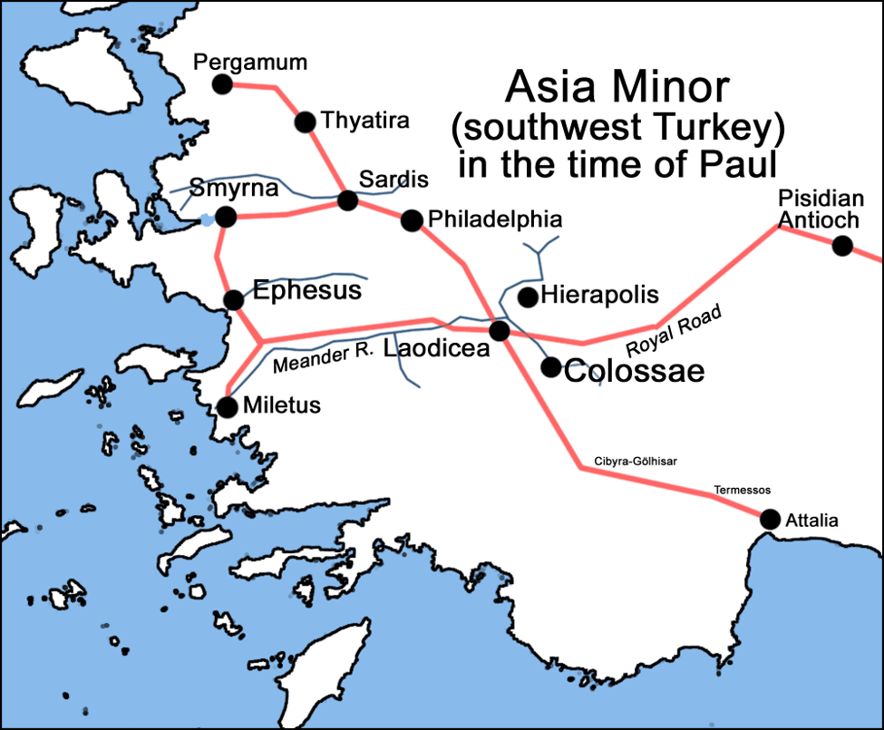

Slide 7
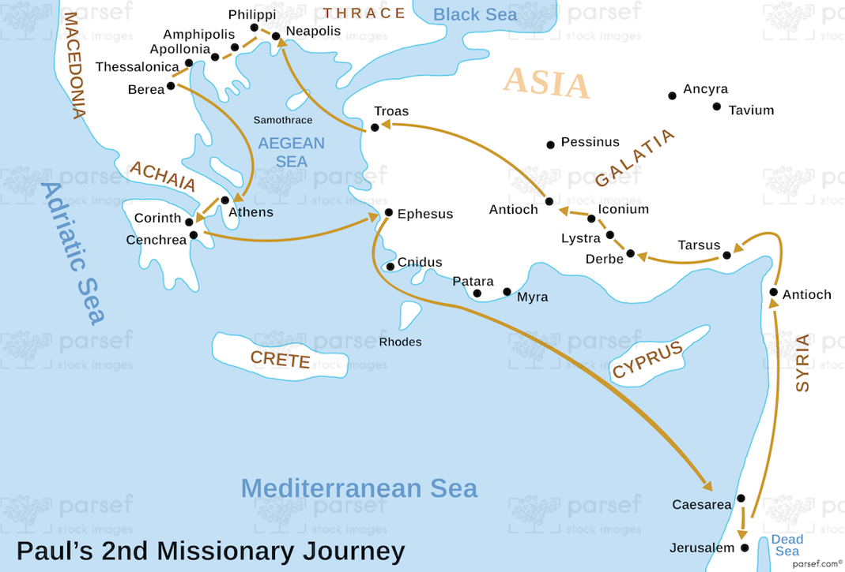

Slide 8
Col 2:2 that their hearts may be encouraged, having been knit together in love, and attaining to all the wealth that comes from the full assurance of understanding, resulting in a true knowledge of God’s mystery, that is,
Christ Himself,

Slide 9
Col 2:3 in whom are hidden all the treasures of wisdom and knowledge.
Col 2:4 I say this so that no one will delude you with persuasive argument.

Slide 10
The knowledge Paul refers to is that the treasures of wisdom are hid, not from us, but for us,
In Christ. (His thinking)
*Nosis turned into Epinosis by way of 2 spiritual power options:
The Word of God (doctrine) and filling power of the Holy Spirit.

Slide 11
“hidden” – apokruphos –
(G614 a-PO-kroo-fos)
= kept secret or treasured; to hide
*Stored away as a treasure for the one who seeks.

Slide 12
God’s way are not our ways…
Scripture holds concealment and disclosure in a divinely ordered sequence.
God reveals as when believers build capacity to take the word into our mind and soul.

Slide 13
Believers need to repeat doctrine until they can never forget it, living it out and using the truth to discern the false and evil things that may become desirable or impressionable to the OSN within them.
Know the mind of Christ!

Slide 14
When believers continue to grow In Him (by grace and knowledge) and maintain this relationship, it is a far easier path to advance spiritually and not merely exist.

Slide 15
Col 2:6 Therefore as you have received Christ Jesus the Lord, so walk in Him,
Col 2:7 having been firmly rooted and now being built up in Him and established in your faith, just as you were instructed, and overflowing with gratitude.

Slide 16
Col 2:8 See to it that no one takes you captive through philosophy and empty deception, according to the tradition of men, according to the elementary principles of the world, rather than according to Christ.

Slide 17
‘captive’ – sulagógeó –
(G4812 soo-lag-ogue-eh'-o)
= to lead away as booty; seduce or take captive
= to plunder or take away as spoil.
A hapax legomenon – word that appears only once in the Bible.

Slide 18
‘Philosophy’ – This type that Paul bring into light was one of vain speculation of human though ability over God’s establishment in Christ accomplished work, as to see the full completeness in intelligence.

Slide 19
‘Empty deception’ – convincing by argument or force to a belief system that lacks the genuine substance, truth, or correct spiritual value.

Slide 20
Col 2:17 things which are a mere shadow of what is to come; but the substance belongs to Christ.

Slide 21
False Gnostic philosophy
1. God could not come into direct contact with the material world. So, they reject the deity of Jesus, as he was a man, part of the world.

Slide 22
2. Since that is true, then God could not have created the world as we know it. SO, he worked through other lower creations in angels.

Slide 23
3. God therefore could not deal directly with man, So he only deals with man through a series of mediators.

Slide 24
‘elementary principles’ – stoicheion – (G4747 stoy-KHI-on)
= rudiment or principle;
= something in orderly arrangement;
= the initial element of a fundamental series

Slide 25
Vain deceit - A superficial logic that manipulates or misleads people by relying on worldly standards rather than solid facts or objective truth in divine revelation.

Slide 26
Col 2:11 and in Him you were also circumcised with a circumcision made without hands, in the removal of the body of the flesh by the circumcision of Christ;

Slide 27
Col 2:12 having been buried with Him in baptism, in which you were also raised up with Him through faith in the working of God, who raised Him from the dead.

Slide 28
Col 2:13 When you were dead in your transgressions and the uncircumcision of your flesh, He made you alive together with Him, having forgiven us all our transgressions,

Slide 29
Deu 30:6 “Moreover the Lord your God will circumcise your heart and the heart of your descendants, to love the Lord your God with all your heart and with all your soul, so that you may live.

Slide 30
Col 2:17 things which are a mere shadow of what is to come; but the substance belongs to Christ.

Slide 31
FF Bruce said,
“It would be preposterous indeed for those who had reaped the benefit of Christ’s victory to put themselves voluntarily under the control of the powers which he had conquered.”

Slide 32
Col 2:23 These are matters which have, to be sure, the appearance of wisdom in self-made religion and self-abasement and severe treatment of the body, but are of no value against fleshly indulgence.

Slide 33
Col 3:2 Set your mind on the things above, not on the things that are on earth.
Col 3:3 For you have died and your life is hidden with Christ in God.

Slide 35
Salt & Light Bible Ministries
Help, Letters, Prayer & Donations write to us: SLBM@gmail.org visit our website: SLBM.org -*paypal watch on YouTube @SaltandLightBibleMinistries or mail:
Salt and Light Bible Ministries c/o Pastor Jason Kauranen
2 Dianne Drive or 44A Troy Street
East Wareham, Ma 02538 Fall River, Ma 02720

