Slide 1
Please respect the Word of God as it is being taught by shutting off all cell phones and electronics, giving your undivided attention while service is in session. Thank you! SLBM

Slide 2
Salt and Light Bible Ministries ‘A Daily Cross with Thee’ # 056 The Analogies of the Shadows; Sin and Trespasses Only God Can Forgive - Part 8. Pastor Jason Kauranen Sunday April 12, 2026

Slide 3
Rebound - 1John 1:9 states, “ If we confess our sins, He is faithful and righteous to forgive us our sins and to cleanse us from all unrighteousness”.

Slide 4
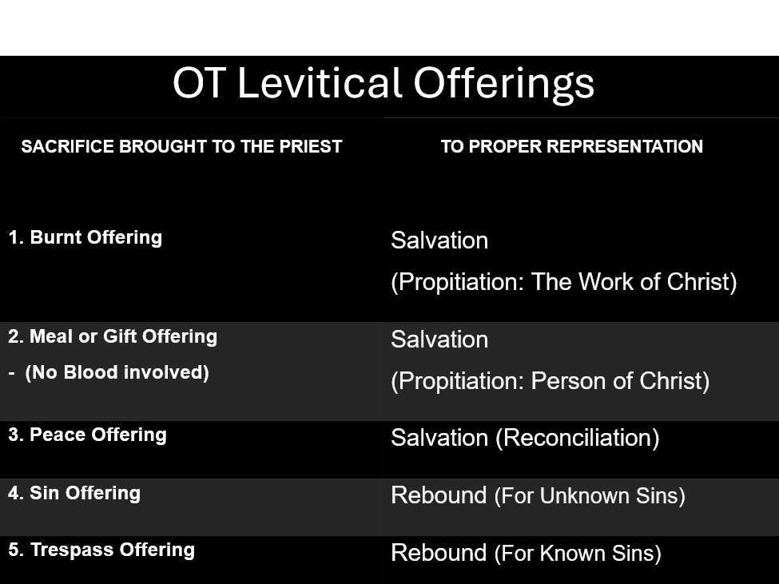

Slide 5
1Pe 1:18-19 knowing that you were not redeemed with perishable things like silver or gold from your futile way of life inherited from your forefathers, but with precious blood, as of a lamb unblemished and spotless, the blood of Christ.

Slide 6
Pro 28:13 He who conceals his transgressions will not prosper, But he who confesses and forsakes them will find compassion.

Slide 7
‘conceal’ - kacah – (H3680 kaw-saw’) = to cover or conceal; by way of secrecy = to plump (fill up hollows) = flee to hide

Slide 8
‘confess’ – yadah – (H3034 yah-DAH) = to use or hold out the hand; to throw or cast * Hebrew Hiphil stem has the act of giving thanks by gesture and arrives at a definition = to acknowledge or confess.

Slide 9
‘forsake’ - `azab – (H5800 ah-ZAHV) = to loosen or leave; = depart from, as an accusative of person; abandon.

Slide 10
Pro 28:14 How blessed is the man who fears always, But he who hardens his heart will fall into calamity.

Slide 11
Col 2:13 When you were dead in your transgressions and the uncircumcision of your flesh, He made you alive together with Him, having forgiven us all our transgressions,

Slide 12
Col 2:14 having canceled out the certificate of debt consisting of decrees against us, which was hostile to us; and He has taken it out of the way, having nailed it to the cross.

Slide 13
Mat 26:28, Jesus speaking, “for this is My blood of the covenant, which is poured out for many for forgiveness of sins.”

Slide 14
Maskil or Maschil – (H4905 mahs-KEEL) = instructive or a contemplation From the Hebrew root - śākal – (H7919 sah-KAL) = "to be prudent" or "to have insight".

Slide 15
Psa 32:1 How blessed is he whose transgression is forgiven, Whose sin is covered!

Slide 16
Psa 32:5 I acknowledged my sin to You, And my iniquity I did not hide; I said, “I will confess my transgressions to the Lord”; And You forgave the guilt of my sin. Selah.

Slide 17
Mark 11:24 Therefore I say to you, all things for which you pray and ask, believe that you have received them, and they will be granted you.

Slide 18
Psa 32:7 You are my hiding place; You preserve me from trouble; You surround me with songs of deliverance. Selah.

Slide 19
Psa 32:11 Be glad in the Lord and rejoice, you righteous ones; And shout for joy, all you who are upright in heart.

Slide 20
Selah – (H5542 seh-lah) from calah = pause, as in a musical notation of voice or instrument. = to praise, to lift up; = to hang or to measure/weigh in the balances. *“to pause and calmly think about that” which preceded.

Slide 21
Psa 89:14 Righteousness and justice are the foundation of Your throne; Lovingkindness and truth go before You.

Slide 22
Mercy and truth – “These shall be the heralds that shall announce the coming of the Judge. His truth binds Him to fulfill all His declarations; and His mercy shall be shown to all those who have fled for refuge to the hope that is set before them in the Gospel.” (Adam Clarke)

Slide 23
Lev 26:40 If they confess their iniquity and the iniquity of their forefathers, in their unfaithfulness which they committed against Me, and also in their acting with hostility against Me⁠ —

Slide 24
Lev 26:42a then I will remember My covenant with Jacob, …

Slide 25
Rom 7:18 For I know that nothing good dwells in me, that is, in my flesh; for the willing is present in me, but the doing of the good is not.

Slide 26
Rom 7:19 For the good that I want, I do not do, but I practice the very evil that I do not want.

Slide 27
Rom 7:20 But if I am doing the very thing I do not want, I am no longer the one doing it, but sin which dwells in me.

Slide 28
Lev 4:35b… Thus the priest shall make atonement for him in regard to his sin which he has committed, and he will be forgiven.

Slide 30
Salt & Light Bible Ministries Help, Letters, Prayer & Donations write to us: SLBM@gmail.org visit our website: SLBM.org -*paypal watch us youtube @SaltandLightBibleMinistries or mail: Salt and Light Bible Ministries c/o Pastor Jason Kauranen 2 Dianne Drive East Wareham, Mass 02538

