Slide 1
Please respect the Word of God as it is being taught by shutting off all cell phones and electronics, giving your undivided attention while service is in session. Thank you! SLBM

Slide 2
Salt and Light Bible Ministries ‘A Daily Cross with Thee’ # 058 The Analogies of the Shadows; The Sin Offering Applies to All, Starting with Leadership - Part 10. Pastor Jason Kauranen Sunday April 19, 2026

Slide 3
Rebound - 1John 1:9 states, “ If we confess our sins, He is faithful and righteous to forgive us our sins and to cleanse us from all unrighteousness”.

Slide 4
Lev 4:2 “Speak to the sons of Israel, saying, ‘If a person sins unintentionally in any of the things which the Lord has commanded not to be done, and commits any of them,

Slide 5
‘Sins’ – chata’ – (H2398 khaw-taw’) = to miss, go wrong, sin *Qual stem indicates this is always against God.

Slide 6
Unintentional - ḇišḡāḡāh - (H7684 Bi-shgah-GAH) = inadvertent transgression; a mistake = error of ignorance; at unawares, unwittingly. *From root shagag meaning = to go astray, to wander.

Slide 7
Num 35:11 then you shall select for yourselves cities to be your cities of refuge, that the manslayer who has killed any person unintentionally may flee there.

Slide 8
Num 35:15 These six cities shall be for refuge for the sons of Israel, and for the alien and for the sojourner among them; that anyone who kills a person unintentionally may flee there.

Slide 9
1. The anointed priest – offering a bull - Lev 4:3-12. 2. The whole congregation (nation of Israel) – offering a bull – Lev 4:13-21. 3. A tribal leader (or clan representative) - offering a male goat - Lev 4:22-26. 4. A common person – offering a female goat or lamb - Lev 4:27-35.

Slide 10
Lev 4:3 if the anointed priest sins so as to bring guilt on the people, then let him offer to the Lord a bull without defect as a sin offering for the sin he has committed.

Slide 11
Lev 4:13 ‘Now if the whole congregation of Israel commits error and the matter escapes the notice of the assembly, and they commit any of the things which the Lord has commanded not to be done, and they become guilty;

Slide 12
Proverbs 14:34 Righteousness exalts a nation, But sin is a disgrace to any people.

Slide 13
Lev 4:3 if the anointed priest sins so as to bring guilt on the people, then let him offer to the Lord a bull without defect as a sin offering for the sin he has committed.

Slide 14
‘to bring guilt on’ – ashmah – (H819 ash-maw’) = guiltiness, a fault; wrongdoing, = the presentation of a sin-offering

Slide 15
In God’s justice system … This is Corporate Liability of failed leadership from the priesthood or high priest himself, that placed the entire nation under guilt. (Lev 4:3)

Slide 16
Mat 7:1 “Do not judge so that you will not be judged. Mat 7:2 For in the way you judge, you will be judged; and by your standard of measure, it will be measured to you.

Slide 17
Principle – In God’s program, a leader’s ungodly decisions can “bring guilt on the people,” whereas humble obedience can lead people into renewal.

Slide 18
1Pe 2:24 and He Himself bore our sins in His body on the cross, so that we might die to sin and live to righteousness; for by His wounds, you were healed.

Slide 19
1Pe 2:9 But you are a chosen race, a royal priesthood, a holy nation, a people for God’s own possession, so that you may proclaim the excellencies of Him who has called you out of darkness into His marvelous light;

Slide 20
1Pe 2:10 for you once were not a people, but now you are the people of God; you had not received mercy, but now you have received mercy.

Slide 21
Lev 4:4 He shall bring the bull to the doorway of the tent of meeting before the Lord, and he shall lay his hand on the head of the bull and slay the bull before the Lord.

Slide 22
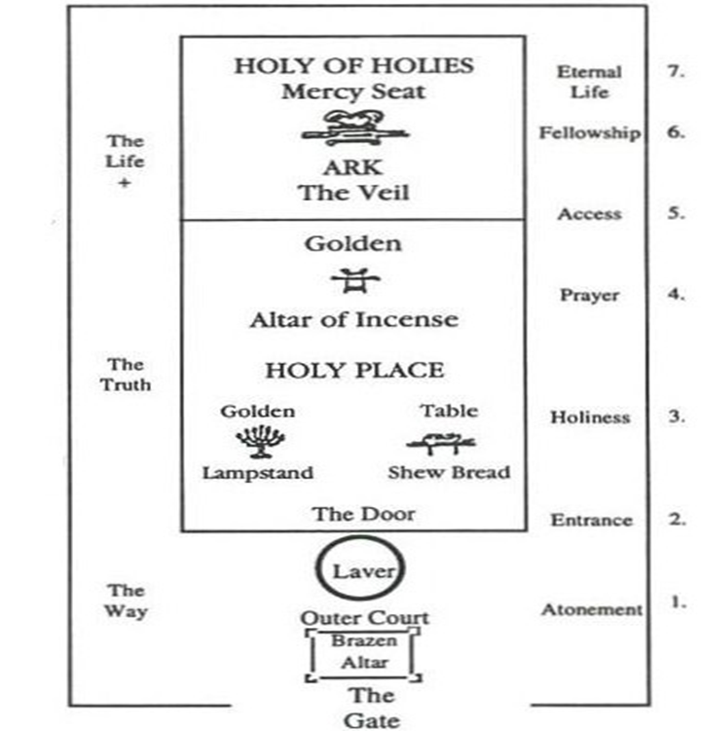

Slide 23
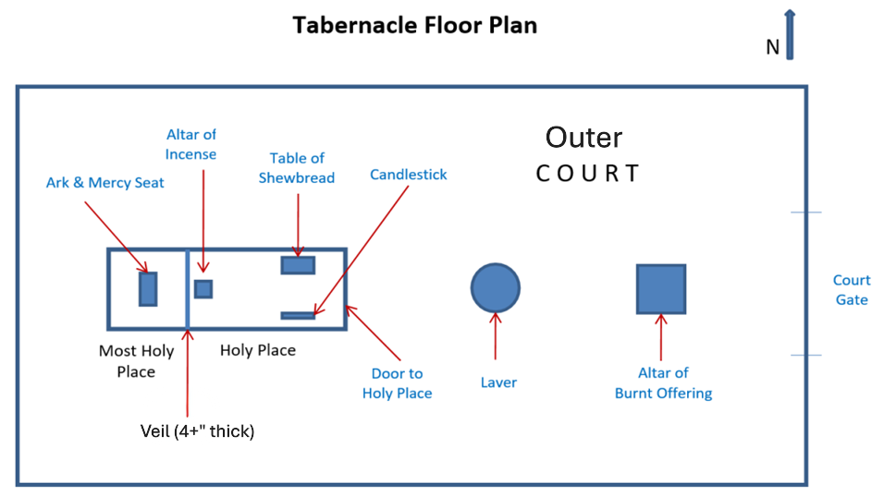
The Tabernacle - God Has a Perfect (Blueprint) Plan!
Design by Pastor Jason Kauranen for the Study of : Building a Spiritual House and Positional Truth - GBC 9/22
: Analogies of the Shadows, Levitical Offerings – SLBM 4/26

Slide 24
Lev 4:4 He shall bring the bull to the doorway of the tent of meeting before the Lord, and he shall lay his hand on the head of the bull and slay the bull before the Lord.

Slide 25
Lev 4:6 and the priest shall dip his finger in the blood and sprinkle some of the blood seven times before the Lord, in front of the veil of the sanctuary.

Slide 26
The sprinkling of blood seven times signifies the complete purification and sanctification required to approach a Holy God. This was looking forward to the completed perfect work of Jesus Christ on the cross.

Slide 27
Mat 27:51 And behold, the veil of the temple was torn in two from top to bottom; and the earth shook and the rocks were split.

Slide 28
Heb 9:11 But when Christ appeared as a high priest of the good things to come, He entered through the greater and more perfect tabernacle, not made with hands, that is to say, not of this creation;

Slide 29
Heb 9:12 and not through the blood of goats and calves, but through His own blood, He entered the holy place once for all, having obtained eternal redemption.

Slide 30
The golden altar represents Prayer, and the horns represent Power = the Power of prayer; To the believer, this is a symbol to the effectiveness of the rebound principle, due to the amount of doctrine in the soul.

Slide 31
1. Intersession, Heb 7:24-25. Heb 7:24 ‘but Jesus, on the other hand, because He continues forever, holds His priesthood permanently. Heb 7:25 Therefore, He is able also to save forever those who draw near to God through Him, since He always lives to make intercession for them’.

Slide 32
2. Advocacy, 1Jo 2:1-2. 1Jo 2:1 My little children, I am writing these things to you so that you may not sin. And if anyone sins, we have an Advocate with the Father, Jesus Christ the righteous; 1Jo 2:2 and He Himself is the propitiation for our sins; and not for ours only, but also for those of the whole world.

Slide 33
Lev 4:12 that is, all the rest of the bull, he is to bring out to a clean place outside the camp where the ashes are poured out, and burn it on wood with fire; where the ashes are poured out it shall be burned.

Slide 34
Typology - Type and Antitype The type representing an earthly truth (a shadow), while the antitype reveals the same truth on a higher spiritual scale (reality), Heb 13:11-13.

Slide 35
Heb 13:11 For the bodies of those animals whose blood is brought into the holy place by the high priest as an offering for sin, are burned outside the camp.

Slide 36
Heb 13:12 Therefore Jesus also, that He might sanctify the people through His own blood, suffered outside the gate. Heb 13:13 So, let us go out to Him outside the camp, bearing His reproach.

Slide 37
Salt & Light Bible Ministries Help, Letters, Prayer & Donations write to us: SLBM@gmail.org visit our website: SLBM.org -*paypal watch us youtube @SaltandLightBibleMinistries or mail: Salt and Light Bible Ministries c/o Pastor Jason Kauranen 2 Dianne Drive East Wareham, Mass 02538

