Slide 1
Please respect the Word of God as it is being taught by shutting off all cell phones and electronics, giving your undivided attention while service is in session.
Thank you! SLBM

Slide 2
Salt and Light Bible Ministries
‘A Daily Cross with Thee’ # 062
The Analogies of the Shadows; Sin Cannot Be Concealed – Part 14.
Pastor Jason Kauranen
Sunday May 3, 2026

Slide 3
Rebound - 1John 1:9 states,
“ If we confess our sins,
He is faithful and righteous to forgive us our sins and to cleanse us from all unrighteousness”.

Slide 4
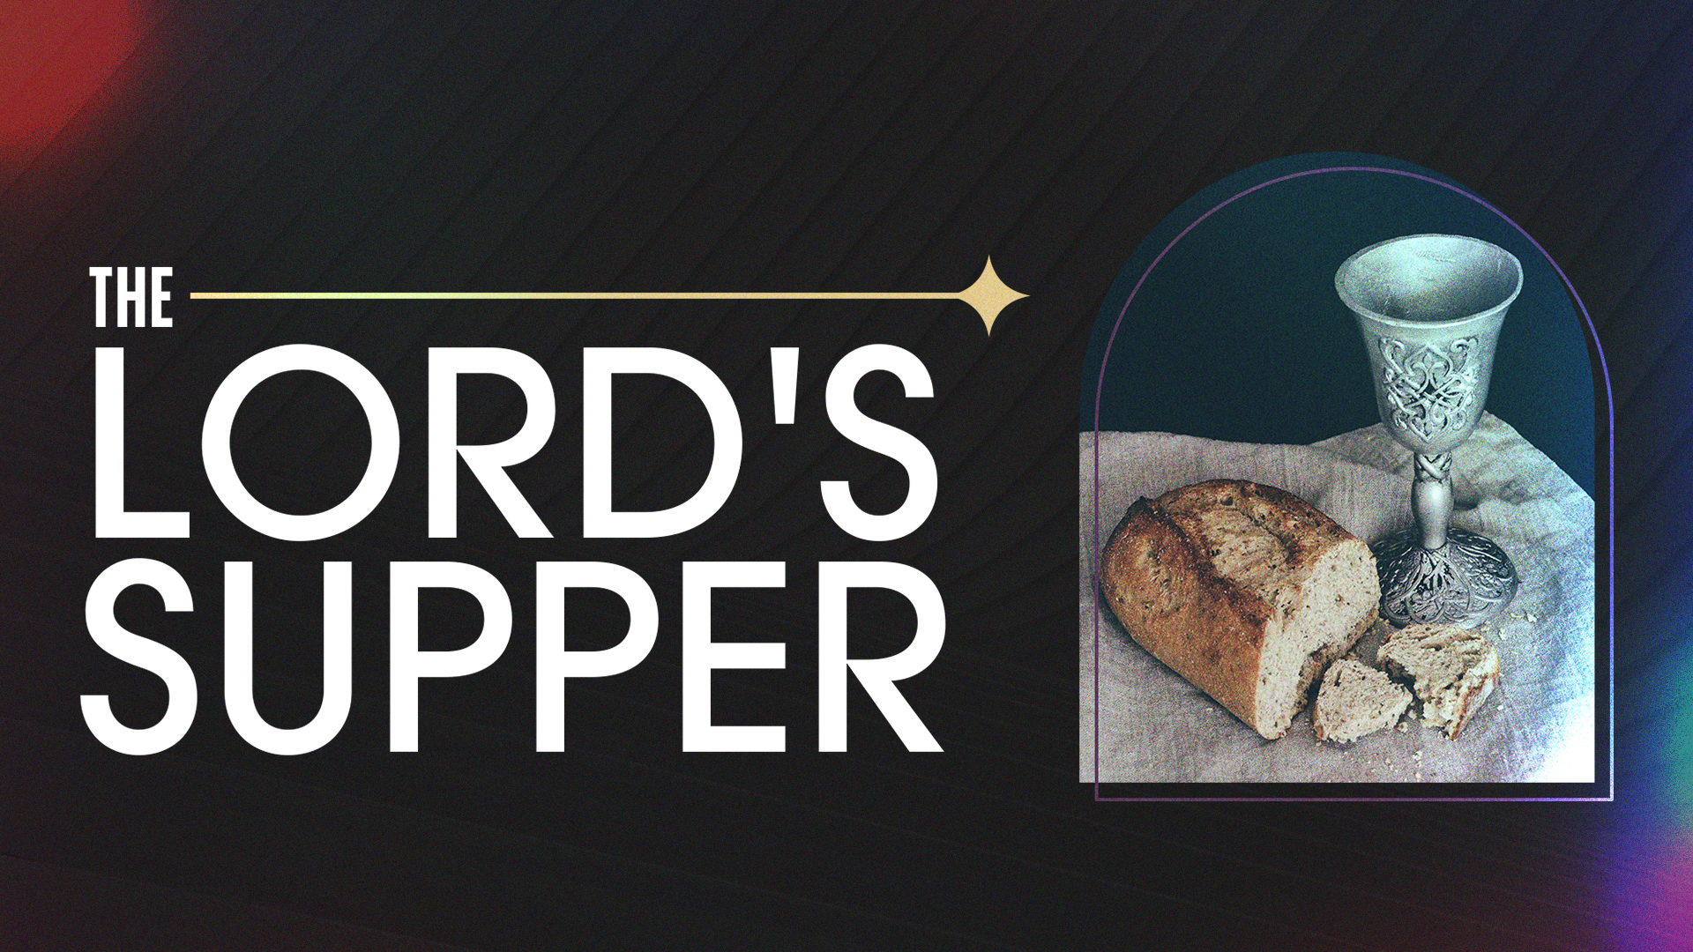

Slide 5
The primary purpose of the Mosaic Law: a) to reveal human sinfulness, Rom 3:19-20, 7:7, b) to act as a tutor leading to Christ, Gal 3:19-26, c) define God's standard of holiness, Rom 7:12, Psa 119.

Slide 6
Jam 2:10 For whoever keeps the whole law and yet stumbles in one point, he has become guilty of all.

Slide 7
1Ti 2:13 For it was Adam who was first created, and then Eve.
1Ti 2:14 And it was not Adam who was deceived, but the woman being deceived, fell into transgression.

Slide 8
Gen 2:16 The Lord God commanded the man, saying, “From any tree of the garden you may eat freely;

Slide 9
Gen 2:17 but from the tree of the knowledge of good and evil you shall not eat, for in the day that you eat from it you will surely die.”

Slide 10
Gen 3:6 When the woman saw that the tree was good for food, and that it was a delight to the eyes, and that the tree was desirable to make one wise, she took from its fruit and ate; and she gave also to her husband with her, and he ate.

Slide 11
1Jo 5:17 All unrighteousness is sin, and there is a sin not leading to death.

Slide 12
the principle in Luke 12:35-48 …
Luke 12:47 And that slave who knew his master’s will and did not get ready or act in accord with his will, will receive many lashes,

Slide 13
Luke 12:48 but the one who did not know it, and committed deeds worthy of a flogging, will receive but few.
From everyone who has been given much, much will be required; and to whom they entrusted much, of him they will ask all the more.

Slide 14
Lev 5:1 ‘Now if a person sins after he hears a public adjuration to testify when he is a witness, whether he has seen or otherwise known, if he does not tell it, then he will bear his guilt.

Slide 15
Lev 5:5 So it shall be when he becomes guilty in one of these, that he shall confess that in which he has sinned.

Slide 16
Lev 5:7 ‘But if he cannot afford a lamb, then he shall bring to the Lord his guilt offering for that in which he has sinned, two turtledoves or two young pigeons, one for a sin offering and the other for a burnt offering.

Slide 17
1. Sin Offering (First Bird): Deals specifically with the guilt of the sin or ceremonial impurity (Lev. 5:5-6). It cleanses the person so they can enter the sanctuary.

Slide 18
2. Burnt Offering (Second Bird): Represents full surrender, dedication, and consecration to God. It signals a restored relationship, not just a forgiven action.

Slide 19
Lev 5:13 So the priest shall make atonement for him concerning his sin which he has committed from one of these, and it will be forgiven him; then the rest shall become the priest’s, like the grain offering.’”

Slide 20
This beginning section of Lev 5 …
- Verses 1-6 are an extension of the sin offering as far as purification and cleansing,
- verses 7-10 speaking concessions of the poor,
- and verses 11-13 covers the destitute and extreme poor.

Slide 21
The analogy of the sin offering shadow is the reality to the substitutional spiritual death of Christ and His blood to provide for the forgiveness of sin,
Eph 1:7; 2Co 5:21.

Slide 22
Eph 1:7 In Him (Jesus Christ) we have redemption through His blood, the forgiveness of our trespasses, according to the riches of His grace.

Slide 23
Lev 5:1 ‘Now if a person sins after he hears a public adjuration to testify when he is a witness, whether he has seen or otherwise known, if he does not tell it, then he will bear his guilt.

Slide 24
‘utterance’ - qowl (H6963 kohl)
= a voice or sound;
‘of an oath’ - alah (H423 aw-law') = a curse or earnest request;
= swearing or oath.

Slide 25
‘hears’ - shama`-
(H8085 shaw-mah’)
= heard, hear, listen to with attention
*This is in the QAL stem, conjunctive perfect (wa- ) which indicates this is heard clearly and with obedience in mind, attentive in the information brough forward or act done. = >> ‘And in hearing’

Slide 26
God required His people to make the truth known at all times …
To fail in this area (not faithfully representing the truth), was to sin against a Godly principle and bear guilt or be guilty.

Slide 27
Lev 5:2 Or if a person touches any unclean thing, whether a carcass of an unclean beast or the carcass of unclean cattle or a carcass of unclean swarming things, though it is hidden from him and he is unclean, then he will be guilty.

Slide 28
‘unclean things’ - tame' dabar –
(H2931,H1697 tah-MAY dah-VAHR)
= polluted or defiled, unclean,
= of any such thing or matter, a cause of.

Slide 29
Lev 5:3 ‘Or if he touches human uncleanness, of whatever sort his uncleanness may be with which he becomes unclean, and it is hidden from him, and then he comes to know it, he will be guilty.

Slide 30
Salt & Light Bible Ministries
Help, Letters, Prayer & Donations write to us: SLBM@gmail.org visit our website: SLBM.org -*paypal watch us youtube @SaltandLightBibleMinistries or mail: Salt and Light Bible Ministries c/o Pastor Jason Kauranen
2 Dianne Drive
East Wareham, Mass 02538

