Slide 1
Make your prayer request known!

Slide 2
Salt and Light Bible Ministries
‘A Daily Cross with Thee’ Part 3 – The Biblical Darkness That Separates.
Pastor Jason Kauranen
Sunday, June 9, 2024

Slide 3
1. God is Light, 1 Jo 1:5.

Slide 4
2. God dwells in light,
1TI 6:15-16a.

Slide 5
3. Christ is the Light of the world, John 8:12.

Slide 6
4. Christ is the Light shining
in the darkness, JOH 1:4,5.

Slide 7
‘Darkness’ - skotia
(4653 skot-ee'-ah) = darkness, dimness, or obscurity, meaning spiritual darkness or the consequence of sin, depravity.

Slide 8
A strong Greek nominative adjective - oudemia
(3762 oo-dice) = none, not at all, not in any way.

Slide 9
‘darkness’ - Skotos (4655 skot’-os)
= darkness, the absence of light,
or moral shadiness, immorality and
is a representation of sin.

Slide 10
1st - Darkness is used in Scripture as a Metaphor representing the Sin and Evil
in the world.

Slide 11
2nd - Darkness can be a
symbol of Ignorance and
Divine Mystery.

Slide 12
3rd - Darkness is most often used in terms which depict emotions of Fear,
Despair, and Isolation.

Slide 13
4th - Darkness can also be used in Scripture to demonstration God's Powerful Presence or God’s Judgement.

Slide 14
Mat 24:29 But immediately after the tribulation of those days
THE SUN WILL BE DARKENED, AND THE MOON WILL NOT GIVE ITS LIGHT, AND THE STARS WILL FALL from the sky, and the powers of the heavens will be shaken.

Slide 15
A. Physical ‘Darkness’ –
The absence of Created light;
Gen 1:2, Exo 10:21-23

Slide 16
Darkness – chôshek (CHO-SHECH) =
is a Hebrew masculine noun
meaning a thick darkness, which
connotes no light at all.

Slide 17
Exo 10:21 Then the LORD said to
Moses, “Stretch out your hand toward
the sky, that there may be darkness
over the land of Egypt, even
a darkness which may be felt.”

Slide 18
Exo 10:22 So Moses stretched out
his hand toward the sky, and
There was thick darkness
in all the land of Egypt
for three days.

Slide 19
Exo 10:23 They did not see
one another, nor did anyone
rise from his place for three days,
but all the sons of Israel had
light in their dwellings.

Slide 20
Darkness - Arâphel (6205 ar-aw-fel);
it adds depth and intensity to the
portrayal of darkness, symbolizing
divine mysteries and judgments.

Slide 21
Psa 97:2 Clouds and thick darkness
surround Him;
Righteousness and justice are
the foundation of His throne.

Slide 22
Rev 22:5 And there will no longer
be any night; and they will not have
need of the light of a lamp nor
the light of the sun, because
the Lord God will illumine them; and
they will reign forever and ever.

Slide 23
B. The Natural Darkness,
Eph 4:18-19, 1Jo 4:12,
2Jo 2:15-16.

Slide 24
Eph 4:18 being darkened
in their understanding,
excluded from the life of God because of the ignorance
that is in them, because of the
hardness of their heart;

Slide 25
Darkness is in all mankind, every human being, therefore in order to be right with God by His righteousness, we must be “called out of the darkness into His marvelous light” and
“be born again of the Spirit.”
1Pe 2:9, Joh 3:3-7

Slide 26
Both in the concise and
unconscious of our soul …
norms and standards are being
controlled by the OSN.

Slide 27
2JO 2:15 Do not love the world nor the things in the world.
If anyone loves the world, the love of the Father is not in him.

Slide 28
2JO 2:16 For all that is
in the world, the lust of the flesh
and the lust of the eyes
and the boastful pride of life,
is not from the Father,
but is from the world.

Slide 29
C. Willful Darkness – aka Spiritual Blindness,
2 Co 4:4, John 3:19-21.

Slide 30
2Co 4:4 in whose case the god of this world has blinded the minds of the unbelieving so that they might not see the light of the gospel of the glory of Christ, who is the image of God.

Slide 31
2Co 4:6 For God, who said,
“Light shall shine out of darkness,” is the One who has shone in our hearts to give the Light of the knowledge of the glory of God in the face of Christ.

Slide 32
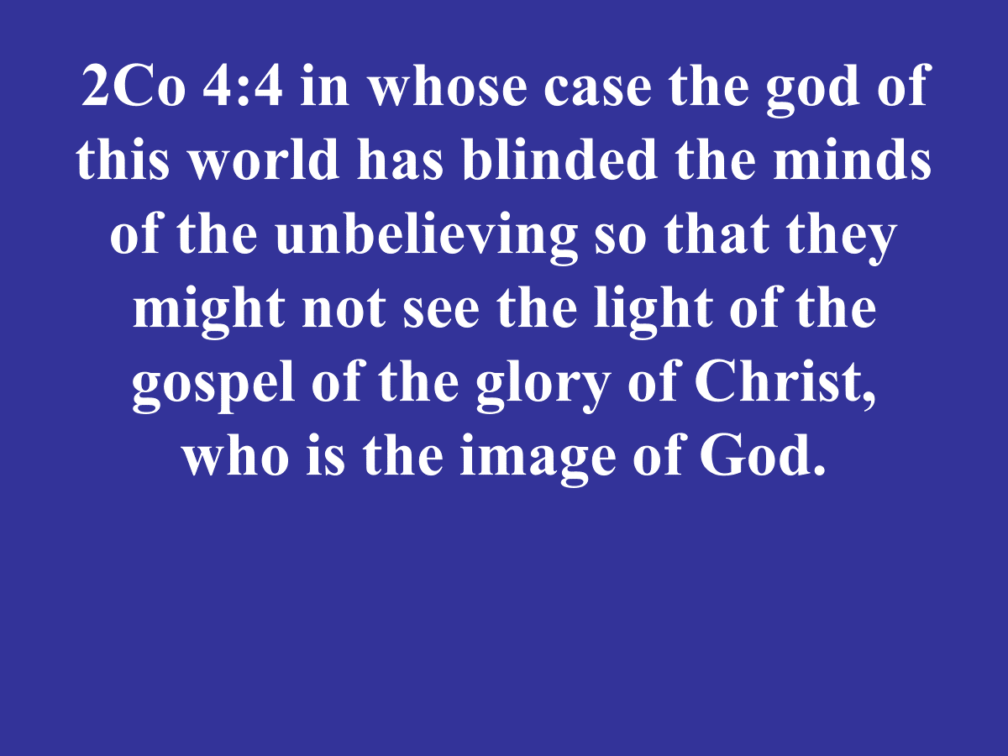

Slide 33
Joh 3:19 This is the judgment,
that the Light has come into the world,
and men loved the darkness
rather than the Light,
for their deeds were evil.

Slide 34
“Those who consciously
reject Jesus often present
themselves as heroic characters
who bravely put away superstition
and deal honestly with deep
philosophical problems.”

Slide 35
“Many opponents of Christianity
have a vested interest in fighting
against the truth of Jesus,
because they love their sin
and don’t want to face it or
face a God who will
judge their sin.” – FF Bruce.

Slide 36
D. Judicial Darkness –
God’s Sovereignty, Jer 13:16,
2 Th 2:10-12.

Slide 37
The Word of God declares,
the world did not create itself
or come about by chance.
The world, and everything in it,
was created by the Sovereign
Will of God.

Slide 38
An Almighty God who is,
Eternal and has always been (existed) and always will be –
Immutable, He does not change.

Slide 39
Gen 1:3 Then God said, “Let there be light”; and there was light
Gen 1:4 God saw that the light was good; and God separated the light from the darkness.

Slide 40
God created and separated
both ‘light and darkness’
therefore, both have a purpose to
His plan within the order
of divine decrees.

Slide 41
Psa 139:11 If I say, “Surely the
darkness will overwhelm me,
And the light around me
will be night,”

Slide 42
Psa 139:12 Even the darkness is not dark to You,
And the night is as bright as the day.
Darkness and light are alike to You.

Slide 43
Jer 13:16 Give glory to the LORD your God, Before He brings darkness
And before your feet stumble
On the dusky mountains, and while you are hoping for light,
He makes it into deep darkness and turns it into gloom.

Slide 44
2Th 2:10 and with all the deception
of wickedness for those who
perish, because they did not
receive the love of the truth,
so as to be saved.

Slide 45
2Th 2:11 For this reason God will send upon them a deluding influence so that they will believe what is false,

Slide 46
2Th 2:12 in order that they all
may be judged who did not believe
the truth but
took pleasure in wickedness.

Slide 47
‘wickedness’ - Adikia
(93 ad-ee-kee'-ah) =
that which is not conformable with justice;
what ought not to be; iniquity.

Slide 48
A form of the main Noun
(94 ad’-ee-kos) adikos = unjust, unrighteousness, wicked or dark.

Slide 49
Aorist tense – refers to simple action.
Subjective mood – has the connotation of uncertainty, similar to a future action as not occurring yet but will be carried out at an undisclosed time unless indicated.
Passive voice – the subject receives the action.

Slide 50
‘Judged’ - krinō (2919 kree'-no) =
Properly decided (mentally or judicially); by implication to condemn, conclude, determine, be sentence to.

Slide 51
an aorist participle - ‘ took’ is a simple action with no refer to time. and it signifies the action of the main verb

Slide 52
‘Pleasure’ = eudokeō -
(2106 yoo-dok-eh'-o)
to think well of or approve (an act); specifically, to approbate (a person or thing): - think good,
(be well) please (-d),

Slide 53
The constative aorist: they habitually and continually do not believe doctrine and therefore they approve of unrighteousness, (darkness) which they live in.
Cosmic Living promoting the KOD with cosmic viewpoint!

Slide 54
Pro 2:12 To deliver you from the way of evil,
From the man who speaks perverse things;
Pro 2:13 From those who leave the paths of uprightness
To walk in the ways of darkness;

Slide 55
E. Outer (Eternal) or Black Darkness,
Jude 1:12-13, Mat 22:13,
2Pe 2:17, Job 10:21.

Slide 56
Jude 1:13 wild waves of the sea, casting up their own shame like foam; wandering stars, for whom the black darkness has been reserved forever.

Slide 57
Mat 25:30 Throw out the worthless slave into the outer darkness; in that place there will be weeping and gnashing of teeth.

Slide 58
2Pe 2:17 These are springs without water and mists driven by a storm, for whom the black darkness has been reserved.

Slide 59
Job 10:22 The land of utter gloom as darkness itself,
Of deep shadow without order,
And which shines as the darkness.”

Slide 60
The warnings about the darkness that all the NT writers emphasize is the critical need for the internal illumination.

Slide 61
Doctrine of Separation is described as:
A biblical principle for removing oneself from people or ideas that hinder your advancement in the Plan of God.

Slide 62
EPH 5:7 Therefore do not be partakers with them;
EPH 5:8 for you were formerly darkness, but now you are Light in the Lord; walk as children of Light

Slide 63
EPH 5:11 Do not participate in the unfruitful deeds of darkness, but instead even expose them;

Slide 64
2CO 6:14 Do not be bound together with unbelievers; for what partnership have righteousness and lawlessness, or what fellowship has light with darkness?

Slide 65
2Ti 3:5 holding to a form of godliness, although they have denied its power;
Avoid such men as these.

Slide 66
Communion
“Do this in Remebrance of Me”
I Am the Light of the world.

Slide 67
