Slide 1
Salt and Light Bible Ministries
‘A Daily Cross with Thee’ # 8 – The Necessity of Biblical Separation – Part 5
Pastor Jason Kauranen
Sunday September 8, 2024

Slide 2
Don’t let anything take you away from the continued growth in grace and knowledge of the Lord Jesus Christ and upholding His divine viewpoint and principles that are commanded in the Word of God.

Slide 3
4. There are two Categories of Biblical Separation – a. Mental Separation. b. Physical Separation.

Slide 4
Positive Volition = making a choice of lining up with Divine thinking, aka: the Mind of Christ, that allows us to be ‘cleansed’ and maintain having fellowship with GOD.

Slide 5
Principle - No person or inanimate thing that is in or comes into your life, via the cosmic system, is worth losing your fellowship with God.
You Must Separate from them!

Slide 6
Impersonal love is a spiritual function of the royal family of God and cannot be duplicated by the unbeliever or the believer out of fellowship in the cosmic system.

Slide 7
Impersonal love allows the act of mental separation to occur, without involving emotions to interfere with Godly mandates.

Slide 8
Principle: You believers are NEVER excused from sin because we obeyed an authority that told us to sin.

Slide 9
The doctrine of impersonal love is described as “a royal law (of love)” for the royal family of God.
Impersonal, unconditional Love is the Basis for the Royal Family Honor Code,
Gal 5:13-14; Jam 2:8.

Slide 10
Gal 5:13 For you were called to freedom, brethren; only do not turn your freedom into an opportunity for the flesh, but through love serve one another.

Slide 11
Gal 5:14 For the whole Law is fulfilled in one word, in the statement, “YOU SHALL LOVE YOUR NEIGHBOR AS YOURSELF.”

Slide 12
‘Through love serve one another’ –
‘dia tēs agapēs douleuete allēlōn’ –

Slide 13
‘Dia’ - G1223 – the primary preposition denoting the channel of an act = through.
‘Tēs’ – G3588 – is the definite article – placing emphasis on the context of subject matter.
‘agapēs’- G26 – love of special affection, benevolence; a love-feast.

Slide 14
‘douleuete’ – (G1398 – dool-yoo’-o) to be devote or subject to, a total giving of oneself for the benefit of, a slave of = to serve.
‘allēlon’ – (G240 – al-lay'-lone; genitive plural of allos) showing reduplicated of each other = one another

Slide 15
You are to be devoted and duplicate service to one another now and keep doing this into the future by means of impersonal love.

Slide 16
Jam 2:8 “If, however, you are fulfilling the royal law on the basis of the Scripture, in this you are doing well.”
Jam 2:9 But if you show partiality, you are committing sin and are convicted by the law as transgressors.

Slide 17
Jonathan separated ‘unto’ the Lord and Separated ‘from’ the evil, yet Jonathan still honored the authority God had established and place over him.

Slide 18
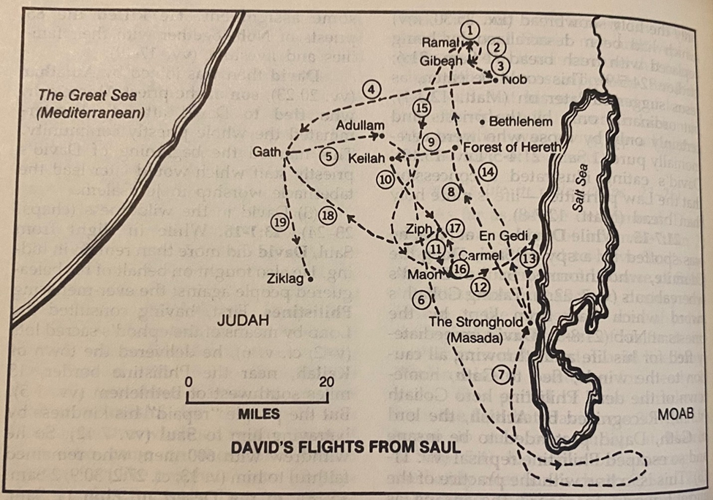

Slide 19
1Sa 23:14 David stayed in the wilderness in the Strongholds, and remained in the hill country in the wilderness of Ziph.
And Saul sought him every day, but God did not deliver him into his hand.

Slide 20

’Sought’ - bâqash – (baw-kash' H1245) A primitive root = to search out (by any method; specifically in worship or prayer); by implication to strive after =
Make a request to search for - beg, beseech, enquire, make inquisition.

Slide 21
1Sa 23:16 And Jonathan,
Saul’s son, arose and went to David at Horesh, and encouraged him in God.

Slide 22
1Sa 23:18 So the two of them made a covenant before the LORD; and David stayed at Horesh while Jonathan went to his house.

Slide 23
Renewing or reconfirming a covenant does not make the previous covenant less precious; it makes the covenant more precious and brings validity to the commitment.

Slide 24
1Sa 23:19 Then Ziphites came up to Saul at Gibeah, saying, “Is David not hiding with us in the strongholds at Horesh, on the hill of Hachilah, which is on the south of Jeshimon?

Slide 25
The Ziphites were also of David’s own tribe, his own people ….
And like the men of Keilah, the Ziphites are also turning on David, by telling Saul where he was hiding.

Slide 26
A maskil is known as a literary or musical term.
Most likely, it relates to the purpose of specific psalms or instruct how they were performed or recited, to be meditative and to impart wisdom.

Slide 27
Do not expect godly behavior from ungodly people.
We should recognize that they are sinners, and we can see them, treating them as such, but not approving of their sin.
Unconditional Love!

Slide 28
The Ziphites are going to bring a curse upon themselves, even though they think they are obeying the King, they are going against God’s anointed.

Slide 29
Principle: You, Believers, are NEVER excused from sin because we obeyed an authority that told us to sin.

Slide 30
1Sa 23:21 Saul said, “May you be blessed of the LORD, for you have had compassion on me.

Slide 31
Psa 1:1 How blessed is the man who does not walk in the counsel of the wicked, Nor stand in the path of sinners,
Nor sit in the seat of scoffers!
Psa 1:2 But his delight is in the law of the LORD,
And in His law he meditates day and night.

Slide 32
1Sa 23:23 So look, and learn about all the hiding places where he hides himself and return to me with certainty, and I will go with you; and if he is in the land, I will search him out among all the thousands of Judah.”

Slide 33
1Sa 23:25 When Saul and his men went to seek him, they told David, and he came down to the rock and stayed in the wilderness of Maon. And when Saul heard it, he pursued David in the wilderness of Maon.

Slide 34
Deu 23:21 “When you make a vow to the LORD your God, you shall not delay to pay it, for it would be sin in you, and the LORD your God will surely require it of you.

Slide 35
Church-Age Believers have instruction about vows and vowing, in the NT for which Jesus Christ spoke of himself, Mat 5:33-37.

Slide 37
Jam 5:12 But above all, my brethren, do not swear, either by heaven or by earth or with any other oath; but your yes is to be yes, and your no, no, so that you may not fall under judgment.

Slide 38
1Sa 23:25 When Saul and his men went to seek him, they told David, and he came down to the rock and stayed in the wilderness of Maon. And when Saul heard it, he pursued David in the wilderness of Maon.

Slide 39
The wilderness is a place of encounter, separation, and revelation that God provides to the Believer in order to help the believer grow.

Slide 40
‘pursued’ - râdaph – (H7291 raw-daf') A primitive root = to run after (usually with hostile intent; figuratively (of time) gone by) = chase, put to flight, follow (after, on), hunt, (be under) persecute (-ion, -or), pursue (-r).

Slide 41
Keep praying in the Spirit always …so you will have the power and fellowship of God actively working in you.

Slide 42
1Sa 23:26 Saul went on one side of the mountain, and David and his men on the other side of the mountain; and David was hurrying to get away from Saul, for Saul and his men were surrounding David and his men to seize them.

Slide 43
1Sa 23:27 But a messenger came to Saul, saying, “Hurry and come, for the Philistines have made a raid on the land.”

Slide 44
Messenger used here is the Hebrew word: mal'âk.
(H4397 mal-awk') meaning to despatch as a deputy = a messenger; specifically of God, that is, an angel (also a prophet, priest or teacher): - ambassador, angel, king, messenger.

Slide 45
1Sa 23:28 So Saul returned from pursuing David and went to meet the Philistines; therefore they called that place the Rock of Escape.

Slide 46
1Sa 23:28 (KJV) Wherefore Saul returned from pursuing after David, and went against the Philistines; therefore, they called that place Selahammahlekoth.

Slide 47
sela‛ hammachleqôth (H5555 seh'-lah ham-makh-lek-oth') From H5553 and the plural of H4256 with the article interposed; = rock of the divisions; referring to Sela ham Machlekoth, a place in Palestine
Total KJV occurrences: 1

Slide 48
sela‛ - (H5553 seh'-lah meaning to be lofty = a craggy rock, literally or figuratively (a fortress): - (ragged) rock, stone (-ny), strong hold.

Slide 49
machălôqeth (H4256 makh-al-o'-keth) From H2505; a section (of Levites, people or soldiers) = - company of course or division, portion by separation of.

Slide 50
châlaq – (H2505 khaw-lak' ) A primitive root; to be smooth (figuratively); by implication (as smooth stones were used for lots) to apportion or separate = distribute, divide, take away a portion, separate self.

Slide 51
David and his men named that place - A fortress of craggy rock or mountain, that allowed us to separate and keep us from our enemy by the provision of God-
The Rock of Separation.

Slide 52
Be alert, be sober of mind, staying inside the PPOG and learning to Separate, whenever needed, from the roots of unrighteousness.

Slide 53
Rom 13:8, “Owe nothing to anyone except to love one another; for when he loves the other, he has fulfilled the Law.”

