Slide 1
Please respect the Word of God as it is being taught by shutting off all cell phones and electronics, giving your undivided attention while service is in session.
Thank you! SLBM

Slide 2
Salt and Light Bible Ministries
‘A Daily Cross with Thee’ # 045
The Visual Sacrifice for Covering
- Life is in the Blood
Pastor Jason Kauranen
Sunday January 4, 2026

Slide 3
Rebound - 1John 1:9 states,
“ If we confess our sins,
He is faithful and righteous to forgive us our sins and to cleanse us from all unrighteousness”.

Slide 4
1Jo 1:7 but if we walk in the Light as He Himself is in the Light, we have fellowship with one another, and the blood of Jesus His Son cleanses us from all sin.

Slide 5
“The blood of Jesus” – to hamia Iēsou –
To (G3588 ta; ho) = the; neuter of definite article
Hamia (G129 HAH-ee-mah) = blood
Iēsou (G2424 ee-ay-soos') = Jesus (in Heb- "Yehoshua"/Jehoshua, contracted to "Joshua")

Slide 6
‘His Son of Him’ – tou Huiou autou– (G3588, G5207, G846)
Tou – (tos) = his own
Huiou – (hwee-os') = son, of kinship, a descendant; resembling same character or likeness
Autuo – (ow-TOS) = of him, oneself, same

Slide 7
Lev 17:10 ‘And any man from the house of Israel, or from the aliens who sojourn among them, who eats any blood, I will set
My face against that person who eats blood and will cut him off from among his people.

Slide 8
Lev 17:11 For the life of the flesh is in the blood, and I have given it to you on the altar to make atonement for your souls; for it is the blood by reason of the life that makes atonement.’

Slide 9
‘life’ – nephesh –
(H5315 neh'-fesh)
= a breathing creature, inner self with its thoughts
= soul, living being, life, self, person, beast
= an animal of vitality

Slide 10
‘ the blood’ – hah dam –
(H1818 dahm)
1. blood (as that which when shed causes death) of man or an animal
2. by analogy, the juice of the grape
3. figuratively (especially in the plural) bloodshed, drops of blood

Slide 11
Lev 17:14 “For as for the life of all flesh, its blood is identified with its life. Therefore I said to the sons of Israel,
‘You are not to eat the blood of any flesh, for the life of all flesh is its blood; whoever eats it shall be cut off.’

Slide 12
Heb 9:22 And according to the Law, one may almost say, all things are cleansed with blood, and without shedding blood there is no forgiveness.

Slide 13
Gen 4:3 So it came about in the course of time that Cain brought an offering to the Lord of the fruit of the ground.

Slide 14
Gen 4:4 Abel, on his part also brought of the firstlings of his flock and of their fat portions.
And the Lord had regard for Abel and for his offering;

Slide 15
Gen 4:5 but for Cain and for his offering He had no regard.
So Cain became very angry and his countenance fell.

Slide 16
Gen 4:10 He said,
“What have you done?
The voice of your brother’s blood is crying to Me from the ground.

Slide 17
Principle - Any injustice will not stay hidden from God forever.
The earth demands the bloodshed for judgement, Isa 26:21,
Job 16:18.

Slide 18
Isa 26:21 For behold, the Lord is about to come out from His place
To punish the inhabitants of the earth for their iniquity;
And the earth will reveal her bloodshed
And will no longer cover her slain.

Slide 19
Job 16:18 “O earth, do not cover my blood,
And let there be no resting place for my cry.

Slide 20
Gen 3:7 Then the eyes of both of them were opened, and they knew that they were naked; and they sewed fig leaves together and made themselves loin coverings.

Slide 21
Gen 3:11 And He said, “Who told you that you were naked?
Have you eaten from the tree of which I commanded you not to eat?”

Slide 22
Gen 3:21 The Lord God made garments of skin for Adam and his wife, and clothed them.
Sacrifice for the covering of sin, Principle of Atonement.

Slide 23
Gen 9:4 Only you shall not eat flesh with its life, that is, its blood.

Slide 24
Gen 9:5 Surely I will require your lifeblood; from every beast I will require it. And from every man, from every man’s brother I will require the life of man.

Slide 25
Gen 9:6 “Whoever sheds man’s blood,
By man his blood shall be shed,
For in the image of God
He made man.

Slide 26
Gen 6:14 Make for yourself an ark of gopher wood; you shall make the ark with rooms, and shall cover it inside and out with pitch.

Slide 27
‘pitch’ – kopher –
(H3724 KOH-fer)
= a cover (literally- covered in a village)
= a redemption- price, bribe, or sum of money
= camphire, pitch, bitumen (used for coating).

Slide 28
1. A legal covering that the OT shows us the principle of substitution, Exo 21:30, 30:12, Num 35: 31-32.

Slide 29
Ransom - Kopher
= To secure release by paying a price or
= To redeem or deliver from sin or punishment

Slide 30
Exo 21:30 If a ransom is demanded of him, then he shall give for the redemption of his life whatever is demanded of him

Slide 31
Redemption – pidyowm –
(H6306 pid-yome’)
= denotes the price paid to secure release, rescue, or liberation.
It refers to a concrete payment rendered in exchange for a life or possession, functioning as a legal and theological bridge between guilt and restored relationship.

Slide 32
Heb 9:22 And according to the Law, one may almost say, all things are cleansed with blood, and without shedding of blood there is no forgiveness.
A very heavy price to pay, this was the ransom note, 1Ti 2:6.

Slide 33
2. A protective covering sealed in Him for deliverance and security, Gen 6:14, Job 14: 16-17.

Slide 34
Job 14:16 “For now You number my steps,
You do not observe my sin.
Job 14:17 “My transgression is sealed up in a bag,
And You wrap up my iniquity.

Slide 35
1Pe 3:18 For Christ also died for sins once for all, the just for the unjust, so that He might bring us to God, having been put to death in the flesh, but made alive in the spirit;

Slide 36
3. An aromatic covering going up to God as a sweet smell of satisfaction, SOS 1:14, 4:13-14.
…the satisfaction of knowledge in Christ, 2Co 2:14-15.

Slide 37
SOS 4:13 Your shoots are an orchard of pomegranates
With choice fruits, henna with nard plants,

Slide 38
SOS 4:14 Nard and saffron, calamus and cinnamon,
With all the trees of frankincense,
Myrrh and aloes, along with all the finest spices.

Slide 39
2Co 2:15 For we are a fragrance of Christ to God among those who are being saved and among those who are perishing;

Slide 40
Heb 10:26 For if we go on sinning willfully after receiving the knowledge of the truth, there no longer remains a sacrifice for sins,

Slide 41
Heb 10:27 but a terrifying expectation of judgment and the fury of a fire which will consume the adversaries.

Slide 42
Heb 10:29 How much severer punishment do you think he will deserve who has trampled underfoot the Son of God, and has regarded as unclean the blood of the covenant by which he was sanctified, and has insulted the Spirit of grace?

Slide 43
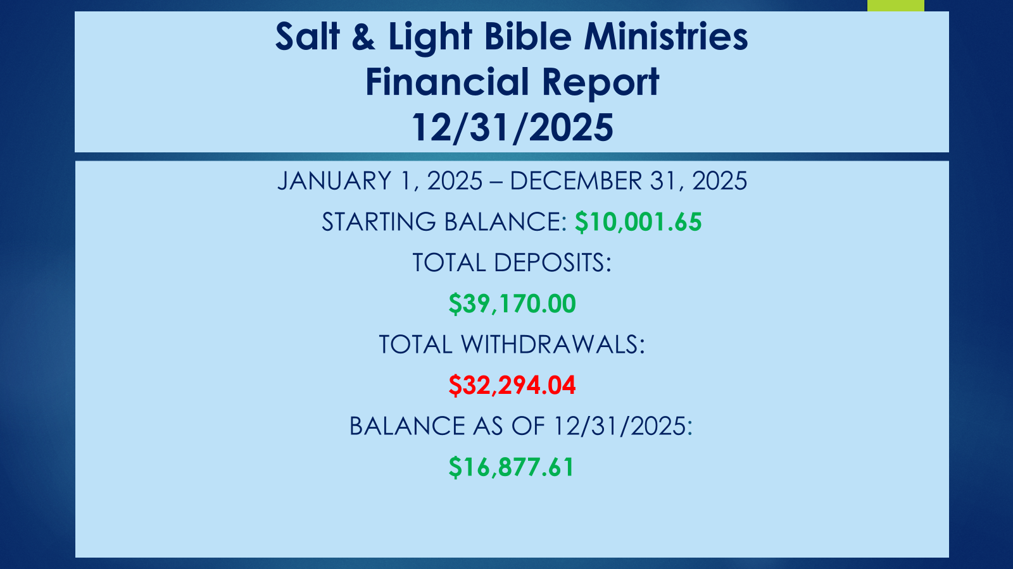

Slide 44


Slide 45
Salt & Light Bible Ministries
Help, Letters, Prayer & Donations write to us: SLBM@gmail.org visit our website: SLBM.org -*paypal watch us youtube @SaltandLightBibleMinistries or mail: Salt and Light Bible Ministries c/o Pastor Jason Kauranen
2 Dianne Drive
East Wareham, Mass 02538

