Slide 1
Please respect the Word of God as it is being taught by shutting off all cell phones and electronics, giving your undivided attention while service is in session.
Thank you! SLBM

Slide 2
Salt and Light Bible Ministries
‘A Daily Cross with Thee’ # 074
Be Careful What You Hear, Warnings to the Spiritual Illusions from
False Teachers.
Pastor Jason Kauranen
Wednesday June 17, 2026

Slide 3
Rebound - 1John 1:9 states,
“ If we confess our sins,
He is faithful and righteous to forgive us our sins and to cleanse us from all unrighteousness”.

Slide 4
Col 2:2 that their hearts may be encouraged, having been knit together in love, and attaining to all the wealth that comes from the full assurance of understanding, resulting in a true knowledge of God’s mystery, that is,
Christ Himself,

Slide 5
Col 2:3 in whom are hidden all the treasures of wisdom and knowledge.
Col 2:4 I say this so that no one will delude you with persuasive argument.

Slide 6
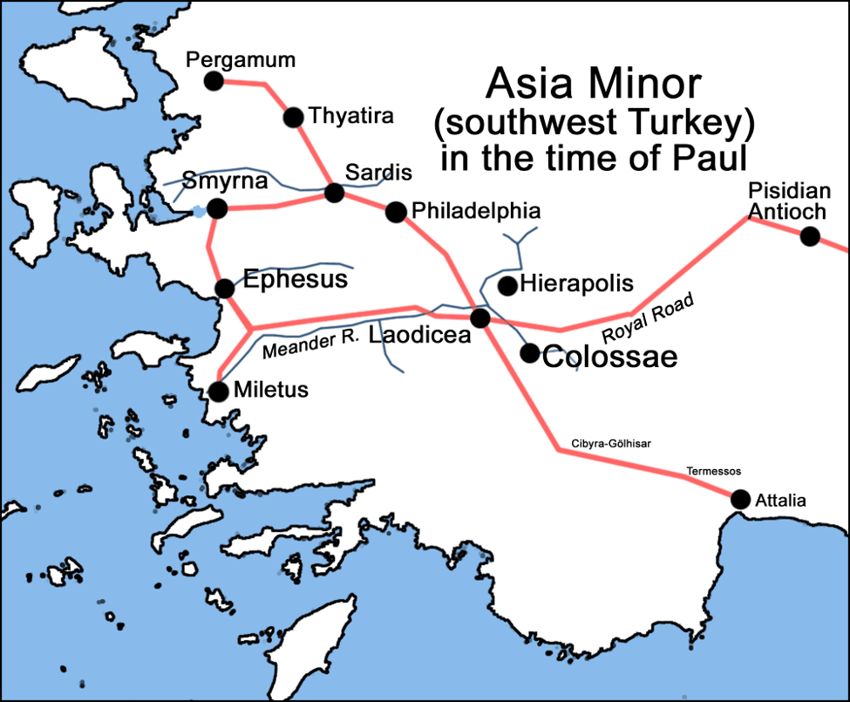

Slide 7
The infiltration of false teaching upon the early church, was a mix of Jewish legalism, Greek philosophy, and Orient mysticism.

Slide 8
Col 2:8 See to it that no one takes you captive through philosophy and empty deception, according to the tradition of men, according to the elementary principles of the world, rather than according to Christ.

Slide 9
Col 2:11 and in Him you were also circumcised with a circumcision made without hands, in the removal of the body of the flesh by the circumcision of Christ;

Slide 10
Col 2:12 having been buried with Him in baptism, in which you were also raised up with Him through faith in the working of God, who raised Him from the dead.

Slide 11
Col 2:13 When you were dead in your transgressions and the uncircumcision of your flesh, He made you alive together with Him, having forgiven us all our transgressions,

Slide 12
Deu 30:6 “Moreover the Lord your God will circumcise your heart and the heart of your descendants, to love the Lord your God with all your heart and with all your soul, so that you may live.

Slide 13
The Apostle Paul wants them to:
Perceive it, metabolize it, believe it, and strengthen their faith by using the doctrine … and be confident in the truth of being in union with Christ.
‘It’ is the mystery doctrine.

Slide 14
Col 2:17 things which are a mere shadow of what is to come; but the substance belongs to Christ.

Slide 15
FF Bruce said,
“It would be preposterous indeed for those who had reaped the benefit of Christ’s victory to put themselves voluntarily under the control of the powers which he had conquered.”

Slide 16
Col 2:23 These are matters which have, to be sure, the appearance of wisdom in self-made religion and self-abasement and severe treatment of the body, but are of no value against fleshly indulgence.

Slide 17
Col 3:2 Set your mind on the things above, not on the things that are on earth.
Col 3:3 For you have died and your life is hidden with Christ in God.

Slide 18
“hidden” – apokruphos –
(G614 a-PO-kroo-fos)
= kept secret or treasured; to hide
*Stored away as a treasure for the one who seeks

Slide 19
Col 3:4 When Christ, who is our life, is revealed, then you also will be revealed with
Him in glory.

Slide 20
Col 3:24 a knowing that from the Lord you will receive the reward of the inheritance….
Col 3:24b It is the Lord Christ whom you serve.
Our focus and main objective!!!!

Slide 21
1. Who Jesus Is:
Colossians 2:9 declares that in Christ, all the fullness of the Deity lives in bodily form.
1 John 1:1–3 describes Jesus as the Word of life who was with the Father and was physically manifested to humanity.

Slide 22
2. Victory Over Sin:
In Col 2:13–15, Paul writes that God forgave us all our trespasses and triumphed over the spiritual powers of darkness through the cross.
1 John 1:7 assures believers that the blood of Jesus cleanses us from all sin.

Slide 23
3. Warnings Against Deception:
In Col 2:8, Paul warns the Colossians against being “taken captive” by human tradition and deceptive philosophy.
In 1Jo 1:6, John warns his readers against self-deception and claiming to have fellowship with God while walking in darkness.

Slide 24
4. Walking in the Light:
Col 2:6–7 exhorts believers to continue being rooted and built up in Christ.
1Jo 1:7–9, which calls believers to walk in the Light as He Himself is in the light, bringing sins before God in honest confession.

Slide 25
A. The Source of Deception
Paul warns against "hollow and deceptive philosophy" driven by human traditions and worldly principles rather than truth
In Christ. (Col 2:8)

Slide 26
(cont. A. The Source of Deception)
John warns against self-deception regarding one's own moral standing, a depiction between defilement and purity. The danger is thinking you have fellowship with God, while harboring sin in the darkness where your spiritual life is dead, (1Jo 1:6,8).

Slide 27
B. The Target of the Warning
Col 2: Focuses on the danger of being "taken captive" by others' rules and persuasive arguments.
The warning is: Do not let others dictate your faith. Be careful what you listen to (hear), be careful what you see (optics) … don’t keep the company of liars and deceivers.

Slide 28
1Jo 1: Focuses on the danger of making yourself and God a liar by claiming to be without sin.
The warning is: Do not lie to yourself about your condition, but if you fall, deal with it appropriately and live in Your position In Christ.

Slide 29
C. The Solution / Response
Col 2:2,9 Points to Christ being ALL sufficiency.
Because ALL believers are fully complete In Him, they should reject ALL man-made regulations, that places themselves outside the divine plan of God.

Slide 30
1 John 1:7, 9 Points to the necessity of confession.
Walking in the Light means acknowledging the reality of sin and trusting God’s faithfulness to forgive.
BE accountable and judge ourselves rightly.

Slide 31
1Jo 1:6 If we say that we have fellowship with Him and yet walk in the darkness, we lie and do not practice the truth;

Slide 32
1Jo 1:7 but if we walk in the Light as He Himself is in the Light, we have fellowship with one another, and the blood of Jesus His Son cleanses us from all sin.

Slide 33
1Jo 1:8 If we say that we have no sin, we are deceiving ourselves and the truth is not in us.

Slide 34
Koine Greek Conditional Clauses
First-class: Assumes the premise is true for the sake of argument ("If... and it is true").
Second-class: Contrary-to-fact ("If... but it is not").

Slide 35
Third-class: Hypothetical, potential, or contingent on the volition of the listener ("If... maybe yes, maybe no") to probability.
Fourth-class: A highly improbable hypothetical (rare in the NT).

Slide 36
An illusion = a state or fact of being deceived, a misconception or false impression, in which the perception fails to give the true character of the object that is perceived.

Slide 37
Evil, in the form of the depravity of man, will take any good invention or doctrine and turn it on its head to be used for personal gain or greed through a false system
(cosmic system thinking).

Slide 38
Reversionist and apostate believers become deceived pawns and are called: enemies of the cross, enemies of God; contradicting the very thing they believe in, by defending and living in that illusion.
Phi 3:18-19; Jam 4:4; 1Jo2:18.

Slide 39
Salt & Light Bible Ministries
Help, Letters, Prayer & Donations write to us: SLBM@gmail.org visit our website: SLBM.org -*paypal watch on YouTube @SaltandLightBibleMinistries or mail:
Salt and Light Bible Ministries c/o Pastor Jason Kauranen
2 Dianne Drive or 44A Troy Street
East Wareham, Ma 02538 Fall River, Ma 02720

