Slide 1
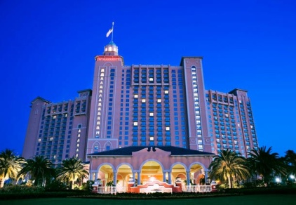
Baltimore G-Men Weekend “License to Party”
Website Completed
Registration closing next week
Current Registrants – 506
Table Assignments following Registration
Attire Selected and Ordered
Ladies Event Planned
Registration Details Outlined
Day Captains Assigned
Dre Mode On-track for Event Logistics
Enhanced experience with Theme
“We’re on track and in good shape!!”

Slide 2
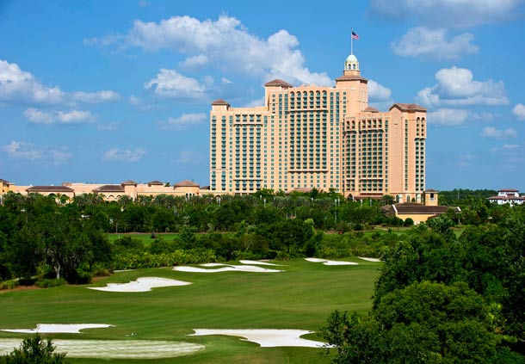
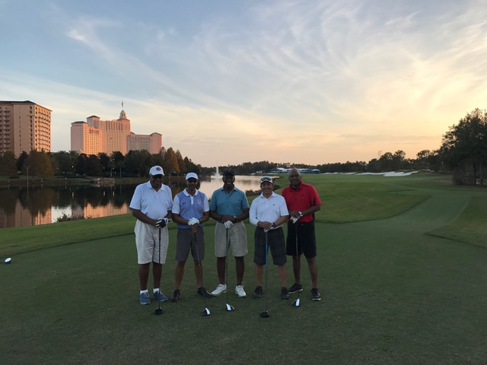
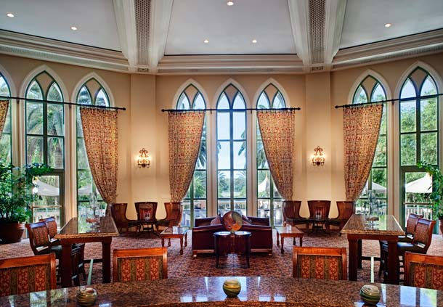
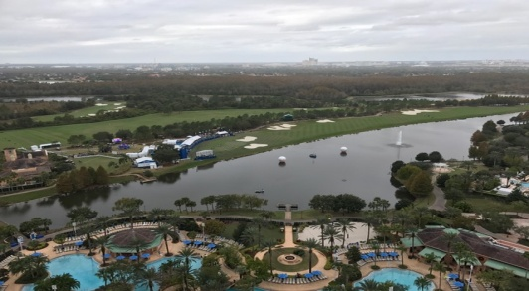
“License to Party” Wednesday, November 15th
12:00 PM | Member Check-In by noon
2:30 PM | Physical Walk through of Script and Logistics of Resort
4:00 PM | BG Chapter's Reception
5:30 PM | Location: Highball &Harvest
7:00 PM | Committee Leads Final Prep Meeting

Slide 3
“License to Party” Thursday, November 16th
Attire: White Nordstrom Polo shirt w/Guardsmen LOGO with your own khaki trousers with brown /tan belt and brown /tan shoes
8:00 AM | Breakfast for Chapter Members
9:00 AM | Day Captain (Ken T. and Craig - Prep Session)
11:00 AM - 5:00 PM | Registration Open Period (4-6 People Needed - Leads: Jeff & Crissy)
11:00 AM - 1:00 PM | Greeters, (Lead - Craig - 6 Needed)
1:00 PM - 3:00 PM | Greeters, (Lead - Craig - 6 Needed)
3:00 PM - 5:00 PM | Greeters, (Lead - Craig - 6 Needed)
12:00 PM | Event Check-in
4:00 PM | Location: Grand Registration Desk
4:00 PM - 4:30 PM | Chapter Pulse Check (Recap, address any issues)
6:45 PM - 7:45 PM | Logistics People - Elevator, Hall, Outside Venue (3 people Needed)
Attire: Tommy Bahama camp shirt (color is called fusion is like a bright coral color) with the cream trousers that will be comp’d by Strong Suit with your own brown/tan shoes and matching brown/tan belt.
7:00 PM | Welcome Reception Theme: "Havana Nights"
 | Location: Valencia Terrace
10:00 PM | (Weather Back Up - Mediterranean Salon 1-3)

Slide 4
“License to Party” - Friday, November 17th
Attire: Blue Lake Nordstrom Polo shirt w/Guardsmen LOGO with white Cutter & Buck Long Golf shorts. Shoes will be your own golf shoes.
6:00 AM | Need greeters in Lobby and Citron to direct to Golf Clubhouse
6:45 AM | Golf & Tennis Breakfast 6:45a - 7:45a
 | Location: Fairways Pub
7:45 AM | Golf Begins (shotgun at 8a)
8:00 AM | Tennis Begins
8:00 AM | Take down the Golf and Tennis signs
9:00 AM | Day Captain (Kerry - , Co Captain - Dallas - Prep Session)
9:00 AM | Ladies Offsite Excursion 9a - 12p |  | Ride & Drive (9a - 1p)
 | Location: Hotel Valet |  | Location: Hotel Valet
11:00 AM - 1:00 PM | Registration Opens (3 - 4 people Needed)
 | Location: Grand Registration Desk
1:00 PM | Winners for Tennis and Golf will be announced
 | Luncheon Reception 1p-3p | Location: Fairways Lawn (Weather Back Up- Mediterranean Salon 1-3)
3:00 PM | President's Mtg 3:30p - 5:30p Location: Fairways Boardroom
3:00 PM - 4:00 PM | Registration Opens (2 people Needed)
4:00 PM - 4:30 PM | Chapter Pulse Check (Recap, address any issues)
6:45 PM - 7:45 PM | Logistics People - Elevator, Hall, Outside Venue (3 people Needed)
7:00 PM | Chapter Members Greet Guest
Attire: Made-to-Measure blue mini check sport coat with cream color trousers and navy crew neck Robert Barakett T-shirt, brown/tan shoes and brown/tan belt.
7:30 PM | EVENING FUNCTION Theme: "Macau Casino Night"
 | Location: Palazzo Foyer & Ballroom
 | Dinner/Dance/Awards/BG Chapter Intro
8:00 PM | Speakers - Mike & Marcellous
 | Introduce President
 | New President Introductions
 | Past President and New Guardsmen
11:00 PM | Late Night Reception
1:30 AM | Location: Mediterranean Salons 1-3

Slide 5
“License to Party” - Saturday, November 18th
Attire: Black Nordstrom Polo shirt w/Guardsmen LOGO with your own khaki trousers or shorts, shoes of your choosing.
7:30 AM | Day Captain (Craig - Prep Session)
8:00 AM | Nat'l Meeting Breakfast 8a-10a
 | Location: Mediterranean Salons 1-3
9:00 AM | Nat'l Meeting 9a-11a
10:00 AM | Location: Mediterranean Salons 1-3 |  | Ladies Event 10a - 12:30p
11:00 AM |  | Ride & Drive (11a - 1p) | Location: Segura 1-6
12:00 PM |  | Location: Hotel Valet | & Citrus Garden
1:00 PM | Luncheon
 | Location: Valencia Terrace (weather: Palazzo Salon A-D)
3:00 PM
4:00 PM - 4:30 PM | Chapter Pulse Check (Recap, address any issues)
Attire: Made-to-Measure navy tuxedo, your own tuxedo shirt, tie, bow tie , cuff links, studs, shoes, etc.
6:45 PM - 7:15 PM | Logistics People - Elevator, Hall, Outside Venue (3 people Needed)
7:00 PM | Chapter Members Greet Guest
7:30 PM | EVENING FUNCTION Theme: "London Calling"
 | Dinner/Dance/New Organization Members
 | Location: Palazzo Foyer & Ballroom
8:30 PM | Introduction of Chapter Members
11:00 PM
11:00 PM | Late Night Reception
1:30 AM | Location: Mediterranean Salons 1-3

Slide 6
“License to Party” - Sunday, November 19th
Attire: Gray Nordstrom Polo shirt w/Guardsmen LOGO with your own khaki trousers or shorts, shoes of your choosing.
8:00 AM | Breakfast
 | Location: Citron Restaurant & Monterey Room
11:00 AM
11:00 AM
“Mission Accomplished!!!!

Slide 7
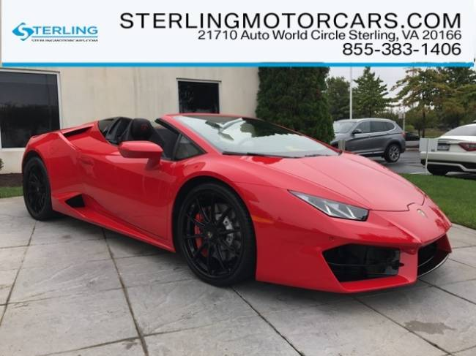
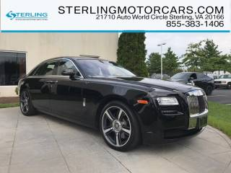
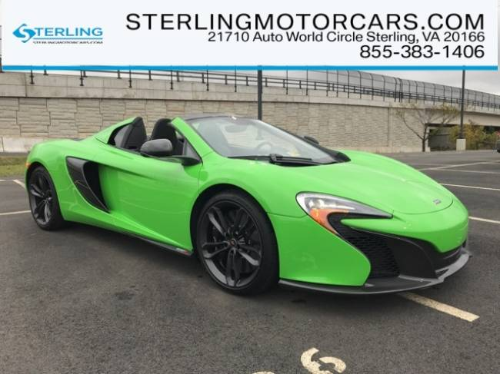
“License to Party” Ride and Drive – Thank You Tom & Joyce!!

Slide 8
“License to Party” – Committee Report Out
Registration (Jeff & Crissy)
Attire (Rick)
Web & Mobile Application (Edwin)
Day Captains (Marcellous)
Budget (Bryant)
Signage (JP)
Golf & Tennis (Dwight, James, Zed)
Ladies Event (Mya)

