Slide 1
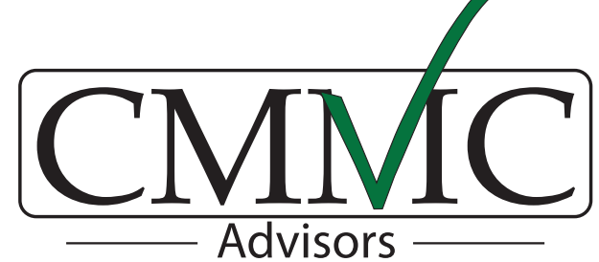
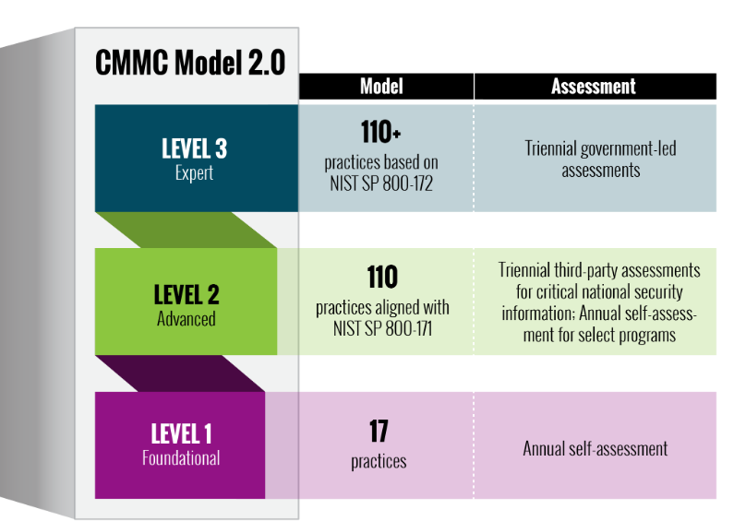
The Federal Government and Department of Defense (DoD) are implementing the CMMC 2.0 security & compliance program on December 15, 2024.
Are you Ready?
CMMC 2.0 program (CFR 32) will be implemented on December 15, 2024.
By early 2025, subsequent DoD contracts will include CMMC level (1, 2, or 3) pre-prerequisites for contract award (CFR 48).
In 2020, over $1 Trillion of intellectual property was exfiltrated by US adversaries and global criminals. The US public sector, universities, and private businesses are vulnerable to these cybersecurity attacks which erode our U.S. military advantages, threaten our critical infrastructure, and reduce our economic prosperity.
The DoD has responded and is now implementing CMMC 2.0 starting December 15, 2024 and will affect most of the 300,000+ Defense suppliers globally.
Organizations that fail to meet the CMMC 2.0 cybersecurity and compliance requirements risk:
  Business Disruption – Unexpected business disruption and customer, supplier impact that could result insignificant liability, business impact, and bankruptcy.
  Business and Contract Loss - Government suppliers are being disqualified for non-compliance, resulting in loss of current and future business
  Legal & Personal Accountability – Customers and partners are holding suppliers personally liable for information loss and fraud (e.g., Negligence & False Claim Act)
  Negative Brand Impact - Security & Compliance failures have created negative brand impact and increased risk of future business loss and liability
CMMC Advisors can provide leaders with the knowledge and tools to make CMMC a competitive advantage and enable informed decisions on how to navigate and invest in their CMMC Journey.
12/15/24
CMMC 2 Timeline Rollout
Q125
Q126
Q127
Q128
Phase 1
Phase 2
Phase 3
Phase 4
CMMC 2.0 program (CFR 32)
CMMC 2.0 program (CFR 48)
Level 1 is equivalent to all of the safeguarding requirements from FAR Clause 52.204-21. It is focused on protecting FCI for suppliers such as landscapers, food service, etc.
Level 2 is equivalent to all of the security requirements in NIST SP 800-171 Revision 2. It is focused on protecting CUI and ITAR for organizations such as manufacturers, cloud service providers, etc.
Level 3 will be based on a subset of NIST SP 800-172, and more detailed information will be released at a later date. It is focused on protecting higher sensitivity CUI and ITAR.

Slide 2
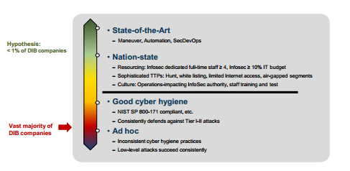
CMMC Advisors helps guides organizations through their DoD cybersecurity & compliance journey. CMMC Advisors provides affordable cybersecurity training and an ecosystem of affordable and capable solution providers.
Executive Insight
Leaders are required today to understand their legal, regulatory, contractual, and business obligations and risks to make informed business decisions and investments
Top-Down Approach
A top-down cybersecurity framework and approach is needed to assess, analyze, document, and implement secure & compliant solutions
Compliant Solutions Ecosystem
Organizations need guidance on secure and compliant business and technical solutions to accelerate risk reduction and cost optimization
Full Service Trusted Advisor
A trusted advisor and subject matter expert that can guide leaders through their cybersecurity journey
intelligence which you can then use to optimize resources and services
How Can CMMC Advisors Help?
Education – Provide educational workshops for leaders and stakeholders on business and operational impacts
Strategy – Perform high level assessment to enable executives to make informed CMMC roadmap and investments decisions
Advisory - Provide ad-hoc support and solutions to navigate with proven, credible, and affordable security & compliance suppliers
Learn more
For more information please visit:
Contact: info@cmmcadvisors.com
DOD estimates 90+% of suppliers do not currently meet Contractual Cybersecurity requirements!
CMMC Advisors brings Defense industry leadership and experience to help small and medium organizations meet their cybersecurity and compliance requirements including regulatory, legal, contractual and business operational requirements.

