Slide 1

What symptoms are normal, what should raise alarm bells?
Kate Gatenby
Consultant Cardiologist LTHT

Slide 2

Chest pain

Slide 3

35 year old lady P1 G2
39+6/40
No risk factors for IHD
Presents via 999 with chest pain
Where should she go?
  Delivery suite?
  A&E?
  Take some gavison?

Slide 4
Chest pain requiring opiate analgesia
Repeated presentations with chest pain
Ischemic sounding chest pain
Chest pain in patients at high risk of IHD

Slide 5
36 year old
G2P1
Incidental finding of dilated aortic root
42mm pre pregnancy
Mid pregnancy 45 mm
No family history
Not known to have marfan / loeys deitz
Trileaflet aortic valve
Chest pain at 35 + 4 –contacts local maternity unit … reassured
Chest pain at 36/40 – presents in extremis to A&E at LGI

Slide 6
Severe chest / back pain
Presentation in 3rd trimester or post partum
Known dilated aortic root
Known inherited aneurysmal syndrome
Repeated presentations

Slide 7
Breathlessness

Slide 8
30 year old G3P0
BMI 45
Late booker to service
Increasingly SOB since around 26 weeks pregnant
Presents with marked SOB at 36/40
What could be causing her breathlessness?
What would point us in a “cardiac direction”
Any tests that might help?

Slide 9
Repeated presentations with SOB and anxiety
Orthopnoea and paroxysmal nocturnal dyspnoea
Breathlessness interrupting activities of daily living
Persistent sinus tachycardia
Nocturnal cough

Slide 10
Repeated presentations with SOB and anxiety
Orthopnoea and paroxysmal nocturnal dyspnoea
Persistent sinus tachycardia
Nocturnal cough
Urgent NT pro BNP
Urgent echo unless NT pro BNP is normal

Slide 11
Palpitations / collapse

Slide 12
32 year old female
Presented 3 months post partum
Recurrent episodes of collapse precipitated by loud noises
Seizure like activity with collapses
Collapses associated with loud noises

Slide 13
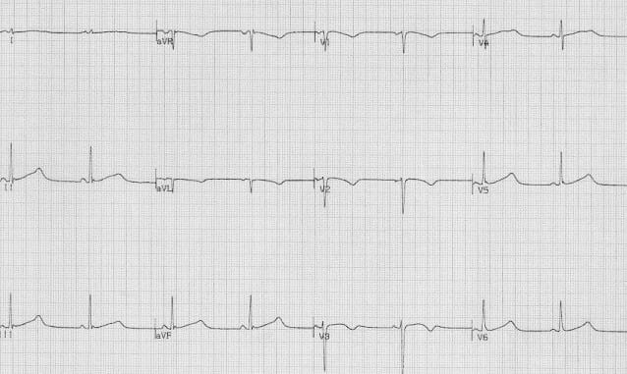
QT interval > 500ms

Slide 14
Palpitations associated with severe symptoms
Palpitations with known heart disease
Family History of SCD
Syncope
Any broad complex tachycardia
Repeated presentations

Slide 15

Take home messages….

Slide 16
Red flag presentations
Severe chest pain
Persistent Sinus tachycardia
Orthopnoea and paroxysmal nocturnal dyspnoea
Syncope during exercise
Elevated respiratory rate
Extreme anxiety and breathlessness

Slide 17
Investigation and Management
Troponin and NT pro BNP
ECG
Angiography if needed
Echo
DCCV safe at any stage
MDT involvement

Slide 18


Thank You
Kate Gatenby
@kate_gatenby
Kate.gatenby@nhs.net

