Slide 1
Pulmonary hypertension and pregnancy
James Oliver, Leeds

Slide 2
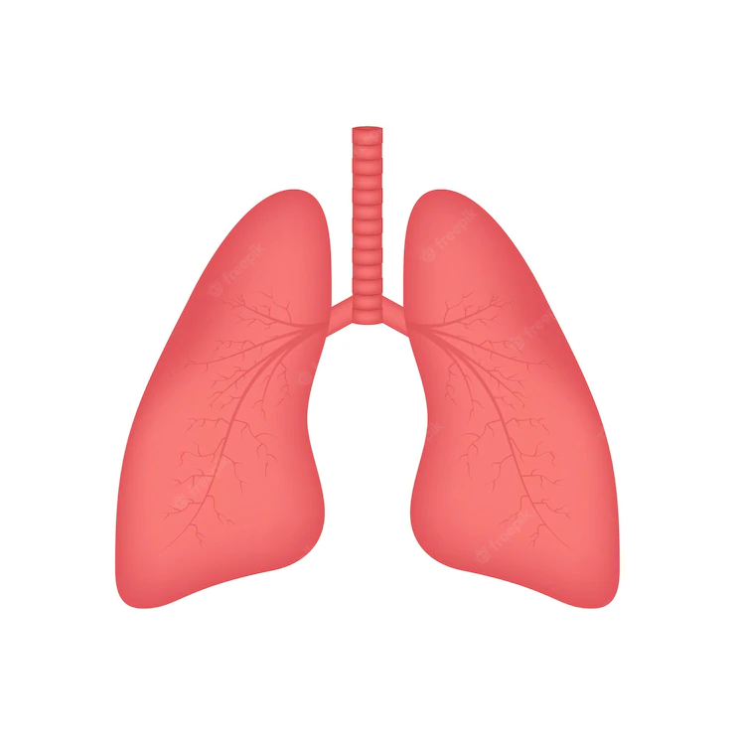

Pulmonary artery
Normal mean pressure < 20 mmHg

Slide 3
Pulmonary hypertension
Pulmonary artery pressure > 20 mmHg

Slide 4
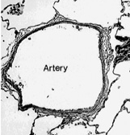
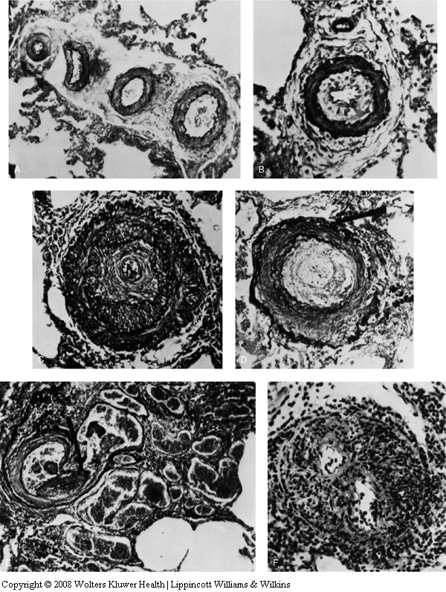
Pulmonary hypertension
Disease of the very small arteries of the lungs
Normal
Progressively more abnormal

Slide 5
Pulmonary hypertension
Various causes
Idiopathic (primary)
Congenital heart disease
Chronic PEs
And lots more

Slide 6
Pulmonary hypertension
Effect on patient
Strain on / failure of right ventricle
Reduced ability to increase flow through lungs and, so increase cardiac output
Breathless
Palpitations
Haemoptysis
Syncope
Signs of right heart failure

Slide 7
Pulmonary hypertension
Treatment and prognosis
Treat with pulmonary vasodilators
PDE5 inhibitors
Sildenafil
Tadalafil
Endothelin antagonists
Bosentan
Macitentan
Ambrisentan
Prostacyclin analogues
Iloprost
Treprostinil
Selexipag
Prognosis
Variable according to cause and severity
In current era, overall 20% mortality at 3 years in idiopathic PH

Slide 8
Pulmonary hypertension and pregnancy
Normal physiological changes present a major challenge in women with PH
May unmask previously undiagnosed PH
Inability to accommodate increase in cardiac output
Inability to cope with volume load
Usual fall in PVR attenuated or absent
RV ischaemia
Thrombosis

Slide 9
PH and historical maternal mortality
Time period | No. of pregnancies | PH type | Maternal mortality rate (%)
1948–1978¹ | 70 | Eisenmenger | 52 Overall 52%
1978–1996² | 27 73 25 | IPAH Eisenmenger Other PH | 30 36 Overall 38% 56
1997–2007³ | 29 29 15 | IPAH Eisenmenger Other PH | 17 28 Overall 25% 33
1. Gleicher N et al. Obst Gyn Surv 1979, 2. Weiss BM et al. J Am Coll Cardiol 1998, 3. Bédard E et al. Eur Heart J 2009.

Slide 10
Pregnancy in PH: Outcomes in the modern era
 | Kiely et al. 2010 | Curry et al. 2012 | Jais et al. 2012 | Duarte et al. 2013 | Sheffield 2017 *
Type of study | 1 centre, retrospective 2002–09 | 1 centre, retrospective 1995–2010 | Multi-centre prospective 2007–10 | Multi-centre retrospective 1999–2009 | 1 centre retrospective 2002-17
Pregnancies | 15 | 12 | 26 | 18 | 36
Terminations | 3 | – | 6 | 6 | 9
Continued pregnancy | 12 | 12 | 20 | 12 | 27
Miscarriages | 2 | 3 | 2 (2 deaths) | 0 | 7
Deliveries | 10 | 9 | 18* | 12 | 20
Maternal deaths/Tx, n (%) | 1 (8%) | 2 (17%) | 4 (20%) | 2 (16%) | 2 (7%)
PAH/LHD/PH owing to respiratory disease/ CTEPH/other | 12/0/0/1/0 | 7/1/1/0/0 | 26/0/0/0/0 | 18/0/0/0/0 | 32/0/0/0/4
CS/NVD | 9/1 | 9/0 | 15/1 | 12/0 | 19/1
Anaesthetic: local/general | 10/0 | 2/7 | 15/3 | 8/3 | 20/0
PAH treatment | 10/10 | 5/9 | >16/20* | 9/12 | 20/20
*8 patients were calcium channel blocker responders. CS, cesarean section; CTEPH, chronic thromboembolic pulmonary hypertension; LHD, left heart disease; NVD, normal vaginal delivery; Tx, transplantation.

Slide 11
Management of pregnancy in PH
Pre-pregnancy counselling, clear contraceptive advice
Detailed clinical assessment
Aggressive management
Multiprofessional involvement
Detailed planning

Slide 12
Sheffield’s management protocol
Pregnancy with suspected
diagnosis of PH
Pregnancy in patient
with known PH
Standard investigation including echocardiography + imaging
Echocardiography +/- MRI
Consider repeat imaging and RHC if clinically indicated
RHC if significant PH not demonstrated on imaging
Full counselling regarding risks of continuing with pregnancy (multiprofessional review)
Kiely DG et al. BJOG 2010, Kiely DG et al. Obstet Med 2013.
.

Slide 13
Sheffield’s management protocol
Full counselling regarding risks of continuing with pregnancy (multiprofessional review)
Termination of pregnancy (method indicated by stage of pregnancy)
Patient wishes to continue with pregnancy
Kiely DG et al. BJOG 2010, Kiely DG et al. Obstet Med 2013.
.

Slide 14
Sheffield’s management protocol
Patient wishes to continue with pregnancy
Early sildenafil or nebulized iloprost. Prophylactic LMWH unless otherwise indicated
Addition of sildenafil or nebulized iloprost or escalation to iv prostanoid as clinically indicated
Frequent monitoring of clinical status and exercise capacity, echocardiography and MRI, with regular foetal scans
Elective admission at around 36/40
Cesarean section under combined spinal/epidural with specialist obstetrician, anaesthetist, and pulmonary vascular physician in attendance
Close post-partum monitoring in critical care setting with central and arterial line and non-invasive cardiac output monitoring
Kiely DG et al. BJOG 2010, Kiely DG et al. Obstet Med 2013.
.

Slide 15
A PH in pregnancy case from Sheffield
23-years old, idiopathic PH
WHO functional class II, clinically stable on bosentan and warfarin
Warned about the teratogenicity of bosentan
Seen by gynaecologist for contraception advice
Right heart catheter
  Mean PA pressure: 38 mmHg
  RA pressure: 1 mmHg
  Cardiac output: 5.9 L/min
  PVR: 380 dyne.s.cm⁻⁵ (normal < 180)
  +ve vasodilator response

Slide 16
24+4/40: threatened labour, given steroids
25/40: collapse and cardiorespiratory arrest, IV iloprost started
Cesarean section 25+5/40 with epidural/spinal, live birth
 | Early pregnancy | Day 1 | Day 5 pre-CS | Day 5 CS + 4 hr
FiO₂ |  | 0.60 | 0.45 | 0.45
mPAP (mmHg) | 38 | 68 | 42 | 34
RAP (mmHg) | 1 | 18 | 3 | 1
TPR (dyne·s·cm⁻⁵)* | 380 | 1265 | 533 | 451
CO (L/min) | 5.9 | 4.3 | 6.3 | 6.03
*Total pulmonary resistance, normal <180
Notes:
iv iloprost between day 1 and 5; delivery between pre-CS and CS + 4 hr

Slide 17
So, good baseline functional class and clinical stability doesn’t necessarily mean all will be OK

Slide 18
Pulmonary hypertension in pregnancy
Very high risk
Not quite as high risk with modern treatment
PH pregnancy should always be managed in an expert centre

