Slide 1
Cardiac Drugs in Pregnancy
Dr Ken Hodson MD MRCP(UK) MRCOG
Consultant in Obstetrics and Maternal Medicine, Newcastle upon Tyne Head of the UK Teratology Information Service (UKTIS)

Slide 2
What I’m going to talk about
Pharmacological management of:
Heart failure
Arrythmia
Hypertension
Antiplatelet drugs
Mainstream medication
From a drug safety perspective
Where to go for information
PubMed reference numbers/REPROTOX/MicroMedex

Slide 3
What I’m not going to talk about
Metal heart valves & anticoagulation
More obscure drugs… phone UKTIS(!)
Indications/efficacy/etc…

Slide 4
Free advice on medication use and chemical exposure in pregnancy
Systematic review of over 450 medications, updated every 4yrs
Patient information sheets on commonly prescribed medications
Registry CAG approved teratology/pregnancy outcome database
www.uktis.org
www.medicinesinpregnancy.org
   0344 892 0909

Slide 5
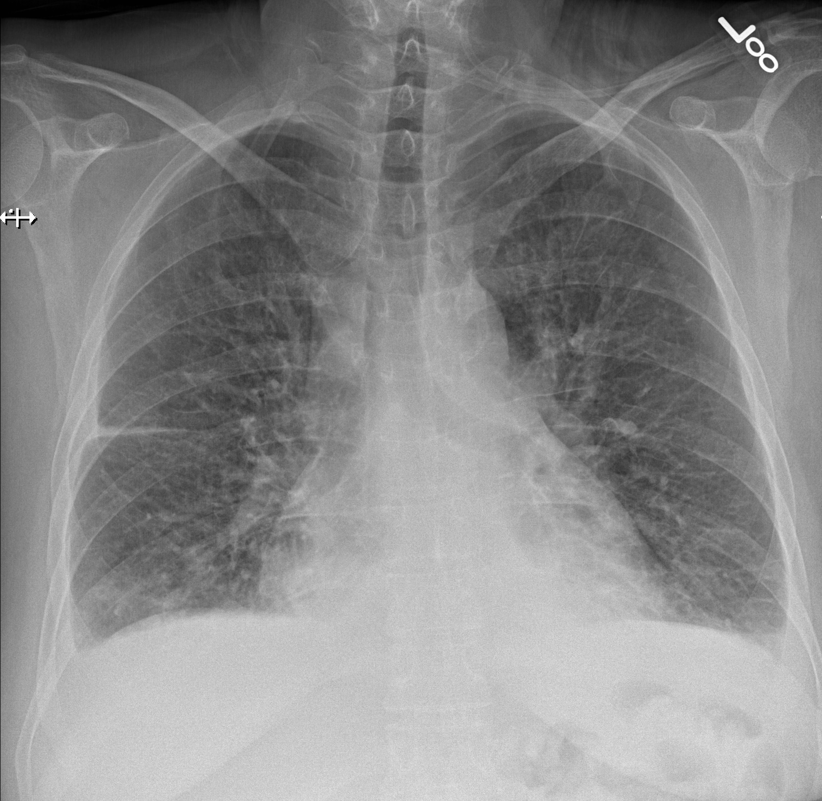
Heart failure: acute management
Do what you normally do!
Diuretics
Opiates
Oxygen
Nitrates
Betablocker
… all safe to give in pregnancy, don’t delay treatment because of pregnancy

Slide 6
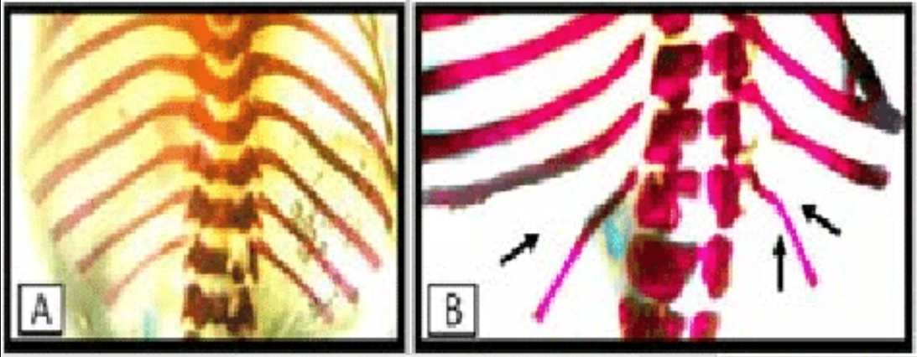
Loop diuretics - furosemide
No human evidence malformation²
Ototoxicity – not statistically significant (1,020 prem babies, >28 days furosemide)³
Small doses in breast milk – not harmful
‘Wavy ribs’ – rats 90mg/kg/day¹
Key Messages
Furosemide is safe in pregnancy and BF
Monitor Electrolytes
¹ PMID: 7281172
² REPROTOX
³ PMID: 30193125

Slide 7
Thiazide diuretics – BFZ, metolazone
Little data on BFZ and metolazone
Thiazides: 5,000 exposures¹
No increase in malformation rate
Case report/series of
Neonatal thrombocytopenia² (n=7)
Fetal biochemical disturbance
Uteroplacental insufficiency
1,040 infants³, hydrochlorothiazide for HTN – no complications
Key Messages
Can use thiazides if needed
Don’t use for hypertension
Check baby after delivery
¹ REPROTOX
² PMID: 14158963
³ PMID: 5532963

Slide 8
Spironolactone & feminization
K⁺ sparing diuretic, antagonises aldosterone
Anti-androgen properties (weak)
?feminization of male fetus
Rats, 40mg spironolactone/day¹
No human cases have been reported²
0.11% transfer into breastmilk³
Key Messages
Spironolactone is safe in pregnancy and BF
Antiandrogen effects theoretical
¹ PMID: 7456979
² REPROTOX

Slide 9
ACEi: First trimester exposure
No good evidence of ↑ miscarriage risk
Overall CM rate¹
5 studies: 4,000 T1 exposures
4 studies – no ↑risk CM
One study - ↑risk, but diabetics
CVS/CNS/renal malformations
One study², n=209: ↑3.7x CVS, ↑4.4x CNS, ↑9x renal
Outlier – not reproduced larger cohorts
Should ACEi be stopped prior to conception?
Key Messages
ACEi probably not teratogenic
Consider stopping prior to conception
¹UKTIS monograph: ACEi
² PMID:

Slide 10
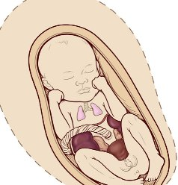
ACEi: 2nd and 3rd trimester exposure
Hypocalvaria
~60% fetuses affected (ACEi)
~100% fetuses affected (ARBs)
Oligohydramnios
Key Messages
ACEi/ARBs should be stopped in 2nd and 3rd TM
ARBs are more toxic to fetus
Pulmonary hypoplasia
Limb contractures
Renal tubular dysgenesis
Renal Failure

Slide 11
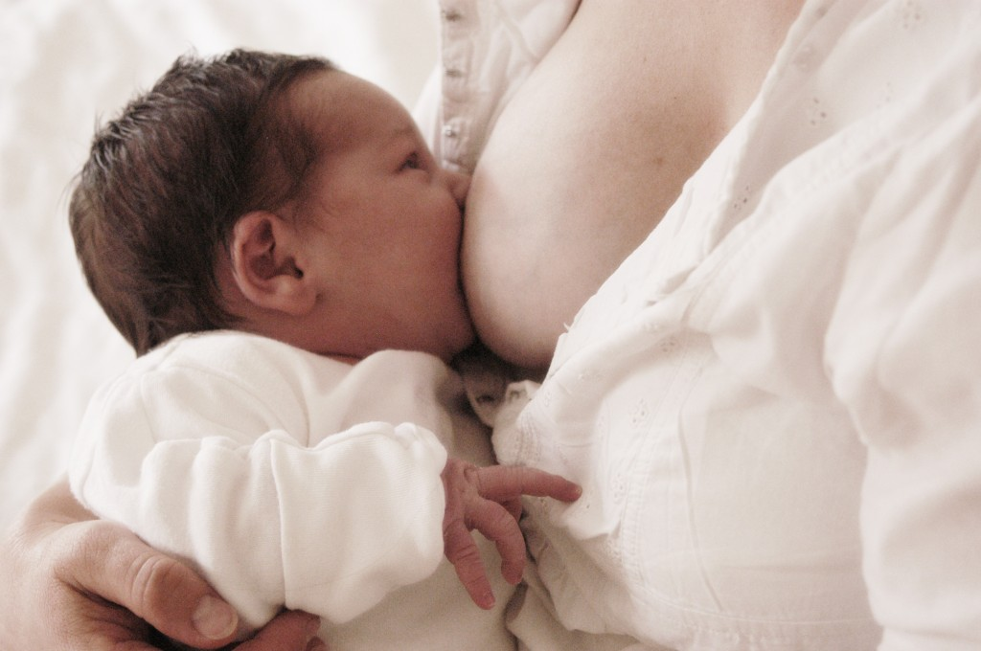
ACEi, ARBs and breastfeeding
Enalapril
Captopril
Quinapril
No data on:
Other ACEi
ARBs – although ARBs are heavily protein bound
Low concentration No clinical significance¹
Key Message
Enalapril, captopril and quinapril are recommended by NICE

Slide 12
Nitrates: GTN, ISMN
Safe
Have been used to treat:
Maternal hypertension
Tocolytic
Retained placenta
No concerns from animal/human data¹
Key Message
Nitrates are safe to use in pregnancy

Slide 13
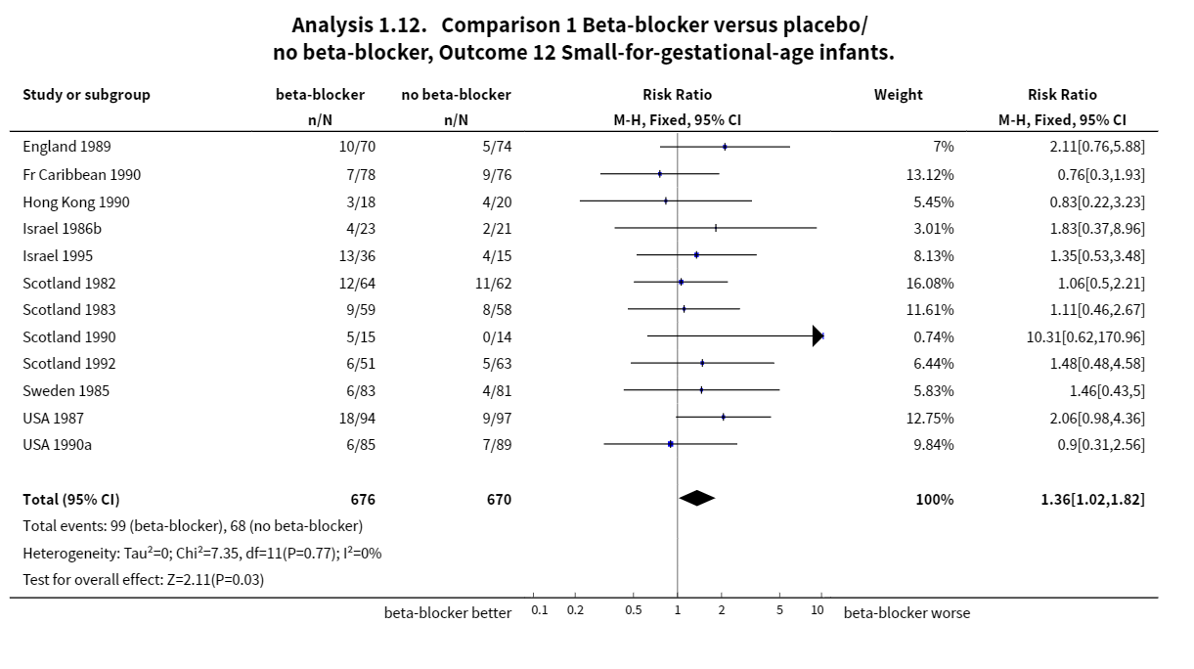
Beta Blockers
No increased risk of CM
Increased risk SGA
Confounding
Neonatal effects at term
Are all beta blockers equal?
Labetalol used for hypertension
Sotolol, cavedolol, etc are ok
Key Message
Beta blockers can be used in pregnancy Monitor fetal growth Neonatal hypoglycaemia

Slide 14
Calcium channel blockers
Little data available on individual drugs (most data nifedipine)
As a class:
No increase in miscarriage rates
No increase in malformation rate (470 exposures, 4 studies)
SGA – no significant difference in SGA rates compared to women on labetalol
BF: nifedipine OK, amlodipine – limited data (but probably OK)
Key Message
Nifedipine is safe to use in pregnancy
Less data on amlodipine, widely used

Slide 15
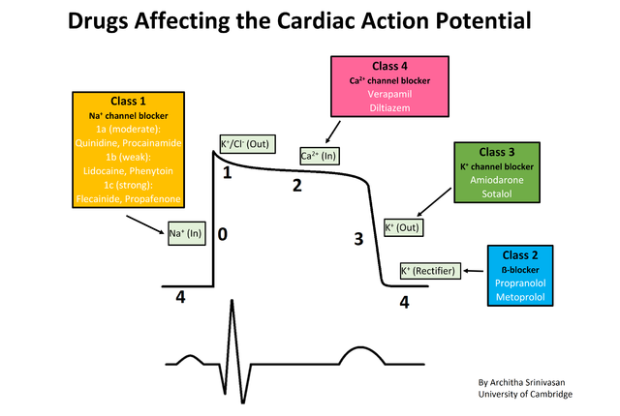
…all other antiarrhythmic drugs
Sotalol, flecanide and digoxin are treatment for fetal SVT
Adenosine:
limited data
reports of successful cardioversion
Avoid amiodarone (if possible)
Affects fetal thyroid gland
Key Message
Most antiarrhytmic drugs can be used
Try to avoid amiodarone

Slide 16
Antiplatelet Drugs
Aspirin
Low dose (75-150mg) safe
Wide spread evidence
Used to prevent pre-eclampsia
63% RR reduction, high risk population, <16/40, 150mg nocte (ASPRE study)
Clopidogrel
Little human data
Not thought to be harmful
Key Message
LDA is safe to use in pregnancy

Slide 17
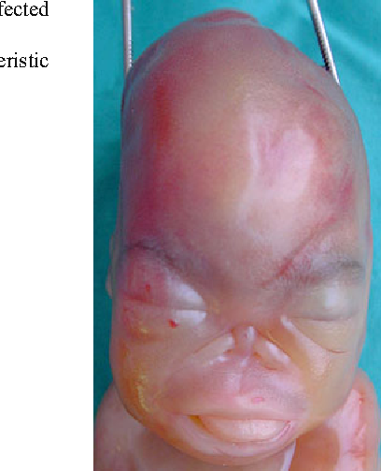
Warfarin Embryopathy
0.6-10% overall
6-9 weeks gestation
Nasal and mid facial hypoplasia
Stippling epiphysis
Feeding/breathing problems
Spinal deformity
?? dose dependent
0.45-0.9% with low dose (<5mg/day)

Slide 18
Warfarin Fetopathy
0.7-2% risk
2nd and 3rd trimester exposure
Late fetal loss/stillbirth
Microcephaly
Cerebral atrophy
Hydrocephalus
Optic atrophy
Fetus more anticoagulated than mother
Dose dependency
Intracerebral bleeding

Slide 19
DOACs
Very little data
Animal models
Female fertility: decrease in implantations/increase in pre-implantation loss (5x human dose)
decrease in fetal body weight and embryofoetal viability in rodents (5-10x human dose)
increased maternal bleeding (vaginal/uterine) in rodents

Slide 20
Summary
Most cardiac drugs are safe in pregnancy and BF
Exceptions:
ACEi
ARBs
Warfarin/DOACs
Amiodarone
Manage patient as if not pregnant
Medication safety information requires careful interpretation
“Bottom line” – seek advice from UKTIS if unsure

